Slide 1
Thought of the Day
“Crime is not just about breaking laws; it’s about breaking the trust that holds society together.”
Sir Keir Starmer

Slide 2

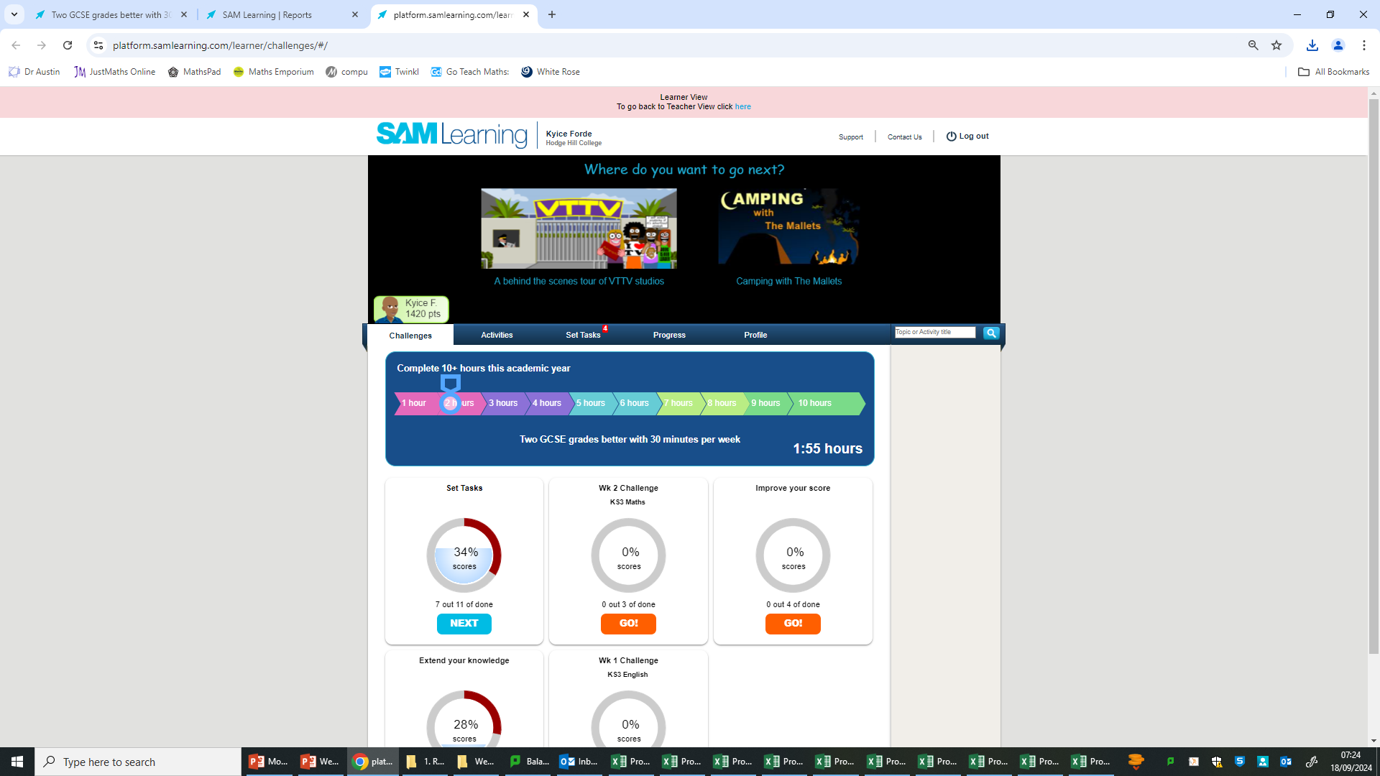
Remember to complete all homework tasks on SAM Learning
We still use Classcharts for announcements, surveys and revision material
Homework Club every morning in West Canteen from 8am
Library is open before school and at break times
Students on the following slides have not completed ALL tasks
Make sure you are completing the SET TASKS! These are the tasks your teachers have set.
Notes:
Please give time for the students to produce answers for themselves before showing answers.

Slide 3


Slide 4


Secure your Wellbeing: Learning Journey
Importance of role models
Why is failure a good thing
What is criminal activity?
Dangers of gang culture
Dangers of knife crime
What does your online presence look like?
Today we will look at:
What is criminal activity?
This includes:
Definition of criminal activity
Most common types of criminal activity
Statistics of crime in Birmingham
Please remember that during the lesson we should not be asking any pupil or teacher personal questions.
Your teacher can ask you questions but this will be to check your knowledge in the lesson.

Slide 5

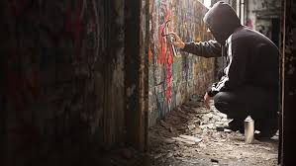
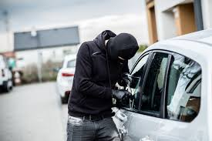
What is criminal activity?
Criminal activity is…
“Actions that break the law and harm individuals, communities, or property.”

Slide 6




Why are we learning about this?
This links to the Golden Thread of “Secure your Wellbeing”
Knowing what is classed as criminal activity is important for your wellbeing as it can help protect you physically and mentally. It also lets you make informed decisions you may face and what the consequences of this may be.

Slide 7
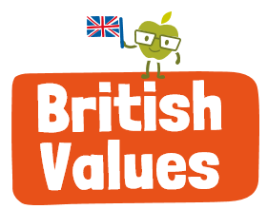
Why are we learning about this?
Rule of Law is a British Value that means “rule by the people”. All people living in the UK are expected to adhere to the law of the country in order to keep everyone safe and treated fairly. This means people should not take part in criminal activity.

Slide 8
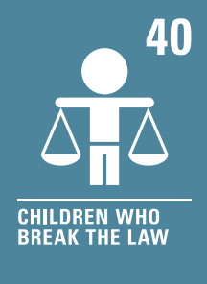
Why are we learning about this?
Article 40 states that children who do break the law have the right to legal help and there should be lots of solutions to help children become good members of their communities.
UN Rights
of a Child

Slide 9

What is criminal activity?
Notes:
https://www.youtube.com/watch?v=6kA0RjrE2ug

Slide 10

Types of criminal activity
Take out your oracy helpsheet from your learning wallet.
You have 1 minute to think about the following question:
“what crime in the video do you think is most common?”

Slide 11
Types of criminal activity
Using your oracy helpsheet, with the person next to you, discuss your response to the question:
“what crime in the video do you think is most common?”
Remember to use the sentence starters to add, build or challenge what your partner has said.
Be ready to share your discussion with the class

Slide 12
Criminal Activity Statistics
From June 2023 to June 2024 there were 6.7 million crimes reported to the Police in England and Wales.
This includes lots of different types of crime but some of the most common crimes were:

Slide 13
Criminal Activity Statistics
Fraud
Theft
Violent Crime
Computer misuse
Vehicle Offences
Burglary
Robbery
Knife Crime
Sexual offences
Homicide (Murder) – this was significantly less common than the other crimes listed.

Slide 14
Types of criminal activity in Birmingham
Take out your oracy helpsheet from your learning wallet.
You have 1 minute to think about the following question:
“what criminal activity do you think is most common in Birmingham?”

Slide 15
Types of criminal activity in Birmingham
Using your oracy helpsheet, with the person next to you, discuss your response to the question:
“what criminal activity do you think is most common in Birmingham?”
Remember to use the sentence starters to add, build or challenge what your partner has said.
Be ready to share your discussion with the class

Slide 16
Criminal Activity Statistics in Birmingham
The 5th most common criminal activity in Birmingham is anti social behaviour.
This means that a person or group of people were causing trouble, annoyance or suffering to a community.
Levels of anti social behaviour have been steadily decreasing over the past number of years.

Slide 17
Criminal Activity Statistics in Birmingham
The 4th most common criminal activity in Birmingham is criminal damage
This means that a person or group of people have caused damage to another person’s property.
In 2023 there were over 10,000 reports of criminal damage in Birmingham.

Slide 18
Criminal Activity Statistics in Birmingham
The 3rd most common criminal activity in Birmingham is theft.
This means that a person or group of people have stolen another person’s property.
In 2023 levels of theft were significantly higher than the UK city average.

Slide 19
Criminal Activity Statistics in Birmingham
The 2nd most common criminal activity in Birmingham is vehicle crime.
This can include driving offences such as speeding, but also damage caused to vehicles.
In 2023 there were over 13,000 offences in Birmingham. This is significantly higher than other UK city averages.

Slide 20
Criminal Activity Statistics in Birmingham
The most common criminal activity in Birmingham is violent/sexual offences.
This means that a person or group of people are causing harm to another person through violence or sexual offences.
In 2023 this made up 40% of all offences recorded in the city. This means that compared to other places in the West Midlands, Birmingham has higher levels of violent/sexual offences.

Slide 21
Types of criminal activity in Birmingham
Take out your oracy helpsheet from your learning wallet.
You have 1 minute to think about the following question:
“Are you shocked by the most common crimes in Birmingham?”

Slide 22
Types of criminal activity in Birmingham
Using your oracy helpsheet, with the person next to you, discuss your response to the question:
“Are you shocked by the most common crimes in Birmingham?”
Remember to use the sentence starters to add, build or challenge what your partner has said.
Be ready to share your discussion with the class

