Slide 1
Thought of the Day
“What you share online is a reflection of who you are. Make sure it’s something you’d be proud to stand by in the real world.”
Bear Grylls

Slide 2


Remember to complete all homework tasks on SAM Learning
We still use Classcharts for announcements, surveys and revision material
Homework Club every morning in West Canteen from 8am
Library is open before school and at break times
Students on the following slides have not completed ALL tasks
Make sure you are completing the SET TASKS! These are the tasks your teachers have set.
Notes:
Please give time for the students to produce answers for themselves before showing answers.

Slide 3


Slide 4


Secure your Relationships: Learning Journey
What is the difference between equality and equity
What does diversity and inclusion mean?
What does discrimination mean?
Exploring the 9 Protected Characteristics
What is a hate crime?
What laws impact society?
Today we will look at:
The difference between equality and equity
This includes:
Definition of equality and equity
Examples
Please remember that during the lesson we should not be asking any pupil or teacher personal questions.
Your teacher can ask you questions but this will be to check your knowledge in the lesson.

Slide 5

Equality vs Equity
Take out your oracy helpsheet from your learning wallet.
You have 1 minute to think about the following question:
“What do you think the difference is between equality and equity?”

Slide 6
Online Presence
Using your oracy helpsheet, with the person next to you, discuss your response to the question:
“What do you think the difference is between equality and equity?”
Remember to use the sentence starters to add, build or challenge what your partner has said.
Be ready to share your discussion with the class

Slide 7



Equality
Equality is…
“treating everyone the same regardless of their individual needs or circumstances”

Slide 8
Equity
Equity is…
“giving people the resources they need based on their individual circumstances to achieve the same outcome”

Slide 9

Why are we learning about this?
This links to the Golden Thread of “Secure your Relationships”
Being able to treat people so they are treated fairly and increase their opportunities will strengthen your relationships with people.

Slide 10

Why are we learning about this?
Rule of Law is a British Value that means everyone is expected to follow the laws. In the UK we have The Equality Act (2010) which states that people should all have equal rights

Slide 11

Why are we learning about this?
Article 2 states that all children have rights and no child should be treated unfairly for any reason. Everyone at Hodge Hill College has the same opportunities to access all the learning available in school. This is an example of equality in school
UN Rights
of a Child

Slide 12
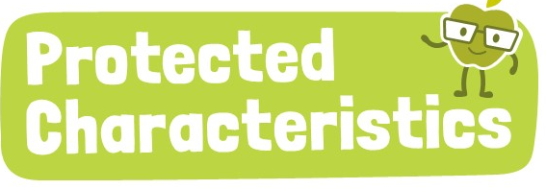
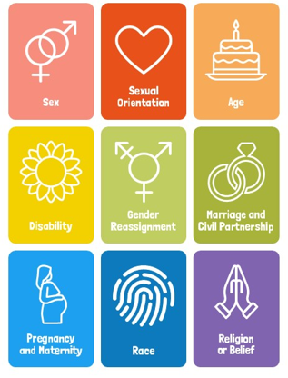
Why are we learning about this?
The Equality Act (2010) sets out 9 Protected Characteristics. This means that people who identify with ay of the characteristics should be treated fairly and not discriminated against.

Slide 13

More on Equality vs Equity
Notes:
https://www.youtube.com/watch?v=9isVHRDeGis

Slide 14
Equality vs Equity
Take out your oracy helpsheet from your learning wallet.
You have 1 minute to think about the following question:
“What was your main learning point from the video?”

Slide 15
Online Presence
Using your oracy helpsheet, with the person next to you, discuss your response to the question:
“What was your main learning point from the video?”
Remember to use the sentence starters to add, build or challenge what your partner has said.
Be ready to share your discussion with the class

Slide 16
Equality vs Equity
You will be learning much more about equality and equity in your Personal Development lesson this week.
This will include looking at examples of equality and equity.

