Slide 1
Thought of the Day
“What you share online is a reflection of who you are. Make sure it’s something you’d be proud to stand by in the real world.”
Bear Grylls

Slide 2


Remember to complete all homework tasks on SAM Learning
We still use Classcharts for announcements, surveys and revision material
Homework Club every morning in West Canteen from 8am
Library is open before school and at break times
Students on the following slides have not completed ALL tasks
Make sure you are completing the SET TASKS! These are the tasks your teachers have set.
Notes:
Please give time for the students to produce answers for themselves before showing answers.

Slide 3
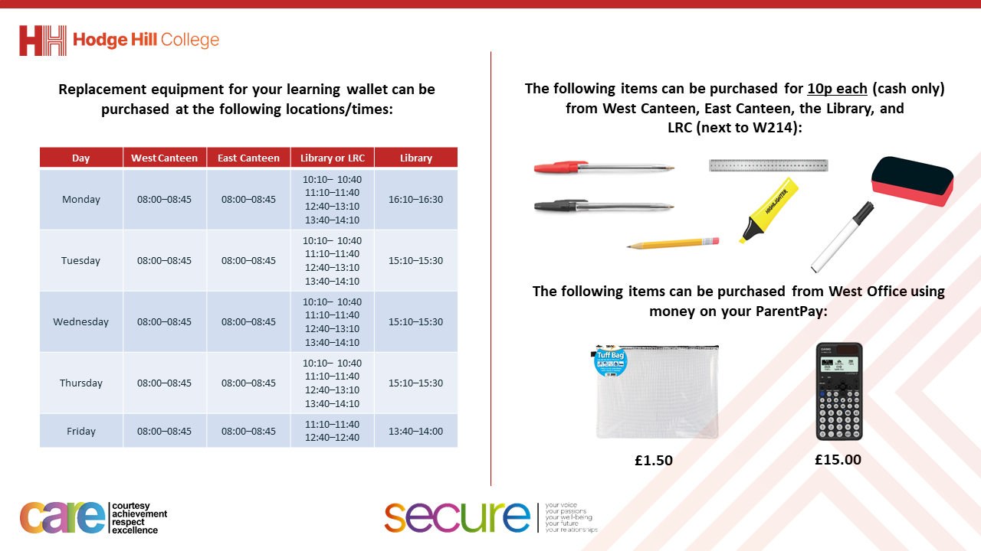

Slide 4


Secure your Wellbeing: Learning Journey
Importance of role models
Why is failure a good thing
What is criminal activity?
Dangers of gang culture
Dangers of knife crime
What does your online presence look like?
Today we will look at:
The importance of online presence
This includes:
Definition of online presence
Thinking about examples of positive and negative online presence
Please remember that during the lesson we should not be asking any pupil or teacher personal questions.
Your teacher can ask you questions but this will be to check your knowledge in the lesson.

Slide 5



Online Presence
Online presence is…
“everything someone posts, likes, shares and interacts with online”

Slide 6




Why are we learning about this?
This links to the Golden Thread of “Secure your Wellbeing”
People are spending more and more time online. It is important to know who this can impact you in the future.

Slide 7

Why are we learning about this?
Rule of Law is a British Value that means everyone is expected to follow the laws. There are laws around what can be posted online. An easy way to think is – would this be acceptable offline? If no, it is not acceptable online.

Slide 8

Why are we learning about this?
Article 29 states that children’s education should help them live peacefully. Unfortunately lots of young people comment, like and share negative and hurtful things online. It is important to know that this adds to your online presence which in most cases is permanent.
UN Rights
of a Child

Slide 9

Importance of your online presence
Notes:
https://www.youtube.com/watch?v=KvfbNBnSGio

Slide 10
Online Presence
It is important to remember that even small actions like liking a post on social media or commenting on a post all contributes to a person’s online presence.

Slide 11

Online Presence
Take out your oracy helpsheet from your learning wallet.
You have 1 minute to think about the following question:
“What is it important to think about you present yourself online?”

Slide 12
Online Presence
Using your oracy helpsheet, with the person next to you, discuss your response to the question:
“What is it important to think about you present yourself online?”
Remember to use the sentence starters to add, build or challenge what your partner has said.
Be ready to share your discussion with the class

Slide 13
Online Presence
Take out your oracy helpsheet from your learning wallet.
You have 1 minute to think about the following question:
“Can you think of someone who has a positive online presence? Why?”

Slide 14
Online Presence
Using your oracy helpsheet, with the person next to you, discuss your response to the question:
“Can you think of someone who has a positive online presence? Why?”
Remember to use the sentence starters to add, build or challenge what your partner has said.
Be ready to share your discussion with the class

Slide 15
Online Presence
Take out your oracy helpsheet from your learning wallet.
You have 1 minute to think about the following question:
“Can you think of someone who has a negative online presence? Why?”

Slide 16
Online Presence
Using your oracy helpsheet, with the person next to you, discuss your response to the question:
“Can you think of someone who has a negative online presence? Why?”
Remember to use the sentence starters to add, build or challenge what your partner has said.
Be ready to share your discussion with the class

Slide 17
Reflection
It is important to remember that much of the internet is a public space.
Anything posted online is likely to exist forever.
How will you ensure your online presence is positive and will not haunt you in the future?

Slide 18



Support
If you ever need support about a negative online presence for yourself, a friend or family member you can find it here:
Childline.org.uk
Call – 08001111
Email or chat online for support
If an emergency call 999 and ask to speak to the police
If it is not an emergency call 101 and ask to speak to the police

