Slide 1
Thought of the Day
“Knife crime steals lives and futures. We must work together to end the violence”
Sadiq Khan, Mayor of London

Slide 2


Remember to complete all homework tasks on SAM Learning
We still use Classcharts for announcements, surveys and revision material
Homework Club every morning in West Canteen from 8am
Library is open before school and at break times
Students on the following slides have not completed ALL tasks
Make sure you are completing the SET TASKS! These are the tasks your teachers have set.
Notes:
Please give time for the students to produce answers for themselves before showing answers.

Slide 3
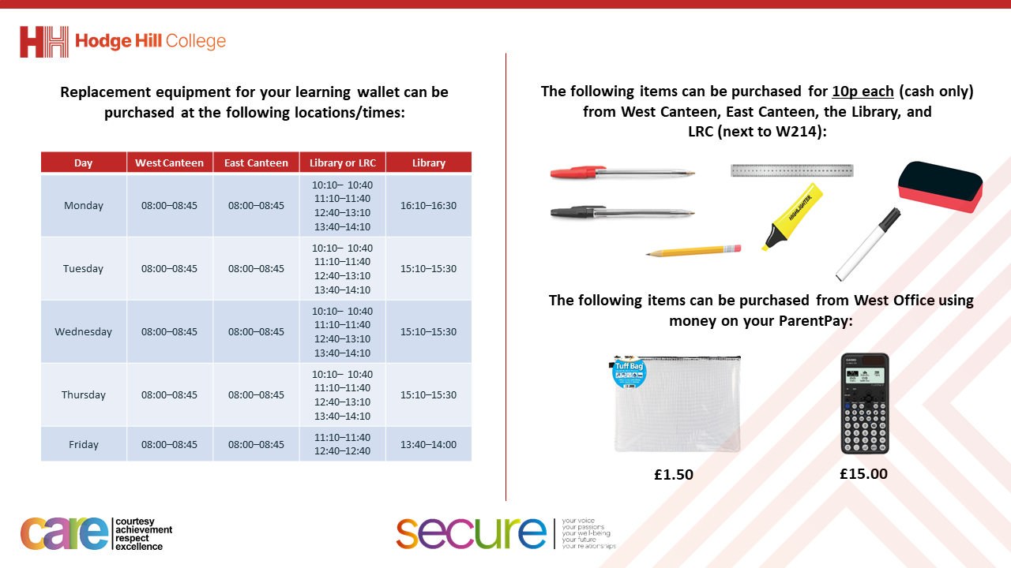

Slide 4


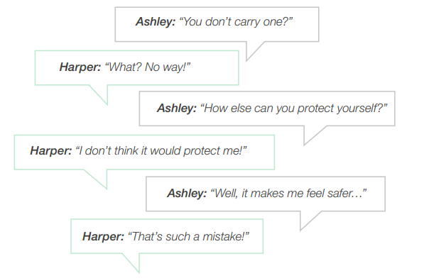
What is being discussed?
Task
Read the conversation on the left of the screen.
What do you think is being discussed in this conversation?

Slide 5

What is being discussed?
Using your oracy helpsheet, with the person next to you, discuss your response to the question:
“What do you think is being discussed in this conversation?”
Remember to use the sentence starters to add, build or challenge what your partner has said.
Be ready to share your discussion with the class

Slide 6
Secure your Wellbeing: Learning Journey
Importance of role models
Why is failure a good thing
What is criminal activity?
Dangers of gang culture
Dangers of knife crime
What does your online presence look like?
Today we will look at:
Dangers of knife crime
This includes:
Definition of knife crime
Statistics around knife crime in the West Midlands
Please remember that during the lesson we should not be asking any pupil or teacher personal questions.
Your teacher can ask you questions but this will be to check your knowledge in the lesson.

Slide 7



Knife Crime
Knife crime is…
“criminal offences committed using a knife as a weapon”

Slide 8




Why are we learning about this?
This links to the Golden Thread of “Secure your Wellbeing”
Knives are extremely dangerous. Unfortunately they are used as weapons which can lead to life changing injuries and death. Many young people do not appreciate the serious consequences knives can have on wellbeing.

Slide 9

Why are we learning about this?
Rule of Law is a British Value that means everyone is expected to follow the laws. Carrying a knife is against the law. Using a knife as a weapon to hurt or threaten to hurt someone is also against the law. Breaking these laws puts people at risk and can make communities unsafe and unwelcoming.

Slide 10

Why are we learning about this?
Article 29 states that children’s education should help them live peacefully. With knife crime being a UK wide issue, it is important that you are taught about the dangers knife crime have to yourself, others around you and the community. This will help to decrease knife crime statistics.
UN Rights
of a Child

Slide 11

Knife Crime in West Midlands
Notes:
https://www.youtube.com/watch?v=PmYNgeis_-A

Slide 12
Knife Crime in the West Midlands
Take out your oracy helpsheet from your learning wallet.
You have 1 minute to think about the following question:
“What did you find most shocking about the video?”

Slide 13
Knife Crime in the West Midlands
Using your oracy helpsheet, with the person next to you, discuss your response to the question:
“What did you find most shocking about the video?”
Remember to use the sentence starters to add, build or challenge what your partner has said.
Be ready to share your discussion with the class

Slide 14
Knife Crime Statistics
In the West Midlands between April 2023 and March 2024 there were 5,268 offences involving a knife.
This means that the West Midlands has the highest rate of knife crime in England and Wales

Slide 15
Knife Crime Statistics
The demographic of people involved in these offences were children under 18 years old.
However, the number of young people involved in knife crime actually dropped 9% compared to the previous year

Slide 16
Knife Crime Statistics
One way this was achieved was through “anonymous weapon surrender” bins.
These provided people an opportunity to surrender their knifes without any legal percussions. This resulted in over 1000 knifes being removed from the streets.

Slide 17
Knife Crime Statistics
Take out your oracy helpsheet from your learning wallet.
You have 1 minute to think about the following question:
“Are you shocked by any of the statistics? Why?”

Slide 18
Knife Crime Statistics
Using your oracy helpsheet, with the person next to you, discuss your response to the question:
“Are you shocked by any of the statistics? Why?”
Remember to use the sentence starters to add, build or challenge what your partner has said.
Be ready to share your discussion with the class

Slide 19
Knife Crime
You will be looking at the dangers of knife crime in more detail in your Personal Development lessons this week.

Slide 20



Support
If you ever need support about knife crime for yourself, a friend or family member you can find it here:
Childline.org.uk
Call – 08001111
Email or chat online for support
If an emergency call 999 and ask to speak to the police
If it is not an emergency call 101 and ask to speak to the police

