Slide 1


Remember to complete all homework tasks on SAM Learning
We still use Classcharts for announcements, surveys and revision material
Homework Club every morning in West Canteen from 8am
Library is open before school and at break times
Students on the following slides have not completed ALL tasks
Make sure you are completing the SET TASKS! These are the tasks your teachers have set.
Notes:
Please give time for the students to produce answers for themselves before showing answers.

Slide 2
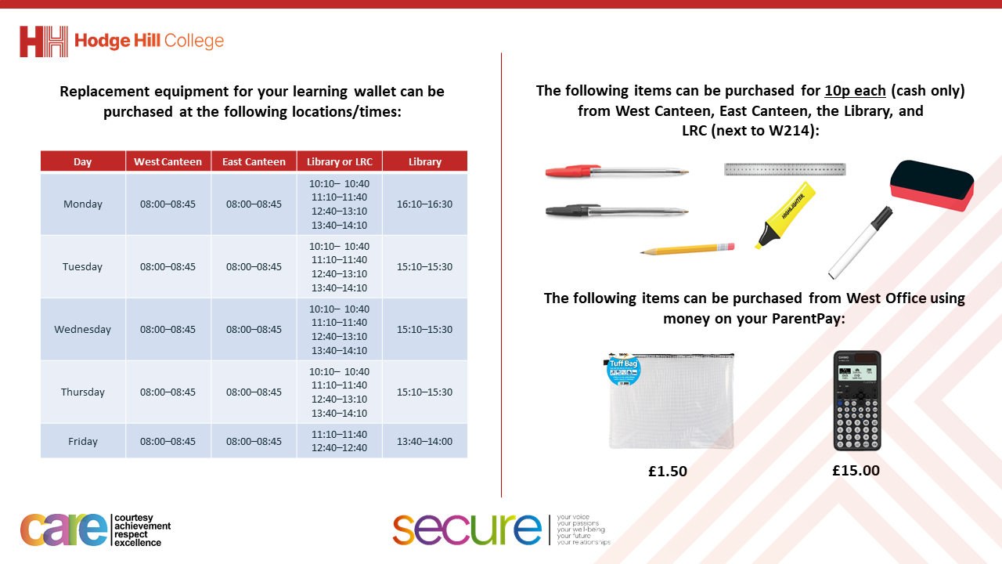

Slide 3
Thought of the Day
“Success is stumbling from failure to failure with no loss of enthusiasm”
Winston Churchill

Slide 4


Secure your Wellbeing: Learning Journey
Importance of role models
Why is failure a good thing
What is criminal activity?
Dangers of gang culture
Dangers of knife crime
What does your online presence look like?
Today we will look at:
Why is failure a good thing
This includes:
What is failure
Alternative viewpoint of failure
Flowchart of failure to success
Please remember that during the lesson we should not be asking any pupil or teacher personal questions.
Your teacher can ask you questions but this will be to check your knowledge in the lesson.

Slide 5
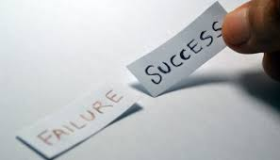


What is failure?
Failure is…
“a lack of success”

Slide 6
What is failure?
However this is only the dictionary definition.
An alternative definition of failure is…
“a stepping stone to success”
This more positive definition is how everyone should see failure.

Slide 7




Why are we learning about this?
This links to the Golden Thread of “Secure your Wellbeing”
Failure is an inevitable part of life. Seeing failure as something positive will help protect against mental health issues. It will also improve your resilience and ultimately lead to even bigger success.

Slide 8

Failure
Take out your oracy helpsheet from your learning wallet.
You have 1 minute to think about the following question:
“How do people normally feel after failure?”

Slide 9
Failure
Using your oracy helpsheet, with the person next to you, discuss your response to the question:
“How do people normally feel after failure?”
Remember to use the sentence starters to add, build or challenge what your partner has said.
Be ready to share your discussion with the class

Slide 10
Failure
It is normal for people to feel deflated after failure.
However it is important that people pick themselves up and try again.
This is because failure is a stepping stone to success

Slide 11
Failure Flowchart
Try something
Experience failure
Learn
Adapt
Succeed

Slide 12

Famous examples of failure
Notes:
https://www.youtube.com/watch?v=hJFS4-v_dhg

Slide 13
Failure
Take out your oracy helpsheet from your learning wallet.
You have 1 minute to think about the following question:
“What example from the video are you most inspired by?”

Slide 14
Failure
Using your oracy helpsheet, with the person next to you, discuss your response to the question:
“What example from the video are you most inspired by?”
Remember to use the sentence starters to add, build or challenge what your partner has said.
Be ready to share your discussion with the class

Slide 15
Failure
You will be looking more at the importance of failure in your Personal Development lesson this week.
Until then in your lessons, remember failure is a stepping stone to success. Do not become deflated when you try and fail at something!

