Slide 1




Progressive Masculinity workshops
The male pupils in your year group are taking part in an assembly held by Progressive Masculinity to celebrate International Men’s Day that happened last week.
This means everyone must:
Go to muster point at the start of Period 3
You must line up in tutor groups and in alphabetic order so staff can take a register.
Female pupils will be taken by staff members. You will be in 1 or 2 classes
Male pupils need to go to West Hall, in the same routine for assembly.
We need to use all chairs so do not take a new row for your tutor group.
The assembly lasts for 50 minutes. The quicker you get in, the less time you lose during break!

Slide 2


Remember to complete all homework tasks on SAM Learning
We still use Classcharts for announcements, surveys and revision material
Homework Club every morning in West Canteen from 8am
Library is open before school and at break times
Students on the following slides have not completed ALL tasks
Make sure you are completing the SET TASKS! These are the tasks your teachers have set.
Notes:
Please give time for the students to produce answers for themselves before showing answers.

Slide 3
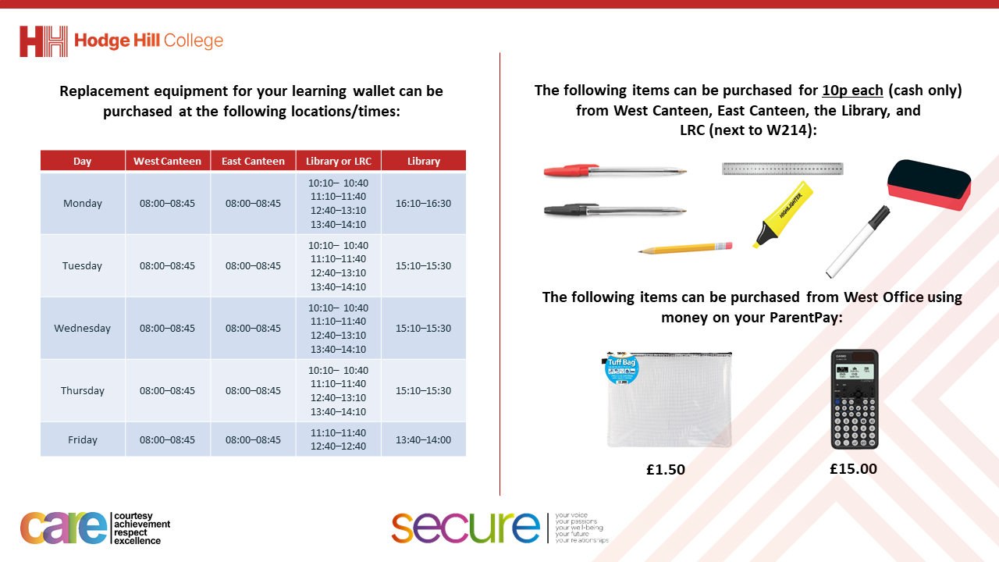

Slide 4
Thought of the Day
“Emotions are like waves. You can’t stop them from coming, but you can choose which ones to surf.”

Slide 5
Secure your Wellbeing: Learning Journey
What is mental health?
Impact of drugs and alcohol on mental health
What is gambling?
What are eating disorders?
How to deal with emotions?
How to deal with fallouts
Today we will look at:
How to deal with emotions
This includes:
What is anger?
What is grief?
Please remember that during the lesson we should not be asking any pupil or teacher personal questions.
Your teacher can ask you questions but this will be to check your knowledge in the lesson.

Slide 6

Why are we learning about this?
Learning about how to deal with emotions will help you secure your wellbeing.
There are many ways to express emotions. Some ways are healthy and others are unhealthy.
Knowing how to cope with emotion and display them in a healthy way will protect your mental health.

Slide 7

What is anger?
Take out your oracy helpsheet from your learning wallet.
You have 1 minute to think about the following question:
“What is anger? When have you heard this word used before?”

Slide 8
What is anger?
Using your oracy helpsheet, with the person next to you, discuss your response to the question:
“What is anger? When have you heard this word used before?”
Remember to use the sentence starters to add, build or challenge what your partner has said.
Be ready to share your discussion with the class

Slide 9

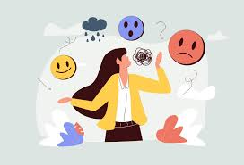

What is anger?
Anger is…
“a natural emotional response to feeling frustrated, hurt or wronged”

Slide 10
What is anger?
Anger can take many different forms.
These forms range from mild irritation, which can be internalized, to intense rage which could involve shouting or physical actions.

Slide 11
What is grief?
Take out your oracy helpsheet from your learning wallet.
You have 1 minute to think about the following question:
“What is grief? When have you heard this word used before?”

Slide 12
What is grief?
Using your oracy helpsheet, with the person next to you, discuss your response to the question:
“What is grief? When have you heard this word used before?”
Remember to use the sentence starters to add, build or challenge what your partner has said.
Be ready to share your discussion with the class

Slide 13
What is grief?
Grief is…
“a natural emotional response to loss”

Slide 14
What is grief?
In this context, loss is associated to bereavement.
Bereavement is the death of someone close such as a friend/family member or even pet.

Slide 15
What is grief?
Grief can also happen due to other reasons such as separation from home, change or family arrangements or a friendship ending.

Slide 16
Hiding emotions
Take out your oracy helpsheet from your learning wallet.
You have 1 minute to think about the following question:
“Why would people hide emotions such as grief and anger?”

Slide 17
Hiding emotions
Using your oracy helpsheet, with the person next to you, discuss your response to the question:
“Why would people hide emotions such as grief and anger?”
Remember to use the sentence starters to add, build or challenge what your partner has said.
Be ready to share your discussion with the class

Slide 18
Emotions
You will be learning much more about how to deal with emotions such as anger and grief in your Personal Development lessons this week.

Slide 19



Support
If you ever need support about anger or grief for yourself, a friend or family member you can find it here:
Childline.org.uk
Call – 08001111
Email or chat online for support
Themix.org.uk
You can email or have one-to-chat online.
There is also a crisis messenger which is available 24/7

