Slide 1


Remember to complete all homework tasks on SAM Learning
We still use Classcharts for announcements, surveys and revision material
Homework Club every morning in West Canteen from 8am
Library is open before school and at break times
Students on the following slides have not completed ALL tasks
Make sure you are completing the SET TASKS! These are the tasks your teachers have set.
Notes:
Please give time for the students to produce answers for themselves before showing answers.

Slide 2


Slide 3
Thought of the Day
“Honest and open communication is the only way to resolve conflict”
Mike Krzyzewski

Slide 4


Secure your Wellbeing: Learning Journey
What is mental health?
Impact of drugs and alcohol on mental health
What is gambling?
What are eating disorders?
How to deal with emotions?
How to deal with fallouts
Today we will look at:
How to deal with fallouts
This includes:
Why fallouts happen?
Differences between fallouts with friends or family
Please remember that during the lesson we should not be asking any pupil or teacher personal questions.
Your teacher can ask you questions but this will be to check your knowledge in the lesson.

Slide 5

Why are we learning about this?
Being able to resolve a fallout or conflict quickly is a great characteristic to develop.
Fallouts/conflicts will happen between family and friends, so being able to resolve these conflicts quickly will ensure that the relationship is secured and not broken.

Slide 6

Why are we learning about this?
Mutual respect and tolerance are British Values. These mean that respect and tolerance is shown to people even when they disagree with each other. If these values are followed it reduces the chances of fallouts happening.

Slide 7
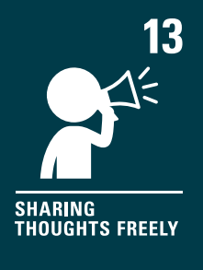
Why are we learning about this?
Article 13 states that children have the right to voice how the feel. However this should only happen if the child is sure that what they say will not harm other people. Fallouts and conflicts can happen when people miscommunicate their thoughts or share thoughts that cause offence to other people.
UN Rights
of a Child

Slide 8
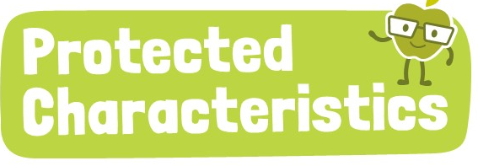
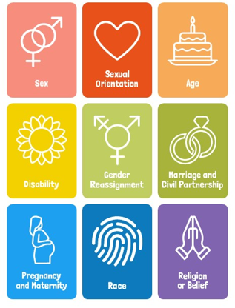
Why are we learning about this?
The Equality Act (2010) states that people should be discriminated against due to the 9 protected characteristics. This should mean that these characteristics are not the reason behind a fallout/conflict.

Slide 9


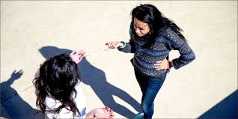
Fallouts
Everyone will experience multiple fallouts throughout their life time.
It is normal for fallouts to happen between family and friends.

Slide 10
Fallouts
Fallouts can happen due to:
Miscommunication or misunderstandings
Arguments or disagreements
Breaking a person’s trust
Feeling ignored by others

Slide 11
Fallouts
Fallouts can also happen due to differences in people’s expectations and also their emotions.
During teenage years, emotions can feel more intense and are a common reason behind fallouts with family and/or friends.

Slide 12

Fallouts between friends
Take out your oracy helpsheet from your learning wallet.
You have 1 minute to think about the following question:
“Why might fallouts happen between friends?”

Slide 13
Fallouts between friends
Using your oracy helpsheet, with the person next to you, discuss your response to the question:
“Why might fallouts happen between friends?”
Remember to use the sentence starters to add, build or challenge what your partner has said.
Be ready to share your discussion with the class

Slide 14
Fallouts between friends
Fallouts between friends can happen due to:
Misunderstanding over a joke
Exclusion from a group chat
Content of social media posts
Jealousy

Slide 15
Fallouts between family
Take out your oracy helpsheet from your learning wallet.
You have 1 minute to think about the following question:
“Why might fallouts happen between family?”

Slide 16
Fallouts between family
Using your oracy helpsheet, with the person next to you, discuss your response to the question:
“Why might fallouts happen between family?”
Remember to use the sentence starters to add, build or challenge what your partner has said.
Be ready to share your discussion with the class

Slide 17
Fallouts between family
Fallouts between family can happen due to:
Disagreement over rules
Having to do chores or a difference in opinion of how well chores have been completed
Perceived favouritism of a younger/older sibling

Slide 18
Fallouts
In your Personal Development lesson this week you will learn more about how to deal with fallouts and the importance of not leaving a fallout unresolved.

Slide 19



Support
If you ever need support about a fallout between friends or family you can find it here:
Childline.org.uk
Call – 08001111
Email or chat online for support
Themix.org.uk
You can email or have one-to-chat online.
There is also a crisis messenger which is available 24/7

