Slide 1


Remember to complete all homework tasks on SAM Learning
We still use Classcharts for announcements, surveys and revision material
Homework Club every morning in West Canteen from 8am
Library is open before school and at break times
Make sure you are completing the SET TASKS! These are the tasks your teachers have set.

Slide 2
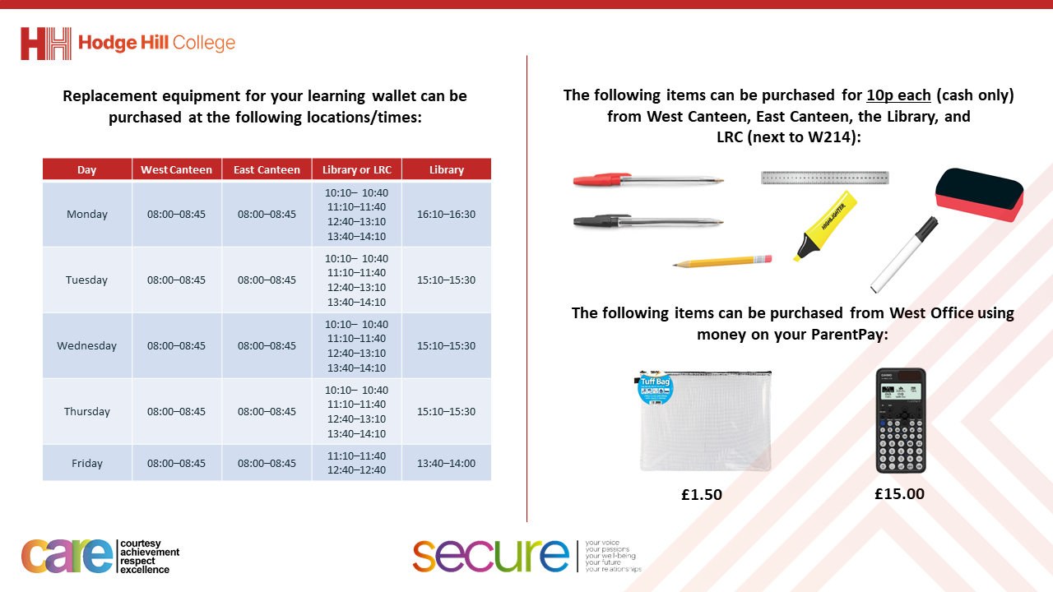

Slide 3
Thought of the Day
“Gambling: The sure way of getting nothing for something”

Slide 4


Secure your Wellbeing: Learning Journey
What is mental health?
Impact of drugs and alcohol on mental health
What is gambling?
What are eating disorders?
How to deal with emotions?
How to deal with fallouts
Today we will look at:
What is gambling?
This includes:
Definition of gambling
Different types of gambling
Please remember that during the lesson we should not be asking any pupil or teacher personal questions.
Your teacher can ask you questions but this will be to check your knowledge in the lesson.

Slide 5

Why are we learning about this?
Learning about gambling helps you to secure your wellbeing as you will learn about the potential negative side effects to your mental health.
Although gambling is prohibited by some religions, it is still important for everyone to learn about gambling and the negative effects it can have.

Slide 6

Why are we learning about this?
Rule of Law is a British Value. In the UK it is illegal for those U18 to gamble or enter a licensed gambling premise (such as a bingo hall or casino). This is in the Gambling Act 2005.

Slide 7

Why are we learning about this?
Article 41 of the UN Rights of a Child states that the best law applies for children. This means that if a law protects children better than the UN Rights of a Child, the law stands. The UN Rights of a Child does not mention gambling but as the UK have made it illegal for children to gamble this protects them better than the UN Rights of a Child.
UN Rights
of a Child

Slide 8

What is gambling?
Take out your oracy helpsheet from your learning wallet.
You have 1 minute to think about the following question:
“What is gambling?”

Slide 9
What is gambling?
Using your oracy helpsheet, with the person next to you, discuss your response to the question:
“What is gambling?”
Remember to use the sentence starters to add, build or challenge what your partner has said.
Be ready to share your discussion with the class

Slide 10
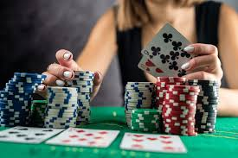
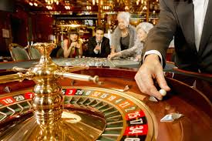
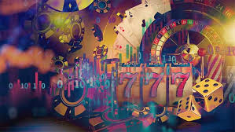
What is gambling?
Gambling is…
“risking something valuable on an event with an uncertain outcome”
Money is normally the “something valuable” that people gamble with.

Slide 11
Types of gambling?
Take out your oracy helpsheet from your learning wallet.
You have 1 minute to think about the following question:
“What types of gambling are there?”

Slide 12
Types of gambling
Using your oracy helpsheet, with the person next to you, discuss your response to the question:
“What types of gambling are there?”
Remember to use the sentence starters to add, build or challenge what your partner has said.
Be ready to share your discussion with the class

Slide 13
Types of gambling
There are lots of different types of gambling:
1. Lottery tickets – this is when a person selects a certain amount of numbers. Numbers are then randomly selected. A person wins if 4 or more numbers match

Slide 14
Types of gambling
There are lots of different types of gambling:
2. Sports Betting – this is when a person bets on the outcome of a sporting event. This is normally who will win a match or race. However there are now “in play” bets such as who will receive a yellow card

Slide 15
Types of gambling
There are lots of different types of gambling:
3. Card Games – These are games played using a deck of cards. A common example is poker

Slide 16
Types of gambling
There are lots of different types of gambling:
4. Scratch Cards - These are cards that an area that needs to be scratched off. If an amount of money is unveiled a certain number of times, that amount is then won

Slide 17
Types of gambling
There are lots of different types of gambling:
5. Casino games – These can be played in a casino or online. An example of this is blackjack or roulette

Slide 18
Types of gambling
All types of gambling has the risk of losing money.
Although the odds of this different between the type of game being played.

Slide 19

Odds of winning
What are the odds of winning in the following types of gambling?
What are the odds of winning a small prize in a lottery?
A – 1 in 10,000
B – 1 in 100
C – 1 in 5,000

Slide 20
Odds of winning
What are the odds of winning in the following types of gambling?
What are the odds of winning the big jackpot (normally millions of pounds) in the lottery ?
A – 1 in 1 million
B – 1 in 45 million
C – 1 in 100,000

Slide 21
Odds of winning
What are the odds of winning in the following types of gambling?
What are the odds of having the highest selection of cards in poker?
A – 1 in 31,000
B – 1 in 100,000
C – 1 in 100

Slide 22

Odds of winning
What are the odds of winning in the following types of gambling?
What are the odds of winning a small prize on a slot machine?
A – 1 in 5,000
B – 1 in 10,000
C – 1 in 15,000

Slide 23
Odds of winning
What are the odds of winning in the following types of gambling?
What are the odds of winning a large jackpot prize on a slot machine?
A – 1 in 10 million
B – 1 in 34 million
C – 1 in 15 million

Slide 24
Why do people gamble?
Take out your oracy helpsheet from your learning wallet.
You have 1 minute to think about the following question:
“Why do people gambling even if the chances of winning are low?”

Slide 25
Why do people gamble?
Using your oracy helpsheet, with the person next to you, discuss your response to the question:
“Why do people gambling even if the chances of winning are low?”
Remember to use the sentence starters to add, build or challenge what your partner has said.
Be ready to share your discussion with the class

Slide 26



Support
If you ever need support about gambling for yourself, a friend or family member you can find it here:
Childline.org.uk
Call – 08001111
Email or chat online for support
Themix.org.uk
You can email or have one-to-chat online.
There is also a crisis messenger which is available 24/7

