Slide 1


Remember to complete all homework tasks on SAM Learning
We still use Classcharts for announcements, surveys and revision material
Homework Club every morning in West Canteen from 8am
Library is open before school and at break times
Students on the following slides have not completed ALL tasks
Make sure you are completing the SET TASKS! These are the tasks your teachers have set.
Notes:
Please give time for the students to produce answers for themselves before showing answers.

Slide 2
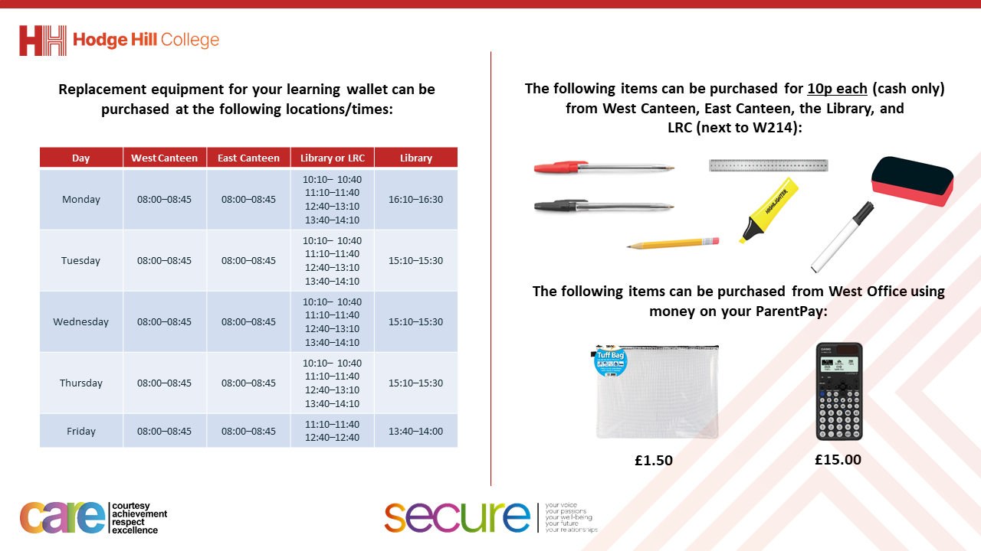

Slide 3
Thought of the Day
“We all need someone to look up to and remind us that we can achieve more than we think is possible”
Mike Krzyzewski

Slide 4


Secure your Wellbeing: Learning Journey
Importance of role models
Why is failure a good thing
What is criminal activity?
Dangers of gang culture
Dangers of knife crime
What does your online presence look like?
Today we will look at:
Importance of role models
This includes:
What is a role model?
Examples of role
Please remember that during the lesson we should not be asking any pupil or teacher personal questions.
Your teacher can ask you questions but this will be to check your knowledge in the lesson.

Slide 5
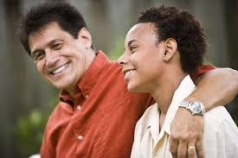
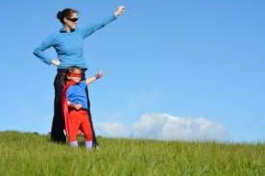
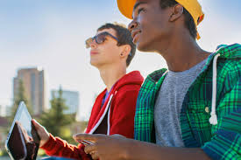
What are role models?
A role model is…
“A person who inspires others by their actions, words or achievements.”

Slide 6




Why are we learning about this?
This links to the Golden Thread of “Secure your Wellbeing”
Role models can help to instill good behaviours and habits in people. This means a role model can help to guide a person and inspire them to be the best possible version of themselves.

Slide 7
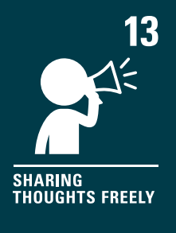
Why are we learning about this?
Article 17 of the UN Rights of a Child states that children have the right to information that is not harmful. Many role models pass on positive messages and displays behaviours which promote respect and inclusivity. Having access to this information can help a child become the best possible version of themselves.
UN Rights
of a Child

Slide 8
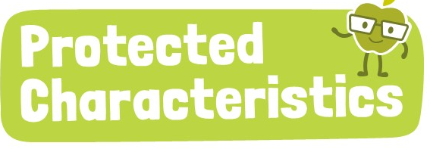
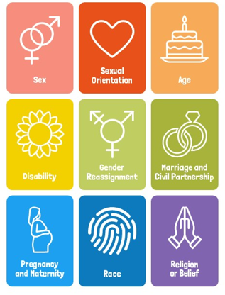
Why are we learning about this?
A role model may celebrate one or more of the protected characteristics. This can be very empowering for a person who also identifies with one of these characteristics as they may initially not embrace the characteristics as they don’t want to be “different”

Slide 9

What are role models?
Notes:
https://www.youtube.com/watch?v=v6n52uy3iRg

Slide 10
Examples of Role Models
In the next few slides, staff will outline:
Who their role model is
What qualities their role model has
How they have been inspired by their role model

Slide 11
Examples of Role Models
Mr Mughal’s role model is The Prophet Muhammad.
Mr Mughal’s says that The Prophet Muhammad is the best character of any living man (in his opinion!). The Prophet Muhammad also shows all of the qualities we have in our CARE brand.
The Prophet Muhammad has inspired Mr Mughal to be a better person, treat people with kindness, speak good or remain silent, to exercise patience and to be positive. This has allowed him to be the best of his ability and connect his inner self with spirituality.

Slide 12
Examples of Role Models
Mr Patel’s role model is his Dad.
Mr Patel says that his Dad is hard working, decisive when it comes to important decisions, practical and works well in a crisis.
Mr Patel has been inspired by his Dad as he came to UK at 6 years old as a non-English speaking migrant. He spent much of his time in the EAL hub at school. However he went on to have a 35 year career as a motor vehicle technician working for VW, Nissan, BMW and Audi. He has shown that with hard work and determination you can accomplish anything. He has always put his family first which is something that Mr Patel hold dear everyday.

Slide 13
Examples of Role Models
Mrs Abdul-Karim’s role model is Jalauddin Rumi, a Persian poet and influential in Muslim writing and culture.
Mrs Abdul-Karim says that Jalauddin is a brilliant writer and poet and alongside his love for faith has used his words to have meaning for millions of people.
They have inspired Mrs Abdul-Karim to be unapologetically true to herself and use poetry as a vehicle to understand and reflect upon the world around them.

Slide 14
Reflection
In your Personal Development lesson this week you will look more at role models. This will include how to choose a role model.
Before the lesson think about do you currently have a role model? Why are they your role model?

