Slide 1


Remember to complete all homework tasks on SAM Learning
We still use Classcharts for announcements, surveys and revision material
Homework Club every morning in West Canteen from 8am
Library is open before school and at break times
Students on the following slides have incomplete Homework Tasks
Make sure you are completing the SET TASKS! These are the tasks your teachers have set.
Notes:
Please give time for the students to produce answers for themselves before showing answers.

Slide 2
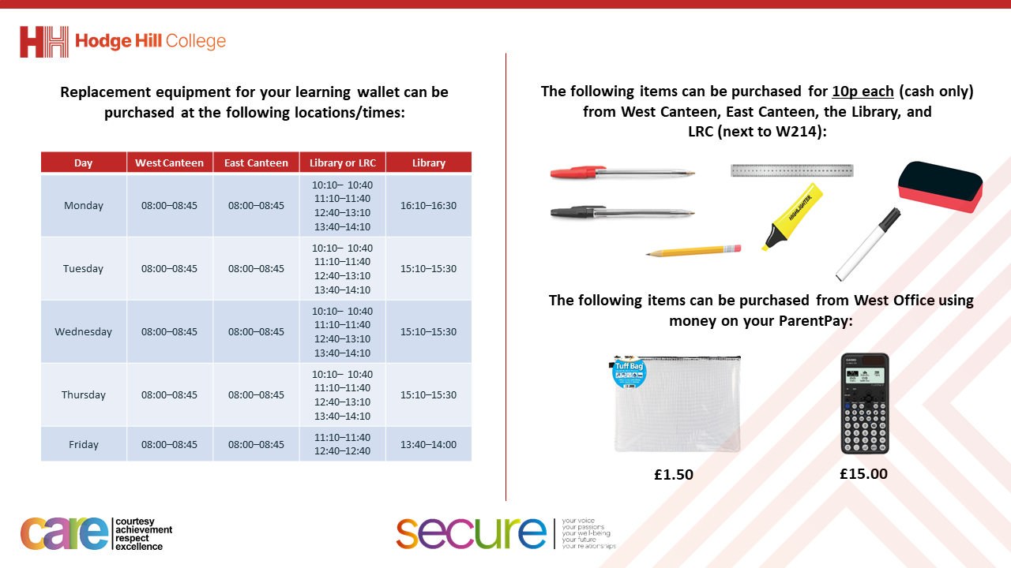

Slide 3
Thought for the Day
“Contraception is about taking control of your life and making decisions that are right for you”
Emma Watson

Slide 4


Slide 5


Secure your Future: Learning Journey
Impact of the media on relationships
What is consent in romantic relationships
What is the impact of pornography?
What is sexting and the law?
What is contraception
What are STI’s?
Today we will look at:
What is contraception?
This includes:
What is contraception
How contraception works
Please remember that during the lesson we should not be asking any pupil or teacher personal questions.
Your teacher can ask you questions but this will be to check your knowledge in the lesson.

Slide 6

Discussion
With the person next to you discuss the following:
“What is contraception? Where have you heard this word before?”
Remember to use your oracy helpsheet to structure your discussion.
Be ready to share your discussions with the class.

Slide 7

What is contraception?
The definition of contraception is:
“a method or technique used to prevent pregnancy and reduce the risk of spreading STI’s as a result of having sex”

Slide 8
What is contraception?
This means that contraception:
Helps to prevent unplanned pregnancies
Gives people control over their future
Allows for healthy decision making

Slide 9

How contraception works
During your Personal Development lesson this week you will look more at the different ways contraception work. While watching this video what are the 3 main types of contraception?
Notes:
https://www.youtube.com/watch?v=Zx8zbTMTncs

Slide 10
How contraception works
The 3 main ways that contraception works are:
Block – This means that sperm is blocked from getting to the egg
Disable – This means that sperm is immobilized and destroyed
Suppress – This means that the action of an egg maturing in the ovary is stopped meaning that it cannot be fertilised by sperm

Slide 11
Discussion
The thought of the day was “contraception is about taking control of your own life and making decisions that are right for you”
Discuss what you think this means and why taking control of ones life is important.
Be ready to share your ideas with the class

Slide 12
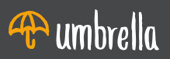

Support
If you need any support about contraception, you can contact
Umbrellahealth.co.uk
List of services near you
Email and contact numbers available online

