Slide 1





Write the date: 14 April 2025
Write the Title and Golden Thread
Title – What laws impact society
Golden Thread – Secure Your Relationships
Underline both using your ruler & take out your oracy helpsheet
Complete the following questions:
What is being described: “a criminal act motivated by prejudice, hostility or hatred towards a person’s race, religion, sexual orientation or gender identity”
Give 3 examples of protected characteristics
How can people celebrate culture and diversity?
Hate crime
Sex, sexual orientation, age, disability, gender reassignment, marriage/civil partnership, pregnancy/maternity, race, religion/belief
Learn about traditions from friends/neighbours, explore cultural art/music exhibitions, learn simple words in different languages, try food from different cultures

Slide 2
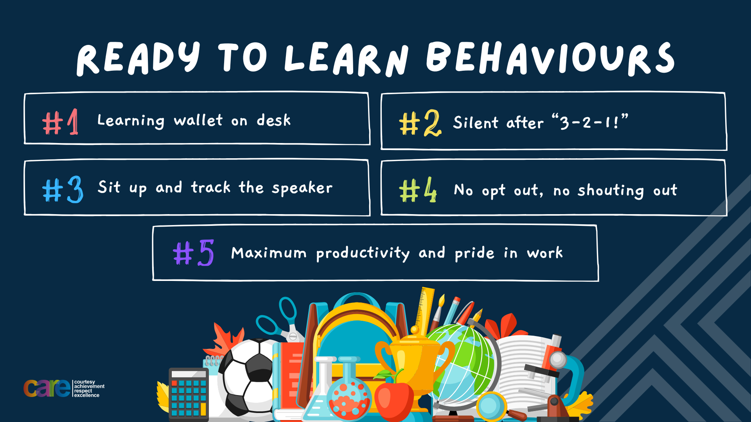

Slide 3


Secure your Relationships: Learning Journey
What is the difference between equality and equity
Celebrating culture and diversity in Birmingham
What are Protected Characteristics?
What is a hate crime?
What laws impact society?
Current issues in the UK
Today we will look at:
What laws impact society?
This includes:
Looking at specific laws to understand why they exist and the impact they have on society
Please remember that during the lesson we should not be asking any pupil or teacher personal questions.
Your teacher can ask you questions but this will be to check your knowledge in the lesson.

Slide 4

Tutor Time Recap
In your Personal Development Tutor Time activity, you started to look at laws that impact society
In your books answer the following question:
“What are laws?”
Sentence starter – “Laws are…”

Slide 5
Tutor Time Recap
Laws are…
“rules created by the government to ensure safety, fairness and order in society”
Task – use your red pen to add to the definitions you had written down.

Slide 6



Tutor Time Recap
This links to the Golden Thread of “Secure your Relationships” as respecting and following laws ensure that people feel safe around you and do not think they will be harmed.
Rule of Law is a British Value that means people are expected to follow the laws to keep everyone safe. There are lots of laws all designed to keep everyone safe and free from harm.
Article 41 states that if a country’s law is better for children than the convention, the law should be used. In the UK there is The Children’s Act (1989) which keeps children safe.
The Equality Act (2010) sets out 9 Protected Characteristics. This means people who identify with 1 or more of the characteristics should not be discriminated against and have equal opportunities in employment, education and public services.
UN Rights
of a Child

Slide 7
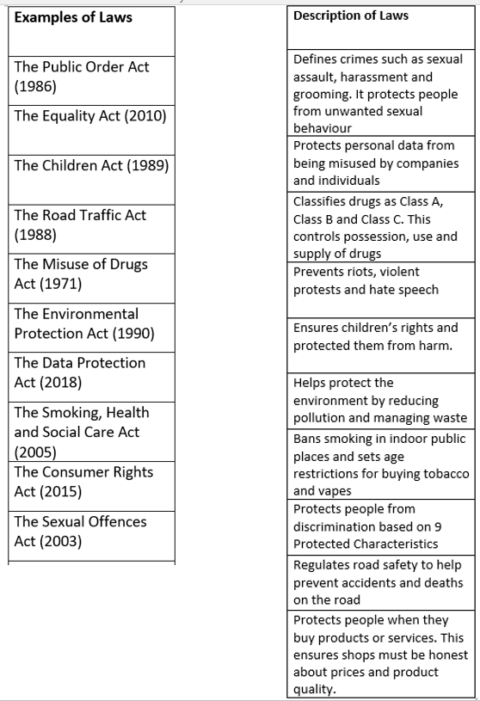
Examples of Laws
On your worksheet draw a line from the law to the matching description.

Slide 8
Examples of Laws - answers
The Public Order Act (1986)…
“prevents riots, violent protests and hate speech”
Use your red pen to mark your answer as correct or make a correction

Slide 9
Examples of Laws - answers
The Equality Act (2010)…
“protects people from discrimination based on 9 Protected Characteristics”
Use your red pen to mark your answer as correct or make a correction

Slide 10
Examples of Laws - answers
The Children Act (1989)…
“ensures children’s rights and protect them from harm”
Use your red pen to mark your answer as correct or make a correction

Slide 11
Examples of Laws - answers
The Road Traffic Act (1988)…
“regulates road safety to help prevent accidents and deaths on the road”
Use your red pen to mark your answer as correct or make a correction

Slide 12
Examples of Laws - answers
The Misuse of Drugs Act (1971)…
“classifies drugs as Class A, Class B and Class C. This controls possession, use and supply of drugs”
Use your red pen to mark your answer as correct or make a correction

Slide 13
Examples of Laws - answers
The Environmental Protection Act (1990)…
“helps protect the environment by reducing pollution and managing waste”
Use your red pen to mark your answer as correct or make a correction

Slide 14
Examples of Laws - answers
The Data Protection Act (2018)…
“protects personal data from being misused by companies and individuals”
Use your red pen to mark your answer as correct or make a correction

Slide 15
Examples of Laws - answers
The Smoking and Health and Social Care Act (2005)…
“bans smoking in indoor public places and sets restrictions for buying tobacco and vapes”
Use your red pen to mark your answer as correct or make a correction

Slide 16
Examples of Laws - answers
The Consumer Rights Act (2015)…
“protects people when they buy products or services. This ensures shops must be honest about the prices and product quality”
Use your red pen to mark your answer as correct or make a correction

Slide 17
Examples of Laws - answers
The Sexual Offences Act (2003)…
“defines crimes such as sexual assault, harassment and grooming. It protects people from unwanted sexual behaviour”
Use your red pen to mark your answer as correct or make a correction

Slide 18
UK Laws
In the margin write “SYV” – this stands for “Secure Your Voice”
Highlight “SYV”
Complete the following sentences...
“I think the law that affects people most in society is…”
“I think this because…”

Slide 19

UK Laws
Using your oracy helpsheet, discuss with the person next to you the question:
“What law do you think affects people most in society? Why?”
Remember to use the sentence starters to add, build or challenge what your partner has said.
Be ready to share your discussion with the class

Slide 20
UK Laws
We are now going to look at 3 laws in more detail.
These are:
The Road Traffic Act (1988)
The Public Order Act (1986)
The Environmental Protection Act (1990)

Slide 21
The Road Traffic Act (1988)
The Road Traffic Act (1988)…
“regulates road safety to help prevent accidents and deaths on the road”
This includes setting speed limits, seatbelts, drink & drug driving and mobile phone use while driving

Slide 22
Hinge Questions – whiteboard activity
3
Rules!
I will ask the question and give you some thinking time. (no more than 10 seconds)
Write the answer and turn your whiteboard over so nobody can see it.
When I am ready I will put on the 3 to 1 counter.
When ‘Show me’ appears on the board you must hold up your whiteboard (even if you don’t know the answer and there is nothing on your board)
2
1
Show me!
(even if your whiteboard is blank)

Slide 23

Hinge Questions – whiteboard activity
What is the minimum legal driving age in the UK for a car?
A – 16
B – 17
C - 18

Slide 24
Hinge Questions – whiteboard activity
If you are caught using a handheld phone while driving, what is the minimum penalty?
A – A warning
B – £200 fine and 6 penalty points
C - £1000 fine and a driving ban
12 penalty points = a driving ban. However in the first 2 years after passing your driving test, 6 penalty points = a driving ban. This means that using a mobile phone when driving can lead to many young people getting banned.

Slide 25
Hinge Questions – whiteboard activity
What does a red traffic light mean?
A – Stop and Wait
B – Slow down and check if it’s safe to go
C – Keep driving if there are no other cars

Slide 26
Hinge Questions – whiteboard activity
What must all passengers wear while in a moving car?
A – A seatbelt
B – A helmet
C – Nothing
If a passenger is found not wearing a seatbelt and they are 13 years old or younger, the driver is fined. If the passenger is 14 years old or older, the passenger gets fined

Slide 27
Hinge Questions – whiteboard activity
How old must a child be to legally ride in the front seat without a car seat?
A – 8 years old
B – 12 years old or 135cm tall
C – 16 years old

Slide 28
The Road Traffic Act (1988)
From June 2023 to June 2024, there were 1,607 deaths and 128,920 accidents which caused injury.
Take a subtitle “The Road Traffic Act 1988)
In the margin write “SYV” – this stands for “Secure Your Voice”
Highlight “SYV”
Complete the following question:
Should punishments be stricter for dangerous driving to reduce the number of accidents on UK roads?

Slide 29
UK Laws
Using your oracy helpsheet, discuss with the person next to you the question:
“Should punishments be stricter for dangerous driving to reduce the number of accidents on UK roads?”
Remember to use the sentence starters to add, build or challenge what your partner has said.
Be ready to share your discussion with the class

Slide 30
The Public Order Act (1986)
The Public Order Act (1986)…
“prevents riots, violent protests and hate speech”
This law also covers anti-social behaviour

Slide 31
The Public Order Act (1986)
Anti-social behaviour can cause distress, harassment or alarm to others.
It may not always be violent but it affects society and make public places unsafe
An example of anti social behaviour is in Manchester in 2023. There were large number of teenagers vandalising bus stops and intimidating shop owners. This made local residents feel unsafe and stopped some people from using public transport.

Slide 32
Hinge Questions – whiteboard activity
3
Rules!
I will ask the question and give you some thinking time. (no more than 10 seconds)
Write the answer and turn your whiteboard over so nobody can see it.
When I am ready I will put on the 3 to 1 counter.
When ‘Show me’ appears on the board you must hold up your whiteboard (even if you don’t know the answer and there is nothing on your board)
2
1
Show me!
(even if your whiteboard is blank)

Slide 33
Hinge Questions – whiteboard activity
Is the description legal behaviour or anti-social behaviour?
“A group of teenagers playing extremely loud music in their back garden at 1am, disturbing neighbours trying to sleep”
A – legal behaviour
B – anti-social behaviour

Slide 34
Hinge Questions – whiteboard activity
Is the description legal behaviour or anti-social behaviour?
“A group of teenagers playing football in the public park without disturbing other park users”
A – legal behaviour
B – anti-social behaviour

Slide 35
Hinge Questions – whiteboard activity
Is the description legal behaviour or anti-social behaviour?
“Two drivers race their cars at high speeds down a residential street, nearly hitting pedestrians”
A – legal behaviour
B – anti-social behaviour

Slide 36
Hinge Questions – whiteboard activity
Is the description legal behaviour or anti-social behaviour?
“Two teenagers kick and smash the glass panels of a bus stop, leaving broken glass everywhere”
A – legal behaviour
B – anti-social behaviour

Slide 37
Hinge Questions – whiteboard activity
Is the description legal behaviour or anti-social behaviour?
“A group of friends sitting on a bench in a park, talking and laughing during the afternoon”
A – legal behaviour
B – anti-social behaviour

Slide 38
The Public Order Act (1986)
In 2024 there were over 19,000 anti social behaviour crimes
Take a subtitle “The Public Order Act (1986)
In the margin write “SYV” – this stands for “Secure Your Voice”
Highlight “SYV”
Complete the following question:
Give an example of anti social behaviour and explain how it can negatively impact local communities

Slide 39
UK Laws
Using your oracy helpsheet, discuss with the person next to you the question:
“What example of anti-social behaviour did you choose? How does this affect local communities?”
Remember to use the sentence starters to add, build or challenge what your partner has said.
Be ready to share your discussion with the class

Slide 40
The Environmental Protection Act (1990)
The Environmental Protection Act (1990)…
“helps protect the environment by reducing pollution and managing waste”

Slide 41
The Environmental Protection Act (1990)
This law makes it illegal to:
Dump waste irresponsibly such as fly tipping
Release dangerous chemicals into the air, land or water
Cause excessive noise or air pollution
Allow businesses to pollute the environment without proper permits

Slide 42
The Environmental Protection Act (1990)
Water companies are allowed to release untreated waste water (raw sewage) into rivers and seas during heavy rainfalls.
However many companies have been fined for illegal releases of untreated waste water into UK rivers and seas.
In 2023 there were over 3.5 million hours worth of untreated waste water disposed into UK rivers and seas. This is extremely bad for local wildlife and makes the rivers and seas unsuitable for human use.

Slide 43
The Environmental Protection Act (1990)
Take a subtitle “The Environmental Protection Act (1990)
In the margin write “SYV” – this stands for “Secure Your Voice”
Highlight “SYV”
Complete the following question:
Why should businesses care more for the environment?

Slide 44
UK Laws
Using your oracy helpsheet, discuss with the person next to you the question:
“Why should businesses care more about the environment?”
Remember to use the sentence starters to add, build or challenge what your partner has said.
Be ready to share your discussion with the class

Slide 45
Summary
There are many laws in the UK.
All laws are designed to keep people safe and free from harm.
Some laws impact people more than others. However it is important that all laws are respected and followed to ensure everyone can live peacefully alongside each other

Slide 46


