Slide 1





Write the date: 14 April 2025
Write the Title and Golden Thread
Title – Culture and Diversity in Birmingham
Golden Thread – Secure Your Relationships
Underline both using your ruler & take out your oracy helpsheet
Complete the following questions:
What is being described: “treating everyone the same regardless of their individual needs or circumstances”
True or False – Your online presence can impact future jobs and university places
Explain the ripple effect of knife crime
Equality
True
The effect of knife crime does not stop when an attack happens. It impacts many people for a long period of time

Slide 2
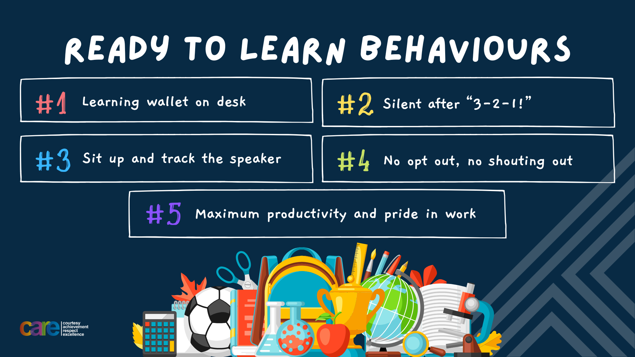

Slide 3


Secure your Relationships: Learning Journey
What is the difference between equality and equity
Celebrating culture and diversity in Birmingham
What are Protected Characteristics?
What is a hate crime?
What laws impact society?
Current issues in the UK
Today we will look at:
Celebrating culture and diversity in Birmingham
This includes:
Different celebrations of culture that happen in Birmingham
Why it is important to celebrate culture and diversity
Please remember that during the lesson we should not be asking any pupil or teacher personal questions.
Your teacher can ask you questions but this will be to check your knowledge in the lesson.

Slide 4
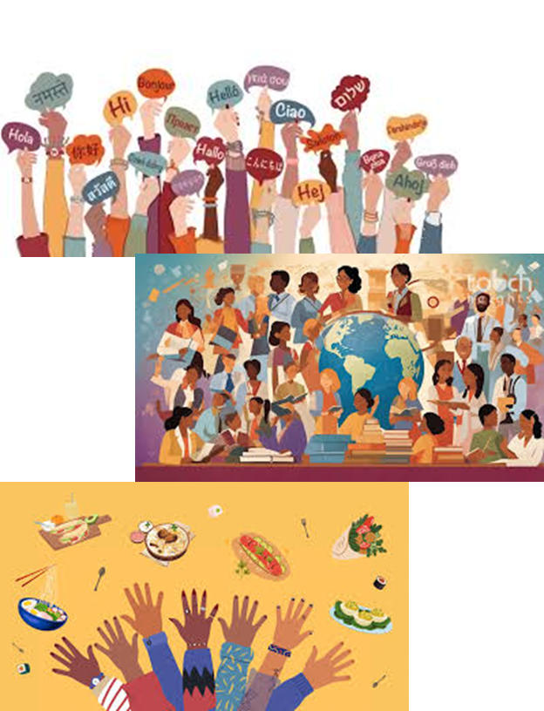
Tutor Time Recap
In your Personal Development Tutor Time activity, you started to look at culture and diversity.
In your books answer the following question:
“What is culture?”
Sentence starter – “Culture is…”

Slide 5
Tutor Time Recap
In your Personal Development Tutor Time activity, you started to look at culture and diversity.
In your books answer the following question:
“What is diversity?”
Sentence starter – “Diversity is…”

Slide 6
Tutor Time Recap
Culture is:
“a way of life of a group of people”
Diversity is:
“the variety of differences among people”
Task – use your red pen to add to the definitions you had written down.

Slide 7



Tutor Time Recap
This links to the Golden Thread of “Secure your Relationships” as stronger relationships are formed if people understand and appreciate each others culture and celebrate diversity
Mutual Respect & Tolerance is a British Value that means people should appreciate that everyone is different due to their culture but should be treated with respect regardless of their background.
There are lots of different UN Rights of a Child that link to culture and diversity including Article 30 which states that children from a minority group have the right to share their culture, language and religion
The Equality Act (2010) sets out 9 Protected Characteristics which means people who identify with these characteristics should not be treated any differently and these differences should be celebrated
UN Rights
of a Child

Slide 8

Diversity in Birmingham
Notes:
https://www.youtube.com/watch?v=wlf6Un_Ks9Y

Slide 9
Diversity in Birmingham
Birmingham is home to 1.1 million people from over 187 nationalities.
Each of these nationalities will have its own culture.
This makes Birmingham one of the most diverse cities in the UK

Slide 10
Diversity in Birmingham
There are over 90 languages spoken in the city. These include English, Urdu, Punjab, Bengali, Polish and Somali
There are lots of religions represented in the city including; Christianity, Islam, Hinduism, Sikhism, Buddhism, Judaism.

Slide 11
How does Birmingham celebrate different cultures
One way Birmingham celebrates different cultures is through religious events.
Examples of these events are:
Diwali (Festival of Lights) at Soho Road
Eid in the Park Celebrations in Small Heath Park

Slide 12
How does Birmingham celebrate different cultures – Diwali Mela
Notes:
https://www.youtube.com/watch?v=170JWijdR9g

Slide 13
How does Birmingham celebrate different cultures
One way Birmingham celebrates different cultures is through specific cultural events.
Examples of these events are:
St Patrick’s Day parade in Digbeth
Caribbean Carnival in Handsworth Park

Slide 14
How does Birmingham celebrate different cultures – St Patrick’s Day Parade
Notes:
https://www.youtube.com/watch?v=K4rJ7pKVHQU

Slide 15
How does Birmingham celebrate different cultures
One way Birmingham celebrates different cultures is through festivals
Examples of these festivals are:
Birmingham International Dance Festival
German Christmas Markets

Slide 16
How does Birmingham celebrate different cultures – Birmingham international dance festival
Notes:
https://www.youtube.com/watch?v=nfkiZrg3w0E

Slide 17

Celebrating culture
In the margin write “SYV” – this stands for “Secure Your Voice”
Highlight “SYV”
Complete the following sentences – “one cultural event I would like to go to is… This is because…

Slide 18
Celebrating culture
Using your oracy helpsheet, discuss with the person next to you the question:
“From the events you have just seen, what event would you like to go to?”
Remember to use the sentence starters to add, build or challenge what your partner has said.
Be ready to share your discussion with the class

Slide 19
Why celebrate culture and diversity
Promotes understanding – People can learn about different cultures in their own city. The more people learn the more cultural stereotypes reduce
Fosters community spirit – Having cultural celebrations in the city you live in creates a sense of belonging specially when they are attended by people of other cultures.

Slide 20
Everyday celebrations of culture and diversity
Everyday ways of celebrating culture and diversity are:
1. Learn about traditions from friends and neighbours that come from a different background than you

Slide 21
Everyday celebrations of culture and diversity
Everyday ways of celebrating culture and diversity are:
2. Explore cultural art and music exhibitions in museums and art galleries in Birmingham

Slide 22
Everyday celebrations of culture and diversity
Everyday ways of celebrating culture and diversity are:
3. Learn to simple words in different languages of your friends and neighbours

Slide 23
Everyday celebrations of culture and diversity
Everyday ways of celebrating culture and diversity are:
4. Be open to trying new foods or listening to different music of friends or neighbours in they are from a different culture to you

Slide 24
Celebrating culture and diversity
Everyday ways of celebrating diversity:
Learn about traditions from friends and neighbours that come from a different background than you
Explore cultural art and music exhibitions in museums and art galleries in Birmingham
Learn to simple words in different languages of your friends and neighbours
Be open to trying new foods or listening to different music of friends or neighbours in they are from a different culture to you
In the margin write “SYV” – this stands for “Secure Your Voice”
Highlight “SYV”
Write down the 4 everyday ways of celebrating diversity in order of what you think is most easy to do

Slide 25
Celebrating culture
Using your oracy helpsheet, discuss with the person next to you the question:
“What everyday way of celebrating culture and diversity is the easiest?”
Remember to use the sentence starters to add, build or challenge what your partner has said.
Be ready to share your discussion with the class

Slide 26
Why you matter in celebrating diversity
It can seem daunting to celebrate a culture that you do not follow or know a lot about.
However, every small action that celebrates culture or promotes diversity has a huge impact.
The more culture and diversity is celebrate the more people feel welcome. This makes people happy. This makes the atmosphere and feeling around the city better.

Slide 27
Celebrating culture and diversity
You now have 1 minute to think about the question:
“How would you like culture and diversity celebrated at Hodge Hill College?”
In the margin write “SYV” – this stands for “Secure Your Voice”
Highlight “SYV”
Complete the following sentence – “I would like culture and diversity celebrated at Hodge Hill College by…

Slide 28
Celebrating culture
Using your oracy helpsheet, discuss with the person next to you the question:
“How would you like culture and diversity celebrated at Hodge Hill College?”
Remember to use the sentence starters to add, build or challenge what your partner has said.
Be ready to share your discussion with the class

Slide 29
Reflection
Diversity is not just a fact in Birmingham and the UK, it is also a strength of the city and wider country.
Celebrating it just makes Birmingham and the UK more special.
It is important to never stop learning and sharing culture with other people.

Slide 30


