Slide 1





Write the date: 14 April 2025
Write the Title and Golden Thread
Title – How are laws made?
Golden Thread – Secure Your Future
Underline both using your ruler & take out your oracy helpsheet
Complete the following questions:
True or False: You have to be 18 years old to drive in the UK?
Give an example of a hate crime
True or False: age is a Protected Characteristic
False
Physical attacks, threats, vandalism, verbal abuse, online harassment
True

Slide 2
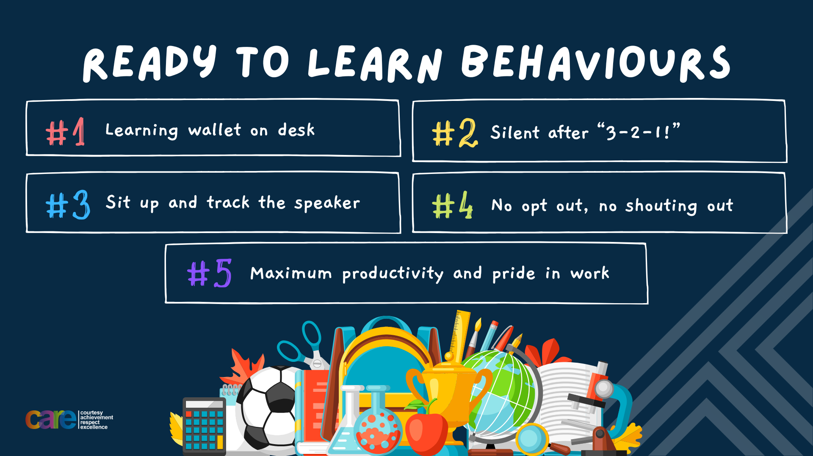

Slide 3


Secure your Relationships: Learning Journey
How are laws made?
What is the difference between civil and criminal law?
What is court and how does it work?
What is the role of police in dealing with crime?
Is youth crime really a problem?
What can communities do to help prevent crime?
Today we will look at:
How are laws made?
This includes:
Process of making a law
What happens if laws are broken?
Please remember that during the lesson we should not be asking any pupil or teacher personal questions.
Your teacher can ask you questions but this will be to check your knowledge in the lesson.

Slide 4

Tutor Time Recap
In your Personal Development Tutor Time activity, you started to look at what are laws
In your books answer the following question:
“What are laws?”
Sentence starter – “Laws are…”

Slide 5
Tutor Time Recap
Laws are…
“a system of rules that a country have agreed to follow.”
Task – use your red pen to add to the definitions you had written down.

Slide 6
Tutor Time Recap
Laws are necessary because they:
Keep everyone safe
Ensure everyone is treated fairly
Ensure everyone’s property is protected

Slide 7


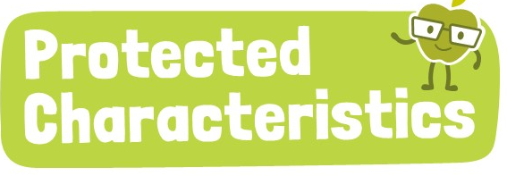
Tutor Time Recap
This links to the Golden Thread of “Secure your Future” as breaking the law can lead to criminal records which can negatively impact job opportunities
Rule of Law is a British Value which means everyone living in the UK is required to follow the law.
The UN Rights of a Child is an example of international law which is designed to keep all children safe.
Protected characteristics is an example of a law in the UK called the Equality Act (2010) which stops people being discriminated against due to any of the characteristics.
UN Rights
of a Child

Slide 8
How laws are made
In the UK it is up to the Government to make the laws.
However it is not as simple as the Prime Minister deciding that something is now a law.
There is a process that has to be followed

Slide 9

How laws are made
You have been given a worksheet with each step of the law making process. While watching the video you should write a number beside each step.
Example – The first step is “a bill is put forward” beside this is “1”
Label the next steps using numbers between 2 and 7
Notes:
https://www.youtube.com/watch?v=iM4CKYCrW7Y

Slide 10
How laws are made
The first step is
“A bill is put forward”
This can be by a range of people or groups. The bill could be to propose a new law or to amend an existing law

Slide 11
How laws are made
The second step is
“A green paper is published”
This presents the Governments ideas for the bill and it is open to the public to discuss. This is called a public consultation.

Slide 12
How laws are made
The 3rd step is
“A white paper is published”
This includes finding from the public consultation and outlines the proposed bill in more detail than the green paper

Slide 13
How laws are made
The 4th step is
“Government ministers must agree if the proposal is taken forward”
Government ministers are MP’s who are part of the Prime Ministers closest team. An easy way to think about this is SLT teachers support Mrs Herrmann. Government ministers have the same role for the Prime Minister.
These Government ministers have to agree that the proposal should be taken forward

Slide 14
How laws are made
The 5th step is
“The bill is presented to Parliament”
The Government Minister responsible for the area that will be impacted by the new or changed law presents it to all MP’s in the House of Commons

Slide 15
How laws are made
The 6th step is
“MPs in the House of Commons and the House of Lords debate the bill”
This can happen multiple times as both the House of Commons and House of Lords can make changes to the proposal. Before it goes any further both the House of Commons and House of Lords have to agree on all changes.

Slide 16
How laws are made
The 7th step is
“Passed to Monarch for formal approval”
The King is given a copy of the bill. Once they have approved it this is now law which is called an Act of Parliament

Slide 17
Hinge Questions – whiteboard activity
3
Rules!
I will ask the question and give you some thinking time. (no more than 10 seconds)
Write the answer and turn your whiteboard over so nobody can see it.
When I am ready I will put on the 3 to 1 counter.
When ‘Show me’ appears on the board you must hold up your whiteboard (even if you don’t know the answer and there is nothing on your board)
2
1
Show me!
(even if your whiteboard is blank)

Slide 18
Hinge Questions – whiteboard activity
What is being described?
“a system of laws that a country have agreed to follow”
Laws

Slide 19

Hinge Questions – whiteboard activity
True or False
Breaking the law can lead to a criminal record that may affect future employment
A – True
B – False

Slide 20
Hinge Questions – whiteboard activity
True or False
Rule of Law is a British Value
A – True
B – False

Slide 21
Hinge Questions – whiteboard activity
True or False
Laws are unnecessary and they do not keep people safe
A – True
B – False

Slide 22
Hinge Questions – whiteboard activity
True or False
The Prime Minister can immediately decide a law?
A – True
B – False

Slide 23
Hinge Questions – whiteboard activity
True or False
There are 7 steps to a something becoming law. The final step is the Monarch (The King) giving approval
A – True
B – False

Slide 24
Laws
In the margin write “SYV” – this stands for “Secure Your Voice”
Highlight “SYV”
Complete the following sentence…
“A bill I would put forward to make as a law would be…”

Slide 25

What are laws?
Using your oracy helpsheet, discuss with the person next to you:
“If you could put forward a bill as the first step to making a new law in the UK, what would you suggest?”
Remember to use the sentence starters to add, build or challenge what your partner has said.
Be ready to share your discussion with the class

Slide 26
What happens when laws are broken?
When someone breaks the law, they may face consequences based on the severity of their actions.
Consequences can include:
1. Cautions – this is warning. If a person gets too many cautions then the consequence is escalated.

Slide 27
What happens when laws are broken?
When someone breaks the law, they may face consequences based on the severity of their actions.
Consequences can include:
2. Fines – a person is required to pay a fine. These are for minor offences such as parking tickets or littering

Slide 28
What happens when laws are broken?
When someone breaks the law, they may face consequences based on the severity of their actions.
Consequences can include:
3. Community service. A person will have to help out in the community (litter picking, cleaning graffiti). This is normally given for vandalism offences

Slide 29
What happens when laws are broken?
When someone breaks the law, they may face consequences based on the severity of their actions.
Consequences can include:
4. Prison. A person can go to prison for committing very serious crimes such as robbery, assault or murder.

Slide 30
Laws
After the summer riots, people have been sent to prison for things they posted online
In the margin write “SYV” – this stands for “Secure Your Voice”
Highlight “SYV”
Complete the following sentence…
“I agree/disagree with people being sent to prison for things they post online because…”

Slide 31
Consequences of breaking the law
Using your oracy helpsheet, discuss with the person next to you:
“Do you think people should go to prison for something posted on social media?”
Remember to use the sentence starters to add, build or challenge what your partner has said.
Be ready to share your discussion with the class

Slide 32
What happens when laws are broken?
It is everyone’s responsibility to know what the law says and to obey it.
Ignorance (saying “I didn’t know”) of the law is not regarded as a valid excuse if a person is found breaking the law.

Slide 33
Scenarios
In your books answer the following questions:
Has a law been broken?
What consequence could the person face?
A student is at a park and leaves their phone on a bench while playing football. Another person walking by notices the phone and decides to take it home, knowing it doesn’t belong to them.

Slide 34
Scenarios
Using your oracy card, discuss with your partner your answers to the questions below.
Has a law been broken?
What consequence could the person face?
Remember to add, build or challenge.
A student is at a park and leaves their phone on a bench while playing football. Another person walking by notices the phone and decides to take it home, knowing it doesn’t belong to them.

Slide 35
Scenarios
In your books answer the following questions:
Has a law been broken?
What consequence could the person face?
A car is driving through a school zone where the speed limit is 20 mph. The driver is in a rush and drives at 40 mph. They are pulled over by the police before anyone gets hurt.

Slide 36
Scenarios
Using your oracy card, discuss with your partner your answers to the questions below.
Has a law been broken?
What consequence could the person face?
Remember to add, build or challenge.
A car is driving through a school zone where the speed limit is 20 mph. The driver is in a rush and drives at 40 mph. They are pulled over by the police before anyone gets hurt.

Slide 37



Support
If you, a friend or a family member need any support about any laws being broken, support is available
Childline.org.uk
Call – 08001111
Email or chat online for support
Themix.org.uk
You can email or have one-to-chat online.
There is also a crisis messenger which is available 24/7

Slide 38


