Slide 1
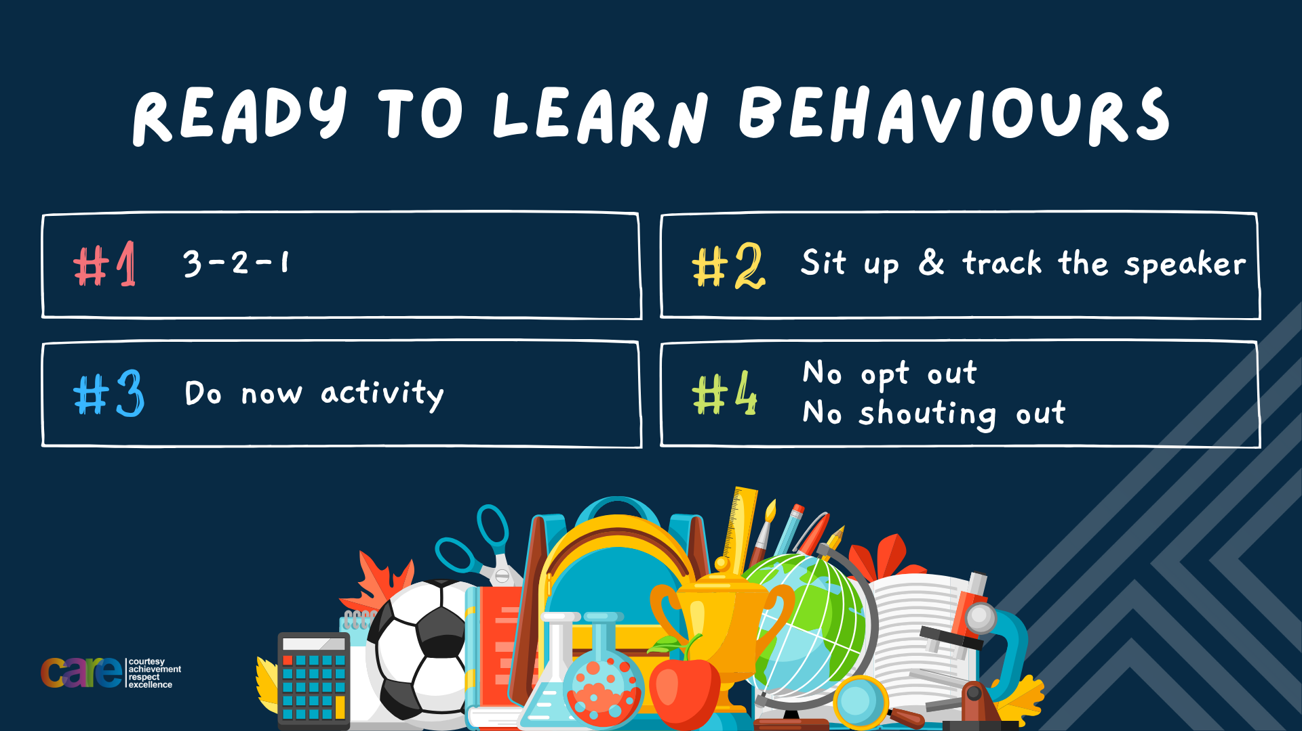

Slide 2





Write the date: 14 April 2025
Write the Title and Golden Thread
Title – What is gang culture?
Golden Thread – Secure Your Wellbeing
Underline both using your ruler & take out your oracy helpsheet
Complete the following questions:
What is being described: “actions that break the law and harm individuals, communities or property.”
True or False – “Failure is a good thing”
Give one characteristic of a role model
Criminal activity
True
Integrity, hardworking, compassionate, resilient, passionate

Slide 3


Secure your Wellbeing: Learning Journey
Importance of role models
Why is failure a good thing
What is criminal activity?
Dangers of gang culture
Dangers of knife crime
What does your online presence look like?
Today we will look at:
What are the dangers of gang culture
This includes:
Definition of gangs
Structure of gangs
Recruitment to gangs
County lines
Please remember that during the lesson we should not be asking any pupil or teacher personal questions.
Your teacher can ask you questions but this will be to check your knowledge in the lesson.

Slide 4
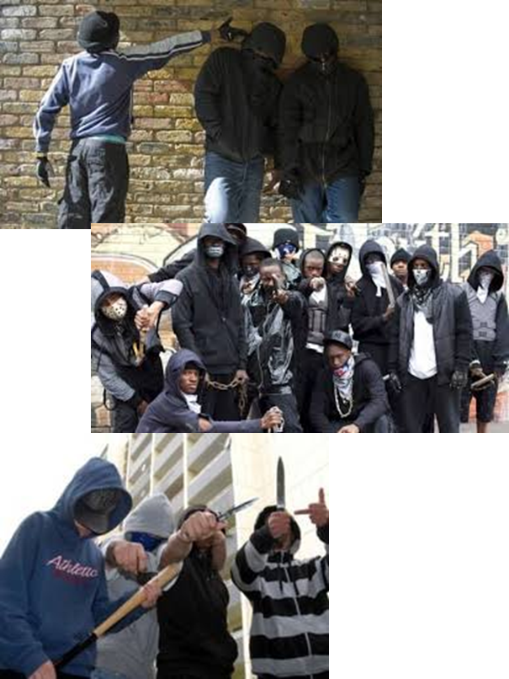
Tutor Time Recap
In your Personal Development Tutor Time activity, you started to look at gangs.
In your books answer the following question:
“What is the definition of a gang?”
Sentence starter – “gangs are…”

Slide 5
Tutor Time Recap
Gangs are:
“A group of people who come together with a shared identity, often involving illegal activities or antisocial behaviour.”
Task – use your red pen to add to the definition you had written down.

Slide 6





Tutor Time Recap
This links to the Golden Thread of “Secure your Wellbeing” as being in a gang is dangerous and it can limit your future options as they are difficult to leave
Rule of Law is a British Value that means everyone in the UK is expected to adhere to the law. Gangs operate outside of the law and normally display antisocial behaviour
Article 36 of the UN Rights of Child states that children have the right to be protected from exploitation. Gangs exploit children in order to get them to join. This is against your rights.
UN Rights
of a Child

Slide 7
Structures of Gangs
Many gangs have a very clear structure. This is made up of 3 sections:
Elders
Faces
Soldiers
Wannabees

Slide 8
Structures of Gangs
The best way to think of this is in a pyramid.
Elders are at the top. They normally have access to large amounts of money and luxury items. They have all the power in the gang and make decisions for the rest of the gang members. They will very rarely get involved in incriminating actions or behaviour
Elders
Faces
Soldiers
Wannabees

Slide 9
Structures of Gangs
The best way to think of this is in a pyramid.
Faces are the “middle men” between the elders at the top and those on the street. They have lots of control over those below them in the structure and often known to use violence to display their power.
Elders
Faces
Soldiers
Wannabees

Slide 10
Structures of Gangs
The best way to think of this is in a pyramid.
Soldiers are those in charge at street level. They are recruited to sell drugs and they will use other people to help them do this. They can also be violent if they are owed money due to the pressure above them
Elders
Faces
Soldiers
Wannabees

Slide 11
Structures of Gangs
The best way to think of this is in a pyramid.
Wannabees are the lowest at street level and they often want to be higher in the gang. This is often young people who want to have the glamourous lifestyle displayed by the elders of the gang.
Elders
Faces
Soldiers
Wannabees

Slide 12
Hinge Questions – whiteboard activity
3
Rules!
I will ask the question and give you some thinking time. (no more than 10 seconds)
Write the answer and turn your whiteboard over so nobody can see it.
When I am ready I will put on the 3 to 1 counter.
When ‘Show me’ appears on the board you must hold up your whiteboard (even if you don’t know the answer and there is nothing on your board)
2
1
Show me!
(even if your whiteboard is blank)

Slide 13
Hinge Questions – whiteboard activity
What is being described?
“A group of people who come together with a shared identity, often involving illegal activities or antisocial behaviour.”
Gangs

Slide 14

Hinge Questions – whiteboard activity
What Golden Thread does today’s lesson relate to?
A – Secure your Voice
B – Secure your Relationships
C – Secure your Wellbeing
D – Secure your Future

Slide 15
Hinge Questions – whiteboard activity
What section of a gang is being described?
“often young people who want to live a glamourous lifestyle”
A – Elders
B – Faces
C – Soldiers
D - Wannabees

Slide 16
Hinge Questions – whiteboard activity
What section of a gang is being described?
“those at the top of the gang. They normally have access to large amounts of money and luxury items”
A – Elders
B – Faces
C – Soldiers
D - Wannabees

Slide 17
Hinge Questions – whiteboard activity
What section of a gang is being described?
“middle men between the elders and those on street level”
A – Faces
B – Wannabees
C – Elders
D - Soldiers

Slide 18
Hinge Questions – whiteboard activity
What section of a gang is being described?
“those in charge at street level and are recruited to sell drugs”
A – Faces
B – Wannabees
C – Elders
D - Soldiers

Slide 19
Structures of Gangs
In your books draw out the structure of a gang.
You can use the key words below
Elders
Faces
Soldiers
Wannabees
You should also write a short sentence to describe each section

Slide 20
Recruitment
Young people are often recruited into gangs with the promise of a glamourous lifestyle.
To give people a taste of this lifestyle they may give a young person:
A large sum of money for a young person
Luxury items such as trainers, phones, clothes
Jewellery such as chains and bracelets

Slide 21

Recruitment to gangs
Complete the instructions below:
In the margin write “SYV” – this stands for “Secure Your Voice”
Highlight “SYV”
Answer the following question “do you think the items given during recruitment are really free?”

Slide 22
Recruitment to gangs
Using your oracy helpsheet, discuss with the person next to you the question:
“do you think the items given during recruitment are really free?”
Remember to use the sentence starters to add, build or challenge what your partner has said.
Be ready to share your discussion with the class

Slide 23
Recruitment
Although the money and items will be given to the person to keep they are not really free.
These luxury items or money is immediately considered a “debt”
If the person takes the items or money but then tries to leave, they have to pay back the debt plus a lot of interest.
This will make it unaffordable meaning the person is stuck in the gang and will have to do as the gang wants.

Slide 24
County Lines
One major gang activity is selling drugs in smaller towns and villages. This is known as county lines.

Slide 25
County Lines
These types of gangs do this in 3 stages:
Import/manufacture – Gang will make the drugs or import them from abroad
Distribution – those in charge will send them to the head of their local supply chain ready to be sold on the street
Delivery – this is actually selling the drugs to people on the street

Slide 26
County Lines
It is normally at the delivery stage that young people are involved after being recruited into the gang.

Slide 27

County Lines
While watching the video answer the following questions in your book
How did Evan get involved in the gang?
What level of the gang is Evan?
Does Evan really want to be in the gang?
What are the consequences for Evan at the end of the video?
Notes:
https://www.youtube.com/watch?v=aS1tlx47-uc

Slide 28
Video
Using your oracy helpsheet, discuss with the person next to you the questions you answered while watching the video.
Remember to use the sentence starters to add, build or challenge what your partner has said.
Be ready to share your discussion with the class

Slide 29
Reflection
It is important to remember that despite appearances, gangs are very dangerous.
Being in a gang can put people in significantly dangerous situations that can lead to serious injury.
They also limit future options as they tie people up into the gang making it very difficult to leave.

Slide 30



Support
If you ever need support about gangs for yourself, a friend or family member you can find it here:
Childline.org.uk
Call – 08001111
Email or chat online for support
Themix.org.uk
You can email or have one-to-chat online.
There is also a crisis messenger which is available 24/7

Slide 31


