Slide 1
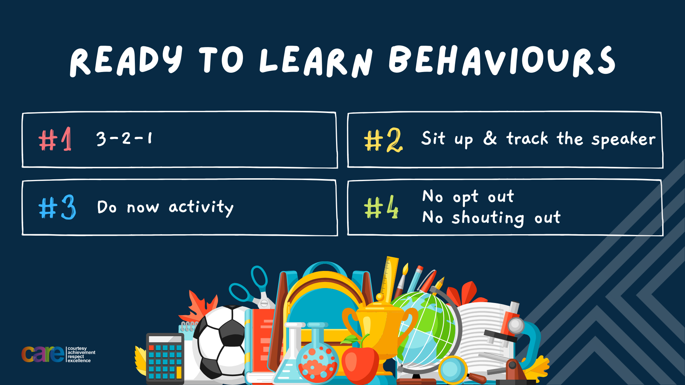

Slide 2








Write the date: 14 April 2025
Write the title: what is criminal activity
Underline both using your rule in your learning wallet. Take out your oracy helpsheet too.
Complete the following tasks
What is being described? ““a stepping stone to success”
2. What types of role models are there?
3. Give one example of what to do if a fallout happens
Failure
Personal, public, community
Don’t call people names or behave threatening, never broadcast feelings to other people/online, stay calm and walk away, don’t bring up old issues

Slide 3


Secure your Wellbeing: Learning Journey
Importance of role models
Why is failure a good thing
What is criminal activity?
Dangers of gang culture
Dangers of knife crime
What does your online presence look like?
Today we will look at:
What is criminal activity
This includes:
What is criminal activity
Different types of criminal activity
The negative impact this can have on the community
Please remember that during the lesson we should not be asking any pupil or teacher personal questions.
Your teacher can ask you questions but this will be to check your knowledge in the lesson.

Slide 4

Tutor Time Recap
Criminal activity is “actions that break the law and harm individuals, communities or property.”
The 5 most common crimes in Birmingham are – antisocial behaviour, criminal damage, theft, vehicle offences and violent/sexual offences.

Slide 5





Tutor Time Recap
This links to the Golden Thread of “Secure your Wellbeing” as criminal activity can impact your physical and mental wellbeing.
Rule of Law is a British Value that means everyone in the UK is expected to adhere to the law and not take part in criminal activity.
Article 40 of the UN Rights of Child states that if a child does break the law they have the right to legal help and support in becoming a good member of their community
UN Rights
of a Child

Slide 6
Criminal Damage
Criminal Damage includes anything that destroys or destroys another person’s property.
Intentional actions that could have damaged property despite no damage happening, is also classed as criminal damage.
This is outlined in the Criminal Damage Act 1971.

Slide 7
Criminal Damage
One of the most common example of criminal damage is graffiti.
Graffiti is a form of art. However, if a person has not received permission to graffiti on a building it is illegal.

Slide 8
Criminal Damage
The negative impact graffiti has on a community is:
Cost of clean up
Decreases property value in the community
Creates a negative perception of the community

Slide 9

Graffiti
In your books write your answer to the following question:
“What is your opinion on graffiti in your local community?”
Sentence starter
My opinion on graffiti in my local community is….

Slide 10
Graffiti
Using your oracy helpsheet, with the person next to you, discuss your response to the question:
“What is your opinion on graffiti in your local community?”
Remember to use the sentence starters to add, build or challenge what your partner has said.
Be ready to share your discussion with the class

Slide 11
Graffiti scenario
A group of teenagers spray-paint slogans on the walls of a local business without permission. The business owner reports it to the police, leading to an investigation. When questioned the teenagers say they didn’t think that it was illegal because the business next door had an artist to graffiti their building
Task
In your books answer the following question
What type of criminal activity have the teenagers taken part in?
Why was their graffiti illegal?

Slide 12
Antisocial behaviour
Antisocial behaviour is actions that cause harassment, alarm or distress to others.
Examples of antisocial behaviour are vandalism, public drunkenness and verbal abuse.
This is outlined in the antisocial, crime and policing act 2014.

Slide 13
Antisocial behaviour
One of the most common examples of antisocial behaviour is through intimidating gatherings.
For teenagers this can mean meeting in a large group with hoods up or wearing face coverings.
If this is in a busy public area, this can intimidate other members of the community so they avoid that area. This is not fair to these people especially if the group is outside a shop, bus stop or outside their house.

Slide 14
Antisocial behaviour
The negative impact of antisocial behaviour in the community is:
Creates unsafe environments
Erodes trust within communities
Antisocial behaviour often leads to more serious criminal activity in the area.

Slide 15
Antisocial Behaviour
In your books write your answer to the following question:
“Do you think a large gathering of teenages outside a shop be classed as antisocial behaviour?”

Slide 16
Antisocial Behaviour
Using your oracy helpsheet, with the person next to you, discuss your response to the question:
“Do you think a large gathering of teenages outside a shop be classed as antisocial behaviour?”
Remember to use the sentence starters to add, build or challenge what your partner has said.
Be ready to share your discussion with the class

Slide 17
Antisocial behaviour scenario
Mark needs to go to his local shop. As he gets closer to the shop, he spots a large group of teenagers outside the shop. He can hear they are playing loud rap music on their phones. Some of the group are shouting including saying multiple swear words. Mark decides not to go to the shop so returns home and calls the Police.
Task
In your books answer the following question
What type of criminal activity have the teenagers taken part in?
Do you think Mark should have gone home or went into the shop?

Slide 18
Stealing
Stealing is when a person takes something that does not belong to them without permission.
Examples of stealing is theft from peers and online theft such as fraud and scams.

Slide 19
Stealing
One of the most common examples of stealing is shoplifting.
In 2024, reports of shop lifting increased by 29%.
This is particularly difficult for businesses as shoplifting leads to a financial losses and could mean a business has to close or put up their prices for other customers.
One reason suggested for this rise is the cost of living crisis.

Slide 20
Shoplifting
In your books write your answer to the following question:
“Why do you think the cost of living crisis has been linked to a rise in shoplifting? Does this make it ok to steal?”
Sentence Starter
I think the cost of living crisis has been linked to shoplifting increase because…

Slide 21
Shoplifting
Using your oracy helpsheet, with the person next to you, discuss your response to the question:
“Why do you think the cost of living crisis has been linked to a rise in shoplifting? Does this make it ok to steal?”
Remember to use the sentence starters to add, build or challenge what your partner has said.
Be ready to share your discussion with the class

Slide 22
Shoplifting scenario
Max and George are in their local cornershop. They have a total of £5 to spend. What they want to buy comes to £5.50. So they can get everything they want, Max puts one of the chocolate bars in his pocket and walks out. George goes to the counter and pays for the rest of the items.
Task
In your books answer the following question
What type of criminal activity has happened in the scenario?
Has George committed a crime as he paid for the items?

Slide 23
Why people take part in criminal activity
People take part in criminal activity for numerous reasons. Some of these reasons are:
1. Pressure – this could be from their friends, older teenagers in the community, people in the community who are known to be part of a gang or even sometimes family members.

Slide 24
Why people take part in criminal activity
People take part in criminal activity for numerous reasons. Some of these reasons are:
2. Financial Difficulties – This is normally linked to shoplifting so people can have food to eat if they cannot afford it

Slide 25
Why people take part in criminal activity
People take part in criminal activity for numerous reasons. Some of these reasons are:
3. Boredom – This is especially true for young people as there is a lack of community events to get involved in. This can lead to antisocial behaviour and criminal damage.

Slide 26
Why people take part in criminal activity
People take part in criminal activity for numerous reasons. Some of these reasons are:
4. Revenge – This is to get pay back from something that has annoyed a person. This is normally linked to criminal damage and theft.

Slide 27
Why people take part in criminal activity
Reasons for taking part in criminal activity:
Pressure
Financial Difficulties
Boredom
Revenge
Task
In your books write down the reason for taking part in criminal activity in order of what you think is the most important reason why people take part in criminal activity.
Be ready to discuss why you put them into that order

Slide 28
Reasons why people take part in criminal activity
Using your oracy helpsheet, with the person next to you, discuss your response to the question:
“What did you put as the most important reason why people take part in criminal activity?”
Remember to use the sentence starters to add, build or challenge what your partner has said.
Be ready to share your discussion with the class

Slide 29
Hinge Questions – whiteboard activity
3
Rules!
I will ask the question and give you some thinking time. (no more than 10 seconds)
Write the answer and turn your whiteboard over so nobody can see it.
When I am ready I will put on the 3 to 1 counter.
When ‘Show me’ appears on the board you must hold up your whiteboard (even if you don’t know the answer and there is nothing on your board)
2
1
Show me!
(even if your whiteboard is blank)

Slide 30
Hinge Questions – whiteboard activity
What is being described?
“actions that break the law and harm individuals, communities or property”
Criminal activity

Slide 31

Hinge Questions – whiteboard activity
What Golden Thread does today’s lesson relate to?
A – Secure your Voice
B – Secure your Relationships
C – Secure your Wellbeing
D – Secure your Future

Slide 32
Hinge Questions – whiteboard activity
What type of criminal activity is being described?
“a form of art but when done without permission is illegal”
A – Criminal Damage
B – Antisocial Behaviour
C - Theft

Slide 33
Hinge Questions – whiteboard activity
What type of criminal activity is being described?
“a person taking something that does not belong to them without permission”
A – Antisocial Behaviour
B – Theft
C – Criminal Damage

Slide 34
Hinge Questions – whiteboard activity
What type of criminal activity is being described?
“actions that cause harassment, alarm or distress to others”
A – Theft
B – Criminal Damage
C – Antisocial behaviour

Slide 35


