Slide 1





Write the date: 14 April 2025
Write the Title and Golden Thread
Title – Importance of online presence
Golden Thread – Secure Your Wellbeing
Underline both using your ruler & take out your oracy helpsheet
Complete the following questions:
What is being described: “Criminal offences committed using a knife as a weapon”
True or False – everyone in a gang is equal
Give an example of criminal activity
Knife Crime
False
Criminal damage, graffiti, anti social behaviour, shoplifting

Slide 2
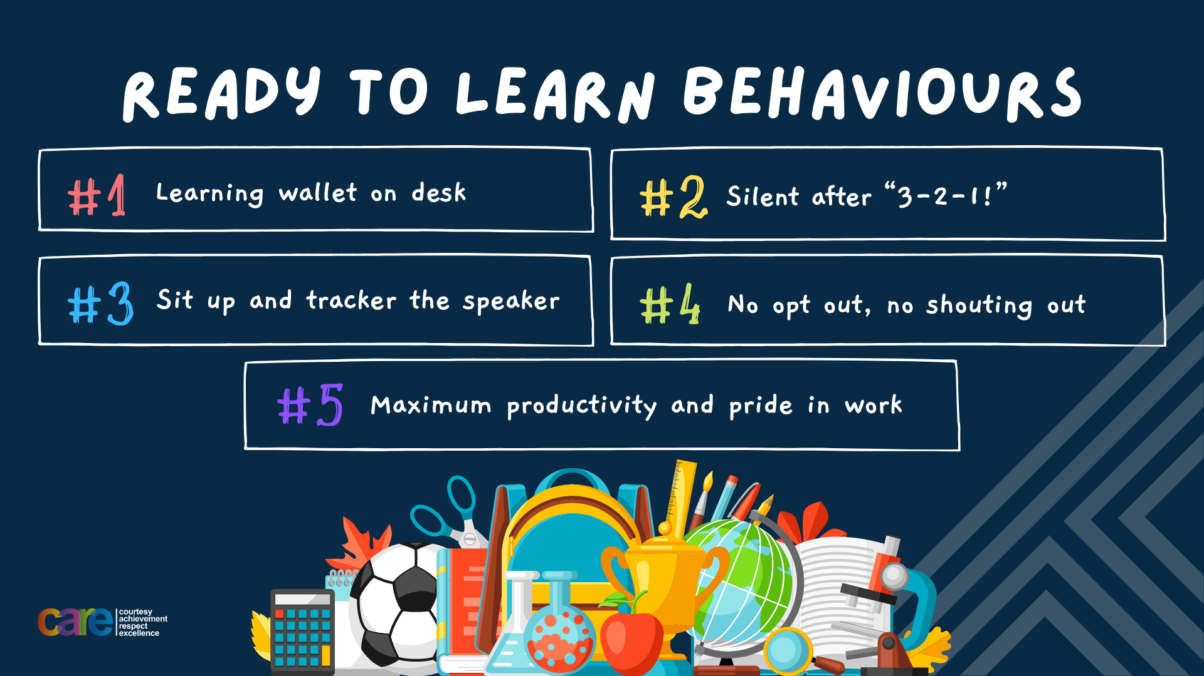

Slide 3


Secure your Wellbeing: Learning Journey
Importance of role models
Why is failure a good thing
What is criminal activity?
Dangers of gang culture
Dangers of knife crime
What does your online presence look like?
Today we will look at:
What does your online presence look like?
This includes:
Definition of online presence
Why a positive online presence is important
What adds to a positive/negative online presence
Please remember that during the lesson we should not be asking any pupil or teacher personal questions.
Your teacher can ask you questions but this will be to check your knowledge in the lesson.

Slide 4

Tutor Time Recap
In your Personal Development Tutor Time activity, you started to look at the importance of online presence
In your books answer the following question:
“What is the definition of online presence?”
Sentence starter – “online presence is…”

Slide 5



Tutor Time Recap
Online presence is:
“everything someone posts, likes, shares and interacts with online”
Task – use your red pen to add to the definition you had written down.

Slide 6





Tutor Time Recap
This links to the Golden Thread of “Secure your Wellbeing” as a negative online presence even as a teenager can have an impact on your future opportunities
Rule of Law is a British Value that means everyone in the UK is expected to adhere to the law. There are laws around what can be shared, liked and said online.
Article 29 of the UN Rights of Child states that children’s education should help them live peacefully. Learning about the importance of a positive online presence even as a teenage will help you have more opportunities in the future.
UN Rights
of a Child

Slide 7
Online presence
What a person posts, likes and comments online stays online, even if deleted.
One way that this happens is screenshots that show a post, comment or like after it has been deleted

Slide 8
Online presence
This is important as employers, colleges, universities and even future partners will often review social media profiles.
They will be specifically looking for inappropriate content.
This could impact a person future opportunities, professionally and personally.

Slide 9
Hinge Questions – whiteboard activity
3
Rules!
I will ask the question and give you some thinking time. (no more than 10 seconds)
Write the answer and turn your whiteboard over so nobody can see it.
When I am ready I will put on the 3 to 1 counter.
When ‘Show me’ appears on the board you must hold up your whiteboard (even if you don’t know the answer and there is nothing on your board)
2
1
Show me!
(even if your whiteboard is blank)

Slide 10
Hinge Questions – whiteboard activity
What is being described?
“everything someone posts, likes, shares and interacts with online”
Online presence

Slide 11

Hinge Questions – whiteboard activity
What Golden Thread does today’s lesson relate to?
A – Secure your Voice
B – Secure your Relationships
C – Secure your Wellbeing
D – Secure your Future

Slide 12
Hinge Questions – whiteboard activity
True or False
“employers will not look at social media, they will just take what they see for granted at interview”
A – True
B – False

Slide 13
Hinge Questions – whiteboard activity
True or False
“colleges and universities may look at social media for inappropriate content”
A – True
B – False

Slide 14
Hinge Questions – whiteboard activity
True or False
“what is posted online will most likely always remain online even if deleted”
A – True
B – False

Slide 15
A negative online presence
There are some things that should not be done online to ensure that a person can have a positive online presence.
These include:
Avoid using offensive language
Avoid making discriminatory remarks
Posting, liking or commenting on an inappropriate photo or video
Posting, liking or commenting about a school, college, university or workplace

Slide 16
A negative online presence
There are some things that should not be done online to ensure that a person can have a positive online presence.
These include:
Avoid using offensive language
Avoid making discriminatory remarks
Posting, liking or commenting on an inappropriate photo or video
Posting, liking or commenting about a school, college, university or workplace
In the margin write “SYV” – this stands for “Secure Your Voice”
Highlight “SYV”
Complete the following sentence – “one thing to avoid doing online is…” – you should choose the thing you think is most important to avoid doing online

Slide 17

Negative online presence
Using your oracy helpsheet, discuss with the person next to you the question:
“what did you write down as the most important think to avoid doing online? Why?”
Remember to use the sentence starters to add, build or challenge what your partner has said.
Be ready to share your discussion with the class

Slide 18
Positive online presence
There are lots of things people can post, like and comment on that will show a positive online presence.
These include:
Sharing personal achievements
Supporting others through encouraging comments and sharing positive content
Posting helpful or inspiring content
In the margin write “SYV” – this stands for “Secure Your Voice”
Highlight “SYV”
Complete the following sentence – “one thing to do that is positive online is…” – you should choose the thing you think is most important to do online for a positive presence

Slide 19
Hinge Questions – whiteboard activity
3
Rules!
I will ask the question and give you some thinking time. (no more than 10 seconds)
Write the answer and turn your whiteboard over so nobody can see it.
When I am ready I will put on the 3 to 1 counter.
When ‘Show me’ appears on the board you must hold up your whiteboard (even if you don’t know the answer and there is nothing on your board)
2
1
Show me!
(even if your whiteboard is blank)

Slide 20
Hinge Questions – whiteboard activity
Is the below an example of a positive or negative online presence
“a post saying “volunteering at the animal shelter today! It feels great to give back.”
A – Positive
B – Negative

Slide 21
Hinge Questions – whiteboard activity
Is the below an example of a positive or negative online presence
“a post saying “assembly is school was so rubbish today. What a waste of everyone’s time”
A – Positive
B – Negative

Slide 22
Hinge Questions – whiteboard activity
Is the below an example of a positive or negative online presence
“liking a photo online that is offensive to a group of people. The photo also include offensive language”
A – Positive
B – Negative

Slide 23
Hinge Questions – whiteboard activity
Is the below an example of a positive or negative online presence
“commenting on a post about a friend completing a fitness challenge”
A – Positive
B – Negative

Slide 24
Hinge Questions – whiteboard activity
Is the below an example of a positive or negative online presence
“commenting on a post “Shut up. No one cares”
A – Positive
B – Negative

Slide 25
Your online presence
Complete the following sentence in your book
“The type of online presence I want to have is…”

Slide 26
Your online presence
Complete the following sentence in your book
“If someone looked at my current online presence they would think…”
You choose whether they would think it is positive or negative and the reason why

Slide 27
Your online presence
Complete the following sentence in your book
“To ensure I have a positive online presence I need to start…”

Slide 28
Online presence - scenario
Emma often shares memes and comments mocking classmates and teachers online. One day, a classmate sees a post about them and reports it to the school. This leads to disciplinary action for Emma and a formal warning. When Emma applies for a part-time job, her online behavior is flagged, and she misses out on the opportunity.
In the margin write “SYV” – this stands for “Secure Your Voice”
Highlight “SYV”
Answer the following question:
  Is this an example of a positive or negative online presence?
  What advice do you have for Emma?

Slide 29
Scenarios
Using your oracy helpsheet, discuss with the person next to you the questions you answered on the previous slide.
Remember to use the sentence starters to add, build or challenge what your partner has said.
Be ready to share your discussion with the class

Slide 30
Online presence - scenario
Sarah is a high school student passionate about climate change. She uses her social media to share articles, her own eco-friendly projects, and organises a local cleanup initiative. Her posts attract attention from local media, and she is invited to speak at a community event.
In the margin write “SYV” – this stands for “Secure Your Voice”
Highlight “SYV”
Answer the following question:
  Is this an example of a positive or negative online presence?
  What advice do you have for Sarah?

Slide 31
Scenarios
Using your oracy helpsheet, discuss with the person next to you the questions you answered on the previous slide.
Remember to use the sentence starters to add, build or challenge what your partner has said.
Be ready to share your discussion with the class

Slide 32



Support
If you ever need support about online presence for yourself, a friend or family member you can find it here:
Childline.org.uk
Call – 08001111
Email or chat online for support
Themix.org.uk
You can email or have one-to-chat online.
There is also a crisis messenger which is available 24/7

Slide 33


