Slide 1
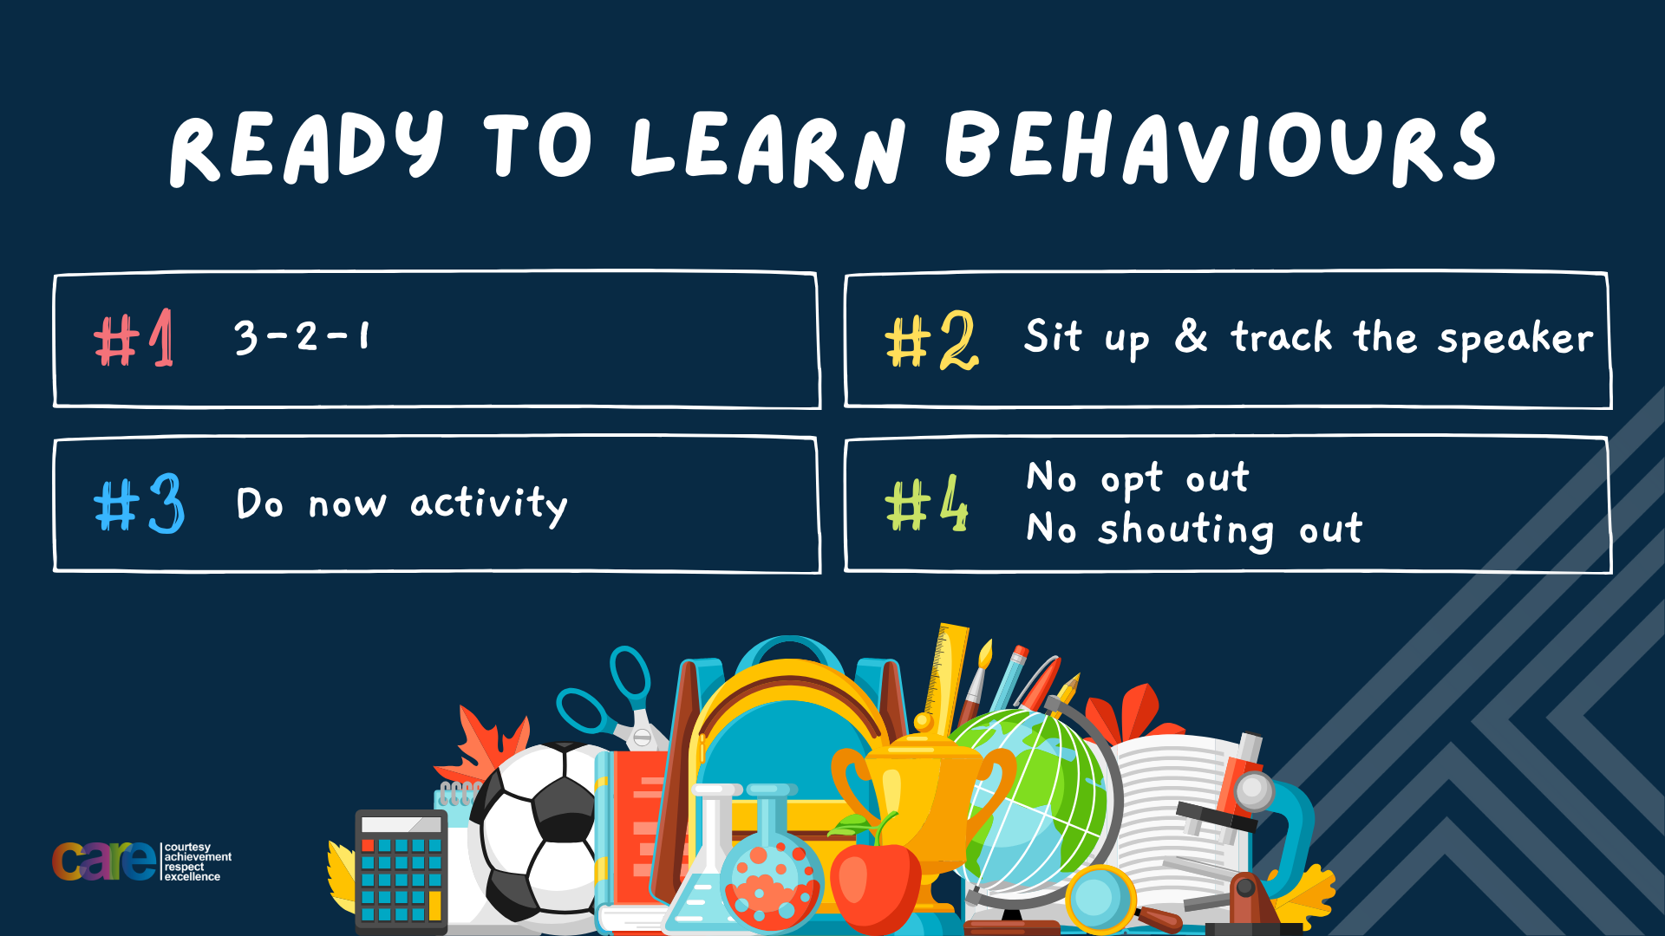

Slide 2








Write the date: 14 April 2025
Write the title: what are eating disorders
Underline both using your rule in your learning wallet. Take out your oracy helpsheet too.
Complete the following tasks
What is being described? “risking something valuable on an event with an uncertain outcome”
2. True or False – all drugs are illegal
3. True or False – people with poor mental health will never be happy again
Gambling
False
False

Slide 3


Secure your Wellbeing: Learning Journey
What is mental health?
Impact of drugs and alcohol on mental health
What is gambling?
What are eating disorders?
How to deal with emotions?
How to deal with fallouts
Today we will look at:
What are eating disorders?
This includes:
Different types of eating disorders
Why people may develop eating disorders
Please remember that during the lesson we should not be asking any pupil or teacher personal questions.
Your teacher can ask you questions but this will be to check your knowledge in the lesson.

Slide 4
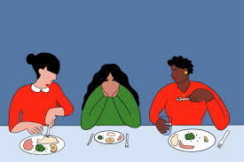
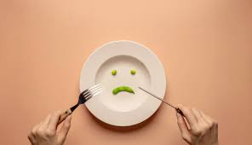
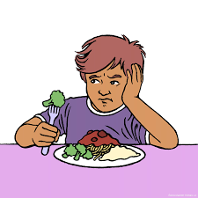
Tutor Time recap
Eating disorders are “mental health conditions where people have an unhealthy focus on food, body weight or shape”
Eating disorders are unfortunately quite common and affect many young people
There are lots of myths about eating disorders such as eating disorders only happen to girls, they are just about food, people say they have an eating disorder to look for attention.

Slide 5
Tutor Time recap
It is important to learn about eating disorders as it will help secure your wellbeing. Knowing about these can help a person get help earlier and start the journey to keep the condition in check or make a full recovery.
Health and food are referenced throughout the UN Rights of a Child as without eating enough healthy food the body and mind can not work to their highest potential

Slide 6

Types of eating disorders?
We are now going to look at different types of eating disorders
You have 1 minute to write down an answer to the following question:
“What eating disorders have you heard before? Where have you heard them talked about?”

Slide 7

Types of eating disorders?
Using your oracy helpsheet, with the person next to you, discuss your response to the question:
“What eating disorders have you heard before? Where have you heard them talked about?”
Remember to use the sentence starters to add, build or challenge what your partner has said.
Be ready to share your discussion with the class

Slide 8
Types of eating disorders
Although there are many eating disorders, today we are going to look at 4 of the most common eating disorders. They are:
1. Anorexia – This is when a person undergoes extreme food restriction due to an intense fear of gaining weight. It is common that they also have a distorted view of their body image

Slide 9
Types of eating disorders
Although there are many eating disorders, today we are going to look at 4 of the most common eating disorders. They are:
2. Bulimia – This is when a person has episode of binge eating followed by purging. This means that they vomit or over exercise to prevent gaining weight from the binge eating. Bulimia can also happen after eating a normal sized meal.

Slide 10
Types of eating disorders
Although there are many eating disorders, today we are going to look at 4 of the most common eating disorders. They are:
3. Binge eating disorder – This is when a person has frequent episode of eating large amounts of food without the purging behaviours associated with bulimia.

Slide 11
Types of eating disorders
Although there are many eating disorders, today we are going to look at 4 of the most common eating disorders. They are:
4. Orthorexia – This is when a person has an unhealthy obsession with “healthy” eating.

Slide 12
Hinge Questions – whiteboard activity
3
Rules!
I will ask the question and give you some thinking time. (no more than 10 seconds)
Write the answer and turn your whiteboard over so nobody can see it.
When I am ready I will put on the 3 to 1 counter.
When ‘Show me’ appears on the board you must hold up your whiteboard (even if you don’t know the answer and there is nothing on your board)
2
1
Show me!
(even if your whiteboard is blank)

Slide 13

Hinge Questions – whiteboard activity
What is being described?
“episodes of binge eating followed by purging to prevent weight gain”
A – Anorexia
B – Bulimia
C – Binge eating disorder
D – Orthorexia

Slide 14
Hinge Questions – whiteboard activity
What is being described?
“Unhealthy obsession with health eating”
A – Orthorexia
B – Bulimia
C – Anorexia
D – Binge eating disorder

Slide 15
Hinge Questions – whiteboard activity
What is being described?
“a person has an extreme food restriction due to an intense fear of gaining weight”
A – Binge eating disorder
B – Orthorexia
C – Anorexia
D – Bulimia

Slide 16
Hinge Questions – whiteboard activity
What is being described?
“frequent episode of eating large amounts of food without purging behaviours”
A – Anorexia
B – Bulimia
C – Orthorexia
D – binge eating disorder

Slide 17
Types of eating disorders - Scenario
Jamie is 14 years old and recently started skipping lunch at school. When asked why, Jamie says they’re just “not hungry” or “ate a big breakfast.” Jamie often complains about feeling “fat,” even though their friends think they’re very thin. Jamie spends a lot of time exercising alone and gets upset if they miss a workout. Friends notice Jamie’s clothes are starting to look too big, but Jamie insists everything is fine.
Questions
In your books write your answers to the following questions:
What eating disorder may Jamie have?
Why have you made this suggestion?

Slide 18
Types of eating disorders - Scenario
Jamie is 14 years old and recently started skipping lunch at school. When asked why, Jamie says they’re just “not hungry” or “ate a big breakfast.” Jamie often complains about feeling “fat,” even though their friends think they’re very thin. Jamie spends a lot of time exercising alone and gets upset if they miss a workout. Friends notice Jamie’s clothes are starting to look too big, but Jamie insists everything is fine.
Discussion
Using your oracy helpsheet, discuss your answers with the person next to you.
Don’t forget to add, build and challenge what your partner has said.
Be ready to share your discussions with the class.

Slide 19
What causes eating disorders?
There are many reasons why a person may develop an eating disorder.
Research suggests that the use of social media may influence the eating habits of young people, leading to an increased frequency of eating disorders in this age group.

Slide 20
What causes eating disorders?
You have 1 minute to write down ideas for discussion about the following question:
“Why do you think social media is a potential cause of young people developing an eating disorder?”

Slide 21
What causes eating disorders?
Using your oracy helpsheet, with the person next to you, discuss your response to the question:
“Why do you think social media is a potential cause of young people developing an eating disorder?”
Remember to use the sentence starters to add, build or challenge what your partner has said.
Be ready to share your discussion with the class

Slide 22
Social Media and eating disorders
The media industry (including social media) regularly promote “ideal” body types and sizes for both males and females.
This can put pressure on a person to get this “ideal” body type or size.
This can lead to some of the eating disorders we discussed earlier.

Slide 23
Social Media and eating disorders
It is important if using social media to not compare yourself to people you see online.
One way of doing this is to develop a mindset of body positivity and self acceptance.
Achieving this mindset can help protect developing an eating disorder.

Slide 24
Protecting against eating disorders
You have 1 minute to write down ideas for discussion about the following question:
“What does body positivity and self acceptance mean?”

Slide 25
Protecting against eating disorders
Using your oracy helpsheet, with the person next to you, discuss your response to the question:
“What does body positivity and self acceptance mean?”
Remember to use the sentence starters to add, build or challenge what your partner has said.
Be ready to share your discussion with the class

Slide 26
Protecting against eating disorders
Body positivity is…
“idea that all bodies are good bodies, regardless of size, shape or appearance”
This promotes the idea that a person’s value is not based on appearance but on a person’s character, skill and unique qualities

Slide 27
Protecting against eating disorders
Self acceptance is…
“the act of fully accepting yourself including strengths and areas you might want to improve”
This is not thinking you are perfect. It is about being ok with who you are and understanding that everyone has unique qualities and things they may want to work on.

Slide 28
Protecting against eating disorders
However, these things are not easy to develop.
Sometimes people are much harder on themselves than what they should be.
This can lead to thinking things that they would not say to someone out loud.
To show this, the next video shows people saying their thoughts out loud about their appearance to a stranger.

Slide 29

Protecting against eating disorders
While watching the video think about:
Did the stranger think the same things as the person speaking?
What did the people in video say they have to do at the end of the video?
Notes:
https://www.youtube.com/watch?v=xBEpOOlhNVQ

Slide 30
Protecting against eating disorders
Using your oracy helpsheet, with the person next to you, discuss your response to the questions:
“Did the stranger think the same things as the person speaking?
What did the people in video say they have to do at the end of the video?
Remember to use the sentence starters to add, build or challenge what your partner has said.
Be ready to share your discussion with the class

Slide 31



Support
If you ever need support about eating disorders for yourself, a friend or family member you can find it here:
Childline.org.uk
Call – 08001111
Email or chat online for support
Themix.org.uk
You can email or have one-to-chat online.
There is also a crisis messenger which is available 24/7

Slide 32
Types of eating disorders – Scenario – extension activity
Alex is 13 years old and loves hanging out with friends, especially when they go out for food. Recently, Alex has been seen eating a lot during meals, even if they were just saying they weren’t hungry. Some friends noticed Alex goes to the bathroom for a long time after eating, often seeming tired afterward. When asked, Alex laughs it off and says they’re just “making room” for more food.
Questions
In your books write your answers to the following questions:
What eating disorder may Alex have?
Why have you made this suggestion?

Slide 33
Types of eating disorders – Scenario - extension activity
Alex is 13 years old and loves hanging out with friends, especially when they go out for food. Recently, Alex has been seen eating a lot during meals, even if they were just saying they weren’t hungry. Some friends noticed Alex goes to the bathroom for a long time after eating, often seeming tired afterward. When asked, Alex laughs it off and says they’re just “making room” for more food.
Discussion
Using your oracy helpsheet, discuss your answers with the person next to you.
Don’t forget to add, build and challenge what your partner has said.
Be ready to share your discussions with the class.

Slide 34
Types of eating disorders – Scenario - extension activity
Taylor is 14 years old and seems to eat normally at school, but on weekends, they often binge on snacks and fast food alone at home. Taylor describes feeling out of control during these times and feels guilty and sad afterward. Taylor tries to hide these habits, worried that friends or family would think they have “no self-control.” Taylor’s mood has been low lately, and they’re not as interested in activities they used to enjoy.
Questions
In your books write your answers to the following questions:
What eating disorder may Taylor have?
Why have you made this suggestion?

Slide 35
Types of eating disorders – Scenario - extension activity
Taylor is 14 years old and seems to eat normally at school, but on weekends, they often binge on snacks and fast food alone at home. Taylor describes feeling out of control during these times and feels guilty and sad afterward. Taylor tries to hide these habits, worried that friends or family would think they have “no self-control.” Taylor’s mood has been low lately, and they’re not as interested in activities they used to enjoy.
Discussion
Using your oracy helpsheet, discuss your answers with the person next to you.
Don’t forget to add, build and challenge what your partner has said.
Be ready to share your discussions with the class.

Slide 36


