Slide 1
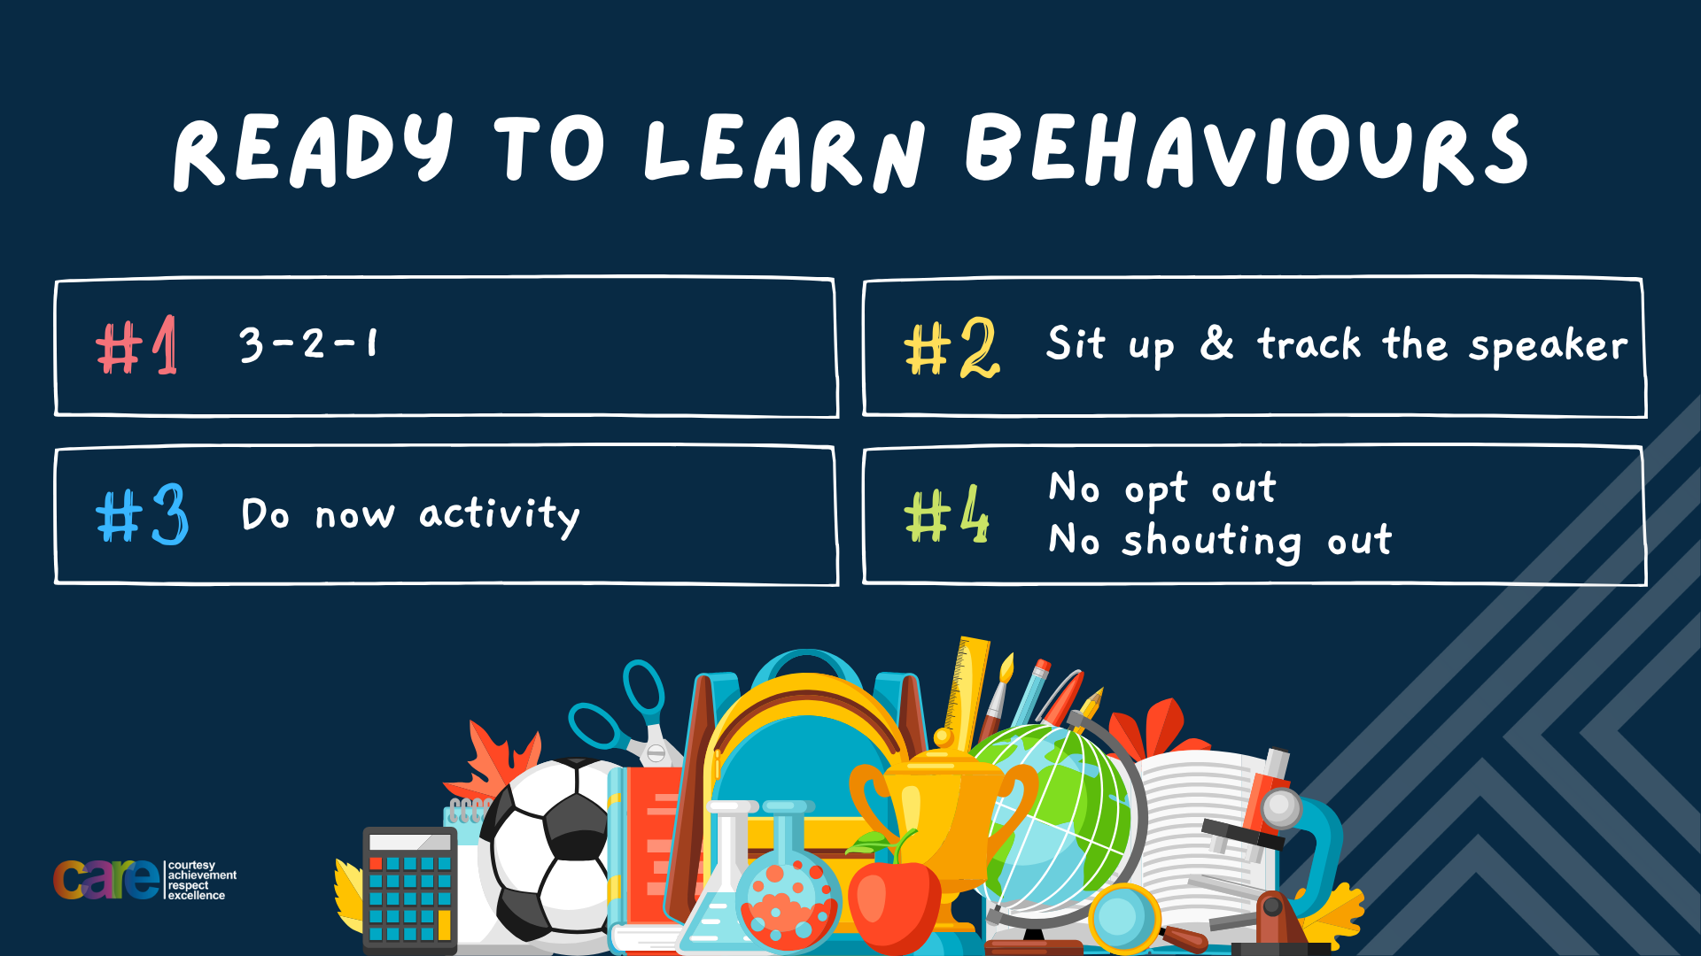

Slide 2








Write the date: 14 April 2025
Write the title: why failure is a good thing
Underline both using your rule in your learning wallet. Take out your oracy helpsheet too.
Complete the following tasks
What is being described? “a person who inspires others by their actions, words or achievements.”
2. Give an example of an action that can build relationships
3. Give one example of how to deal with anger
Role Model
Respect others opinions, actively listen, apologise if a mistake has been made
Pause and breathe, think before reacting, use “I” statements

Slide 3


Secure your Wellbeing: Learning Journey
Importance of role models
Why is failure a good thing
What is criminal activity?
Dangers of gang culture
Dangers of knife crime
What does your online presence look like?
Today we will look at:
Why failure is a good thing
This includes:
Examples of failure that turn to success
How failure is part of everyday life
Benefits of embracing failure
Please remember that during the lesson we should not be asking any pupil or teacher personal questions.
Your teacher can ask you questions but this will be to check your knowledge in the lesson.

Slide 4
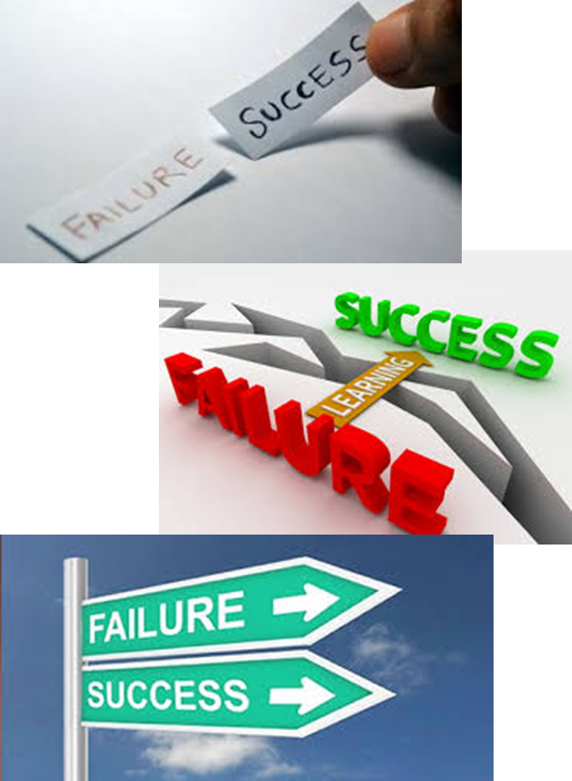
Tutor Time Recap
The dictionary definition of failure is “a lack of success”
However this is very negative and failure should be seen as something positive.
A positive definition of failure is “a stepping stone to success”

Slide 5




Tutor Time Recap
This links to the Golden Thread of “Secure your Wellbeing”
Failure is an inevitable part of life. Seeing failure as something positive will help protect against mental health issues. It will also improve your resilience and ultimately lead to even bigger success.

Slide 6
Famous examples of failure
In tutor time you watched a video that showed lots of famous examples of failure than eventually became success.
Another example is J.K. Rowling. She was turned down by 12 publishers when she sent them the first Harry Potter book. She kept sending samples and now the Harry Potter franchise is worth $25 billion

Slide 7
Famous examples of failure
Another example is Michael Jordan who failed to make his high school basketball team. He eventually became one of the greatest basketballers and athletes ever.
Another example is Steve Jobs who was sacked by Apple in 1985. He later returned as CEO. If that wasn’t enough he overseen huge products like Iphone and Ipod which made Apple the first company to be valued at $1 trillion.

Slide 8

Failure
In your books write your answer to the following question:
“What would have happened if any of the people had quit when they first experienced failure?”
Sentence starter
“If they quit when they first experienced failure then…”

Slide 9
Failure
Using your oracy helpsheet, with the person next to you, discuss your response to the question:
“What would have happened if any of the people had quit when they first experienced failure?”
Remember to use the sentence starters to add, build or challenge what your partner has said.
Be ready to share your discussion with the class

Slide 10
Failure
These are all examples of failure turning into huge success.
However failure is not just limited to big projects were people become famous or rich.
Failure is part of every day life.

Slide 11
Everyday Failure
Examples of everyday failures:
Trying to reverse park a car and not getting into the space first time and having to try again
Getting a question wrong in school when learning about a new topic
Not tying shoelaces properly and having to redo them

Slide 12
Everyday Failure
Failure is also something that comes with learning something new.
It is important to keep persevering when trying something new as failure comes before success.

Slide 13
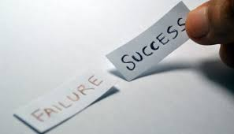


Failure Flowchart
This is shown by the failure flowchart
Try something
Experience failure
Learn
Adapt
Succeed

Slide 14

Example of everyday failure
Babies are an example of how they fail everyday when learning new skills
Notes:
https://www.youtube.com/watch?v=jIzuy9fcf1k

Slide 15
Everyday Failure
Using your oracy helpsheet, with the person next to you, discuss your response to the question:
“How did the baby fail in learning to walk?”
Remember to use the sentence starters to add, build or challenge what your partner has said.
Be ready to share your discussion with the class

Slide 16
Everyday Failure
Using your oracy helpsheet, with the person next to you, discuss your response to the question:
“What happened after the baby experienced multiple failure?”
Remember to use the sentence starters to add, build or challenge what your partner has said.
Be ready to share your discussion with the class

Slide 17
Benefits of failure
Experiencing failure can:
1. Build resilience – This means not giving up when finding things difficult. In school this means you should keep trying in subjects you find difficult in order to get a good grade at GCSE

Slide 18
Benefits of failure
Experiencing failure can:
2. Promote better learning – failing and making mistakes helps to identify gaps in understanding so you can go back and improve. This is why we complete STAR time after assessments.

Slide 19
Benefits of failure
Experiencing failure can:
3. Encourages risk taking – being comfortable with failure will allow you to be more confident in trying new things. For example trying out a new sport or extra curricular club at school.

Slide 20
Benefits of failure
Experiencing failure can:
4. Promotes a growth mindset – you know that failure is part of the path to success and with consistent effort you will improve. An example of this is wanting to know what you got wrong in an assessment, how to fix it and practicing again to learn from your mistake.

Slide 21
Hinge Questions – whiteboard activity
3
Rules!
I will ask the question and give you some thinking time. (no more than 10 seconds)
Write the answer and turn your whiteboard over so nobody can see it.
When I am ready I will put on the 3 to 1 counter.
When ‘Show me’ appears on the board you must hold up your whiteboard (even if you don’t know the answer and there is nothing on your board)
2
1
Show me!
(even if your whiteboard is blank)

Slide 22
Hinge Questions – whiteboard activity
What is being described?
“a stepping stone to success”
Failure

Slide 23

Hinge Questions – whiteboard activity
What Golden Thread does today’s lesson relate to?
A – Secure your Voice
B – Secure your Relationships
C – Secure your Wellbeing
D – Secure your Future

Slide 24
Hinge Questions – whiteboard activity
True or False
“after experiencing failure you should give up as it means you will never be good at it”
A – True
B - False

Slide 25
Hinge Questions – whiteboard activity
True or False
“failure is part of the learning process”
A – True
B - False

Slide 26
Hinge Questions – whiteboard activity
What benefit of failure is being described?
“not giving up when finding things difficult”
A – Builds resilience
B – Promotes better learning
C – Encourages risk taking
D – Builds a growth mindset

Slide 27
Hinge Questions – whiteboard activity
What benefit of failure is being described?
“failing helps to identify gaps in understanding”
A – promotes a growth mindset
B – Encourages risk taking
C – builds resilience
D – Promotes better learning

Slide 28
Hinge Questions – whiteboard activity
What benefit of failure is being described?
“being more confident in trying new things”
A – promotes a growth mindset
B – Builds resilience
C – encourages risk taking
D – Promotes better learning

Slide 29
Benefits of failure
In your books answer the following question:
“what benefit of failure do you think is most important?”
Sentence starter
“The most important benefit of failure is…”

Slide 30
Benefits of failure
Using your oracy helpsheet, with the person next to you, discuss your response to the question:
“what benefit of failure do you think is most important?”
Remember to use the sentence starters to add, build or challenge what your partner has said.
Be ready to share your discussion with the class

Slide 31
Failure scenarios
Sam studied hard for their math test but froze during the exam and didn’t perform well. When the results came back, they had failed, and now Sam feels like giving up on math because they think they’re just not good at it
In your books write down the advice you would give to Sam.
“The advice I would give Sam is…”

Slide 32
Failure scenarios
Using your oracy helpsheet, with the person next to you, discuss your response to the question:
“What advice would you give to Sam?”
Remember to use the sentence starters to add, build or challenge what your partner has said.
Be ready to share your discussion with the class

Slide 33
Failure scenarios
Taylor’s football team lost an important match because Taylor missed a penalty shot. Taylor feels like they’ve let the entire team down and is thinking about quitting the team altogether because they’re embarrassed.
In your books write down the advice you would give to Taylor.
“The advice I would give Taylor is…”

Slide 34
Failure scenarios
Using your oracy helpsheet, with the person next to you, discuss your response to the question:
“What advice would you give to Taylor?”
Remember to use the sentence starters to add, build or challenge what your partner has said.
Be ready to share your discussion with the class

Slide 35
Overcoming fear of failure
It is difficult to embrace failure. Many people have a fear of failure. In order to overcome the fear of failure people can:
Use positive self talk – tell themselves that they can do it
Focus on effort and not results – celebrate trying if even the result is not what they want
Learn from role models – take inspiration from their role models when they find something difficult

Slide 36
Overcoming fear of failure
In your books answer the following question:
“what tip for overcoming failure do you think is the best?
Sentence starter
“The best tip for overcoming fear of failure is…
I think this because…”

Slide 37
Overcoming fear of failure
Using your oracy helpsheet, with the person next to you, discuss your response to the question:
“what tip for overcoming failure do you think is the best?
Remember to use the sentence starters to add, build or challenge what your partner has said.
Be ready to share your discussion with the class

Slide 38


