Slide 1
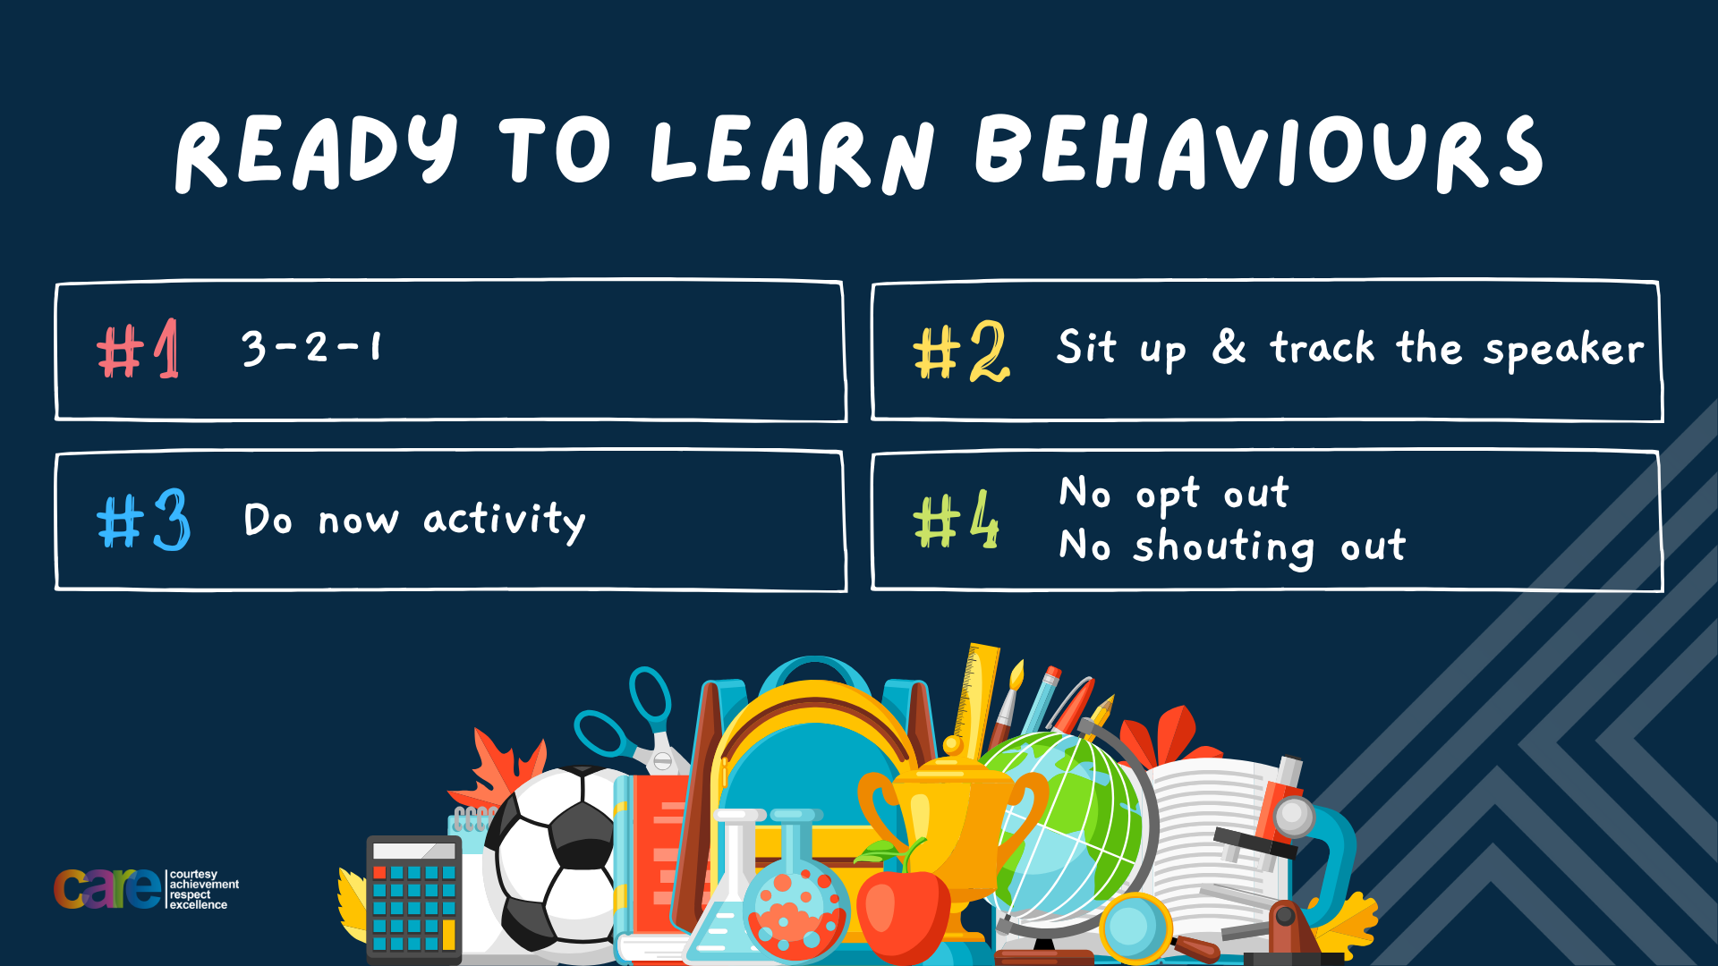

Slide 2








Write the date: 14 April 2025
Write the title: How to deal with emotions
Underline both using your rule in your learning wallet. Take out your oracy helpsheet too.
Complete the following tasks
What is being described? “mental health conditions where people have an unhealthy focus on food, body weight or shape”
2. True or False – it is legal for U16’s to gamble or enter a licensed gambling venue
3. True or False – using illegal drugs can increase paranoia
Eating disorders
False
True

Slide 3


Secure your Wellbeing: Learning Journey
What is mental health?
Impact of drugs and alcohol on mental health
What is gambling?
What are eating disorders?
How to deal with emotions?
How to deal with fallouts
Today we will look at:
How to deal with emotions
This includes:
Common signs of anger and grief
-recognising signs of anger and grief
What to do when you recognise these signs
Please remember that during the lesson we should not be asking any pupil or teacher personal questions.
Your teacher can ask you questions but this will be to check your knowledge in the lesson.

Slide 4

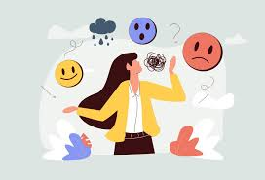

Tutor Time recap
Everyone has emotions and these are displayed in different ways.
We are focusing on 2 emotions – anger and grief

Slide 5
Tutor Time recap
Anger is a natural emotional response to feeling frustrated hurt or wronged.
Grief is a natural emotional response to loss. This is normally bereavement (loss through death) but can also be due to other reasons such as loss of a friendship.

Slide 6
Tutor Time recap
It is important to learn about dealing with emotions as it will help secure your wellbeing.
This is because emotions can be dealt with healthily or unhealthily.
Choosing a healthy response to emotions will help protect your mental health.

Slide 7
Dealing with anger
The first step to learning to control emotions, like anger, is understanding what makes people angry.
On the sticky note you have been given, write something that makes you angry and stick it on the board.
You should not mention any person in your reasons.

Slide 8
Dealing with anger
As well as the reasons you have given, common reasons why people get angry are:
Unfair treatment
Misunderstandings
Arguments
Losing in a game
Feeling ignored

Slide 9
Dealing with anger
The next step is recognizing the signs of anger building.
Recognising these signs early can help a person deal with anger better.

Slide 10

Dealing with anger
We are now going to look at different types of eating disorders
You have 1 minute to write down an answer to the following question:
“what signs are there that people are starting to get angry?”

Slide 11

Dealing with anger
Using your oracy helpsheet, with the person next to you, discuss your response to the question:
“what signs are there that people are starting to get angry?”
Remember to use the sentence starters to add, build or challenge what your partner has said.
Be ready to share your discussion with the class

Slide 12
Dealing with anger
Common signs of anger starting to build are:
Heart rate increases
Starting to sweat or feeling hot
Feeling tight muscles especially around shoulder and neck
Clenching hands into fists
Shaky hands or body shakes

Slide 13
Hinge Questions – whiteboard activity
3
Rules!
I will ask the question and give you some thinking time. (no more than 10 seconds)
Write the answer and turn your whiteboard over so nobody can see it.
When I am ready I will put on the 3 to 1 counter.
When ‘Show me’ appears on the board you must hold up your whiteboard (even if you don’t know the answer and there is nothing on your board)
2
1
Show me!
(even if your whiteboard is blank)

Slide 14

Hinge Questions – whiteboard activity
What is being described?
“a natural emotional response to feeling frustrated, hurt or wronged”
A – Anger
B – Anxiety
C – Sadness
D – Grief

Slide 15
Hinge Questions – whiteboard activity
Give one reason why people get angry
Unfair treatment, misunderstandings, arguments, losing in a game, feeling ignored

Slide 16
Hinge Questions – whiteboard activity
Give one sign that a person may be getting angry.
Heart rate increases, sweating/feeling hot, feeling tight muscles, clenching hands into fists, shaking hands/body

Slide 17
Hinge Questions – whiteboard activity
True or False
“Learning to deal with emotions is important for securing your wellbeing as it protects your mental health”
True

Slide 18
Dealing with anger
Once a person recognizes the signs of becoming angry, they can then learn different techniques to control the anger. These techniques are:
1. Pause and breathe – using the 4-7-8 technique (breathe in for 4 seconds, hold for 8 seconds, breathe out for 8 seconds) helps to slow the heart rate and calms the mind. This helps people make better and healthier decisions when expressing their anger

Slide 19
Dealing with anger
Once a person recognizes the signs of becoming angry, they can then learn different techniques to control the anger. These techniques are:
2. Think before reacting – This is known as the 10 second rule. Counting to 10 before deciding the next action, allows the mind to think through potential consequences of actions

Slide 20
Dealing with anger
Once a person recognizes the signs of becoming angry, they can then learn different techniques to control the anger. These techniques are:
3. Use “I” statements – this frames emotions without putting blame onto a person. Example – “you make me angry when…” becomes “I become angry when…”

Slide 21
Techniques for dealing with anger
You have 1 minute to write down an answer to the following question:
“what technique do you think is best for dealing with anger?”

Slide 22
Techniques for dealing with anger
Using your oracy helpsheet, with the person next to you, discuss your response to the question:
“what technique do you think is best for dealing with anger?”
Remember to use the sentence starters to add, build or challenge what your partner has said.
Be ready to share your discussion with the class

Slide 23
Dealing with grief
Grief is an emotion that will affect everyone at some point in their lives.
Grief can have a huge negative impact on how that person functions day to day.

Slide 24
Dealing with grief
You have 1 minute to write down an answer to the following question:
“how might people feel when they are grieving?”

Slide 25
Dealing with grief
Using your oracy helpsheet, with the person next to you, discuss your response to the question:
“how might people feel when they are grieving?”
Remember to use the sentence starters to add, build or challenge what your partner has said.
Be ready to share your discussion with the class

Slide 26
Dealing with grief
Common feeling when dealing with grief are:
Sadness
Numbness
Denial
Guilt
Anxiety
Loneliness
confusion

Slide 27
Dealing with grief
Everyone has a different way of expressing grief.
It is important to remember that there is no “right” or “wrong” way to express grief.
However there are strategies that can help make grief easier and to limit the negative impact it can have on a person’s daily life.

Slide 28
Dealing with grief
These strategies are:
Talking to a trusted adult
Find people who have had a similar experience
Explore way to express grief. For example – art, music, writing
Create a memory box/photo album/scrap book of the person
Seek professional help from a counsellor
Spend time with friends to help a person laugh and smile

Slide 29
Techniques for dealing with grief
You have 1 minute to write down an answer to the following question:
“what technique do you think is best for dealing with grief?”

Slide 30
Techniques for dealing with grief
Using your oracy helpsheet, with the person next to you, discuss your response to the question:
“what technique do you think is best for dealing with grief?”
Remember to use the sentence starters to add, build or challenge what your partner has said.
Be ready to share your discussion with the class

Slide 31
Dealing with grief
One strategy that should be avoided is using drugs or alcohol.
Some people want to use drugs and alcohol to numb the sadness and pain they are feeling from their grief.
However this is only a temporary fix and in the long term it can exaggerate some feeling associated with grief.
An example of this is a person feeling sad and then using alcohol. Despite wanting to numb the sadness, they become even more emotional.

Slide 32
Hinge Questions – whiteboard activity
3
Rules!
I will ask the question and give you some thinking time. (no more than 10 seconds)
Write the answer and turn your whiteboard over so nobody can see it.
When I am ready I will put on the 3 to 1 counter.
When ‘Show me’ appears on the board you must hold up your whiteboard (even if you don’t know the answer and there is nothing on your board)
2
1
Show me!
(even if your whiteboard is blank)

Slide 33
Hinge Questions – whiteboard activity
What is being described?
“a natural emotional response to loss”
A – Anger
B – Anxiety
C – Sadness
D – Grief

Slide 34
Hinge Questions – whiteboard activity
Give one common feeling people have when experiencing grief
Sadness
Numbness
Denial
Guilt
Anxiety
Loneliness
confusion

Slide 35
Hinge Questions – whiteboard activity
Give one technique people can use to help deal with their grief
Talking to a trusted adult
Find people who have had a similar experience
Explore way to express grief. For example – art, music, writing
Create a memory box/photo album/scrap book of the person
Seek professional help from a counsellor
Spend time with friends to help a person laugh and smile

Slide 36
Hinge Questions – whiteboard activity
True or False
“there is a right way to deal with grief”
A – True
B – False

Slide 37
Hinge Questions – whiteboard activity
True or False
“when dealing with grief people should not rely on drugs and alcohol to numb their feeling”
A – True
B – False

Slide 38



Support
If you ever need support about anger or grief for yourself, a friend or family member you can find it here:
Childline.org.uk
Call – 08001111
Email or chat online for support
Themix.org.uk
You can email or have one-to-chat online.
There is also a crisis messenger which is available 24/7

Slide 39


