Slide 1
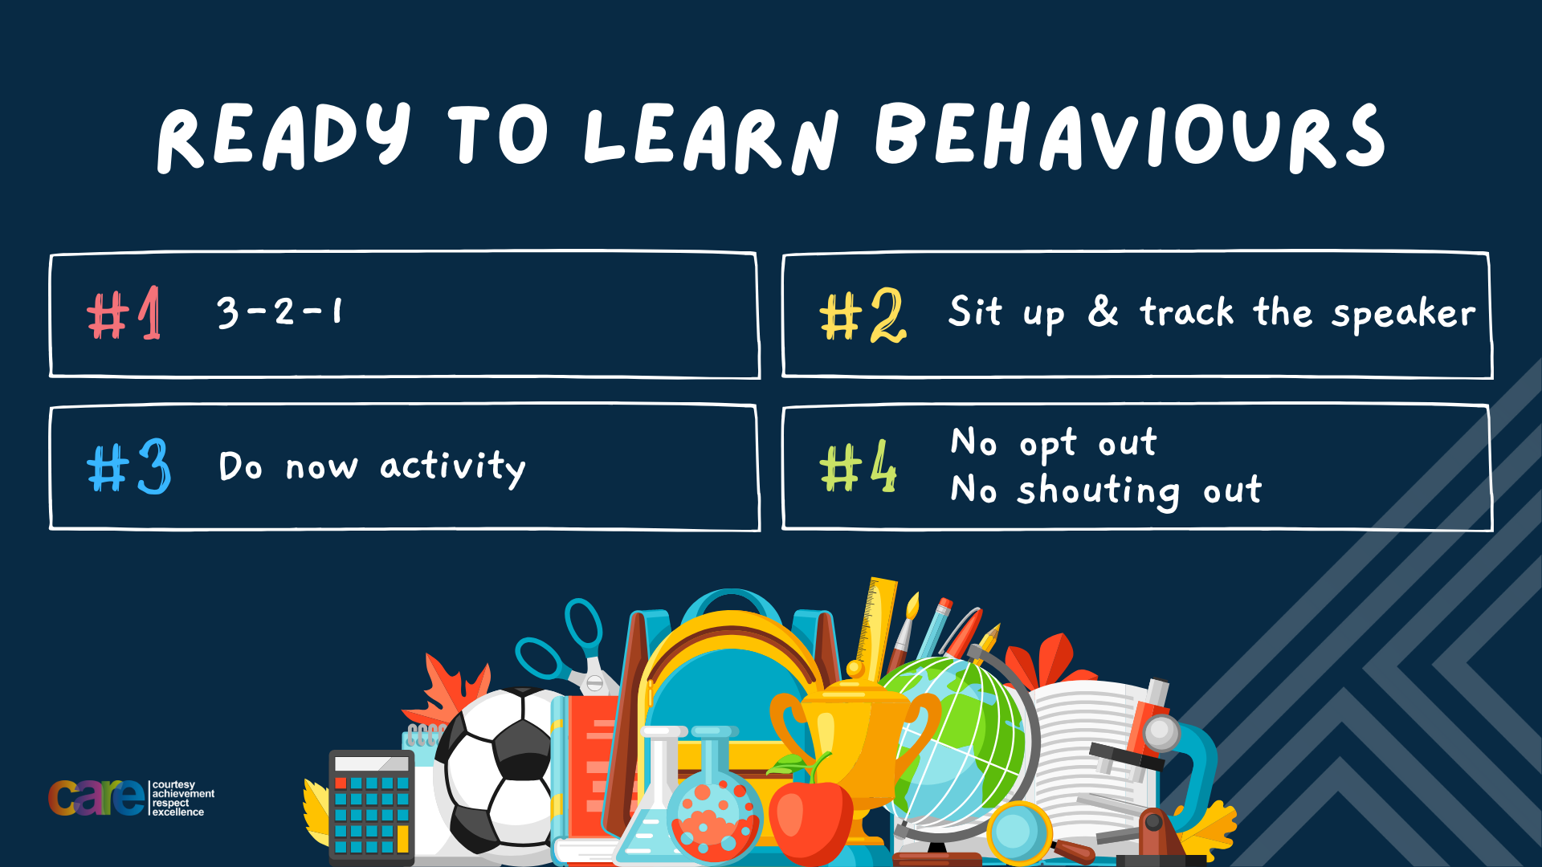

Slide 2








Write the date: 14 April 2025
Write the title: Importance of role models
Underline both using your rule in your learning wallet. Take out your oracy helpsheet too.
Complete the following tasks
True or False – “if you realise you are to blame for a fallout you should not apologise”
2. What is being described? “a natural emotional response to loss”
3. Give an example of an eating disorder
False
Grief
Anorexia, Bulmia, Orthorexia, Binge-eating disorder

Slide 3


Secure your Wellbeing: Learning Journey
Importance of role models
Why is failure a good thing
What is criminal activity?
Dangers of gang culture
Dangers of knife crime
What does your online presence look like?
Today we will look at:
Importance of role models
This includes:
What is a role model?
Examples of role
Please remember that during the lesson we should not be asking any pupil or teacher personal questions.
Your teacher can ask you questions but this will be to check your knowledge in the lesson.

Slide 4
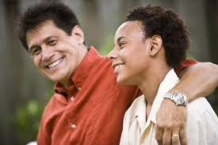
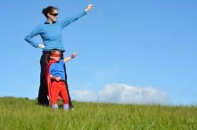

Tutor Time Recap
A role model is “a person who inspires others by their actions, words or achievements.”
You then had example of role models from some staff around school

Slide 5

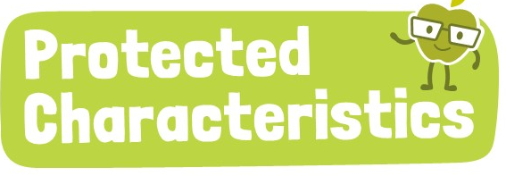
Tutor Time Recap
We are learning this because:
It helps to “secure your wellbeing” as role models can help instill good behaviours and habits that can make you the best possible version of yourself
Article 17 states that children have the right to information that is not harmful. Many role models provide a positive and inspiring message to help children become the best possible version of themselves
Many role models celebrate one or more protected characteristics which can inspire others who identify with those characteristics
UN Rights
of a Child

Slide 6

Role Models
While watching the video in your books write down one key piece of information
Notes:
https://www.youtube.com/watch?v=alO8Ot2WTj0

Slide 7

Role Models
Using your oracy helpsheet, with the person next to you, discuss your response to the question:
“what was your key piece of information from the video?”
Remember to use the sentence starters to add, build or challenge what your partner has said.
Be ready to share your discussion with the class

Slide 8
Role Models
Positive role models boost people’s motivation by modelling a guide to achieving success. Qualities these role models are likely to have are:
An ability to inspire others
A clear set of values
A commitment to community
An acceptance of others
An ability to overcome obstacles

Slide 9
Types of Role Models
There are different types of roles models. Examples are:
1. Personal Role Models – These role models are more likely to be family members, friends or teachers. They will have had a personal relationship with the role model

Slide 10
Types of Role Models
There are different types of roles models. Examples are:
2. Public Role Models - These are more likely to be celebrities, sportspeople or activists. A person will not personally know this role model but will most likely follow them via social media

Slide 11
Types of Role Models
There are different types of roles models. Examples are:
3. Community Role Models - An example of this type of role model are local leaders (just as faith leaders), charity workers or volunteers. A person may have them as a role model because of the positive impact they have had on their lives or how they improve other people’s lives.

Slide 12
Role Model Qualities
Regardless of the type of role model, they will have the following qualities:
Integrity – They practice what they preach
Hardworking – show commitment to their goals and work hard to achieve them
Compassionate – they care for others and their community
Resilient – They don’t give up when faced with a challenge
Passionate – They love and care deeply about what they do and inspire others with the same passion

Slide 13
Role Model Qualities
You have 1 minute to write down an answer to the following question:
“What do you think is the most important quality of a role model?”
Sentence starter to help –
“I think the most important quality is…
I think this because…”
Role model qualities
Integrity – They practice what they preach
Hardworking – show commitment to their goals and work hard to achieve them
Compassionate – they care for others and their community
Resilient – They don’t give up when faced with a challenge
Passionate – They love and care deeply about what they do and inspire others with the same passion

Slide 14
Role Model Qualities
Using your oracy helpsheet, with the person next to you, discuss your response to the question:
“What do you think is the most important quality of a role model?”
Remember to use the sentence starters to add, build or challenge what your partner has said.
Be ready to share your discussion with the class

Slide 15
Hinge Questions – whiteboard activity
3
Rules!
I will ask the question and give you some thinking time. (no more than 10 seconds)
Write the answer and turn your whiteboard over so nobody can see it.
When I am ready I will put on the 3 to 1 counter.
When ‘Show me’ appears on the board you must hold up your whiteboard (even if you don’t know the answer and there is nothing on your board)
2
1
Show me!
(even if your whiteboard is blank)

Slide 16
Hinge Questions – whiteboard activity
What is being described?
“a person who inspires others by their actions, words or achievements.”
Role Models

Slide 17

Hinge Questions – whiteboard activity
What Golden Thread does today’s lesson relate to?
A – Secure your Voice
B – Secure your Relationships
C – Secure your Wellbeing
D – Secure your Future

Slide 18
Hinge Questions – whiteboard activity
What type of role model is being described?
“a family member, friend or teacher”
A – Personal
B – Public
C - Community

Slide 19
Hinge Questions – whiteboard activity
What type of role model is being described?
“a celebrity, sportsperson or activist”
A – Community
B – Personal
C - Public

Slide 20
Hinge Questions – whiteboard activity
What quality of a role model is being described?
“care for others and their communities”
A – Integrity
B – Hardworking
C – Compassionate
D - resilient

Slide 21
Hinge Questions – whiteboard activity
What quality of a role model is being described?
“practice what they preach”
A – Integrity
B – Compassionate
C – Passionate
D - resilient

Slide 22
Are all role models positive
In your books write down your answer to the following question:
“Are role models always a positive influence?”
Sentence starters –
“Yes all role models are positive because…” or “No not all role models are positive because…”

Slide 23
Are all role models positive?
Using your oracy helpsheet, with the person next to you, discuss your response to the question:
“Are role models always a positive influence?”
Remember to use the sentence starters to add, build or challenge what your partner has said.
Be ready to share your discussion with the class

Slide 24
Are all role models positive?
Unfortunately some role models can have a negative influence on people due to their behaviours and actions.

Slide 25
Are all role models positive?
Examples of this include:
1. Promote harmful/dangerous behaviours – celebrities/music artists who promote or glorify harmful behaviours such as taking drugs or carrying weapons

Slide 26
Are all role models positive?
Examples of this include:
2. Treating other people badly – some popular male role models display and promote degrading and violent behaviours towards women and girls.

Slide 27
Are all role models positive?
This is particularly damaging for young people who may idolise these people.
Because they see their role model modelling these behaviours and actions they may assume that they are typical, safe and acceptable.
However, they are extremely damaging and can stop the young person becoming the best possible version of themselves.

Slide 28
How to choose a role model
In order to choose a role model a person should:
Know their own values and choose a role model who has similar values
Research if a role model’s actions always match what they say. This should cover both present actions and previous actions
Research if a role model reacts positively to adversity or pressure – do they quit when times get tough or blame others for failure?

Slide 29
Reflection
In your books you are going to reflect on your role model.
Complete the following sentences:
My role model is…
A quality they have is…
They have a positive influence on me by...

Slide 30


