Slide 1
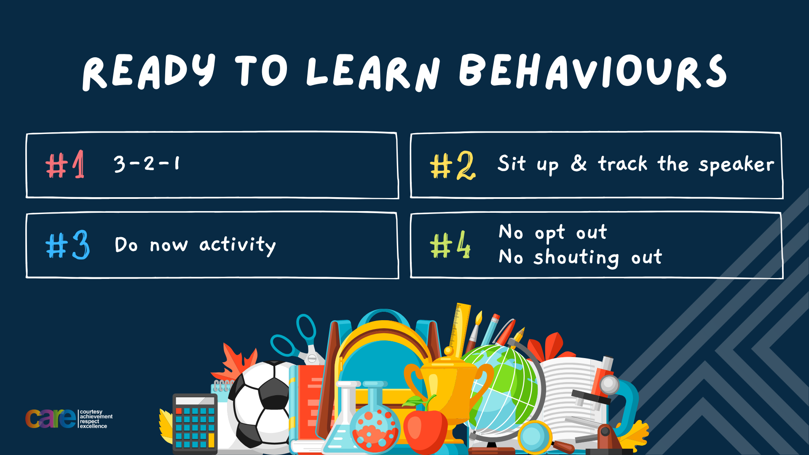

Slide 2








Write the date: 14 April 2025
Write the title: what is gambling
Underline both using your rule in your learning wallet. Take out your oracy helpsheet too.
Complete the following tasks
Give one short term effect of drugs and alcohol
2. True or False – Mental health can only be bad/poor, it can never be good or positive
3. Is the femidom (female condom) a barrier or hormonal method of contraception?
Mood swings, improved judgement, increased anxiety/paranoia, difficulty concentrating and remembering
False
Barrier

Slide 3


Secure your Wellbeing: Learning Journey
What is mental health?
Impact of drugs and alcohol on mental health
What is gambling?
What are eating disorders?
How to deal with emotions?
How to deal with fallouts
Today we will look at:
What is gambling
This includes:
Why people gamble
How gambling can become a problem
Impact of gambling on mental health
Please remember that during the lesson we should not be asking any pupil or teacher personal questions.
Your teacher can ask you questions but this will be to check your knowledge in the lesson.

Slide 4

Discussion
In tutor time this week you looked at gambling.
You have 1 minute to write down 3 things you can remember from your Personal Development tutor time activity on Monday

Slide 5

Tutor Time Recap
Using your oracy helpsheet, discuss with the person next to you the things you remember from your Personal Development tutor time activity.
Remember to use the sentence starters to add, build or challenge what your partner has said.
Be ready to share your discussion with the class

Slide 6
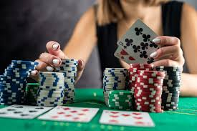
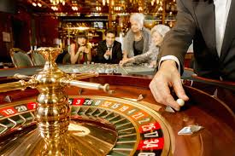
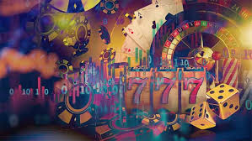
Tutor Time recap
Gambling is “risking something valuable on an event with an uncertain outcome” This is normally money
There are different types of gambling such as lottery, scratch cards, casino/online games, sport betting and card games
The odds of winning a lot of money on any type of gambling is extremely low.

Slide 7
Tutor Time recap
It is important to learn about this, regardless of religious faith, as it can help secure your wellbeing to know about the potential negative impact of gambling.
Rule of Law is a British Value and in the UK it is illegal for U18’s to gamble or enter a licensed gambling premise.
Article 41 of the UN Rights of Child states the best law applies for children. The UN Rights do not specifically mention gambling so the additional laws in the UK protect children the most in terms of gambling.

Slide 8
Why do people gamble?
We are now going to look at reasons why people gamble.
You have 1 minute to write down ideas for discussion about the following question:
“Why do you think people gamble?”

Slide 9

Why do people gamble?
Using your oracy helpsheet, with the person next to you, discuss your response to the question:
“Why do you think people gamble?”
Remember to use the sentence starters to add, build or challenge what your partner has said.
Be ready to share your discussion with the class

Slide 10
Why do people gamble?
There are numerous reasons why people gamble. These include:
Curiosity – some people are intrigued by it and want to try it for the first time.
Boredom – some people can feel like it is a way to add excitement to an otherwise dull routine
Thinking it is easy money – many people believe it is easy to make lots of money without needing a job
Media influence – gambling is advertised a lot especially around sports events

Slide 11

Why do people gamble?
Another reason is that they are addicted to gambling. While watching the video answer the following questions in your book
What is a warning sign of compulsive gambling?
What is a possible outcome for individuals recovering from gambling disorder?
Notes:
https://www.youtube.com/watch?v=H1AXknHzj-s

Slide 12
Hinge Questions – whiteboard activity
3
Rules!
I will ask the question and give you some thinking time. (no more than 10 seconds)
Write the answer and turn your whiteboard over so nobody can see it.
When I am ready I will put on the 3 to 1 counter.
When ‘Show me’ appears on the board you must hold up your whiteboard (even if you don’t know the answer and there is nothing on your board)
2
1
Show me!
(even if your whiteboard is blank)

Slide 13
Hinge Questions – whiteboard activity
What is being described?
““risking something valuable on an event with an uncertain outcome”
Gambling

Slide 14
Hinge Questions – whiteboard activity
True or False
The odds of winning a large amount of money gambling are high. This means that it rarely happens
True

Slide 15
Hinge Questions – whiteboard activity
True or False
It is legal in the UK for children to gamble
False

Slide 16
Hinge Questions – whiteboard activity
True or False
The UN Rights of a child does not mention gambling so UK laws are used to protect children’s rights when it comes to gambling
True

Slide 17
Hinge Questions – whiteboard activity
Give one reason why people gamble
Curosity
Boredom
Thinking that it easy money
Media influence
addiction

Slide 18
How gambling can become a problem?
There are numerous signs that gambling is become a problem for the person gambling. These include:
1. Hiding or lying about gambling – If a person is feeling ashamed or guilty about their gambling, they will begin to lie about it or hide the fact they gamble from their family and friends

Slide 19
How gambling can become a problem?
There are numerous signs that gambling is become a problem for the person gambling. These include:
2. Ignoring their responsibilities – Due to spending too much time and energy on gambling, people will neglect important things like school, work, family and friends

Slide 20
How gambling can become a problem?
There are numerous signs that gambling is become a problem for the person gambling. These include:
3. Losing control – if a person thinks they are gambling too often they find it difficult to stop or reduce their gambling as they have lost control over their gambling habits

Slide 21
How gambling can become a problem?
There are numerous signs that gambling is become a problem for the person gambling. These include:
4. Chasing losses – This means trying to win back money that has been lost. This could lead to spending more money that they initially intended too with no guarantee that they will win the money back

Slide 22
Gambling impact on mental health
It is when these issues start to become more apparent and happen more and more often that gambling can begin to have a negative impact on a person’s mental health.
This can lead to the following mental health issues happening:

Slide 23
Gambling impact on mental health
Stress and anxiety – This will happen if gambling has led to money problems. This can lead to a constant worry and can create a cycle where gambling is used to escape stress, even though it often makes things worse
Emotional highs and lows – the feeling off being on a roller-coaster of emotions can be exhausting as emotions can quickly go from a high to a extreme low if a large amount of money is lost

Slide 24
Gambling impact on mental health
3. Risk of depression - This can potentially happen if a person loses frequently and feels like they have lost control which means they may feel hopeless or sad.
4. Negative self esteem – This can happen after large amounts of money have been lost so people feel like a failure.

Slide 25
Consequences of extreme gambling?
This video shows people talking about what impact gambling has had on them. You will be asked some questions after the video
Notes:
https://www.youtube.com/watch?v=IHYaGAQogaw

Slide 26
Hinge Questions – whiteboard activity
3
Rules!
I will ask the question and give you some thinking time. (no more than 10 seconds)
Write the answer and turn your whiteboard over so nobody can see it.
When I am ready I will put on the 3 to 1 counter.
When ‘Show me’ appears on the board you must hold up your whiteboard (even if you don’t know the answer and there is nothing on your board)
2
1
Show me!
(even if your whiteboard is blank)

Slide 27
Hinge Questions – whiteboard activity
True or False
One of the people in the video started gambling when they were 12
True

Slide 28
Hinge Questions – whiteboard activity
True or False
One of the people in the video claims to have £500 on their first bet?
False

Slide 29
Hinge Questions – whiteboard activity
True or False
One of the people in the video often felt like they were using real money when gambling online
False

Slide 30
Hinge Questions – whiteboard activity
True or False
One of the people in the video ended up taking out loans and credit cards due to having debts of over £1500
True

Slide 31
Supporting people with gambling
You have 1 minute to write down ideas for discussion about the following question:
“What could you do to support someone who is struggling with gambling?”

Slide 32
Supporting people with gambling
Using your oracy helpsheet, with the person next to you, discuss your response to the question:
“What could you do to support someone who is struggling with gambling?”
Remember to use the sentence starters to add, build or challenge what your partner has said.
Be ready to share your discussion with the class

Slide 33
Supporting people with gambling
If a person is struggling with gambling the following support can be given:
1. Advise them to set a limit of time spent gambling or how much they can gamble at one time. They can then slowly reduce the time and money

Slide 34
Supporting people with gambling
If a person is struggling with gambling the following support can be given:
2. Providing information that gambling is not a reliable way to make money especially if they are already in debt

Slide 35
Supporting people with gambling
If a person is struggling with gambling the following support can be given:
3. Be there for them. There could be an agreement that when they feel like gambling they can call/message you to distract them from gambling

Slide 36
Scenario
Josh is a 14 and he loves playing a mobile game that has extra “loot boxes” for special items and upgrades. Recently it has become an option to purchase these loot boxes using real money.
After a few weeks Josh is starting to spend a lot of money on these loot boxes. He easily spends all of this pocket money and asks for extra money but does not tell his parents/carers what it is for.
Josh has recently purchased lots of loot boxes but it has not give him the special item he wants. He is determined to keep going as he thinks that surely it must happen soon for him.
Josh’s friends have noticed that he is no longer able to do things with them as he has no money but they do not know why as they know he gets pocket money from his parents/carers.
You have 2 minute to write down some ideas on the following questions
Do you think Josh has a gambling problem?
What could Josh do instead of playing this mobile game so often?
What possible mental health issues could Josh face if he continues gambling?

Slide 37
Scenario
Josh is a 14 and he loves playing a mobile game that has extra “loot boxes” for special items and upgrades. Recently it has become an option to purchase these loot boxes using real money.
After a few weeks Josh is starting to spend a lot of money on these loot boxes. He easily spends all of this pocket money and asks for extra money but does not tell his parents/carers what it is for.
Josh has recently purchased lots of loot boxes but it has not give him the special item he wants. He is determined to keep going as he thinks that surely it must happen soon for him.
Josh’s friends have noticed that he is no longer able to do things with them as he has no money but they do not know why as they know he gets pocket money from his parents/carers.
Using your oracy helpsheet, with the person next to you, discuss your responses to the questions
Do you think Josh has a gambling problem?
What could Josh do instead of playing this mobile game so often?
What possible mental health issues could Josh face if he continues gambling?
Remember to use the sentence starters to add, build or challenge what your partner has said.

Slide 38



Support
If you ever need support about gambling for yourself, a friend or family member you can find it here:
Childline.org.uk
Call – 08001111
Email or chat online for support
Themix.org.uk
You can email or have one-to-chat online.
There is also a crisis messenger which is available 24/7

Slide 39


