Slide 1
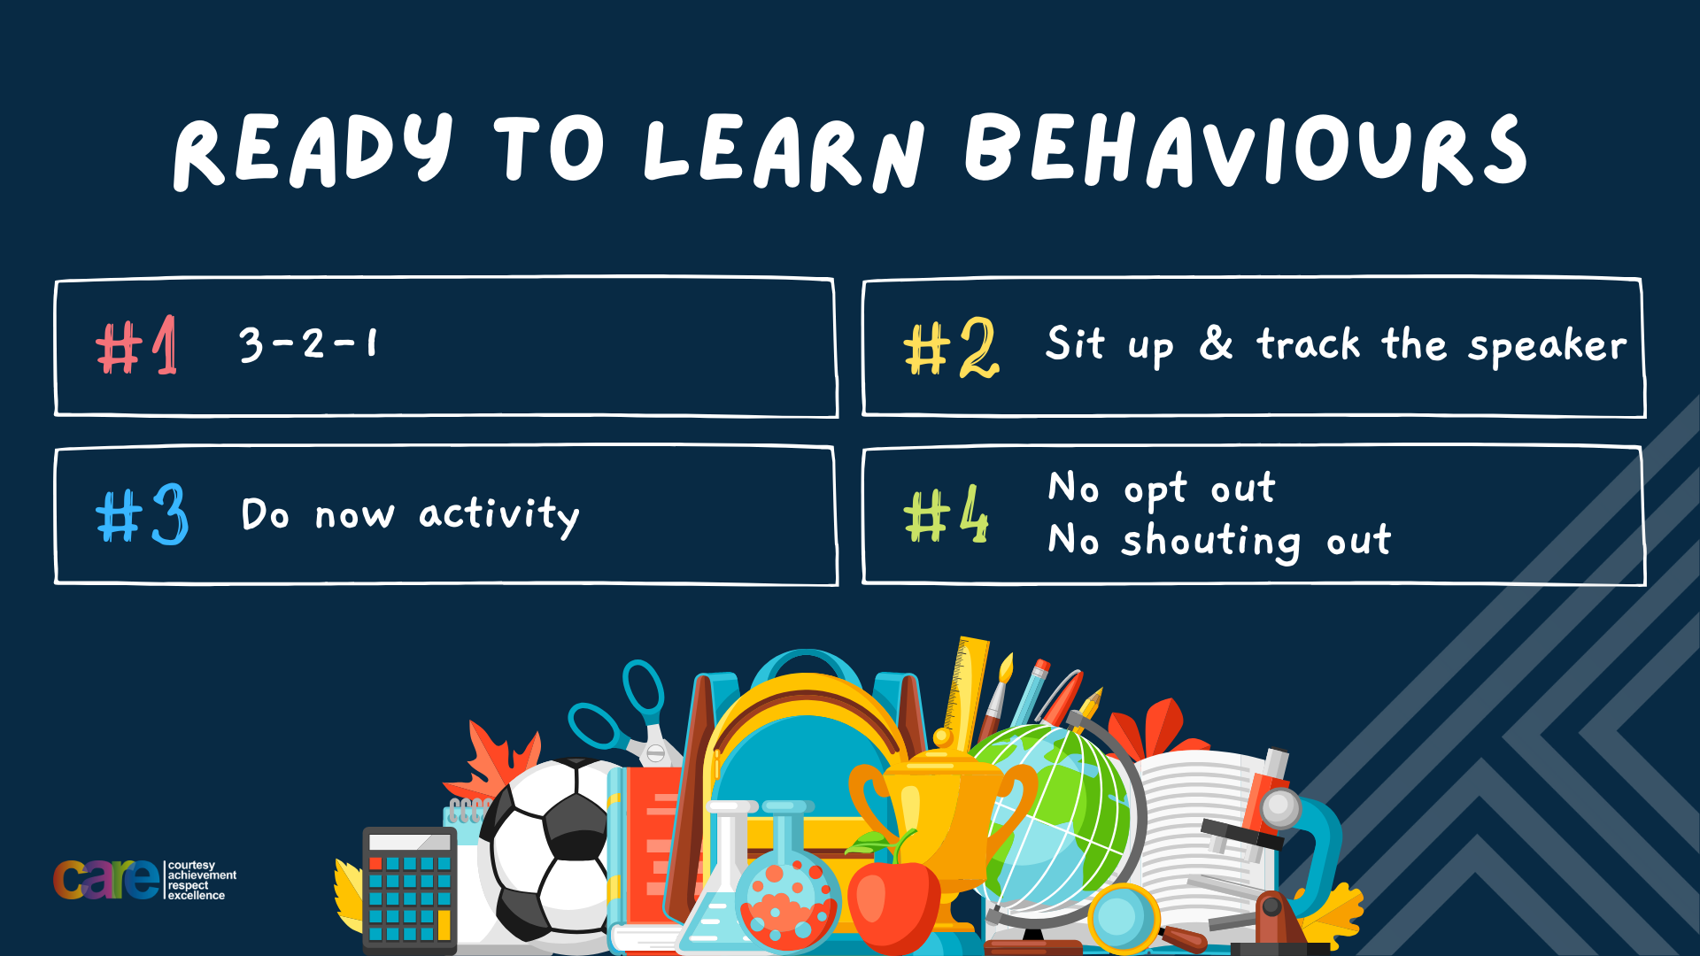

Slide 2








Write the date: 14 April 2025
Write the title: How to deal with fallouts
Underline both using your rule in your learning wallet. Take out your oracy helpsheet too.
Complete the following tasks
What is being described? “a natural emotional response to feeling frustrated hurt or wronged.
2. True or False – Eating disorders only happen to females
3. Give one reason why people gamble
anger
False
Curiosity, Boredom, Thinking it is easy money, media influence

Slide 3


Secure your Wellbeing: Learning Journey
What is mental health?
Impact of drugs and alcohol on mental health
What is gambling?
What are eating disorders?
How to deal with emotions?
How to deal with fallouts
Today we will look at:
How to deal with fallouts
This includes:
How to avoid fallouts from happening
What to when a fallout happens
Please remember that during the lesson we should not be asking any pupil or teacher personal questions.
Your teacher can ask you questions but this will be to check your knowledge in the lesson.

Slide 4
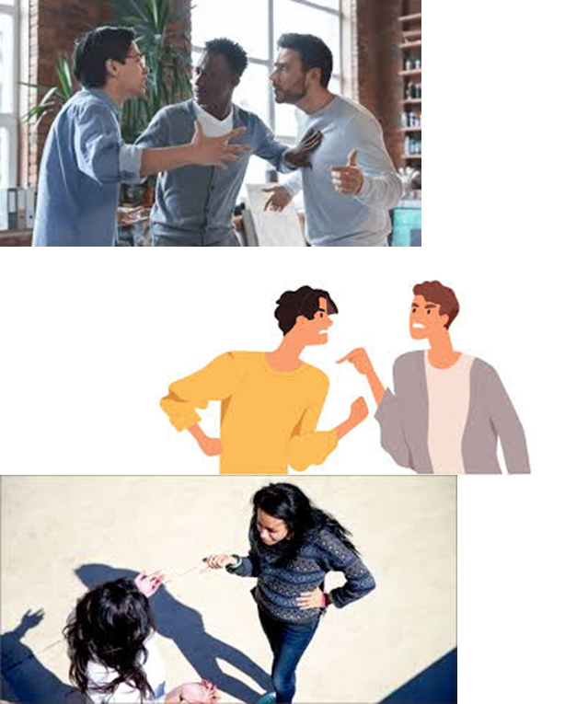
Tutor Time recap
Fallouts happen between family and friends.
These happen due to:
Miscommunication or misunderstandings
Arguments or disagreements
Breaking a person’s trust
Feeling ignored by others

Slide 5
Tutor Time recap
People’s emotions and differences of expectations are also reasons why fallouts happen.
Fallouts happen between friends due to miscommunication, feeling excluded, content on social media and jealousy
Fallouts happen between friends due to disagreements over rules and chores and also perceived favouritism of other siblings

Slide 6
Tutor Time recap
It is important to learn about dealing with fallouts due to:
Helps secure your relationships with people so that a relationship can be repaired after a fallout
Showing mutual respect and tolerance for other people’s opinions. This means you do not have to fallout when you disagree over something

Slide 7
Tutor Time recap
It is important to learn about dealing with fallouts due to:
UN Rights of a Child states that child have a right to voice their opinion but only if it will not cause harm to other people. This means people need to think before they speak
No fallout should happen over a protected characteristic as these are designed to stop people being treated unfairly.

Slide 8

How to avoid fallouts from happening
One way of avoiding fallouts is to ensure that actions and words, build healthy relationships.
This means that people should avoid actions and words that can break relationships.

Slide 9

How to avoid fallouts
You have 1 minute to write down an answer to the following question:
“what actions can help build healthy relationships with friends and family?”

Slide 10

How to avoid fallouts?
Using your oracy helpsheet, with the person next to you, discuss your response to the question:
“what actions can help build healthy relationships with friends and family?”
Remember to use the sentence starters to add, build or challenge what your partner has said.
Be ready to share your discussion with the class

Slide 11
How to avoid fallouts
Examples of actions that help build healthy relationships are:
Being Honest – telling the truth even when it is hard to do so
Offering support when a friend/family member is struggling
Keep promises and always follow through on commitments

Slide 12
How to avoid fallouts
Examples of actions that help build healthy relationships are:
Respect differences of opinion
Listening actively when a friend/family member is talking to you
If a mistake has been made, apologise sincerely and at the earliest opportunity

Slide 13
How to avoid fallouts
You have 1 minute to write down an answer to the following question:
“what actions can break relationships with friends and family?”

Slide 14
How to avoid fallouts?
Using your oracy helpsheet, with the person next to you, discuss your response to the question:
“what actions can break relationships with friends and family?”
Remember to use the sentence starters to add, build or challenge what your partner has said.
Be ready to share your discussion with the class

Slide 15
How to avoid fallouts
Examples of actions that can break relationships are:
Lying or hiding the truth
Spreading gossip about people
Breaking promises or commitments

Slide 16
How to avoid fallouts
Examples of actions that can break relationships are:
Purposefully ignoring someone
Blaming others instead of taking responsibility
Refusing to apologise when behaviours have hurt someone

Slide 17
What to do if a fallout happens?
Unfortunately fallouts will happen even between the closest of friends and family members.
During a fallout it is important to know how to behave during a fallout so the fallout is not made worse

Slide 18
What to do if a fallout happens?
Never call friends names or behave in a threatening way to them
Never broadcast your feelings to other people especially on social media or group chats
Always stay calm and walk away if you feel angry. If a fall out happens online, put your phone/tablet away
Don’t bring up old issues that you have previously fallen out over

Slide 19
Hinge Questions – whiteboard activity
3
Rules!
I will ask the question and give you some thinking time. (no more than 10 seconds)
Write the answer and turn your whiteboard over so nobody can see it.
When I am ready I will put on the 3 to 1 counter.
When ‘Show me’ appears on the board you must hold up your whiteboard (even if you don’t know the answer and there is nothing on your board)
2
1
Show me!
(even if your whiteboard is blank)

Slide 20

Hinge Questions – whiteboard activity
True or False
Fallouts will happen between friends and family members?
A – True
B – False

Slide 21
Hinge Questions – whiteboard activity
True or False
Mutual respect and Tolerance are British Values which mean people should respect other people’s opinions even if they disagree
A – True
B – False

Slide 22
Hinge Questions – whiteboard activity
Give one reason why a fallout could happen between friends
miscommunication, feeling excluded, content on social media and jealousy

Slide 23
Hinge Questions – whiteboard activity
Give one reason why a fallout could happen between family members
disagreements over rules and chores and also perceived favouritism of other siblings

Slide 24
Hinge Questions – whiteboard activity
True or False
Telling lies is an example of an action that builds healthy relationships
A – True
B – False

Slide 25
Hinge Questions – whiteboard activity
True or False
Purposefully ignoring someone is an action that can break a relationship
A – True
B – False

Slide 26
Hinge Questions – whiteboard activity
True or False
During a fallout a person should bring up old issues?
A – True
B – False

Slide 27
Hinge Questions – whiteboard activity
True or False
During a fallout a person should stay calm and walk away if angry?
A – True
B – False

Slide 28
What to do if a fallout happens - scenario
Rachel and Lizzie have been best friends since Year 5 and they have gone to the same secondary school. However they are now in different classes. Rachel sees Lizzie laughing with another girl and Rachel thinks they are looking over at her. That night Rachel puts on a group chat that Lizzie is a snake and 2 faced. She says that all she does is talk about people behind their back. Someone in the group chat has screenshotted the chat and sent the messages to Lizzie. The next day in school Lizzie confronts Rachel, calls her lots of names and tells her that she should never have been friends with her again after their last fall out in Year 6. Lizzie gets so angry that she grabs Rachel by the hair and they start fighting before it is split up by their head of year.
Task
In your books answer the following questions
Give an example of an action that has helped to break the relationship
How could Rachel have acted differently during the fallout?
How could Lizzie have acted differently during the fallout?

Slide 29
What to do if a fallout happens - scenario
Rachel and Lizzie have been best friends since Year 5 and they have gone to the same secondary school. However they are now in different classes. Rachel sees Lizzie laughing with another girl and Rachel thinks they are looking over at her. That night Rachel puts on a group chat that Lizzie is a snake and 2 faced. She says that all she does is talk about people behind their back. Someone in the group chat has screenshotted the chat and sent the messages to Lizzie. The next day in school Lizzie confronts Rachel, calls her lots of names and tells her that she should never have been friends with her again after their last fall out in Year 6. Lizzie gets so angry that she grabs Rachel by the hair and they start fighting before it is split up by their head of year.
Task
Using your oracy helpsheets, discuss your answers with the person next to you.
Remember to listen to your partner, then add, build or challenge what they have said.
Be ready to share your discussions with class

Slide 30
What to do if a fallout is your fault
Sometimes a person may realise that they have caused a fallout.
This could have been unintentional or it could be realizing that they have made a mistake.

Slide 31
What to do if a fallout is your fault
If a person has realized they have caused a fallout they should:
Apologise at the earliest opportunity. This should they are taking responsibility.
Communicate – express feelings clearly but also listen to the other person without interrupting.
Ask for a fresh start or forgiveness
Be patient. Just because the other 3 steps have happened doesn’t mean that a relationship/friendship will return to normal straight away.

Slide 32
What to do if a fallout is your fault - scenario
Task
In your books answer the following question:
What strategies would you recommend Sophie may use now she knows that she caused the fallout?
Sophie and Mia have been best friends for years. Sophie’s birthday is coming up, and she’s planning a small party. She invites a few friends, including Mia, but forgets to send Mia the details about the time and place. Mia assumes Sophie didn’t want her there and feels hurt when she sees photos of the party on social media.
The next day at school, Mia avoids Sophie, and when Sophie tries to talk to her, Mia says, “I get it—you didn’t want me there. Don’t bother pretending you care.” Sophie is confused and upset because she thought Mia just couldn’t make it.
Sophie looks through her messages and realises that she did not send the details about the time and place to Mia. She had typed out the message but forgot to hit send.

Slide 33
What to do if a fallout is your fault - scenario
Task
Using your oracy helpsheets, discuss your answers with the person next to you.
Remember to listen to your partner, then add, build or challenge what they have said.
Be ready to share your discussions with class
Sophie and Mia have been best friends for years. Sophie’s birthday is coming up, and she’s planning a small party. She invites a few friends, including Mia, but forgets to send Mia the details about the time and place. Mia assumes Sophie didn’t want her there and feels hurt when she sees photos of the party on social media.
The next day at school, Mia avoids Sophie, and when Sophie tries to talk to her, Mia says, “I get it—you didn’t want me there. Don’t bother pretending you care.” Sophie is confused and upset because she thought Mia just couldn’t make it.
Sophie looks through her messages and realises that she did not send the details about the time and place to Mia. She had typed out the message but forgot to hit send.

Slide 34



Support
If you ever need support about a fallout between a friend or family member can be found:
Childline.org.uk
Call – 08001111
Email or chat online for support
Themix.org.uk
You can email or have one-to-chat online.
There is also a crisis messenger which is available 24/7

Slide 35
Importance of not leaving a fallout unresolved
It is important to not leave a fallout unresolved because:
Emotional strain – emotions like anger or guilt can build over time which can negatively impact mental health. This is especially true if the fallout is with a family member from the same household.
The relationship may never be rebuilt
Lost opportunities – people may avoid gathers due to a friend or family member being there which means they miss out.

Slide 36
What to do if a fallout is your fault - scenario
Task
In your books answer the following question:
What might happen if this fallout is let unresolved?
What wider impact is the fallout having?
Amara and Zoe have been close friends for years. One day, Zoe borrows £10 from Amara, promising to pay it back by the end of the week. Weeks go by, and Zoe still hasn’t paid Amara back, even though she’s been buying snacks and new accessories. Amara feels hurt and taken advantage of but doesn’t know how to bring it up without causing a fight.
One day, Amara makes a comment in front of a group of friends: “Must be nice to spend money you don’t plan to pay back.” Zoe looks embarrassed and says, “What’s your problem? It’s just £10—why are you making a big deal out of it?”
From that day on, Zoe stops hanging out with Amara, and they both avoid talking to each other. Neither of them takes the first step to address the conflict.
Other friends in the group now feel awkward when they are trying to organise a meet up as they don’t want to take sides.

Slide 37
What to do if a fallout is your fault - scenario
Task
Using your oracy helpsheets, discuss your answers with the person next to you.
Remember to listen to your partner, then add, build or challenge what they have said.
Be ready to share your discussions with class
Amara and Zoe have been close friends for years. One day, Zoe borrows £10 from Amara, promising to pay it back by the end of the week. Weeks go by, and Zoe still hasn’t paid Amara back, even though she’s been buying snacks and new accessories. Amara feels hurt and taken advantage of but doesn’t know how to bring it up without causing a fight.
One day, Amara makes a comment in front of a group of friends: “Must be nice to spend money you don’t plan to pay back.” Zoe looks embarrassed and says, “What’s your problem? It’s just £10—why are you making a big deal out of it?”
From that day on, Zoe stops hanging out with Amara, and they both avoid talking to each other. Neither of them takes the first step to address the conflict.
Other friends in the group now feel awkward when they are trying to organise a meet up as they don’t want to take sides.

Slide 38


