Slide 1
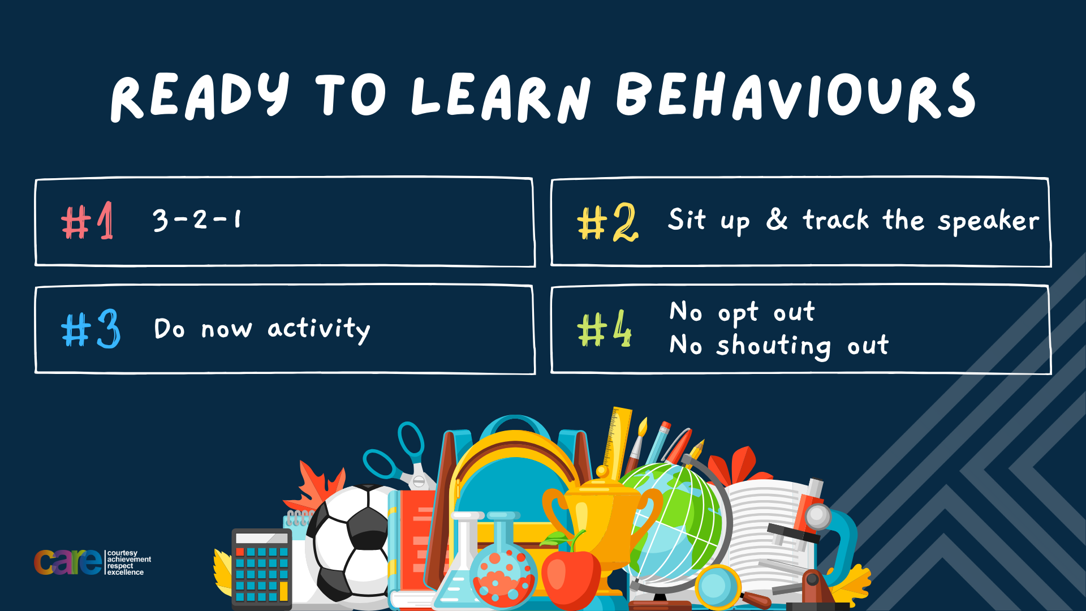

Slide 2








Write the date: 11 October 2024
Write the title: Contraception
Underline both!
Complete the following tasks
What is being described? “nude, semi nude or suggestive images or videos of a person that they have taken of themselves”
2. True or False – it is illegal for an adult to show someone under 18 years old pornography?
3. True or False – once consent is withdrawn, all actions should stop. If they don’t this is against the law
Sexting
True
True

Slide 3


Slide 4


Secure your Future: Learning Journey
Impact of the media on relationships
What is consent in romantic relationships
What is the impact of pornography?
What is sexting and the law?
What is contraception
What are STI’s?
Today we will look at:
What is contraception
This includes:
Names of different contraception methods
What types of method each contraception is
How it works
The effectiveness of each contraception type
Please remember that during the lesson we should not be asking any pupil or teacher personal questions.
Your teacher can ask you questions but this will be to check your knowledge in the lesson.

Slide 5

Discussion
In tutor time this week you looked at contraception.
With your partner discuss what you can remember from tutor time.
Remember you will need to share your discussion with the class

Slide 6

Tutor Time recap
The definition of contraception is:
“a method or technique used to prevent pregnancy and reduce the risk of spreading STIs as a result of having sex”
Contraception works in 3 ways:
Block – This means that sperm is blocked from getting to the egg
Disable – This means that sperm is immobilized and destroyed
Suppress – This means that the action of an egg maturing in the ovary is stopped meaning that it cannot be fertilised

Slide 7
Type of contraception
There are more than 12 different types of contraception. However today we are focusing on:
Male condoms
Femidoms (female condoms)
Contraceptive pill
Contraceptive injection

Slide 8

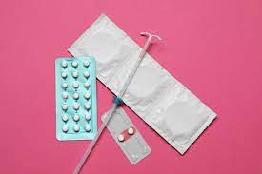
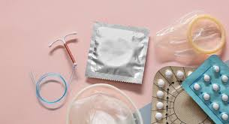
What types of contraception are there?
When discussing these 4 different types of contraception we will cover the following information:
Name of the contraception
Is it designed for male or female use?
Is it a barrier or hormonal method of contraception?
How it works?
How effective is it at stopping pregnancy?

Slide 9
What types of contraception are there?
Before we starting looking at the different types of contraception it is important to clarify what is meant by “barrier” or “hormonal” methods.
Barrier method means that the contraception stops sperm from entering the body
Hormonal method means that hormones are used to alter the internal workings of the female body to prevent pregnancy.

Slide 10

Condoms
This is one of the most common methods of contraception. This is shown by 160 million condoms being purchased every year in the UK.
They are designed for male use
Condoms work as they cover the penis with a thin layer of latex during sex. This means that the condom catches sperm and prevents it from meeting the egg. This means it is a barrier method of contraception.
Condoms are effective between 82%-98% of the time in preventing pregnancy. Reasons why condoms may not be effective is that they are not put on properly, they are out of date or they rip during sex.

Slide 11
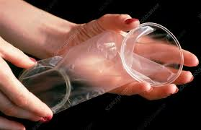
Femidoms (female condom)
Femidoms are a female equivalent to male condoms. However they are not as commonly used.
They are designed for female use
Femidoms are made from soft, thin polyurethane and it is worn inside of the vagina.
They stop pregnancy by stopping sperm from entering the uterus. This means it is a barrier method of contraception.
Femidoms are effective in stopping pregnancy 79%-92% of the time. Reasons why they lose effectiveness is misuse in putting the femidom in place and they may slip out during sex.

Slide 12

Contraceptive Pill
This is another very popular form of contraception with approximately 3.1 million women in UK taking the contraceptive pill.
This is designed for female use.
It works by a female taking one small tablet every day. It stops pregnancy by stopping the female body from releasing an egg each month. This means it is a hormonal contraceptive method.
The contraceptive pill is effective in stopping pregnancy 91%-99% of the time. Reasons why it may not be effective is due to forgetting to taking a tablet every day.

Slide 13

Contraceptive Injection
This is designed for female use.
This works by females being given an injection every 3 months. It stops the female body from producing an egg each month. This means it is a hormonal contraceptive method.
It is effective in stopping pregnancy 94%-99% of the time. One reason why it can lose effectiveness is not getting an injection within 3 months of the last injection.

Slide 14
Hinge Questions – whiteboard activity
3
Rules!
I will ask the question and give you some thinking time. (no more than 10 seconds)
Write the answer and turn your whiteboard over so nobody can see it.
When I am ready I will put on the 3 to 1 counter.
When ‘Show me’ appears on the board you must hold up your whiteboard (even if you don’t know the answer and there is nothing on your board)
2
1
Show me!
(even if your whiteboard is blank)

Slide 15
Hinge Questions – whiteboard activity
What is being defined below?
“a method or technique used to prevent pregnancy and reduce the risk of spreading STIs as a result of having sex”
Contraception

Slide 16
Hinge Questions – whiteboard activity
What type of contraceptive method is being described?
“stopping sperm from entering the body”
Barrier

Slide 17
Hinge Questions – whiteboard activity
What type of contraceptive method is being described?
“use of hormones to alter the internal workings of the female body to prevent pregnacy”
Hormonal

Slide 18

Hinge Questions – whiteboard activity
What type of contraception method is being described?
“designed for male use. A thin layer of latex covers the penis to catch sperm and prevent it from meeting the egg”
A – Condom
B- Femidom
C – Contraceptive Pill
D – Contraceptive Injection

Slide 19
Hinge Questions – whiteboard activity
What type of contraception method is being described?
“designed for female use. A small tablet has to be taken everyday as this stops the female body from producing an egg every month”
A – Contraceptive injection
B- Femidom
C – Condom
D – Contraceptive Pill

Slide 20
Hinge Questions – whiteboard activity
What type of contraception method is being described?
“designed for female use. An injection is given every 3 months and it stops the female body from producing an egg every month”
A – Contraceptive Pill
B- Condom
C – Contraceptive injection
D – Femidom

Slide 21
Hinge Questions – whiteboard activity
What type of contraception method is being described?
“designed for female use. This is made from soft, thin polyurethane and is worn inside the vagina to stop sperm from entering the uterus”
A – Contraceptive Injection
B- Femidom
C – Contraceptive Pill
D – Condom

Slide 22
Information finder
Around the room are some posters.
Working in groups of 4, take it in turns to go to a poster and remember 1 piece of information. You will then tell your group the piece of information you have learnt from the poster. Take it in turns until you all have the information below in your books.
The information you need is
Name
Is designed for male or female use
Is it a barrier or hormonal method of contraception?
How it works?
How effective is it at stopping pregnancy?

Slide 23
Answers
Condoms
They are designed for male use
This means it is a barrier method of contraception.
Condoms work as they cover the penis with a thin layer of latex during sex. This means that the condom catches sperm and prevents it from meeting the egg.
Condoms are effective between 82%-98% of the time in preventing pregnancy.

Slide 24
Answers
Femidoms
They are designed for female use
This means it is a barrier method of contraception.
They are made from soft, thin polyurethane and it is worn inside of the vagina. They stop pregnancy by stopping sperm from entering the uterus.
Femidoms are effective in stopping pregnancy 79%-92% of the time.

Slide 25
Answers
Contraceptive Pill
They are designed for female use
This means it is a hormonal method of contraception.
It works by a female taking one small tablet every day. It stops pregnancy by stopping the female body from releasing an egg each month
The contraceptive pill is effective in stopping pregnancy 91%-99% of the time.

Slide 26
Answers
Contraceptive Injection
They are designed for female use
This means it is a hormonal method of contraception.
This works by females being given an injection every 3 months. It stops the female body from producing an egg each month.
It is effective in stopping pregnancy 94%-99% of the time.

Slide 27
Reflection
In your books complete the following sentences
One type of contraception I learnt about today that I have never heard of was…
One fact about this type of contraception is…

Slide 28
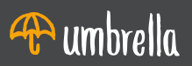

Support
If you need any support about contraception, you can contact
Umbrellahealth.co.uk
List of services near you
Email and contact numbers available online

Slide 29


