Slide 1
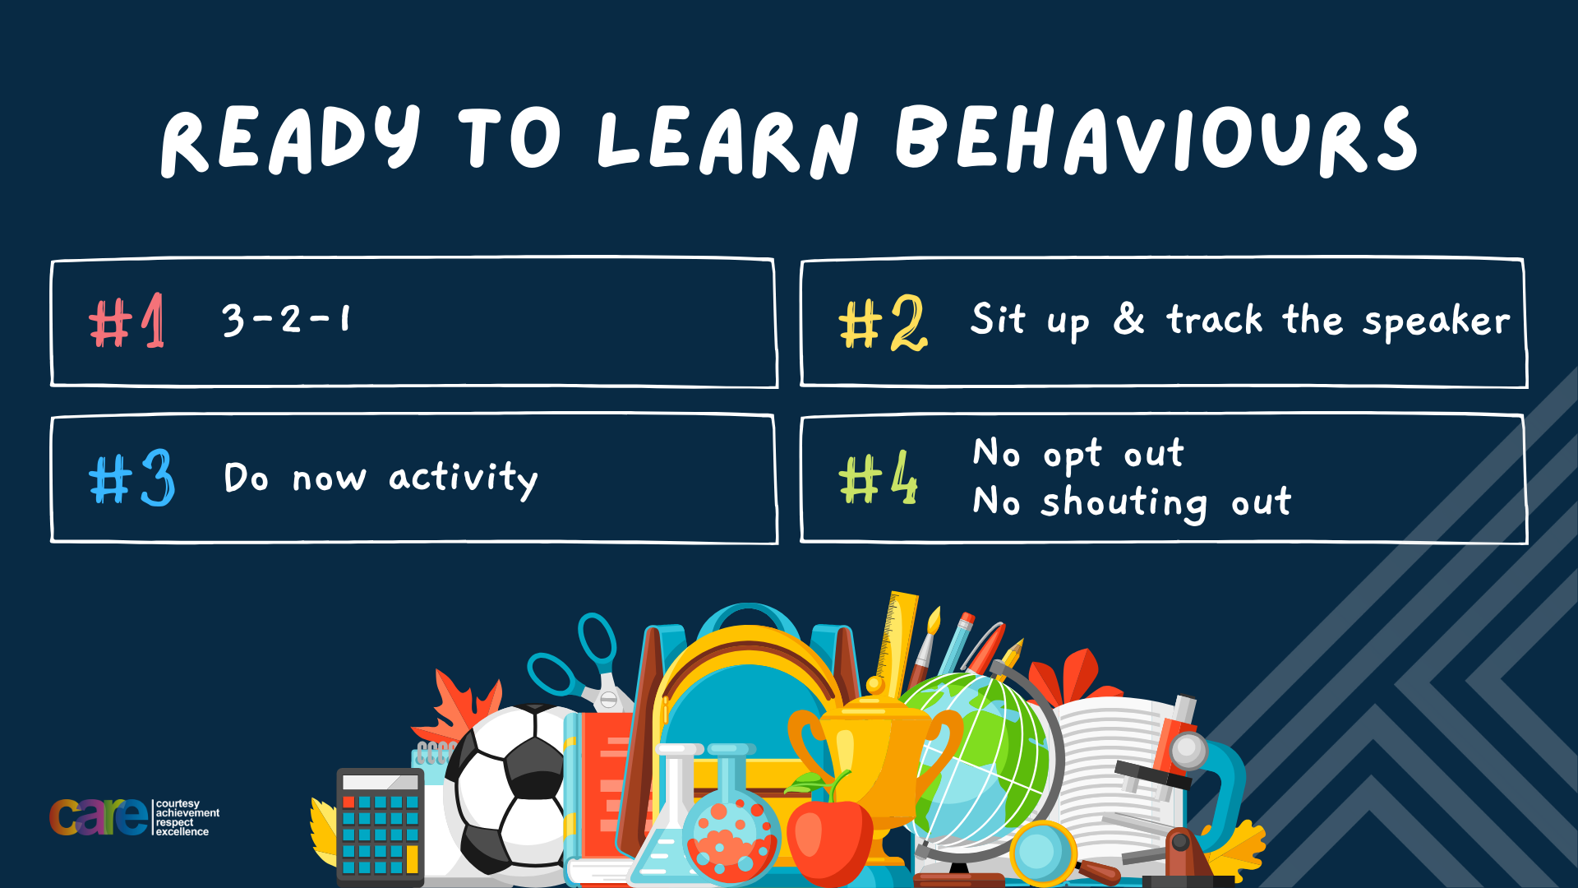

Slide 2








Write the date: 25 September 2024
Write the title: Consent in romantic relationships
Underline both!
Complete the following tasks (if you haven’t done so already):
What is being described “any relationship between people with a desire to be intimate with each other. Both parties must feel an attraction to each other
2. True or False – all relationships shown in the media are examples of healthy and realistic relationships
3. Give one common relationship myth that is promoted by the media
Consent
False
It is typical to fall in love at first sight, people start hating each other before falling in love, relationships involve dramatic argument involving friends, grand romantic gestures win people over who are not interested, relationships involve a lot of breaking up and getting back together, kissing usually leads to other sexual behaviour very quickly

Slide 3


Slide 4


Secure your Future: Learning Journey
Impact of the media on relationships
What is consent in romantic relationships
What is the impact of pornography?
What is sexting and the law?
What is contraception
What are STI’s?
Today we will look at:
What is consent in romantic relationships
This includes:
Recap the definition of consent
The laws around consent
How to know if consent is given
Please remember that during the lesson we should not be asking any pupil or teacher personal questions.
Your teacher can ask you questions but this will be to check your knowledge in the lesson.

Slide 5

Consent
During tutor time this week you learnt recapped the definition of consent.
What can you remember from tutor time?

Slide 6
Consent
The definition of consent is…
“An agreement by choice made by someone with the freedom and capacity to provide consent”
With the person next to you discuss why choice, freedom and capacity are underlined in the definition.
Be ready to share your partners answers with the class

Slide 7
Example of consent
While watching the 2 volunteers, think about the following questions:
Who had the responsibility for stopping how close the 2 people got?
How would you feel if the request was ignored?
If the volunteers did this activity again, can the person who was moving immediately go to where they stopped previously?
Notes:
For this activity you need 2 volunteers – they will stand about 3-5 meters apart. One person will move and the other will stand still. The person moving must ask “can I take a step forward?” The person standing still can say “yes” until the other person gets to close for them at this point the answer to the person moving is “no” – at this point the person moving must not move.

Slide 8

When is consent used in relationships?
Consent is normally linked to sexual relationships as consent is important when as sexual activity happens between 2 people.
Consent means that both people agree to the sexual activity happening

Slide 9

What is the law around consent?
Rule of Law is a value that we follow in the UK.
The law states that if you do not gain consent for any sexual activity, this action is classed as sexual harassment all the way up to sexual assault including rape

Slide 10
What is the law around consent?
The charge is dependent on the sexual action that takes place.
It is also important in terms of the law to understand that consent can be withdrawn at any time.
At this point all actions should stop otherwise this is nonconsensual action.

Slide 11
Hinge Questions – whiteboard activity
3
Rules!
I will ask the question and give you some thinking time. (no more than 10 seconds)
Write the answer and turn your whiteboard over so nobody can see it.
When I am ready I will put on the 3 to 1 counter.
When ‘Show me’ appears on the board you must hold up your whiteboard (even if you don’t know the answer and there is nothing on your board)
2
1
Show me!
(even if your whiteboard is blank)

Slide 12
Hinge Questions – whiteboard activity
True or False – Consent is if one person says “yes” even if the other person says “no”
False – all parties involved in any sexual activity must give consent

Slide 13
Hinge Questions – whiteboard activity
True or False – If a person continues with any sexual activity without consent they are breaking the law.
True – this could be classed as sexual harassment or sexual assault (including rape)

Slide 14
How to provide consent?
There are 2 main ways that consent can be given.
Verbally
Nonverbally
With your partner discuss different ways that consent can be given verbally and nonverbally

Slide 15

Verbal Consent
Verbal consent is when a person actually says their decision around providing consent.
Examples are:
Saying yes
Saying no
A way to check for consent this way is through asking questions. An example of verbal consent was shown in the demonstration earlier this lesson

Slide 16

What is non verbal consent?
Non verbal consent is the use of body language and actions to convey consent.
Non verbal consent is just as important as verbal consent. This is due to people being forced to verbally consent despite not wanting to provide consent.
A persons body language can say more about their choices than what they actually say

Slide 17
Examples of non verbal consent
Actions that provide consent
There is eye contact between people
The person has relaxed body language to show they are comfortable
The person is responsive to any questions or actions
There is touching/kissing and other actions
Actions that do not provide consent
One person is avoiding eye contact
One person is emotional. They may also have a rigid and tense body language
The person is not responsive. They are silent or display stillness
A person flinches when another person goes to touch or kiss them.
With your partner discuss the differences between these body language messages.
Be ready to share your thoughts with the class

Slide 18
What can impact a persons ability to provide consent?
Think – what might impact a persons ability to provide consent?
Pair – with the person next to you discuss your ideas. Remember to listen and respond to what they say?
Share – share what you and your partner discussed

Slide 19
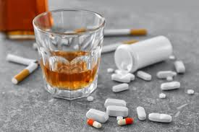
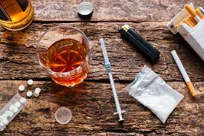
What can impact a persons ability to provide consent?
The two biggest factors that can impact a person’s ability to provide consent are:
Alcohol
Drugs
The law states that a complainant (the person who said they did not provide consent) does not need to be unconscious through alcohol or drugs to lose their capacity.
This means that a person can verbally consent but because of their intake of too much alcohol or drugs, they do not have the capacity to provide consent.

Slide 20
Hinge Questions – whiteboard activity
3
Rules!
I will ask the question and give you some thinking time. (no more than 10 seconds)
Write the answer and turn your whiteboard over so nobody can see it.
When I am ready I will put on the 3 to 1 counter.
When ‘Show me’ appears on the board you must hold up your whiteboard (even if you don’t know the answer and there is nothing on your board)
2
1
Show me!
(even if your whiteboard is blank)

Slide 21
Hinge Questions – whiteboard activity
True or False – Consent can only be given verbally?
False – non verbal consent through body language is just as important as verbal consent

Slide 22
Hinge Questions – whiteboard activity
True or False – A conscious person under the influence of drugs and alcohol may not be able to provide consent
True – they may have taken too many drugs or too much alcohol to have the capacity to make an informed decision

Slide 23
What do you know about consent?
In your books write out the following paragraph and fill in the blanks. Use the Word Bank to help you
Consent is an agreement by _______ made by someone with the freedom and _______ to do so. It is against the ______ to continue any action without consent. The legal age of sexual consent is ____. Consent can be given ________ or ________ and it can be ________ at any time. An example of verbal consent is ________. An example of non verbal consent is __________. Two things that can impair a person’s consent is _________ and ________. If a person has taken to much of these, they may not be able to ________ consent.
Word Bank
Provide
16
Choice
Capacity
withdrawn
drugs
Non verbally
Verbally
Alcohol
Law
You need to give your own examples of verbal and non verbal consent
choice
capacity
law
16
verbally
nonverbally
withdrawn
drugs
alcohol
provide

Slide 24

Consent Recap
This video recaps everything you need to know about consent.
Notes:
https://www.youtube.com/watch?v=pZwvrxVavnQ

Slide 25



Support
You will be learning more about consent in your Personal Development lessons this week. If you ever need support about consent for either yourself or a friend/family member you can get support from the following places
Childline.org.uk
Call – 08001111
Email or chat online for support
Themix.org.uk
You can email or have one-to-chat online.
There is also a crisis messenger which is available 24/7

Slide 26


