Slide 1


Slide 2








Write the date: 11 October 2024
Write the title: What are STI’s?
Underline both!
Complete the following tasks
Are condoms a barrier or hormonal method of contraception?
2. True or False – sexting for U18’s is against the law
3. True or False – actors are often used in pornography. They made also have changed their body shape and size too.
Barrier
True
True

Slide 3


Slide 4


Secure your Future: Learning Journey
Impact of the media on relationships
What is consent in romantic relationships
What is the impact of pornography?
What is sexting and the law?
What is contraception
What are STI’s?
Today we will look at:
What are STI’s?
This includes:
Different types of STI’s
How STI’s are spread
Ways of reducing the risk of contracting a STI
Please remember that during the lesson we should not be asking any pupil or teacher personal questions.
Your teacher can ask you questions but this will be to check your knowledge in the lesson.

Slide 5

Discussion
In tutor time this week you looked at STI’s?.
With your partner discuss what you can remember from tutor time.
Remember you will need to share your discussion with the class

Slide 6
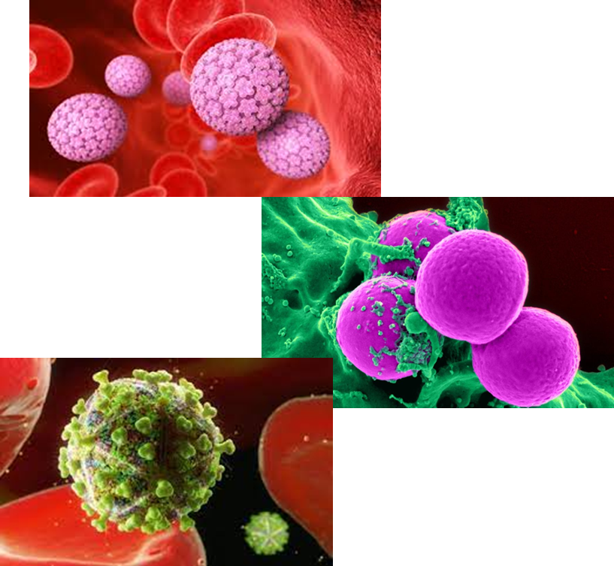
Tutor Time recap
STI stands for “Sexually transmitted infection”
This is the same thing as a STD – “sexually transmitted disease”
Myths such as it is clear when a person has a STI, STI’s will not go away on their own and STI’s can be caught even during a persons first time having sex

Slide 7
Important things to know about STI’s
Is normally passed from person to person when having any form of sex
You do not need to have lots of sexual partners to get a STI
Both men and women can pass on STI’s

Slide 8
What are the names of STI’s
During tutor time you were shown some common STI’s.
Discuss with your partner any names of STI’s you remember from tutor time or ones that you have heard off that were not included in tutor time.
Be ready to share your answers with the class.

Slide 9
What are the names of STI’s
The most common STI’s in the UK are:
Chlamydia – makes up 46% of infections in 2021
Genital Warts and Herpes (HPV) – makes up 15% of infections on 2021
Gonorrhea – an 11% increases of cases on 2021 compared to 2020
Syphilis – an 20% increases of cases in 2021 compared to 2020.
Another STI that is most well known in the UK is HIV/AIDS but cases are declining

Slide 10
Transmission of STI’s
Transmission of STIs is how they spread from person to person.
STIs are spread through the exchange of bodily fluids, primarily through unprotected sex.
Unprotected sex is when a male or female condom has not been used.

Slide 11
Transmission of STI’s - activity
To show how STIs are spread we are going to complete a class activity.
Task – move around the room with the aim of getting 3 people to sign your piece of paper. You have 3 minutes to complete this task.
At this point ignore the letter on the back

Slide 12
Transmission of STI’s - activity
For the next part of the activity to work we need to use our imaginations.
Imagine that the names on your sheet have been sexual partners.
We can now learn what the letters on the back meant and how this relates to transmission of STIs

Slide 13
Transmission of STI’s - activity
Can the people with “S” written on the back of their sheet please stand up
These people without knowing it have a STI
Please remaining standing

Slide 14
Transmission of STI’s - activity
If the people standing up have signed their name on your piece of paper please stand up.
This potentially means that the STI of the people with “S” on the back of their sheet have been spread to everyone standing up.
If there is now someone in the room that is standing and their name is on your sheet, you must now stand up as there is a risk you may have caught the STI.
Now lets look at what other letters are on the back of other people’s sheets

Slide 15
Transmission of STI’s - activity
If there is a “U” on the back of your sheet, this means that you have been having unprotected sex. This means that you must stay standing as there is a high risk you have caught the STI.
If there is a “C” on the back of your sheet, this means a condom was used. You may now sit down as the risk of you having caught the STI is low.

Slide 16
Transmission of STI’s - activity
There are 2 other letters in this activity – “M” and “A”
The people with these letters should not have stood up. This is because these letters mean they are at a reduced risk or no risk at all of catching an STI

Slide 17
Transmission of STI’s - activity
M stands for “Monogamy” This means that a person only has sex faithfully with one partner after both have been tested for STIs
A stands for “Abstinence” This means that a person refrains from having sexual contact with anybody. This means there is no risk of transmitting a STI.
Everyone can now sit down

Slide 18
What does this activity show?
This shows that from a small number of people having a STI, if they are having unprotected sex with multiple partners there is a high risk that a STI will be transmitted. It also shows how fast STIs can be spread
There is a reduced risk of transmitting STIs if you have protected sex (using a condom), limiting sexual partners to one at a time (monogamy) or by not taking part in any sexual activity (abstinence).

Slide 19
Hinge Questions – whiteboard activity
3
Rules!
I will ask the question and give you some thinking time. (no more than 10 seconds)
Write the answer and turn your whiteboard over so nobody can see it.
When I am ready I will put on the 3 to 1 counter.
When ‘Show me’ appears on the board you must hold up your whiteboard (even if you don’t know the answer and there is nothing on your board)
2
1
Show me!
(even if your whiteboard is blank)

Slide 20
Hinge Questions – whiteboard activity
True or False
“STI stands for sexually transmitted infection”
True

Slide 21
Hinge Questions – whiteboard activity
Write down a common STI (don’t worry about spelling at this point)
Chlamydia, Genital Warts/Herpes, Gonorrheo, Syshilis, HIV/AIDS

Slide 22
Hinge Questions – whiteboard activity
True or False
“STIs are transmitted through the exchange of bodily fluids, mostly through having sex”
True

Slide 23

Hinge Questions – whiteboard activity
What is being described below:
“having sex faithfully with only one partner”
A – Abstinence
B – Monogamy
C – Having multiple sexual partners

Slide 24
Task
Word Bank
1. Chlamydia
2. Transmitted
3. Sexually Transmitted Infection
4. Gonorrhea
5. HIV/AIDS
6. Not
7. Condom
8. Fluids
9. Monogamy
10. Abstinence
11. Unprotected sex
Write out the following paragraph and fill in the blanks. You will mark your answers with red pen.
STIs stands for _______________. Some common STIs are _________, __________ and _________. STIs are ________ through exchanging bodily ________. To reduce the risk of transmitting a STI, during sex a ________ should be used. Other ways of reducing the risk of transmitting STI’s it through _________ or ________. A high risk way of transmitting STIs is through having _____________. This is when a condom has ____ been used.
Sexually transmitted infection
Chlamydia
HIV/AIDS
Gonorrhea
transmitted
fluids
condom
monogamy
abstinence
Unprotected sex
not

Slide 25



Support
If you need any support about contraception, you can contact
Umbrellahealth.co.uk
There is a postcode checker for your closest place to receive free sexual health advice
The website also offers text messaging service for help
Brook.org.uk
Information on local sexual health advice centres and an online chat option

Slide 26

Extension Activity
While watching the video answer the following questions in your book:
Does everyone experience the same symptoms?
What are some common symptoms?
Do people generally experience no symptoms, mild symptoms or extreme symptoms?
Notes:
https://www.youtube.com/watch?v=B3_wLdqhLLc

Slide 27


