Slide 1
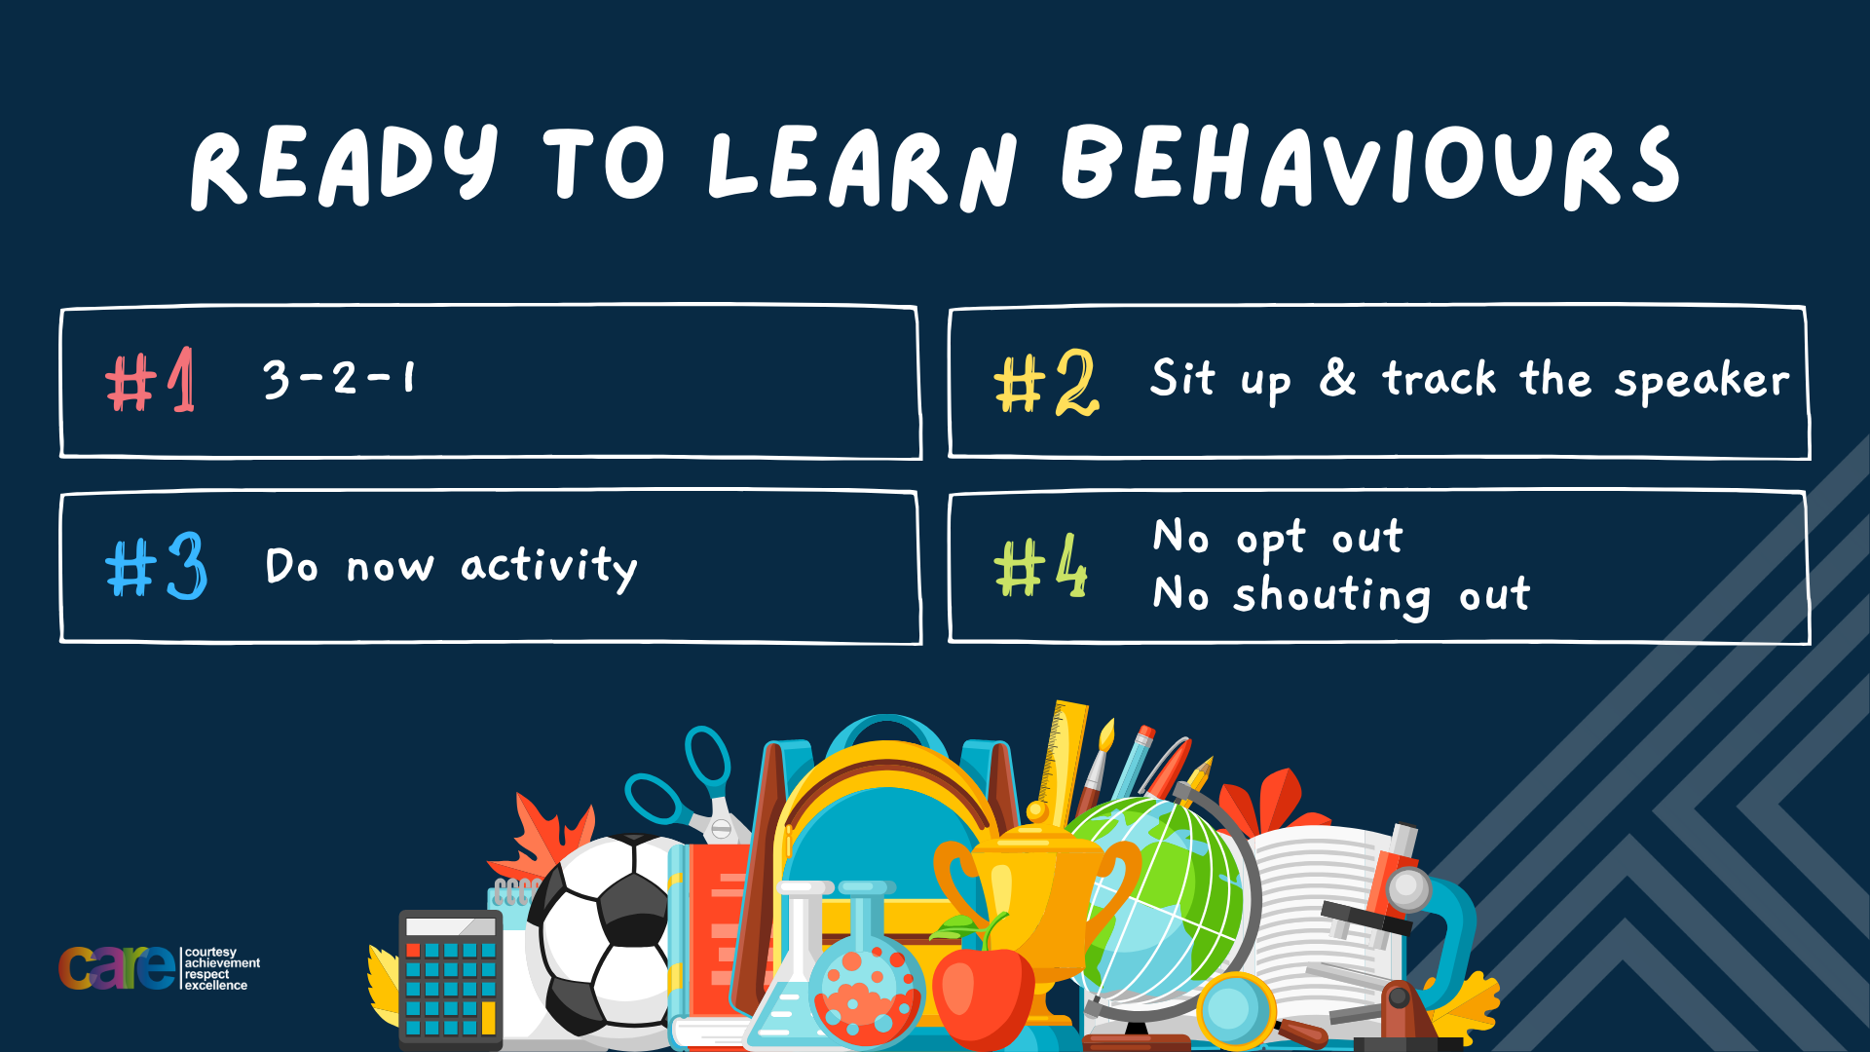

Slide 2








Write the date: 05 November 2024
Write the title: drugs, alcohol and mental health
Underline both using your rule in your learning walley. Take out your oracy helpsheet too.
Complete the following tasks
What is being described? “a state of mental well being that enables people to cope with the stresses of life, realise their abilities, learn well and work well and contribute to their community”
2. How are STI’s commonly transmitted?
3. Is the contraceptive injection a barrier or hormonal method of contraception?
Mental health
Unprotected sex
Hormonal

Slide 3


Secure your Wellbeing: Learning Journey
What is mental health?
Impact of drugs and alcohol on mental health
What is gambling?
What are eating disorders?
How to deal with emotions?
How to deal with fallouts
Today we will look at:
What is mental health?
This includes:
Misconceptions
Reframing language around mental health
Challenging stigma of mental health
Please remember that during the lesson we should not be asking any pupil or teacher personal questions.
Your teacher can ask you questions but this will be to check your knowledge in the lesson.

Slide 4

Discussion
In tutor time this week you looked at alcohol and drugs.
You have 1 minute to write down 3 things you can remember from your Personal Development tutor time activity on Monday

Slide 5

Tutor Time Recap
Using your oracy helpsheet, discuss with the person next to you the things you remember from your Personal Development tutor time activity.
Remember to use the sentence starters to add, build or challenge what your partner has said.
Be ready to share your discussion with the class

Slide 6
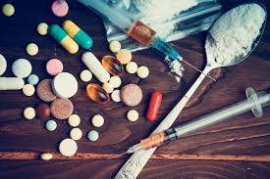

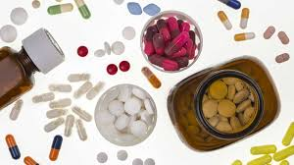
Tutor Time recap
Alcohol is a clear liquid commonly found in drinks such as beer, wine and spirits. It is also a drug.
Drugs are chemicals or substances that change the way our body work. Not all drugs are illegal.

Slide 7
Tutor Time recap
It is important to learn this because:
It helps to secure your wellbeing to make healthy choices around your physical and mental health
Rule of Law is a British Value and it is the law in the UK that U18’s cannot purchase alcohol and there are illegal drugs for anyone in the UK to use
Article 33 of the UN Rights of a Child state that children have a right to be protected from harmful drugs. Learning about them is part of this right.

Slide 8
Drugs, alcohol and mental health
In today’s lesson we will look at how drugs and alcohol impact a person’s mental health

Slide 9

What is mental health?
Before half term you learnt about mental health
You have 1 minute to think about the following question:
“What is mental health?”

Slide 10
What is mental health?
Using your oracy helpsheet, with the person next to you, discuss your response to the question:
“What is mental health?”
Remember to use the sentence starters to add, build or challenge what your partner has said.
Be ready to share your discussion with the class

Slide 11
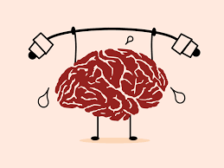
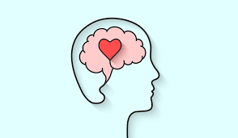

What is mental health?
Mental health is “a state of mental well being that enables people to cope with the stresses of life, realise their abilities, learn well and work well and contribute to their community”

Slide 12
What is mental health?
Everyone has mental health.
Mental health can be good or it can be bad. Just like physical health, when mental health is bad it is important to do something to try to fix the issue.
Drugs and alcohol can increase the likelihood of experiencing bad mental health. If drugs and alcohol are abused over a long period of time it can lead to mental illness.

Slide 13
Short term effects
You now have 1 minute to think about the question:
“what are the short term effects of drugs and alcohol?”
Write your ideas in your book.

Slide 14
Short term effects
Using your oracy helpsheet, discuss with the person next to you the question:
“what are the short term effects of drugs and alcohol?”
Remember to use the sentence starters to add, build or challenge what your partner has said.
Be ready to share your discussion with the class

Slide 15
Short Term effects
Short term effects are the immediate changes drugs and alcohol cause in the brain. These include:
1. Mood swings – drugs and alcohol can cause sudden changes in mood. A person might feel happy or excited at first but this can quickly change to sadness, anger or irritability.

Slide 16
Short Term effects
Short term effects are the immediate changes drugs and alcohol cause in the brain. These include:
2. Impaired judgement – drugs and alcohol affect the brain’s control centre, leading people to act without thinking things through. This can be extremely dangerous.

Slide 17
Short Term effects
Short term effects are the immediate changes drugs and alcohol cause in the brain. These include:
3. Increased anxiety or paranoia – some drugs can trigger feelings or anxiety or paranoia even in people who do not usually experience these feelings.

Slide 18
Short Term effects
Short term effects are the immediate changes drugs and alcohol cause in the brain. These include:
4. Difficulty concentrating and remembering - alcohol and drugs interfere with the brains ability to focus and recall information. If drugs and alcohol have been consumed a person may experience a black out in their memory from when the alcohol and drugs were consumed.

Slide 19
Hinge Questions – whiteboard activity
3
Rules!
I will ask the question and give you some thinking time. (no more than 10 seconds)
Write the answer and turn your whiteboard over so nobody can see it.
When I am ready I will put on the 3 to 1 counter.
When ‘Show me’ appears on the board you must hold up your whiteboard (even if you don’t know the answer and there is nothing on your board)
2
1
Show me!
(even if your whiteboard is blank)

Slide 20
Hinge Questions – whiteboard activity
What is being described?
“a clear liquid commonly found in drinks such as beer, wine and spirits”
Alcohol

Slide 21
Hinge Questions – whiteboard activity
What is being described?
“chemicals or substances that change the way our body work.”
drugs

Slide 22
Hinge Questions – whiteboard activity
True or False
Learning about drugs and alcohol is part of the UN Rights of a Child
True – this is stated in Article 33

Slide 23
Hinge Questions – whiteboard activity
True or False
As part of the Rule of Law in the UK it is legal for U18’s to consume alcohol
False – it is illegal for U18’s to consume alcohol

Slide 24
Hinge Questions – whiteboard activity
What is being described?
“a state of mental well being that enables people to cope with the stresses of life, realise their abilities, learn well and work well and contribute to their community”
Mental health

Slide 25
Hinge Questions – whiteboard activity
Give an example of a short term effect of drugs and alcohol on the brain
Mood swings
Impaired Judgement
Increased anxiety or paranoia
Difficulty concentrating and remembering

Slide 26
Long term effects
You now have 1 minute to think about the question:
“what are the long term effects of drugs and alcohol?”
Write your ideas in your book.

Slide 27
Long term effects
Using your oracy helpsheet, discuss with the person next to you the question:
“what are the long term effects of drugs and alcohol?”
Remember to use the sentence starters to add, build or challenge what your partner has said.
Be ready to share your discussion with the class

Slide 28
Long term Term effects
Long term effects appear after prolonged or frequent use and can lead to serious mental health conditions
1. Dependency/addiction – Over time the brain becomes reliant on substances to feel “normal”. This means the brain craves the substance leading the increased consumption. This is a mental health disorder

Slide 29
Long term Term effects
Long term effects appear after prolonged or frequent use and can lead to serious mental health conditions
2. Anxiety/Depression - some drugs are known as depressants. This can make a person feel low, sad or anxious even when not using drugs and alcohol. This can lead to being diagnosed with anxiety or depression which are mental health illness’

Slide 30
Long term Term effects
Long term effects appear after prolonged or frequent use and can lead to serious mental health conditions
3. Memory loss and cognitive issues – long term use of drugs and alcohol can interfere with the brain’s development, particularly in young people, affecting learning, memory and focus

Slide 31
Long term Term effects
Long term effects appear after prolonged or frequent use and can lead to serious mental health conditions
4. Psychosis and hallucinations - some drugs can lead to episodes of psychosis (loss of contact with reality). This can lead to dangerous behaviour that can put the person at risk.

Slide 32
Hinge Questions – whiteboard activity
3
Rules!
I will ask the question and give you some thinking time. (no more than 10 seconds)
Write the answer and turn your whiteboard over so nobody can see it.
When I am ready I will put on the 3 to 1 counter.
When ‘Show me’ appears on the board you must hold up your whiteboard (even if you don’t know the answer and there is nothing on your board)
2
1
Show me!
(even if your whiteboard is blank)

Slide 33
Hinge Questions – whiteboard activity
Is the following a description of a short term or long term effect?
“drugs and alcohol can cause sudden changes in mood. A person might feel happy or excited at first but this can quickly change to sadness, anger or irritability.”
Short Term

Slide 34
Hinge Questions – whiteboard activity
Is the following a description of a short term or long term effect?
“Over time the brain becomes reliant on substances to feel “normal””
Long Term

Slide 35
Hinge Questions – whiteboard activity
Is the following a description of a short term or long term effect?
“some drugs can lead to episodes of psychosis (loss of contact with reality).”
Long Term

Slide 36
Hinge Questions – whiteboard activity
Is the following a description of a short term or long term effect?
“some drugs can trigger feelings or anxiety or paranoia even in people who do not usually experience these feelings”
Long Term

Slide 37
Importance for Young People
It is very important to learn this as a young person as consuming alcohol and using drugs during teenage years is even more serious than using drugs and alcohol as an adult

Slide 38
Importance for Young People
Using alcohol and drugs as a young person…
1. Impacts brain development. A young person’s brain is still developing. Alcohol and drugs interfere with this development increasing the risk of the young person developing mental health issues

Slide 39
Importance for Young People
Using alcohol and drugs as a young person…
2. Risks of lifelong impact. Using alcohol and drugs as a young person can increase the likelihood of dependency on the substances. This increases the likelihood of developing mental health issues in adulthood.

Slide 40
Scenario
Jamie is 14 years old and has recently started hanging out with a new group of friends. They’re older, and sometimes they drink alcohol at parties or smoke marijuana after school. Jamie was hesitant at first, but eventually, he joined in, thinking it would help him fit in with the group.
At first, Jamie felt more relaxed when drinking with his friends and noticed he was less nervous around them. But after a while, Jamie started feeling different in other parts of his life. He often felt anxious and didn’t want to go to soccer practice anymore, which used to be his favorite activity. He’s been having trouble concentrating in class and can’t remember things the way he used to. He also finds himself feeling sad for no reason and gets easily irritated with his family and friends.
Jamie used to love school and had plans to try out for the advanced math class, but now he feels unmotivated and doesn’t care as much about his grades or future plans. He’s finding it harder to enjoy things that used to make him happy, and he often feels like he just wants to be left alone.
Thinking time – write down ideas to discuss the following questions.
What short term mental health changes do you notice in Jamie?
If Jamie continues using drugs and alcohol what long term mental health issues could he face?
If you were Jamie’s friend, what advice would you give him?

Slide 41
Scenario
Jamie is 14 years old and has recently started hanging out with a new group of friends. They’re older, and sometimes they drink alcohol at parties or smoke marijuana after school. Jamie was hesitant at first, but eventually, he joined in, thinking it would help him fit in with the group.
At first, Jamie felt more relaxed when drinking with his friends and noticed he was less nervous around them. But after a while, Jamie started feeling different in other parts of his life. He often felt anxious and didn’t want to go to soccer practice anymore, which used to be his favorite activity. He’s been having trouble concentrating in class and can’t remember things the way he used to. He also finds himself feeling sad for no reason and gets easily irritated with his family and friends.
Jamie used to love school and had plans to try out for the advanced math class, but now he feels unmotivated and doesn’t care as much about his grades or future plans. He’s finding it harder to enjoy things that used to make him happy, and he often feels like he just wants to be left alone.
Using your oracy help sheet discuss your responses to the questions. Remember to add, build and challenge what your partner has said.
What short term mental health changes do you notice in Jamie?
If Jamie continues using drugs and alcohol what long term mental health issues could he face?
If you were Jamie’s friend, what advice would you give him?

Slide 42



Support
If you ever need support about alcohol and drugs for yourself, a friend or family member you can find it here:
Childline.org.uk
Call – 08001111
Email or chat online for support
Themix.org.uk
You can email or have one-to-chat online.
There is also a crisis messenger which is available 24/7

Slide 43


