Slide 1
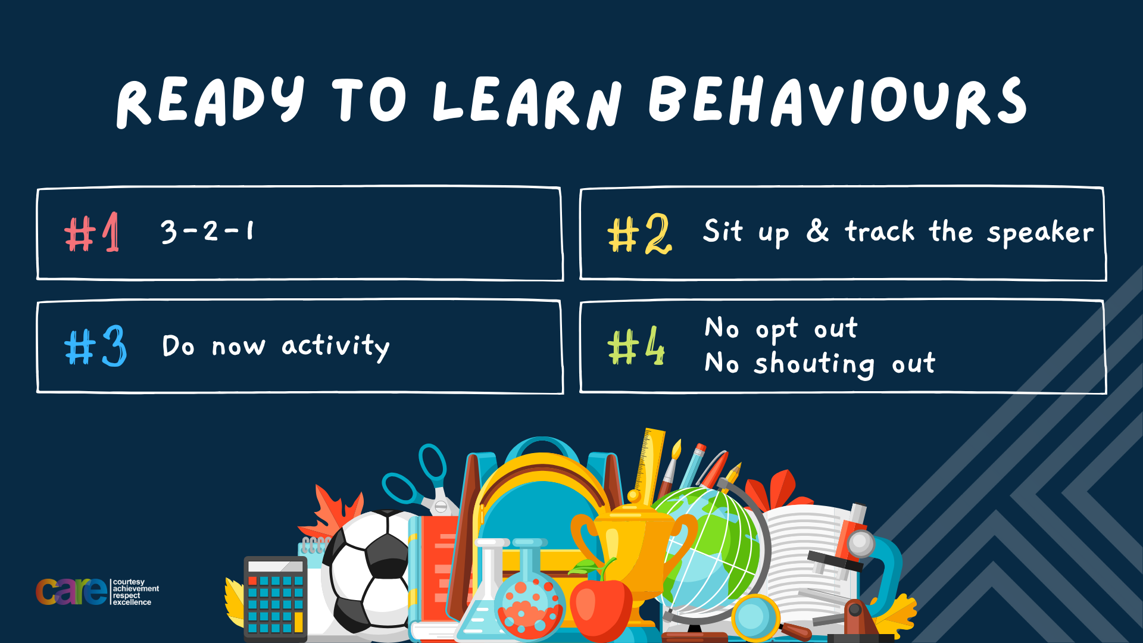

Slide 2








Write the date: 11 October 2024
Write the title: Sexting and the law
Underline both!
Complete the following tasks
True or False – it is illegal for an adult to show a child pornography?
2. True or False – verbal communication is the only way of providing consent?
3. What is a principle of a healthy relationship?
True
False – non verbal communication is just as important.
Communication, respect, trust, equality

Slide 3


Slide 4


Secure your Future: Learning Journey
Impact of the media on relationships
What is consent in romantic relationships
What is the impact of pornography?
What is sexting and the law?
What is contraception
What are STI’s?
Today we will look at:
Sexting and the law
This includes:
What is sexting
Different motivations behind requesting and sending nude images
What is the law around sexting
Please remember that during the lesson we should not be asking any pupil or teacher personal questions.
Your teacher can ask you questions but this will be to check your knowledge in the lesson.

Slide 5
Tutor Time recap
During tutor time this week you recapped what are appropriate or inappropriate images to send/share.
With the person next to you discuss what you learned about in tutor time.
Remember to listen to each other and be ready to share your discussion with the class

Slide 6
Tutor Time recap
In tutor time you looked at:
The 4 things to consider if an image or video is appropriate to share. They were:
The person sending the images knows who it is being sent to
The person or people in the photo are happy for the image/video to be shared
The person knows why the image is going to be sent and how that image will be used
The image does not show any personal information
There was also an introduction to the term “sexting” and a video that showed some negative outcomes of this.

Slide 7



What is sexting?
Sexting is:
“nude, semi nude or suggestive images or videos of a person that they have taken of themselves”
You may know this as “nudes” instead of sexting.

Slide 8

Sexting and the law
The Protection of Children Act 1976 states
“It is illegal to make, distribute, possess or show any indecent images of anyone aged under 18, even if the content was created with the consent of that person under 18”

Slide 9
Sexting and the law
This means the following statements are all illegal
Taking a nude, semi nude or suggestive picture of yourself if you are under 18
Sending a nude, semi nude or suggestive picture of yourself to someone if you or the other person is under 18
Have a nude, semi nude or suggestive photo of someone who is U18 saved on your phone even if they sent it to you of their own accord
Show or share a nude, semi nude or suggestive image of someone under 18 to another person.

Slide 10
Hinge Questions – whiteboard activity
3
Rules!
I will ask the question and give you some thinking time. (no more than 10 seconds)
Write the answer and turn your whiteboard over so nobody can see it.
When I am ready I will put on the 3 to 1 counter.
When ‘Show me’ appears on the board you must hold up your whiteboard (even if you don’t know the answer and there is nothing on your board)
2
1
Show me!
(even if your whiteboard is blank)

Slide 11
Hinge Questions – whiteboard activity
Should the following image be shared?
“A selfie of a person smiling sent directly to a close friend”
Yes – this is an appropriate image to send

Slide 12
Hinge Questions – whiteboard activity
Should the following image be shared?
“A selfie of a person smiling but shows their school badge. The image is on a public page””
No – this shows private information about the person to people they do not know

Slide 13
Hinge Questions – whiteboard activity
What is being described?
“nude, semi nude or suggestive images or videos of a person that they have taken of themselves”
Sexting

Slide 14
Hinge Questions – whiteboard activity
Is the following statement legal or illegal?
“A 16 year old has a semi naked photo of another 16 year old saved on their phone. This image was sent without asking and saved automatically to the photo app on their phone”
Illegal – regardless of the image being sent without asking, it is illegal to possess a naked, semi naked or suggestive image of a person under 18 years old.

Slide 15
Reasons why people “sext”
Think about reasons why people may “sext”
Reminder - this means to send nude/semi nude/suggestive pictures of themselves to other people
You should write down your reasons in your book.
Be ready to share your reasons with the class

Slide 16
Reasons why people “sext”
Revealing Reality are a research agency that have completed research exploring the lives and behaviours of children and young people. One bit of research showed the following reasons why young people “sext”
To turn someone on
Being pressurised into sending one
To want someone to find them attractive
Worried the other person would lose interest
To get a nude picture back
To feel good about themselves
However the reasons change depend whether the person is male or female.
For each reason write on your whiteboard if you think it was given by males or females

Slide 17
Reasons why people “sext”
Revealing Reality are a research agency that have completed research exploring the lives and behaviours of children and young people. One bit of research showed the following reasons why young people “sext”
To turn someone on
Being pressurised into sending one
To want someone to find them attractive
Worried the other person would lose interest
To get a nude picture back
To feel good about themselves
However the reasons change depend whether the person is male or female.
For each reason write on your whiteboard if you think it was given by males or females
63% of males said this
46% of females said this
41% of females said this
29% of females said this
33% of males said this
27% of males and 42% of females said this
Notes:
Take each reason in turn and ask pupils to write “males” or “females” on their whiteboards

Slide 18
Reasons why people “sext”
Revealing Reality are a research agency that have completed research exploring the lives and behaviours of children and young people. One bit of research showed the following reasons why young people “sext”
To turn someone on
Being pressurised into sending one
To want someone to find them attractive
Worried the other person would lose interest
To get a nude picture back
To feel good about themselves
This also shows there is a gender divide to “sexting”. This significant difference in reasons people sext may cause miscommunication or misunderstanding between people of different genders when exchanging images
63% of males said this
46% of females said this
41% of females said this
29% of females said this
33% of males said this
27% of males and 42% of females said this

Slide 19
Reasons why people “sext”
A focus should be put onto the reason “being pressurised into sending one”
This is an example of peer pressure and it is important to look out for signs that this is happening.
This can be done through:
Guilt tripping – “do you not trust me?”
Promises of secrecy – “It’s just between us”
Making the other person feel uncool or boring – “everyone else is doing it”
Threats of breaking up the relationship/friendship – “I don’t think we can be together if you don’t”

Slide 20

Dangers of Sexting
While watching the video think about:
What were some of the consequences of sexting in the video?
Notes:
https://www.youtube.com/watch?v=6anYPanNvBU play to 1;18

Slide 21
Dangers of sexting
Apart from sexting when under 18 years old there are other dangers.
The internet never forgets – once an image is shared digitally it can spread rapidly and cannot be fully deleted
Chain reaction – it can be assumed that when sending a nude image the person wants it to remain private with the person they sent it to. However this does not always happen as this can be shared with others. A screenshot can still be taken even on “disappearing” platforms like Snapchat and Instagram stories
Going viral – This is not just online but it can be around school.

Slide 22
Dangers of sexting
If a private image such as an image involved in sexting is leaked there are consequences:
There is an emotional impact. The person who’s image has been leaked can feel embarrassed and shameful. They may also feel a sense of guilt
Loss of trust. This can lead to future trust issues in future relationships and can make that person feel isolated and lonely
Bullying – The person may have names or comments made to them in school and online.

Slide 23
Dangers of sexting
A really important lesson to learn is:
Once a person hit send/share on a image there is an element of a loss of control over that image.

Slide 24
Hinge Questions – whiteboard activity
3
Rules!
I will ask the question and give you some thinking time. (no more than 10 seconds)
Write the answer and turn your whiteboard over so nobody can see it.
When I am ready I will put on the 3 to 1 counter.
When ‘Show me’ appears on the board you must hold up your whiteboard (even if you don’t know the answer and there is nothing on your board)
2
1
Show me!
(even if your whiteboard is blank)

Slide 25
Hinge Questions – whiteboard activity
Give one reason why a person might sext?
To turn someone on
Being pressurised into sending one
To want someone to find them attractive
Worried the other person would lose interest
To get a nude picture back
To feel good about themselves

Slide 26
Hinge Questions – whiteboard activity
Give an example of something a person might say when they are pressurising a person into sexting
“do you not trust me?”
“It’s just between us”
“everyone else is doing it”
“I don’t think we can be together if you don’t”

Slide 27
Hinge Questions – whiteboard activity
True or False
“Even on disappearing apps like Snapchat or Instagram stories, screenshots can be taken and these are shared with other people”
True

Slide 28
Hinge Questions – whiteboard activity
True or False
A person who has a nude image leaked will feel proud
False – they will mostly like feel embarrassed, guilty. They can also lose trust in people which could affect them later in life

Slide 29
Scenario
Emma is 14 years old and she is messaging Ethan who she has a crush on. Emma thinks Ethan might like her too as they are always messaging. One evening Ethan asks Emma for a nude picture as it will make their relationship even more special. At first Emma is unsure but Ethan keeps pushing saying things like “It’s just between us” and “I would send you one if you asked.” As Emma doesn’t want to upset Ethan as she really likes him, she sends him a photo, as she trusts Ethan.
The next day at school Emma notices people whispering and looking at her strangely. Her best friend stops her between lessons and says “I can’t believe you sent Ethan that picture. Everyone has seen it”
Emma immediately feels sick and very angry at Ethan. The last place she wants to be is in school and around people. Finally Emma bursts into tears and locks herself in the toilets
Questions
What advice would you give Emma when she first received the request from Ethan?
What could she have said to Ethan instead of sending the message?
How did Ethan convince Emma to send the picture?
What were the consequences of Emma sending the picture?
What advice would you give Emma when she found out the picture was leaked?

Slide 30



Support
If you or a friend need any support about sexting, you can contact
Childline.org.uk
Call – 08001111
Email or chat online for support
Themix.org.uk
You can email or have one-to-chat online.
There is also a crisis messenger which is available 24/7

Slide 31
