Slide 1
Thought of the Day
“We must continue to challenge hate in all its forms and ensure that victims are supported and perpetrators are brought to justice”
Graham Lewis, former Chair and Trustee of Stop Hate UK

Slide 2


Homework has been set for this week.
Remember to log in and complete your set tasks.
We still use Classcharts for announcements, surveys and revision material
Homework Club every morning in West Canteen from 8am
Library is open before school and at break times
Students on the following slides have not completed ALL tasks
Make sure you are completing the SET TASKS! These are the tasks your teachers have set.
Notes:
Please give time for the students to produce answers for themselves before showing answers.

Slide 3








Replacement equipment for your learning wallet can be purchased at the following locations/times:
The following items can be purchased for 10p each (cash only) from West Canteen, East Canteen, the Library, and
LRC (next to W214):
Day | West Canteen | East Canteen | Library or LRC | Library
Monday | 08:00–08:35 | 08:30–08:35 | 10:10– 10:30 11:10–11:30 12:40–13:00 13:40–14:00 | 16:10–16:30
Tuesday | 08:00–08:35 | 08:30–08:35 | 10:10– 10:30 11:10–11:30 12:40–13:00 13:40–14:00 | 15:10–15:30
Wednesday | 08:00–08:35 | 08:30–08:35 | 10:10– 10:30 11:10–11:30 12:40–13:00 13:40–14:00 | 15:10–15:30
Thursday | 08:00–08:35 | 08:30–08:35 | 10:10– 10:30 11:10–11:30 12:40–13:00 13:40–14:00 | 15:10–15:30
Friday | 08:00–08:35 | 08:30–08:35 | 11:10–11:30 12:40–12:30 | 13:40–14:00
The following items can be purchased from West Office using money on your ParentPay:
£1.70
£15.00

Slide 4

Secure your Wellbeing: Learning Journey
What is social media and how should you use it?
What are online trends and should you follow them?
What impact can social media influences have?
What is fake news?
What is hate speech online?
How can I manage my time online?
Today we will look at:
What is hate speech online?
This includes:
Definition of hate crime
What is targeted in a hate crime?
Discussion around rising rates on hate crime
Please remember that during the lesson we should not be asking any pupil or teacher personal questions.
Your teacher can ask you questions but this will be to check your knowledge in the lesson.

Slide 5

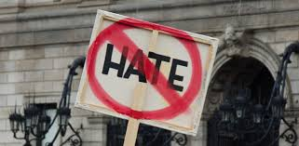

What is an online hate crime?
Online hate crime is…
“a criminal act motivated by prejudice, hostility or hatred towards a person’s race, religion, sexual orientation or gender identity that occurs on the internet”

Slide 6

What is a hate crime
Notes:
https://www.youtube.com/watch?v=tdUUD7jcMVs

Slide 7

Why are we learning about this?
This links to the Golden Thread of “Secure your Relationships”
Hate crime is an extreme form of discrimination which means differences between people are not celebrated. Celebrating people’s differences builds better and stronger relationships between family, friends and colleagues when you begin work.

Slide 8

Why are we learning about this?
Rule of Law is a British Value. This means that people are expected to follow the rules and laws that are designed to keep people safe. Hate crime is against the law (Criminal Justice Act 2003). Depending on the extent of the hate crime people can be given a maximum 14 years in prison

Slide 9
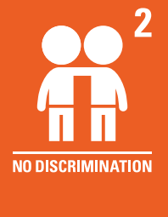
Why are we learning about this?
Article 2 of the UN Rights of a Child states that no child should be treated unfairly for any reason. This means that if a child identifies with one of the protected characteristics they should not be treated differently. If they are treated differently this is against the law and their rights
UN Rights
of a Child

Slide 10
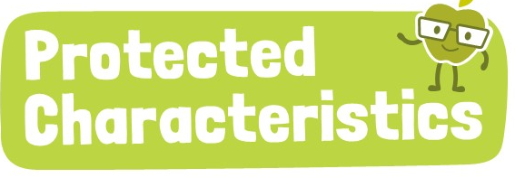
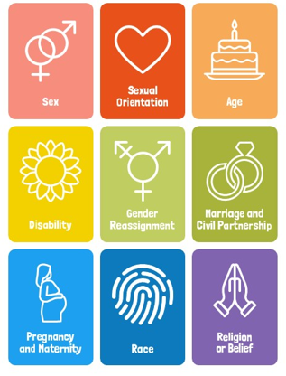
Why are we learning about this?
All of the Protected Characteristics are equal. One does not take priority over the over. Unfortunately, many hate crime incidents happen to people who identify with one or more of the protected characteristics

Slide 11
What is a hate crime?
The UK legally recognises 5 categories of hate crime:
Race – attacking someone due to them being an ethnic minority
Religion – Abusing or attacking a person due to their religious beliefs
Disability – bullying or harming someone due to their physical or mental disability
Sexual orientation – attacking someone for identifying as LGBT+
Gender identity – abusing or attacking someone for being transgender

Slide 12
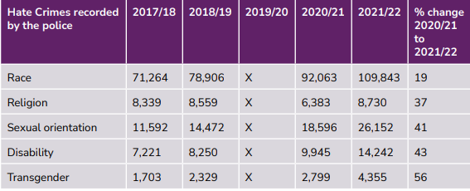
What is a hate crime?
Look at the statistics on the left.
You have 1 minute to think about the following question:
“Why do you think there has been a significant rise in hate crime?”

Slide 13

What is a hate crime?
Using your oracy helpsheet, with the person next to you, discuss your response to the question:
“Why do you think there has been a significant rise in hate crime?”
Remember to use the sentence starters to add, build or challenge what your partner has said.
Be ready to share your discussion with the class

Slide 14
What is a hate crime?
Take out your oracy helpsheet from your learning wallet.
You have 1 minute to think about the following question:
“What do you think could be done to tackle the rise in hate crime?”

Slide 15
What is a hate crime?
Using your oracy helpsheet, with the person next to you, discuss your response to the question:
“What do you think could be done to tackle the rise in hate crime?”
Remember to use the sentence starters to add, build or challenge what your partner has said.
Be ready to share your discussion with the class

Slide 16
What is a hate crime?
You will be learning more about hate crimes in your Personal Development lesson this week, with a particular focus on hate speech that occurs online.
Until then, think about any negative words you see online. Are any of these words actually committing a hate crime?

Slide 17



Support
If you ever need support about hate crimes for yourself, a friend or family member you can find it here:
Childline.org.uk
Call – 08001111
Email or chat online for support
Call 999 if you or a friend is a victim of a hate crime

