Slide 1
Thought of the Day
“We must continue to challenge hate in all its forms and ensure that victims are supported and perpetrators are brought to justice”
Graham Lewis, former Chair and Trustee of Stop Hate UK

Slide 2


Homework has been set for this week.
Remember to log in and complete your set tasks.
We still use Classcharts for announcements, surveys and revision material
Homework Club every morning in West Canteen from 8am
Library is open before school and at break times
Students on the following slides have not completed ALL tasks
Make sure you are completing the SET TASKS! These are the tasks your teachers have set.
Notes:
Please give time for the students to produce answers for themselves before showing answers.

Slide 3


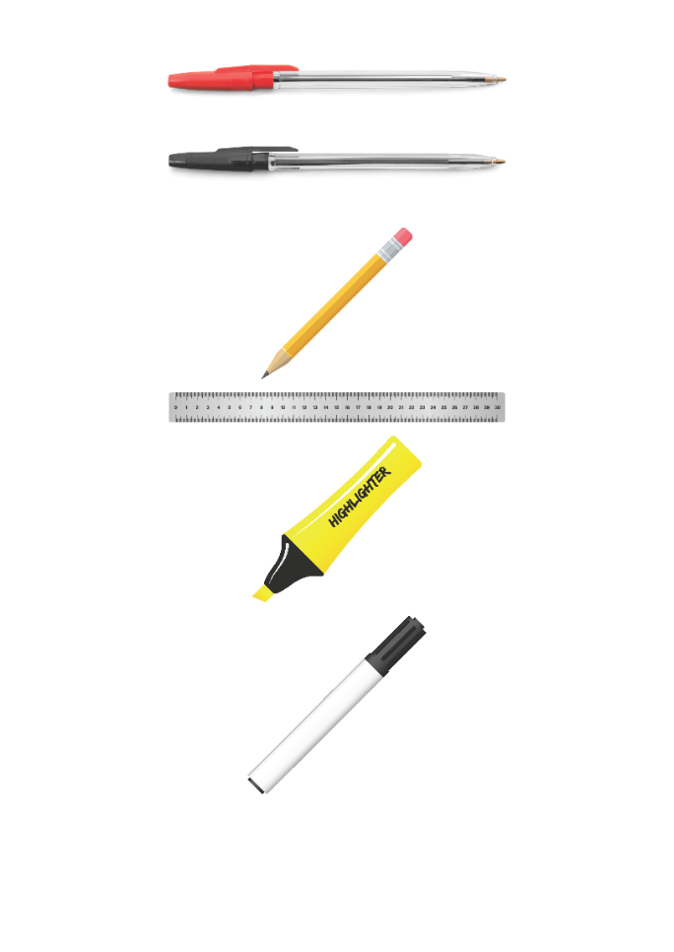


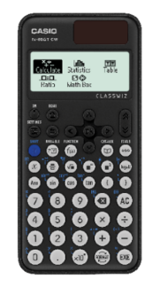


Replacement equipment for your learning wallet can be purchased at the following locations/times:
The following items can be purchased for 10p each (cash only) from West Canteen, East Canteen, the Library, and
LRC (next to W214):
Day | West Canteen | East Canteen | Library or LRC | Library
Monday | 08:00–08:35 | 08:30–08:35 | 10:10– 10:30 11:10–11:30 12:40–13:00 13:40–14:00 | 16:10–16:30
Tuesday | 08:00–08:35 | 08:30–08:35 | 10:10– 10:30 11:10–11:30 12:40–13:00 13:40–14:00 | 15:10–15:30
Wednesday | 08:00–08:35 | 08:30–08:35 | 10:10– 10:30 11:10–11:30 12:40–13:00 13:40–14:00 | 15:10–15:30
Thursday | 08:00–08:35 | 08:30–08:35 | 10:10– 10:30 11:10–11:30 12:40–13:00 13:40–14:00 | 15:10–15:30
Friday | 08:00–08:35 | 08:30–08:35 | 11:10–11:30 12:40–12:30 | 13:40–14:00
The following items can be purchased from West Office using money on your ParentPay:
£1.70
£15.00

Slide 4

Secure your Wellbeing: Learning Journey
What is social media and how should you use it?
What are online trends and should you follow them?
What impact can social media influences have?
What is fake news?
What is hate speech online?
How can I manage my time online?
Today we will look at:
Screen Time
This includes:
Definition of screen time
Research on increased screen time
Please remember that during the lesson we should not be asking any pupil or teacher personal questions.
Your teacher can ask you questions but this will be to check your knowledge in the lesson.

Slide 5
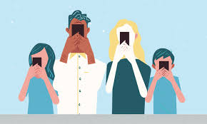

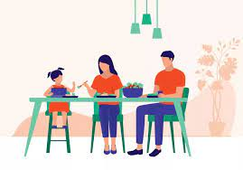
Screen Time
Screen time is…
“Any time spent using a device with a screen.”
This includes:
Mobile phones
Tablets
TV
Computer/laptops

Slide 6

Why are we learning about this?
This links to the Golden Thread of “Secure your Wellbeing”
Spending too much time inside looking at screens can have an impact on physical and mental wellbeing. It is important to put screens away and enjoy the outdoors too

Slide 7

Why are we learning about this?
Article 3 of the UN Rights of a Child state that governments and all adults should do what is best for children. Although this may mean that children disagree with the decision. An example of this is schools banning mobile phones however this allows pupils opportunities to enjoy interacting with each other in person and not through a device.
UN Rights
of a Child

Slide 8

Screen Time
Take out your oracy helpsheet from your learning wallet.
You have 1 minute to think about the following question:
“How many screen devices do you have in your home? Where are they situated?”

Slide 9
Screen Time
Using your oracy helpsheet, with the person next to you, discuss your response to the question:
“How many screen devices do you have in your home? Where are they situated?”
Remember to use the sentence starters to add, build or challenge what your partner has said.
Be ready to share your discussion with the class

Slide 10
Screen Time
Take out your oracy helpsheet from your learning wallet.
You have 1 minute to think about the following question:
“How many hours do you spend on screens per day?”

Slide 11
Screen Time
Using your oracy helpsheet, with the person next to you, discuss your response to the question:
“How many hours do you spend on screens per day?”
Remember to use the sentence starters to add, build or challenge what your partner has said.
Be ready to share your discussion with the class

Slide 12
Screen Time
Research suggests a 52% increase in children’s screen time between 2020 and 2022.
The increase has continued into 2024 with research suggesting that on average teenagers spend 7 hours and 22 minutes looking at screens each day.

Slide 13
Screen Time
Take out your oracy helpsheet from your learning wallet.
You have 1 minute to think about the following question:
“Why do you think there has been such an increase in screen use over the last 5 years?”

Slide 14
Screen Time
Using your oracy helpsheet, with the person next to you, discuss your response to the question:
“Why do you think there has been such an increase in screen use over the last 5 years?”
Remember to use the sentence starters to add, build or challenge what your partner has said.
Be ready to share your discussion with the class

Slide 15
Reflection
You will be learning more about the negative impact of spending too much time in front of a screen in your Personal Development lesson.
Until then, think about the amount of time you spend in front a screen. How do you feel when you put the screen away or turn it off? How else could you have spent that time?

Slide 16



Support
If you ever need support about excessive screen time for yourself, a friend or family member you can find it here:
Childline.org.uk
Call – 08001111
Email or chat online for support
Themix.org.uk
You can email or have one-to-chat online.
There is also a crisis messenger which is available 24/7

