Slide 1
Thought of the Day
“Fake news makes people believe lies, and when they believe lies, they act on lies.” Barack Obama

Slide 2

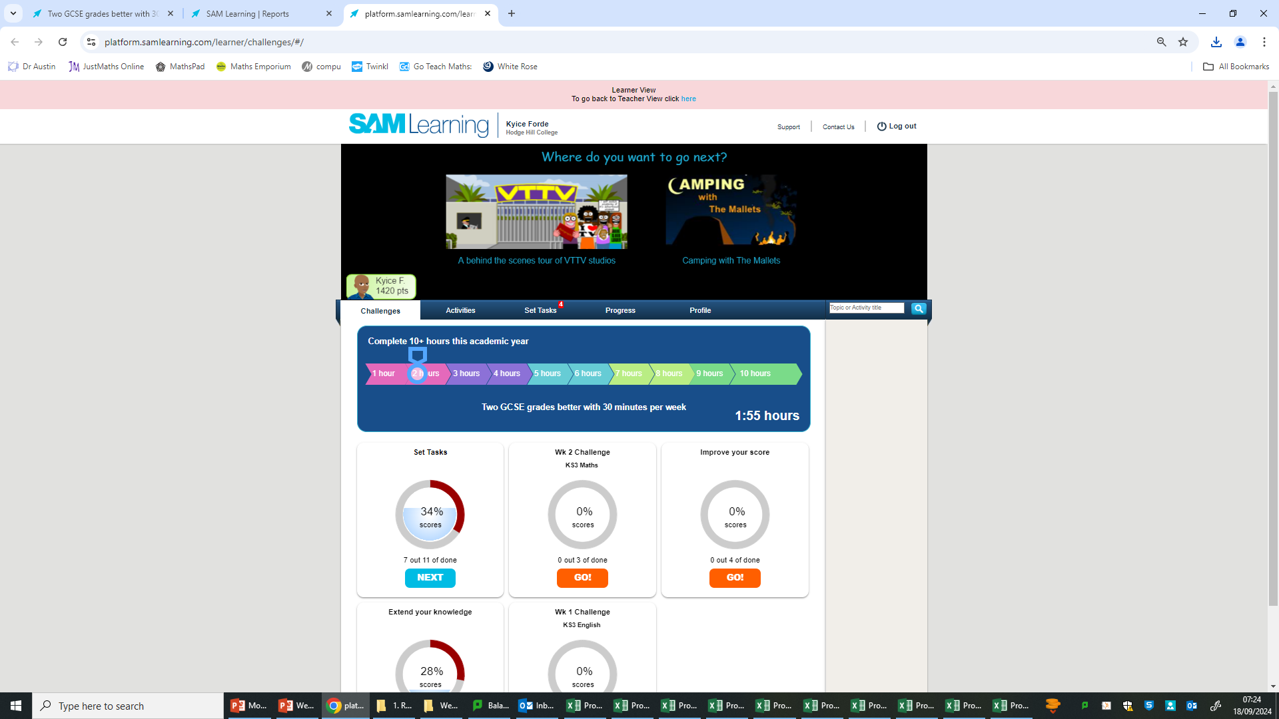
Homework has been set for this week.
Remember to log in and complete your set tasks.
We still use Classcharts for announcements, surveys and revision material
Homework Club every morning in West Canteen from 8am
Library is open before school and at break times
Students on the following slides have not completed ALL tasks
Make sure you are completing the SET TASKS! These are the tasks your teachers have set.
Notes:
Please give time for the students to produce answers for themselves before showing answers.

Slide 3


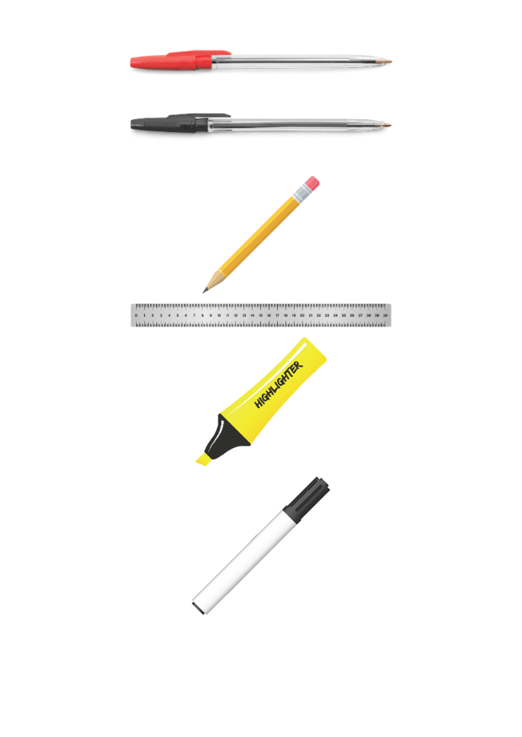


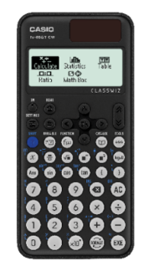


Replacement equipment for your learning wallet can be purchased at the following locations/times:
The following items can be purchased for 10p each (cash only) from West Canteen, East Canteen, the Library, and
LRC (next to W214):
Day | West Canteen | East Canteen | Library or LRC | Library
Monday | 08:00–08:35 | 08:30–08:35 | 10:10– 10:30 11:10–11:30 12:40–13:00 13:40–14:00 | 16:10–16:30
Tuesday | 08:00–08:35 | 08:30–08:35 | 10:10– 10:30 11:10–11:30 12:40–13:00 13:40–14:00 | 15:10–15:30
Wednesday | 08:00–08:35 | 08:30–08:35 | 10:10– 10:30 11:10–11:30 12:40–13:00 13:40–14:00 | 15:10–15:30
Thursday | 08:00–08:35 | 08:30–08:35 | 10:10– 10:30 11:10–11:30 12:40–13:00 13:40–14:00 | 15:10–15:30
Friday | 08:00–08:35 | 08:30–08:35 | 11:10–11:30 12:40–12:30 | 13:40–14:00
The following items can be purchased from West Office using money on your ParentPay:
£1.70
£15.00

Slide 4

Secure your Wellbeing: Learning Journey
What is social media and how should you use it?
What are online trends and should you follow them?
What impact can social media influences have?
What is fake news?
What is hate speech online?
What is fake news?
Today we will look at:
What is fake news?
This includes:
Definition of fake news
Where do you find out news?
Looking at news sources
Please remember that during the lesson we should not be asking any pupil or teacher personal questions.
Your teacher can ask you questions but this will be to check your knowledge in the lesson.

Slide 5

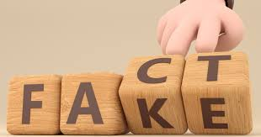

What is fake news?
Fake news is…
“false or misleading information that is spread to deceive people or influence their opinions”

Slide 6

Why are we learning about this?
This links to the Golden Thread of “Secure your Wellbeing”
It is important to understand that fake news can be difficult to spot. Fake news can cause confusion or fear which can impact your mental health as you may start to believe things that are false or have been extremely over exaggerated.

Slide 7
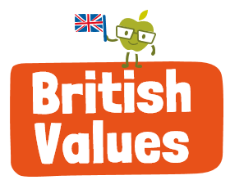
Why are we learning about this?
Rule of Law is a British Value. This means people are expected to follow laws to keep everyone safe. Publications that publish news online are responsible by law (The Online Safety Act 2023) to prevent the publication of certain false information.

Slide 8

Why are we learning about this?
Article 17 of the UN Rights of a Child state that children have the right to get information from a range of sources. The reason for this right is to give a balanced view and to ensure the information is accurate.
UN Rights
of a Child

Slide 9
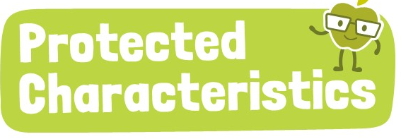
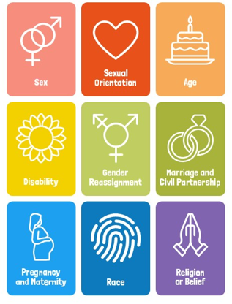
Why are we learning about this?
The Equality Act (2010) sets out 9 Protected Characteristics. No one should be treated differently due to identifying with one or more of the characteristics. Unfortunately, there have been examples of fake news being spread online about people who identify with one or more of the characteristics. This should not happen.

Slide 10

What is Fake News?
Notes:
https://www.youtube.com/watch?v=V4o0B6IDo50 play up to 2:22

Slide 11
What is fake news?
Fake news can appear as:
News articles
Social media posts
Videos
Fake news can be hard to spot as it is designed to look like real news to trick people into believing something that isn’t true

Slide 12
Where do you get your news?
This means people have to be careful where they get their news from.
Common ways of finding out news are:
Written news
TV/radio
Social Media
Friends/Family

Slide 13
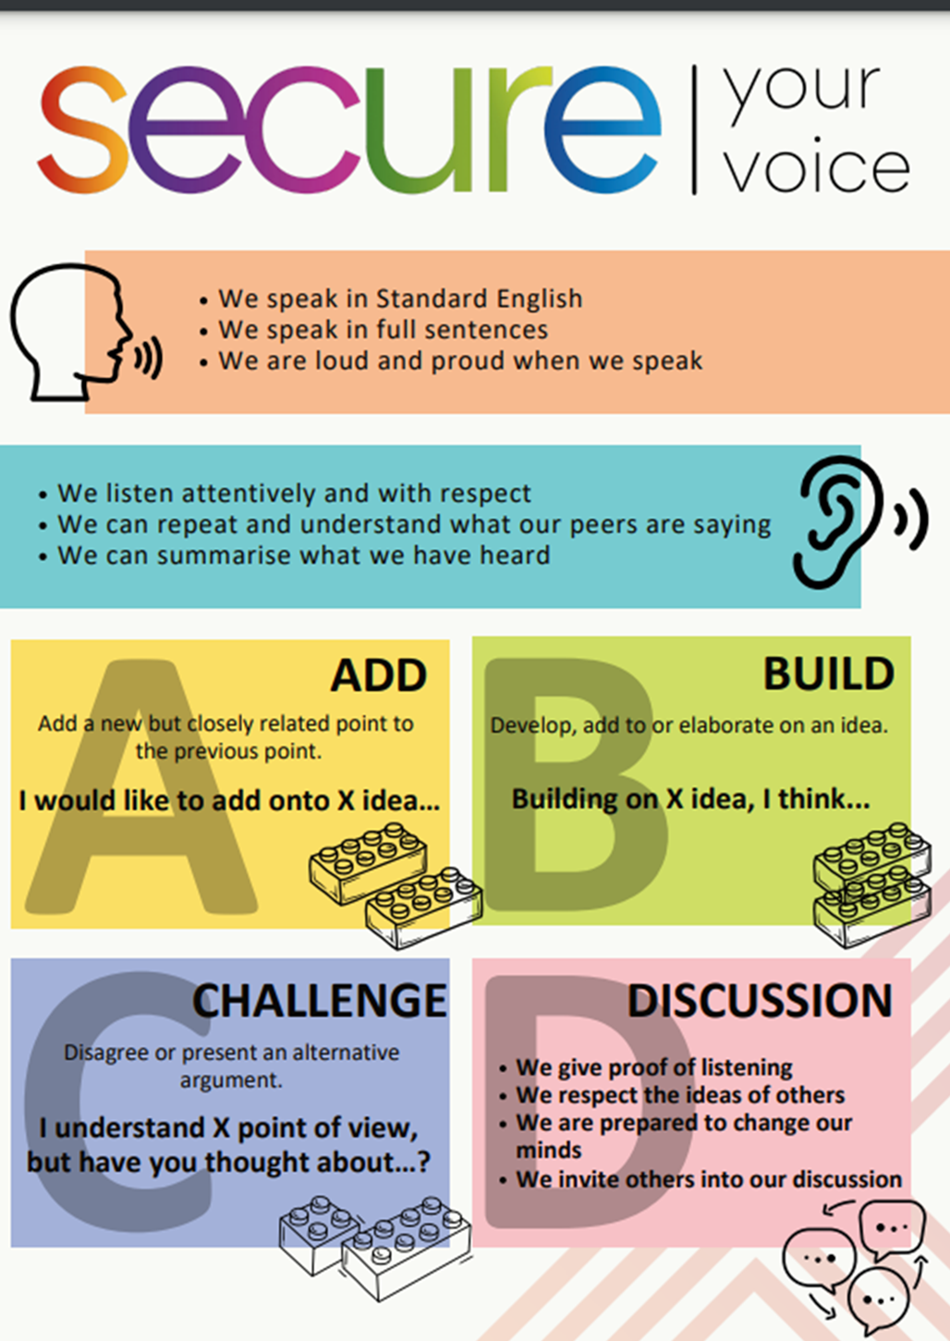
Where do you get news?
You have 1 minute to think about the following question:
“Where do you find out the majority of news?”

Slide 14
Where do you get news?
Using your oracy helpsheet, with the person next to you, discuss your response to the question:
“Where do you find out the majority of news?”
Remember to use the sentence starters to add, build or challenge what your partner has said.
Be ready to share your discussion with the class

Slide 15
Where do you get news?
You have 1 minute to think about the following question:
“Why do you like using the news source you chose? Do you think the news source has any limitations?”

Slide 16
Where do you get news?
Using your oracy helpsheet, with the person next to you, discuss your response to the question:
“Why do you like using the news source you chose? Do you think the news source has any limitations?”
Remember to use the sentence starters to add, build or challenge what your partner has said.
Be ready to share your discussion with the class

Slide 17
Where do you get news?
You have 1 minute to think about the following question:
“Do you think your news source is the most reliable? If no what is the most reliable news source?”

Slide 18
Where do you get news?
Using your oracy helpsheet, with the person next to you, discuss your response to the question:
“Do you think your news source is the most reliable? If no what is the most reliable news source?”
Remember to use the sentence starters to add, build or challenge what your partner has said.
Be ready to share your discussion with the class

Slide 19
Where do you get news?
You have 1 minute to think about the following question:
“What news source do you think has the greatest global reach? Why is this is important to know when looking out for fake news?”

Slide 20
Where do you get news?
Using your oracy helpsheet, with the person next to you, discuss your response to the question:
“What news source do you think has the greatest global reach? Why is this is important to know when looking out for fake news?”
Remember to use the sentence starters to add, build or challenge what your partner has said.
Be ready to share your discussion with the class

Slide 21
What is fake news?
You will be learning more about fake news in your Personal Development lesson this week.
Until then, think about where you access news. Do you think any news you read/watch is fake? What makes it real or fake?

Slide 22



Support
If you ever need support about something you think is fake news that could be harmful for yourself, a friend or family member you can find it here:
Childline.org.uk
Call – 08001111
Email or chat online for support
Themix.org.uk
You can email or have one-to-chat online.
There is also a crisis messenger which is available 24/7

