Slide 1





Write the date: 14 April 2025
Write the Title and Golden Thread
Title – Social Media
Golden Thread – Secure Your Wellbeing
Underline both using your ruler & take out your oracy helpsheet
Complete the following questions:
What is being described: ““sharing information online such as text, image or video with other people”
True or False: “gender identity and sexual orientation are the same thing”
Give an example of a committed relationship
Sharing online
False
Marriage, civil partnership, cohabiting

Slide 2
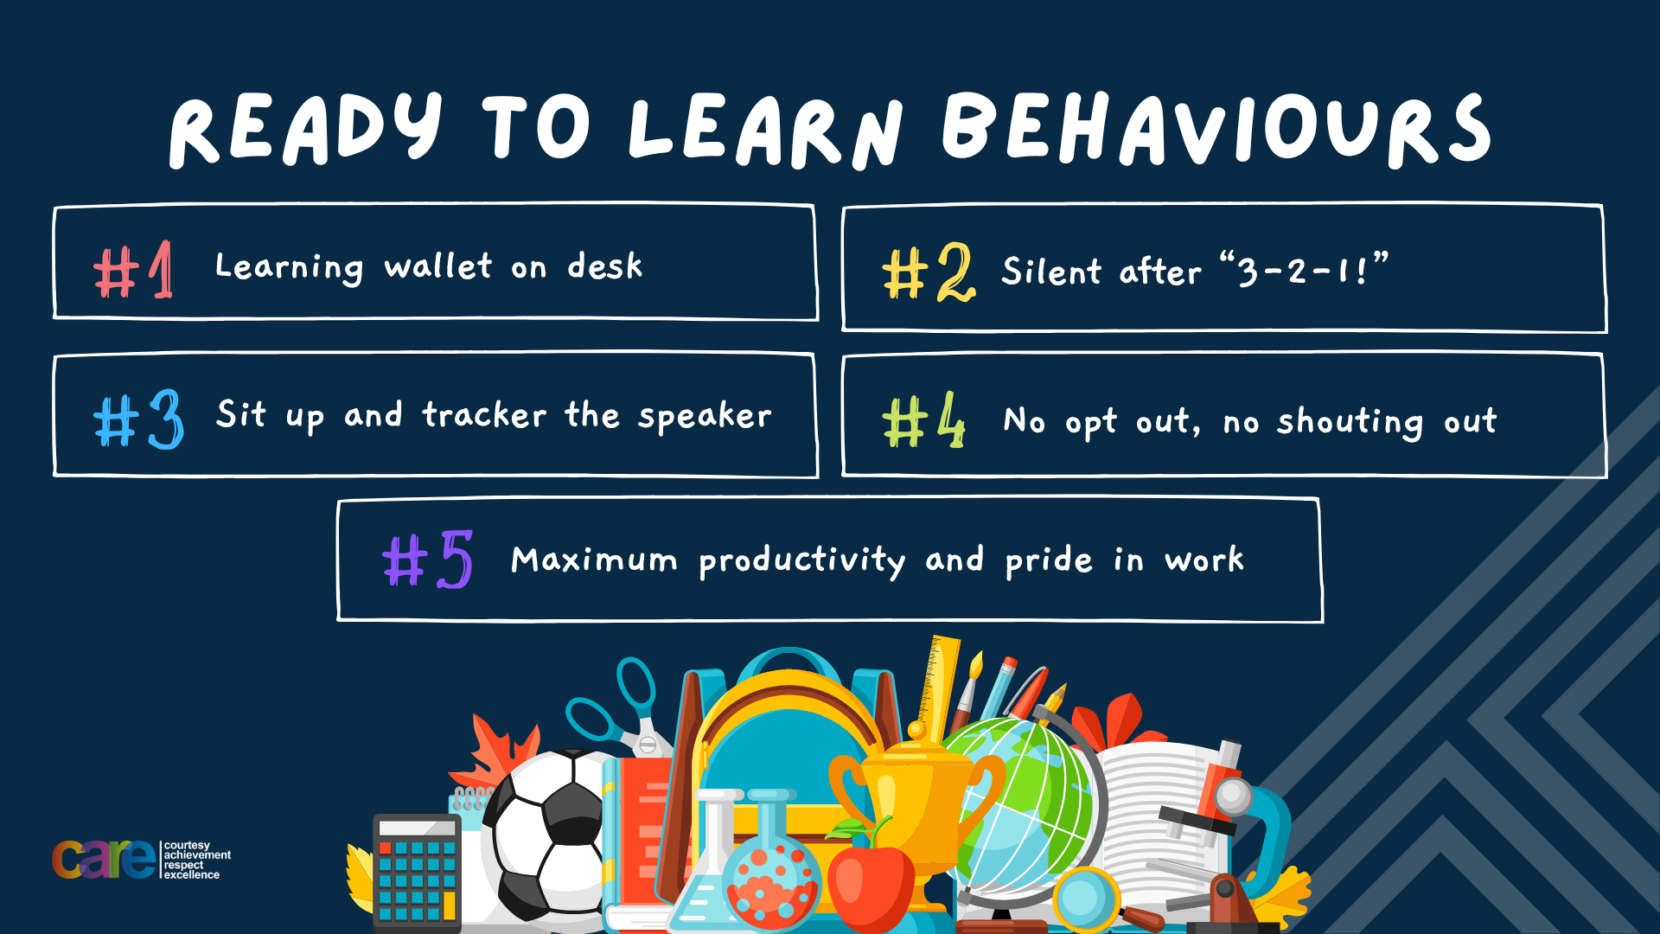

Slide 3


Secure your Relationships: Learning Journey
What does a healthy relationship look like
What does an unhealthy relationship look like?
What are romantic relationships?
Different types of committed relationships
What is gender identity and sexual orientation?
What are appropriate/ inappropriate images to send?
Today we will look at:
What are appropriate/inappropriate images to send online?
This includes:
Why people send images
Thoughts and feeling around images been shared
The law around sending inappropriate images
Please remember that during the lesson we should not be asking any pupil or teacher personal questions.
Your teacher can ask you questions but this will be to check your knowledge in the lesson.

Slide 4

Tutor Time Recap
In your Personal Development Tutor Time activity, you started to look at sharing data online
In your books answer the following question:
“What is the definition of social media?”
Sentence starters – “social media is…”

Slide 5
Tutor Time Recap
Social Media is…
“a way people use the internet to share ideas, photos, videos and communicate with others.”
Task – use your red pen to add to the definition you had written down.

Slide 6


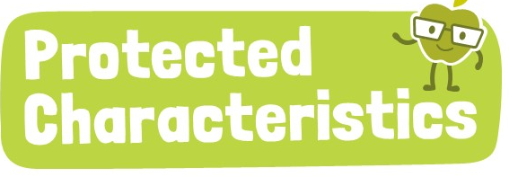
Tutor Time Recap
We are learning this because:
Links to the Golden Thread of “Secure your Wellbeing”. Social media can impact mental health if not used correctly.
Rule of Law is a British Value. Laws apply online as well as offline.
Article 3 states that governments should make decisions that are best for children. This includes age limits for children using social media.
The Protected Characteristics have to be respected on social media as well as in real life.
UN Rights
of a Child

Slide 7
The Law around Social Media
In the UK, most social media platforms require users to be at least 13 years old.
This is due to the UK’s Data Protection Laws which protect children’s personal information online

Slide 8
The Law around Social Media
Other reasons for the age restrictions is due to online safety.
Inappropriate content can be easily accessed online. Age restrictions on social media are designed to stop children from accessing content that is inappropriate for their age.

Slide 9
The Law around Social Media
One other reason is that social media is linked to poor mental health in young people.
Social media can impact mental health of a young person due to:
Feeling pressure to look like others on social media
Comparison to other people’s lifestyles
FOMO

Slide 10
Hinge Questions – whiteboard activity
3
Rules!
I will ask the question and give you some thinking time. (no more than 10 seconds)
Write the answer and turn your whiteboard over so nobody can see it.
When I am ready I will put on the 3 to 1 counter.
When ‘Show me’ appears on the board you must hold up your whiteboard (even if you don’t know the answer and there is nothing on your board)
2
1
Show me!
(even if your whiteboard is blank)

Slide 11
Hinge Questions – whiteboard activity
What is being described?
“a way people use the internet to share ideas, photos, videos and communicate with others.”
Social Media

Slide 12

Hinge Questions – whiteboard activity
What golden thread does today’s lesson link to?
A – Secure your Future
B – Secure your Wellbeing
C – Secure your Relationships
D – Secure your Voice

Slide 13
Hinge Questions – whiteboard activity
True or False
“The age restriction for many social media platforms is at least 13 years old”
A – True
B – False

Slide 14
Hinge Questions – whiteboard activity
True or False
“The age restriction is in place to protect young peoples data, stop them from accessing inappropriate content and to protect their mental health”
A – True
B – False

Slide 15
Task
Complete the following sentences
The age restriction for many social media platforms is…
One reason for this is…

Slide 16
Social Media ban
Australia announced this year that they are going to ban under 16 year olds from using social media.
The next video will tell you more about this story.

Slide 17

Social Media ban
Notes:
https://www.youtube.com/watch?v=EO3XbmqdkU0

Slide 18

Social Media Ban
Task
In the margin write “SYV” – this stands for “Secure Your Voice”
Highlight “SYV”
In your books answer the following question:
  Do you agree or disagree with Australia’s decision? Why?
Sentence starter – “I agree/disagree with the decision because…

Slide 19
Staying safe on Social Media
As you will be turning 13 years old this academic year you will, be law, all able to access social media.
However it is important to know how to stay safe on social media.

Slide 20
Staying safe on Social Media
Rules to follow on social media:
Do not share personal information – this includes your school and school uniform
Only accept requests from people you know
Make sure your profile is private
Think before you post – it is hard to permanently delete anything online

Slide 21
Staying safe on Social Media
Rules to follow on social media:
Do not share personal information – this includes your school and school uniform
Only accept requests from people you know
Make sure your profile is private
Think before you post – it is hard to permanently delete anything online
Task
In the margin write “SYV” – this stands for “Secure Your Voice”
Highlight “SYV”
In your books answer write down the rules to follow on social media in order of most importance

Slide 22

Rules to follow on social media
Using your oracy helpsheet, discuss with the person next to you discuss the question:
  “What rule do you think is most important to follow on social media”
Remember to use the sentence starters to add, build or challenge what your partner has said.
Be ready to share your discussion with the class

Slide 23
The Good Side of Social Media
Although there are many dangers and things to be aware of when using social media, there is also a good side of social media.

Slide 24
The Good Side of Social Media
These include:
Staying in touch with family and friends who do not live near you
Learning new skills due to the educational content on social media
Express creativity through making own videos
Spreading positivity through fundraising for charities or motivational content. In 2022 over £151 million was raised for UK charities.

Slide 25
The Good Side of Social Media
These include:
Staying in touch with family and friends who do not live near you
Learning new skills due to the educational content on social media
Express creativity through making own videos
Spreading positivity through fundraising for charities or motivational content. In 2022 over £151 million was raised for UK charities.
Task
In the margin write “SYV” – this stands for “Secure Your Voice”
Highlight “SYV”
In your books answer write down one reason why social media can be good.

Slide 26
Good Side of Social Media
Using your oracy helpsheet, discuss with the person next to you discuss the question:
  “What do you think is the best thing that can happen on social media?”
Remember to use the sentence starters to add, build or challenge what your partner has said.
Be ready to share your discussion with the class

Slide 27
Scenario
Simon gets a friend request from someone they don’t recognise. They have no mutual friends, but their profile picture looks like they’re about your age. Simon is unsure what to do.
Task
In the margin write “SYV” – this stands for “Secure Your Voice”
Highlight “SYV”
In your books complete the following sentence:
“My advice to Simon is…”

Slide 28
Scenario
Using your oracy helpsheet, discuss with the person next to you discuss the question:
  “What advice did you give Simon?”
Remember to use the sentence starters to add, build or challenge what your partner has said.
Be ready to share your discussion with the class

Slide 29
Scenario
Ella is excited about their birthday party and post a picture of their invitation online, including the time, date, and their home address. Lots of her friends like the post, but someone they don’t know also comments asking if they can come
Task
In the margin write “SYV” – this stands for “Secure Your Voice”
Highlight “SYV”
In your books complete the following sentence:
“My advice to Ella is…”

Slide 30
Scenario
Using your oracy helpsheet, discuss with the person next to you discuss the question:
  “What advice did you give Ella?”
Remember to use the sentence starters to add, build or challenge what your partner has said.
Be ready to share your discussion with the class

Slide 31



Support
If you ever need support about social media for yourself, a friend or family member it can be found here:
Childline.org.uk
Call – 08001111
Email or chat online for support
Themix.org.uk
You can email or have one-to-chat online.
There is also a crisis messenger which is available 24/7

Slide 32


