Slide 1





Write the date: 14 April 2025
Write the Title and Golden Thread
Title – appropriate and inappropriate content to share online
Golden Thread – Secure Your Relationships
Underline both using your ruler & take out your oracy helpsheet
Complete the following questions:
What is being described: “the inner experience of gender”
True or False: “Marriage and civil partnerships are the same thing”
What 2 words differentiate a romantic relationship and a friendship
Gender identity
False
Intimate and attraction

Slide 2
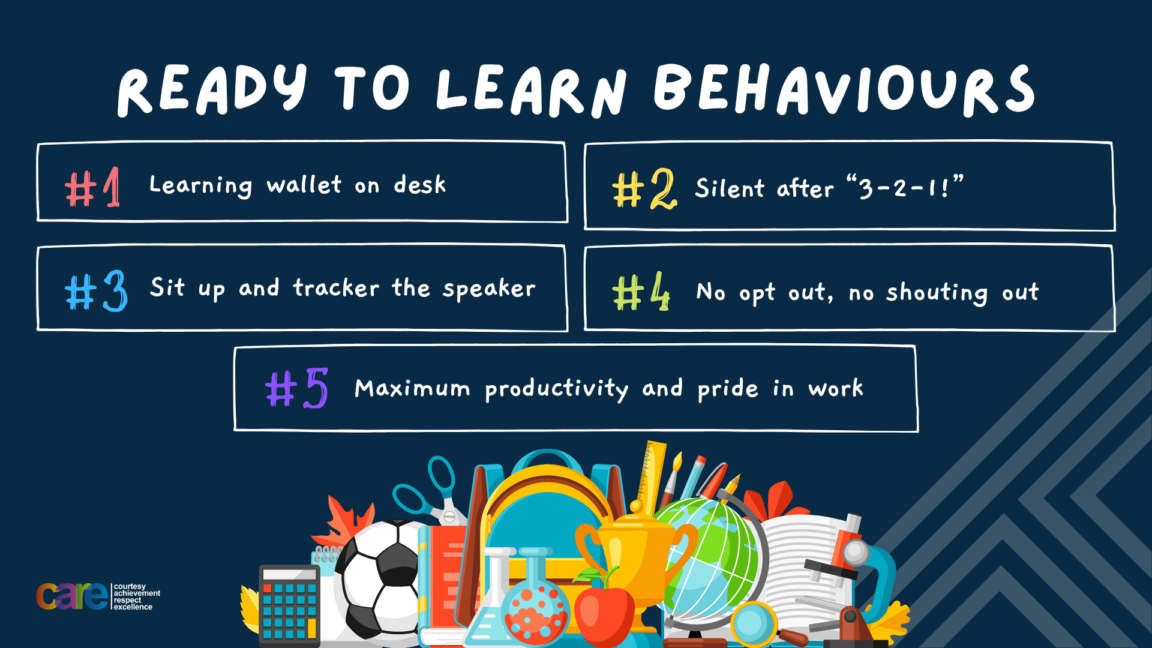

Slide 3


Secure your Relationships: Learning Journey
What does a healthy relationship look like
What does an unhealthy relationship look like?
What are romantic relationships?
Different types of committed relationships
What is gender identity and sexual orientation?
What are appropriate/ inappropriate images to send?
Today we will look at:
What are appropriate/inappropriate images to send online?
This includes:
Why people send images
Thoughts and feeling around images been shared
The law around sending inappropriate images
Please remember that during the lesson we should not be asking any pupil or teacher personal questions.
Your teacher can ask you questions but this will be to check your knowledge in the lesson.

Slide 4

Tutor Time Recap
In your Personal Development Tutor Time activity, you started to look at sharing data online
In your books answer the following question:
“What is the definition of sharing online?”
Sentence starters – “sharing online is…”

Slide 5
Tutor Time Recap
Sharing online is…
“sharing information online such as text, image or video with other people”
Task – use your red pen to add to the definition you had written down.

Slide 6
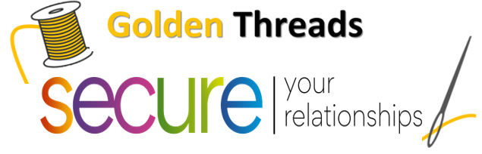

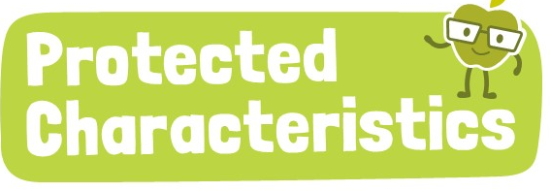
Tutor Time Recap
We are learning this because:
Links to the Golden Thread of “Secure your relationships”. It is important to know about why content is shared and why people ask for content
Rule of Law is a British Value. There are laws around what type of content involving children can be shared online. This also applied to content children share too.
Regardless of content that is shared online, no one should be treated any differently if the content relates to one of the protected characteristics outlined in The Equality Act 2010.

Slide 7
Research about image sharing
Research shows that globally:
61,400 photos are taken every second
3.7 million photos are taken every minute
221 million photos are taken every hour
5.3 billion photos are taken every day
161.5 billion photos are taken every month
Many of these images are shared via social media, including private WhatsApp messages.

Slide 8
Sharing Images
Sharing images and videos is a big part of using social media.
People can share images for many different reasons.
It is important to consider the following things:
Who is the image being sent to?
Why does that person want the image?
What will happen next to the image?
If other people are in the image, have they agreed to it being shared?

Slide 9
Sharing Images
We are now going to look at different scenarios of images being shared.
For each scenario you must decide if the image should be shared or not.
You will write your answer down on your whiteboard before discussing with the class

Slide 10
Sharing Images
Should the images be shared or not shared in the scenarios below?
“a picture of someone in their pyjamas”
“A group photo of friends”
“someone doing a dance routine in their bedroom”

Slide 11

Sharing content
Using your oracy helpsheet, discuss with the person next to you if you thought the content in each scenario should be shared or not.
Remember to use the sentence starters to add, build or challenge what your partner has said.
Be ready to share your discussion with the class

Slide 12
Sharing Images
From your first decision, you will now learn more about context about each scenario. Now consider if you would change your mind about sharing or not sharing the image
“Grandparents have asked for a picture of their grandchild in their pyjamas”
“Most of the friends want to see the picture as it will be funny”
“The dance routine is being live streamed to a fans page of people the person does not know but everyone on the page has an interest in dance”

Slide 13
Sharing content
Using your oracy helpsheet, discuss with the person next to you if you thought the content in each scenario should be shared or not. Have you changed your mind on any scenario?
Remember to use the sentence starters to add, build or challenge what your partner has said.
Be ready to share your discussion with the class

Slide 14
Sharing Images
Now you will get even more context to each scenario about what happens to the images after they have been shared. If the person knew this would they have shared the image or not”
“even though the felt shy in the photo, they shared it with their grandparents. Without the person knowing, the grandparents showed the picture to their friends the next day”
“the one friend who didn’t want the image shared, changes their mind. It is shared into a private group chat and the image is deleted afterwards”
“the person continued to live stream and change the location of the camera. This showed their school blazer and lots of other things in their bedroom”

Slide 15
Sharing content
Using your oracy helpsheet, discuss with the person next to you if you thought the content in each scenario should be shared or not. Have you changed your mind on any scenario?
Remember to use the sentence starters to add, build or challenge what your partner has said.
Be ready to share your discussion with the class

Slide 16
Sharing Images
It is only appropriate to send images or videos if:
The person sending the images knows who it is being sent to.
The person or people in the photo are happy for the image to be shared
The person knows why the image is going to be sent and how that image will be used
The image does not show any personal information
Task
In the margin write “SYV” – this stands for “Secure Your Voice”
Highlight “SYV”
In your books write down these reasons in order of most importance to you

Slide 17
Hinge Questions – whiteboard activity
3
Rules!
I will ask the question and give you some thinking time. (no more than 10 seconds)
Write the answer and turn your whiteboard over so nobody can see it.
When I am ready I will put on the 3 to 1 counter.
When ‘Show me’ appears on the board you must hold up your whiteboard (even if you don’t know the answer and there is nothing on your board)
2
1
Show me!
(even if your whiteboard is blank)

Slide 18
Hinge Questions – whiteboard activity
What is being described?
“sharing information online such as text, image or video with other people”
Sharing Online

Slide 19

Hinge Questions – whiteboard activity
What golden thread does today’s lesson link to?
A – Secure your Future
B – Secure your Wellbeing
C – Secure your Relationships
D – Secure your Voice

Slide 20
Hinge Questions – whiteboard activity
Should the following image be shared online?
“An image of someone at a wedding. It is shared with a hashtag so anyone can access the image. The person in the image did not know they were in the photo”
A – Yes
B – No

Slide 21
Being asked to share images
There may be times that people are asked to share images or videos of themselves.
One example of this is:
What do you think a “flirty photo” means?
“Hey, Send me a flirty photo of yourself”

Slide 22
Sexting and the Law
This means the following statements are all illegal
Taking a nude, semi nude or suggestive picture of yourself if you are under 18
Sending a nude, semi nude or suggestive picture of yourself to someone if you or the other person is under 18
Have a nude, semi nude or suggestive photo of someone who is U18 saved on your phone even if they sent it to you of their own accord
Show or share a nude, semi nude or suggestive image of someone under 18 to another person.

Slide 23
Hinge Questions – whiteboard activity
3
Rules!
I will ask the question and give you some thinking time. (no more than 10 seconds)
Write the answer and turn your whiteboard over so nobody can see it.
When I am ready I will put on the 3 to 1 counter.
When ‘Show me’ appears on the board you must hold up your whiteboard (even if you don’t know the answer and there is nothing on your board)
2
1
Show me!
(even if your whiteboard is blank)

Slide 24
Hinge Questions – whiteboard activity
Legal or Illegal?
“an adult sending a nude, semi nude or suggestive picture of themselves”
A – Legal
B – Illegal

Slide 25
Hinge Questions – whiteboard activity
Legal or Illegal?
“a person under 18 sending a nude, semi nude or suggestive picture of themselves”
A – Legal
B – Illegal

Slide 26
Hinge Questions – whiteboard activity
Legal or Illegal?
“a person under 18 sending a nude, semi nude or suggestive picture of themselves to another person who is under 18”
A – Legal
B – Illegal

Slide 27
Hinge Questions – whiteboard activity
Legal or Illegal?
“any person having a nude, semi nude or suggestive picture of someone under 18 even if they did not ask for it to be sent to them”
A – Legal
B – Illegal

Slide 28
Hinge Questions – whiteboard activity
Legal or Illegal?
“an adult shows a nude, semi nude or suggestive picture of someone under 18 to another person”
A – Legal
B – Illegal

Slide 29
Scenario
Mia is excited about her school art project and takes a photo of her completed painting. She shares it on a class social media group, making sure no personal details are visible and her work is the focus.
Task
In the margin write “SYV” – this stands for “Secure Your Voice”
Highlight “SYV”
In your books answer the following question:
  Should Mia have shared this content?

Slide 30
Sharing content
Using your oracy helpsheet, discuss with the person next to you discuss the question:
  “Should Mia have shared this content?”
Remember to use the sentence starters to add, build or challenge what your partner has said.
Be ready to share your discussion with the class

Slide 31
Scenario
James is 13 years old and he has been messaging a girl in his class. One night James receives an picture from the girl standing in her underwear.
Task
In the margin write “SYV” – this stands for “Secure Your Voice”
Highlight “SYV”
In your books answer the following question:
  Should the girl have sent the image?
  Why should James delete the image?

Slide 32
Sharing content
Using your oracy helpsheet, discuss with the person next to you discuss the questions:
“should the girl have sent the image? Why should James delete the image?”
Remember to use the sentence starters to add, build or challenge what your partner has said.
Be ready to share your discussion with the class

Slide 33



Support
If you ever need support about images that have been sent or that have been received you can get support from:
Childline.org.uk
Call – 08001111
Email or chat online for support
Themix.org.uk
You can email or have one-to-chat online.
There is also a crisis messenger which is available 24/7

Slide 34


