Slide 1
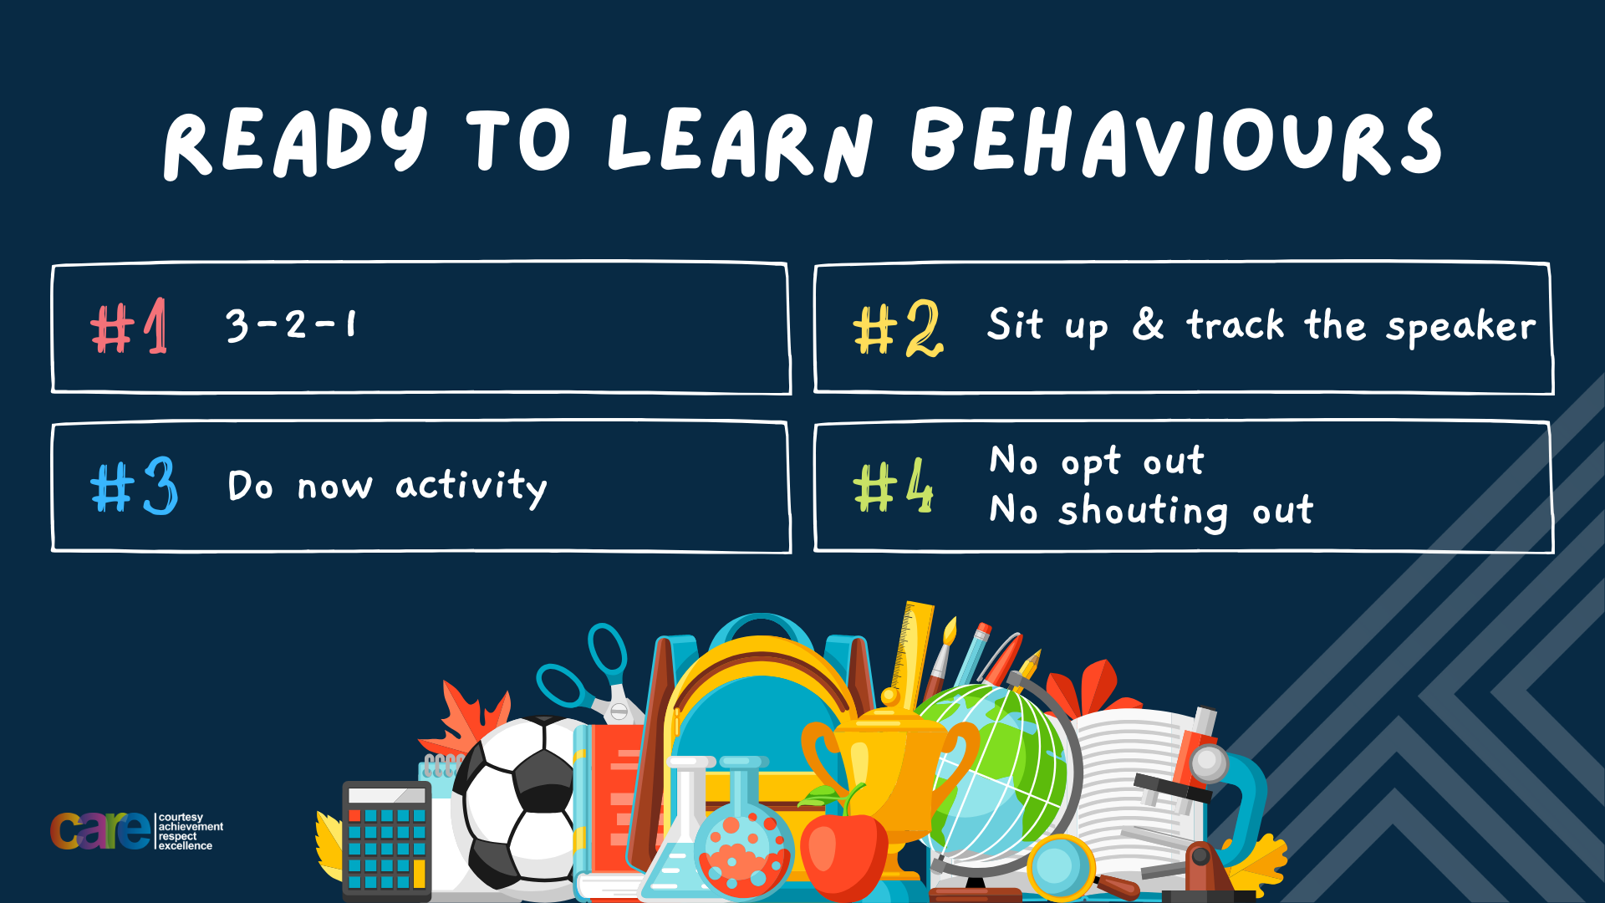

Slide 2





Write the date: 14 April 2025
Write the Title and Golden Thread
Title – Different types of committed relationships
Golden Thread – Secure Your Relationships
Underline both using your ruler & take out your oracy helpsheet
Complete the following questions:
What is being described: “any relationship between people with a desire to be intimate with each other. Both parties must feel an attraction to each other”
Give an example of a positive reason to be in a romantic relationship
Give one characteristic of a healthy relationship
Romantic relationships
Physically attracted to each other, enjoy being with each other, have fun together, enjoy doing things together
Communication, respect, best interests, trust, equality and honesty

Slide 3


Secure your Relationships: Learning Journey
What does a healthy relationship look like
What does an unhealthy relationship look like?
What are romantic relationships?
Different types of committed relationships
What is gender identity and sexual orientation?
What are appropriate/ inappropriate images to send?
Today we will look at:
What are different types of committed relationships
This includes:
Definition of committed relationships
Different types of committed relationships
Please remember that during the lesson we should not be asking any pupil or teacher personal questions.
Your teacher can ask you questions but this will be to check your knowledge in the lesson.

Slide 4
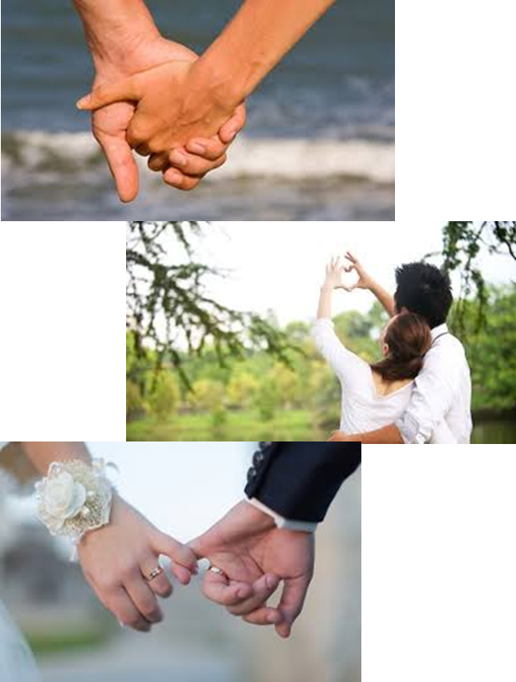
Tutor Time Recap
In your Personal Development Tutor Time activity, you started to look at committed relationships.
In your books answer the following question:
“What is a committed relationship?”
Sentence starter – “a committed relationship is…”

Slide 5
Tutor Time Recap
Committed relationships are:
“a serious and lasting romantic relationship with someone”
Task – use your red pen to add to the definition you had written down.

Slide 6
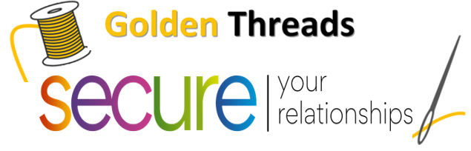

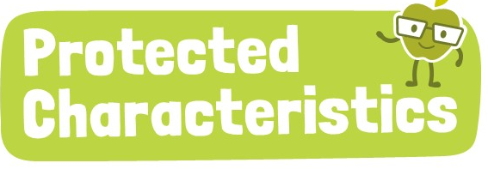
Tutor Time Recap
We are learning this because:
Links to the Golden Thread of “Secure your relationships”. It is important to know what type of committed relationship suits you in the future
Rule of law is a British Value. There are lots of laws around committed relationships to protect the people in the relationship
Sexual orientation and marriage and civil partnerships are protected characteristics and no one should be treated differently for identifying with them.

Slide 7
Types of committed relationships
Three types of committed relationships are:
Marriage
Cohabiting
Civil Partnership

Slide 8
Types of committed relationships
With the person next to you, match up the type of committed relationship with the defintion
Marriage
Cohabiting
Civil Partnership
An arrangement where two people are not married but live together
Legally recognised union with rights similar to those of marriage
Legally recognised union of two people as partners in a personal relationship

Slide 9
What is the difference between marriage and civil partnership?
Marriage and civil partnerships provide similar legal rights for the people in the relationship.
Marriage is formed by vows whereas a civil partnership is formed through signing a document.

Slide 10
What is the difference between marriage and civil partnership?
Civil partnerships were introduced to provide legal recognition and protection for same sex couples as previously same sex couples were not allowed to get married.
The law has since changed and same sex couples can choose whether they wish to get married or form a civil partnership.
Opposite sex couples can also choose between marriage and civil partnership

Slide 11
Hinge Questions – whiteboard activity
3
Rules!
I will ask the question and give you some thinking time. (no more than 10 seconds)
Write the answer and turn your whiteboard over so nobody can see it.
When I am ready I will put on the 3 to 1 counter.
When ‘Show me’ appears on the board you must hold up your whiteboard (even if you don’t know the answer and there is nothing on your board)
2
1
Show me!
(even if your whiteboard is blank)

Slide 12
Hinge Questions – whiteboard activity
What is being described?
“a serious and lasting romantic relationship with someone”
Committed relationships

Slide 13

Hinge Questions – whiteboard activity
What golden thread does today’s lesson link to?
A – Secure your Future
B – Secure your Wellbeing
C – Secure your Relationships
D – Secure your Voice

Slide 14
Hinge Questions – whiteboard activity
What type of committed relationship is being described?
“An arrangement where two people are not married but live together”
A – Marriage
B – Civil Partnership
C - Cohabiting

Slide 15
Hinge Questions – whiteboard activity
What type of committed relationship is being described?
“Legally recognised union with rights similar to those of marriage”
A – Marriage
B – Civil Partnership
C - Cohabiting

Slide 16
Hinge Questions – whiteboard activity
True or False
“Marriage and Civil Partnerships are the same thing”
A – True
B – False

Slide 17
Hinge Questions – whiteboard activity
True or False
“Marriage is formed through vows and civil partnerships are formed by signing a document”
A – True
B – False

Slide 18
Hinge Questions – whiteboard activity
True or False
“Both opposite and same sex couple can get married or form a civil partnership”
A – True
B – False

Slide 19
Complete the sentences
Marriage is a legally recognised _______ between 2 people and formed through ______.
Civil partnerships are similar to a ________ but formed through signing a ________.
__________ sex and _________ sex couples can get married or form a civil partnership.
Alternatively, couples can just live together. This is called __________
Task
In your books complete the sentences and fill in the blanks using the word bank below:
Cohabiting
Union
Same
Marriage
Document
Vows
Opposite

Slide 20
Complete the sentences
Marriage is a legally recognised _______ between 2 people and formed through ______.
Civil partnerships are similar to a ________ but formed through signing a ________.
__________ sex and _________ sex couples can get married or form a civil partnership.
Alternatively, couples can just live together. This is called __________
Task
Use your red pen to mark your answers or write in the correct missing word
Union
vows
marriage
document
Same
opposite
cohabiting

Slide 21

Types of committed relationships
Think about the following question and complete the instructions below:
In the margin write “SYV” – this stands for “Secure Your Voice”
Highlight “SYV”
Answer the following question in your book – “should everyone who is cohabiting should eventually get married or a civil partnership?”

Slide 22
Types of committed relationships
Using your oracy helpsheet, discuss with the person next to you the question:
“should everyone who is cohabiting should eventually get married or a civil partnership?”
Remember to use the sentence starters to add, build or challenge what your partner has said.
Be ready to share your discussion with the class

Slide 23
Ending a committed relationship
Anyone in any type of committed relationship is free to end the relationship at any point.
This means that if they have married their partner they will require a divorce.
If they have formed a civil partnership with their partner they will require a dissolution.
Once a divorce or dissolution happens, people are free to marry or form a civil partnership again.

Slide 24
Blended Families
If a person from a divorced marriage or a dissolved civil partnership has children and starts another committed relationship, this could lead to a blended family.

Slide 25
Blended Family
A blended family is…
“a family formed when a couple moves in together, bringing children from previous relationships into one home”

Slide 26
Blended Family
An example of this is:
“Sophie is divorced with 2 children who live with her. She has asked her partner George to move in with her. George also has a child. This will mean Sophie and George with live with each other and all three children.”

Slide 27
Hinge Questions – whiteboard activity
3
Rules!
I will ask the question and give you some thinking time. (no more than 10 seconds)
Write the answer and turn your whiteboard over so nobody can see it.
When I am ready I will put on the 3 to 1 counter.
When ‘Show me’ appears on the board you must hold up your whiteboard (even if you don’t know the answer and there is nothing on your board)
2
1
Show me!
(even if your whiteboard is blank)

Slide 28
Hinge Questions – whiteboard activity
True or False
“Marriage and civil partnerships cannot be ended”
A – True
B – False

Slide 29
Hinge Questions – whiteboard activity
True or False
“Marriage ends in divorce”
A – True
B – False

Slide 30
Hinge Questions – whiteboard activity
True or False
“Civil Partnership ends in divorce”
A – True
B – False

Slide 31
Hinge Questions – whiteboard activity
True or False
“People who are divorced or have a dissolved civil partnership can enter into another marriage or civil partnership”
A – True
B – False

Slide 32
Hinge Questions – whiteboard activity
What is being described?
“a family formed when a couple moves in together, bringing children from previous relationships into one home”
Blended Family

Slide 33
Scenarios
Ben and Sam are currently living together and want to know what their options are to legalise their relationship. Sam has previously been married and has 2 children that live with Ben and Sam.
Task
Complete the following steps:
In the margin write “SYV” This stands for “Secure your voice”
Highlight “SYV”
Answer the following questions in your book
What type of committed relationship are Ben and Sam currently in
What options do they have to legalise their relationship
What type of family do they currently have?

Slide 34
Scenario
Using your oracy helpsheet, discuss with the person next to you discuss the answers you have from the previous slide.
Remember to use the sentence starters to add, build or challenge what your partner has said.
Be ready to share your discussion with the class

Slide 35


