Slide 1
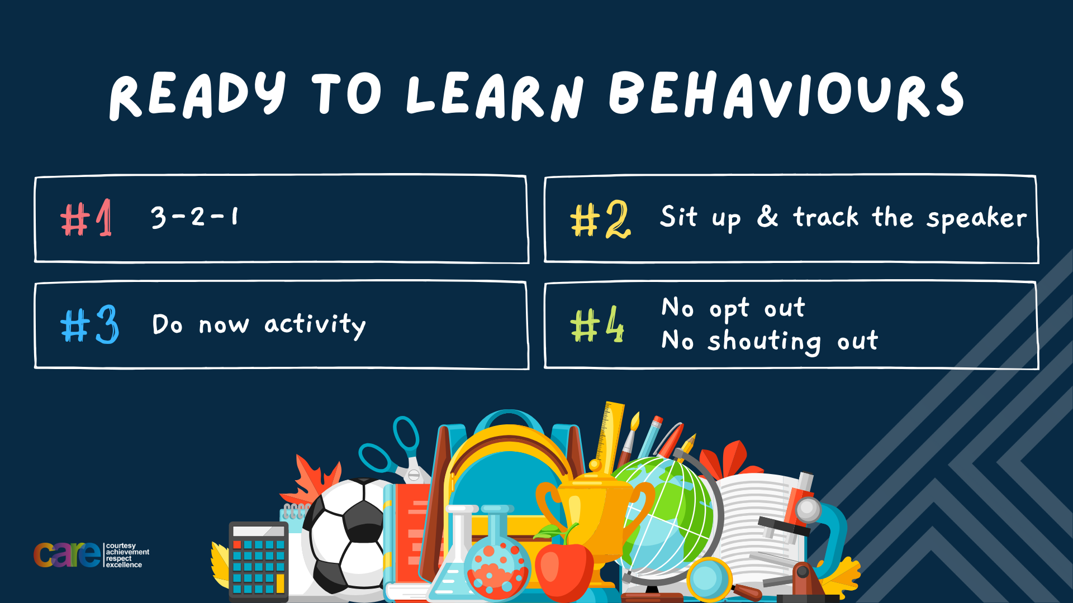

Slide 2








Write the date: 14 April 2025
Write the title: What are romantic relationships?
Underline both with your ruler in your learning wallet. Take out your oracy helpsheet too.
Complete the following questions:
Name 2 characteristics of an unhealthy relationship
Name 2 characteristics of a healthy relationship
If a charity works across different countries it is classed as what type of charity?
Disrespect, control, neglect
Communication, respect, best interests, trust, equality, honesty
International

Slide 3


Secure your Relationships: Learning Journey
What does a healthy relationship look like
What does an unhealthy relationship look like?
What are romantic relationships?
Different types of committed relationships
What is gender identity and sexual orientation?
What are appropriate/ inappropriate images to send?
Today we will look at:
What are romantic relationships?
This includes:
Definition of romantic relationships
Why people want to have romantic relationships
Please remember that during the lesson we should not be asking any pupil or teacher personal questions.
Your teacher can ask you questions but this will be to check your knowledge in the lesson.

Slide 4

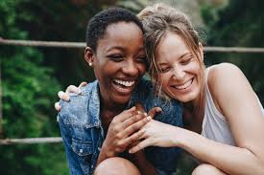

Tutor Time Recap
A romantic relationship is…
“any relationship between people with a desire to be intimate with each other. Both parties must feel an attraction to each other”
It is the keywords intimate and attraction that differentiate a romantic relationship and a friendship

Slide 5
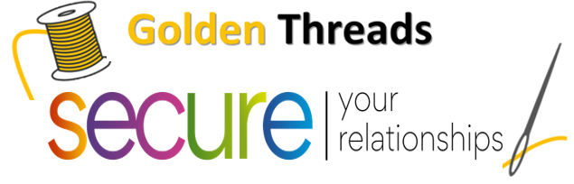
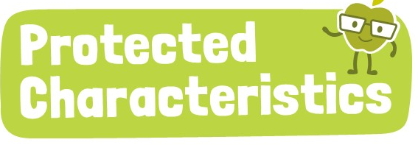
Tutor Time Recap
We are learning this because:
It helps to secure your relationships” as a romantic relationships could be an important part of adult life so it is important to know why people enter romantic relationships and to know if the relationship is healthy
This links to the protected characteristics of sexual orientation and marriage and civil partnership. No one should be treated differently due to who they have a romantic relationship with.

Slide 6

Why people enter a romantic relationship
There are many reasons why people start a romantic relationship.
Some of these are:

Slide 7
Why people enter a romantic relationship
They are physically attracted to the other person
A person likes the attention they get from another person
A person is the only one in the group not in a romantic relationship
People enjoy each others company
People want to be treated like an adult
People have fun together
One person does not want to look like a loser
People enjoy doing things together
A person wants to make their friends jealous

Slide 8
Why people enter a romantic relationship
They are physically attracted to the other person
A person likes the attention they get from another person
A person is the only one in the group not in a romantic relationship
People enjoy each others company
People want to be treated like an adult
People have fun together
One person does not want to look like a loser
People enjoy doing things together
A person wants to make their friends jealous
Task
In your books write down these reasons in rank order starting with the most important to least important
The complete the following sentences:
I think the most important reason is…. And I think this because…..
I think the least important reason is…. And I think this because….

Slide 9

Reasons for entering a romantic relationship
Using your oracy helpsheet, discuss with the person next to you the question:
“What was the most important reason for a person to enter a romantic relationship?”
Remember to use the sentence starters to add, build or challenge what your partner has said.
Be ready to share your discussion with the class

Slide 10
Reasons for entering a romantic relationship
Using your oracy helpsheet, discuss with the person next to you the question:
“What was the least important reason for a person to enter a romantic relationship?”
Remember to use the sentence starters to add, build or challenge what your partner has said.
Be ready to share your discussion with the class

Slide 11
Why people enter a romantic relationship
Regardless of opinion, all of the statements are reasons why people enter romantic relationships.
However some of the statements are positive reasons and some are negative reasons

Slide 12
Why people enter a romantic relationship
Each statement is now going to appear on the board.
On your whiteboard choose one of the following options:
Positive
Negative
Depends

Slide 13
Why people enter a romantic relationship
“They are physically attracted to the other person”
On your whiteboards write either positive, negative or depends
This is positive reason to enter a romantic relationship

Slide 14
Why people enter a romantic relationship
“A person is the only one in the group not in a romantic relationship”
On your whiteboards write either positive, negative or depends
This is negative reason to enter a romantic relationship

Slide 15
Why people enter a romantic relationship
“People have fun together”
On your whiteboards write either positive, negative or depends
This depends on if there is also a physical attraction. If there is no attraction this is a friendship.

Slide 16
Why people enter a romantic relationship
“A person wants to make their friends jealous”
On your whiteboards write either positive, negative or depends
This is a negative reason to enter a romantic relationship

Slide 17
Why people enter a romantic relationship
Romantic relationships should not be entered based on anything negative such as “pressure”/”everyone else is doing it.
People should make the decision to enter a romantic relationship when they feel ready too.
There is no expectation for everyone to be dating just because other people are. This is true for people of any age regardless of being a teenager, in their 30’s or even older.

Slide 18
Hinge Questions – whiteboard activity
3
Rules!
I will ask the question and give you some thinking time. (no more than 10 seconds)
Write the answer and turn your whiteboard over so nobody can see it.
When I am ready I will put on the 3 to 1 counter.
When ‘Show me’ appears on the board you must hold up your whiteboard (even if you don’t know the answer and there is nothing on your board)
2
1
Show me!
(even if your whiteboard is blank)

Slide 19
Hinge Questions – whiteboard activity
What is being described?
“any relationship between people with a desire to be intimate with each other. Both parties must feel an attraction to each other”
Romantic relationships

Slide 20

Hinge Questions – whiteboard activity
What golden thread does today’s lesson link to?
A – Secure your Future
B – Secure your Wellbeing
C – Secure your Relationships
D – Secure your Voice

Slide 21
Hinge Questions – whiteboard activity
True or False
“Romantic relationships and friendships are the same thing?”
A – True
B – False

Slide 22
Hinge Questions – whiteboard activity
True or False
“People should enter a romantic relationship because everyone else is”
A – True
B – False

Slide 23
Hinge Questions – whiteboard activity
True or False
“People should enter a romantic relationship if they are attracted to each other and enjoy being with them”
A – True
B – False

Slide 24
Scenarios
Alex and Jordan met in their school music club. They bonded over their shared love for music and spent time helping each other practice for performances. Over time, Alex realized that Jordan always listened and supported them when they felt stressed. Alex felt understood and valued and decided to ask Jordan to go on a date
Task
In your books answer the following question:
What makes Alex and Jordan’s relationship a positive example of people entering a romantic relationship?

Slide 25
Scenario
Using your oracy helpsheet, discuss with the person next to you the question:
“What makes Alex and Jordan’s relationship a positive example of people entering a romantic relationship?”
Remember to use the sentence starters to add, build or challenge what your partner has said.
Be ready to share your discussion with the class

Slide 26
Scenarios
Emma’s friends often teased her about being the only one in their group without a boyfriend. Feeling left out, she started dating Liam, even though she didn’t feel a real connection. Emma wasn’t happy in the relationship but stayed because she feared her friends would judge her.
Task
In your books answer the following question:
Why is this an example of a negative reason to enter a romantic relationship?

Slide 27
Scenario
Using your oracy helpsheet, discuss with the person next to you the question:
“Why is this an example of a negative reason to enter a romantic relationship?”
Remember to use the sentence starters to add, build or challenge what your partner has said.
Be ready to share your discussion with the class

Slide 28
Scenarios
Ben started dating Mia because she was one of the most popular students in school. He thought being seen with her would make him more liked by others. However, Ben didn’t feel comfortable being himself around Mia and often acted differently to impress her friends.
Task
In your books answer the following question:
Is this an example of a person entering a romantic relationship for a positive or negative reason? Explain your answer.

Slide 29
Scenario
Using your oracy helpsheet, discuss with the person next to you the question:
“Is this an example of a person entering a romantic relationship for a positive or negative reason?”
Remember to use the sentence starters to add, build or challenge what your partner has said.
Be ready to share your discussion with the class

Slide 30



Types of abuse
If you need any support about romantic relationships for yourself, a friend or family member there is support out there for you
Childline.org.uk
Call – 08001111
Email or chat online for support
Themix.org.uk
You can email or have one-to-chat online.
There is also a crisis messenger which is available 24/7

Slide 31


