Slide 1
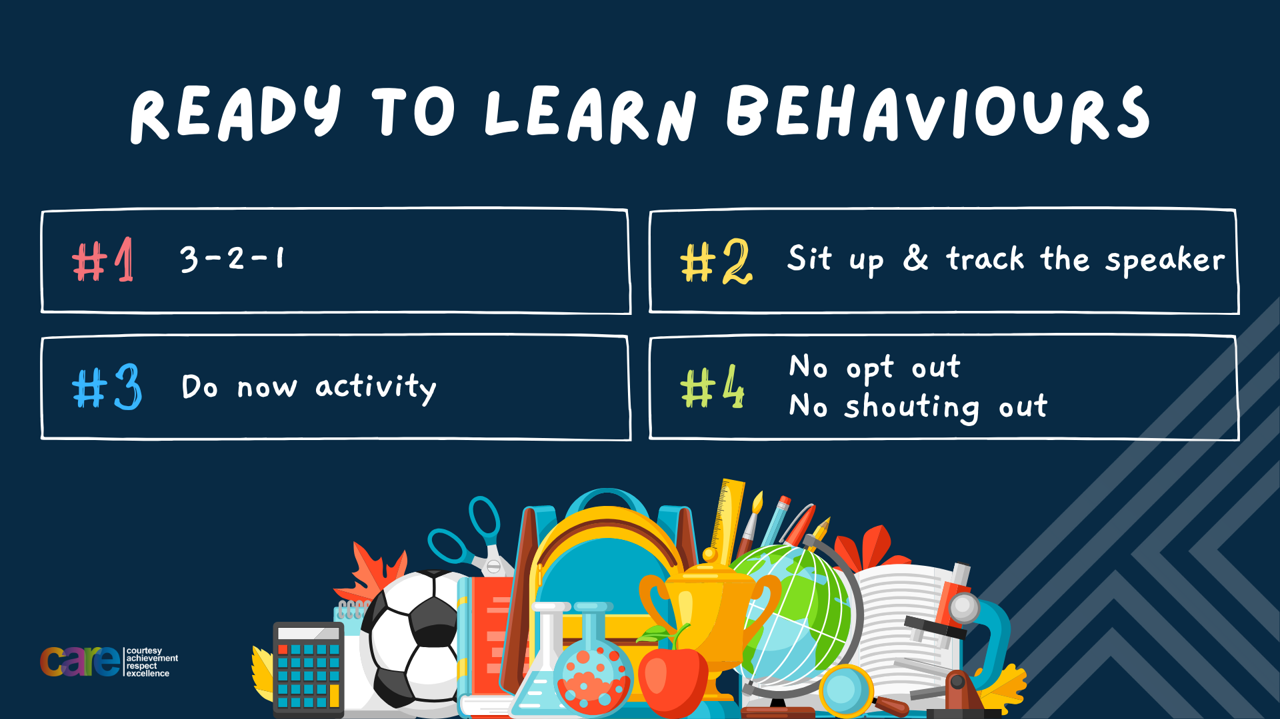

Slide 2








Write the date: 14 April 2025
Write the title: What is goal setting?
Underline both using your ruler in your learning wallet. Take out your oracy helpsheet too.
Complete the following questions:
Name 3 things you learnt about in Personal Development before the Christmas holidays.

Slide 3





What is goal setting?
Goal Setting is…
“a process of deciding what you want to achieve and planning steps to make it happen”

Slide 4
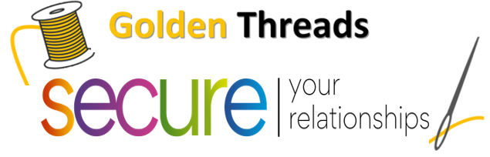



Why this is important
We are learning this because:
Links to the Golden Thread of “Secure your relationships, future and wellbeing” as depending on what goals people set it can impact them differently such as improving physical and/or mental health, how they interact with family and friends, teachers or colleagues and what they decide to do after Year 11 or finding their first or new job.
Individual Liberty is a British Value. This means everyone has the right to “believe, act and express oneself freely”. Goal setting is very personal and should reflect the individual and not be influenced by other people.

Slide 5
Types of Goals
There are different types of goals:
Academic – wanting to improve grades in school
Health – wanting to exercise more or eat more healthy food
Financial – save money or stop spending money on needless items
Community – doing something for others in the community or for a charity.

Slide 6
Types of Goals
There are different types of goals:
Academic – wanting to improve grades in school
Health – wanting to exercise more or eat more healthy food
Financial – save money or stop spending money on needless items
Community – doing something for others in the community or for a charity.
Task
In your books rank the different types of goals in order of most importance for you.

Slide 7

Types of goals
Using your oracy helpsheet, discuss with the person next to you:
“What type of goal did you rank as the most important?”
Remember to use the sentence starters to add, build or challenge what your partner has said.
Be ready to share your discussion with the class

Slide 8

Hinge Questions – whiteboard activity
3
Rules!
I will ask the question and give you some thinking time. (no more than 10 seconds)
Write the answer and turn your whiteboard over so nobody can see it.
When I am ready I will put on the 3 to 1 counter.
When ‘Show me’ appears on the board you must hold up your whiteboard (even if you don’t know the answer and there is nothing on your board)
2
1
Show me!
(even if your whiteboard is blank)

Slide 9
Hinge Questions – whiteboard activity
What is being described?
“a process of deciding what you want to achieve and planning steps to make it happen”
Goal Setting

Slide 10

Hinge Questions – whiteboard activity
What British Value does this topic relate to?
A – Mutual Respect
B – Tolerance
C – Individual Liberty
D – Democracy

Slide 11
Hinge Questions – whiteboard activity
What type of goal is being described?
“improving science grades in the next assessment”
A – Academic
B – Health
C – Financial
D – Community

Slide 12
Hinge Questions – whiteboard activity
What type of goal is being described?
“helping to organise a charity event”
A – Financial
B – Academic
C – Community
D – Health

Slide 13
Hinge Questions – whiteboard activity
What type of goal is being described?
“learning to swim”
A – Community
B – Health
C – Financial
D – Academic

Slide 14
Hinge Questions – whiteboard activity
What type of goal is being described?
“saving pocket money to buy a new pair of trainers”
A – Health
B – Academic
C – Community
D – Financial

Slide 15
SMART Goals
To set goals, people should follow the SMART rule. This rule is:
S – Specific
M – Measureable
A – Achievable
R – Relevant
T – Time bound
Task - Write out the SMART rule leaving 2 lines between each word

Slide 16

SMART Goals
Task
While watching the video write down the meaning of each part of SMART goal setting
Notes:
https://www.youtube.com/watch?v=i0QfCZjASX8

Slide 17
SMART Goals
Using your red pen, make sure you have the correct definition
S – Specific – should include what, when and why to make sure the goal is not vague

Slide 18
SMART Goals
Using your red pen, make sure you have the correct definition
M – Measurable - metrics attached to the goal so it is easy to see if goal has been achieved

Slide 19
SMART Goals
Using your red pen, make sure you have the correct definition
A – Achievable – break the goal down to show how it will be completed

Slide 20
SMART Goals
Using your red pen, make sure you have the correct definition
R – relevant – does the goal fit with your life right now? If it doesn’t then this is not a good goal

Slide 21
SMART Goals
Using your red pen, make sure you have the correct definition
T – Time Bound – set a deadline to achieve the goal

Slide 22
SMART Goals
Example – “do better in science” is not a SMART goal.
To be SMART this would be:
S – score 1 grade higher in the next science assessment
M – measured through grade/percentage score
A – complete all homework, revise for 30 minutes each night for a week before assessment
R – yes – want to get into a higher class set
T – date of next assessment

Slide 23
SMART Goals
Set yourself a SMART goal.
You should:
Identify what type of goal it is
Use SMART to make sure your goal is not vague
You should write this goal in your books.

Slide 24
SMART Goals
Using your oracy helpsheet, discuss with the person next to you:
“What SMART goal did you set?”
You will not be able to challenge anyone’s goal but you can add or build if you think they have missed part of SMART out.
Be ready to share your discussion with the class

Slide 25
Obstacles/Challenges
Setting SMART goal does not always mean that achieving the goal will be easy.
There will be many obstacles and challenges to overcome on the journey to achieving the goal.
It is important to not give up on a goal when faced with an obstacle or challenge

Slide 26
Types of Obstacles/Challenges
There are different types of obstacles and challenges:
Procrastination – putting off tasking until the last minute
Distractions – losing focus to things like social media
Loss of motivation – feeling like progress is slow or goal is to hard
Fear of failure – avoiding a task due to a fear of making a mistake

Slide 27
Hinge Questions – whiteboard activity
3
Rules!
I will ask the question and give you some thinking time. (no more than 10 seconds)
Write the answer and turn your whiteboard over so nobody can see it.
When I am ready I will put on the 3 to 1 counter.
When ‘Show me’ appears on the board you must hold up your whiteboard (even if you don’t know the answer and there is nothing on your board)
2
1
Show me!
(even if your whiteboard is blank)

Slide 28
Hinge Questions – whiteboard activity
What type of obstacle/challenge is being described?
“Jamie has been meaning to start a school project but keeps putting it off, saying, "I’ll do it tomorrow." The deadline is now only two days away”
A – Procrastination
B – Distractions
C – Loss of motivation
D – Fear of Failure

Slide 29
Hinge Questions – whiteboard activity
What type of obstacle/challenge is being described?
“Alex wanted to learn to play the piano but stopped practicing after a week because they didn’t feel they were improving fast enough.”
A – Fear of failure
B – Procrastination
C – Distractions
D – Loss of motivation

Slide 30
Hinge Questions – whiteboard activity
What type of obstacle/challenge is being described?
“Sarah didn’t sign up for the school talent show because she was worried she wouldn’t perform well in front of others.”
A – Fear of failure
B – Procrastination
C – Distractions
D – Loss of motivation

Slide 31
Hinge Questions – whiteboard activity
What type of obstacle/challenge is being described?
“Mia sits down to study but keeps getting distracted by her phone notifications. She ends up scrolling through social media for an hour.”
A – Procrastination
B – Distractions
C – Loss of motivation
D – Fear of Failure

Slide 32
Types of Obstacles/Challenges
Task
Choose one of the scenarios on the right and suggest one way that the obstacle could be avoided or overcome.
Sentence starter
One way of overcoming the obstacle is…
Scenarios
Jamie has been meaning to start a school project but keeps putting it off, saying, "I’ll do it tomorrow." The deadline is now only two days away
Alex wanted to learn to play the piano but stopped practicing after a week because they didn’t feel they were improving fast enough.
Sarah didn’t sign up for the school talent show because she was worried she wouldn’t perform well in front of others
Mia sits down to study but keeps getting distracted by her phone notifications. She ends up scrolling through social media for an hour.

Slide 33
Obstacles/challenges
Using your oracy helpsheet, discuss with the person next to you:
“How could the person in the scenario avoid or overcome the obstacle/challenge?”
Remember to add, build or challenge what your partner says
Be ready to share your discussion with the class

Slide 34
Obstacles/Challenges
Look at your SMART goal.
Now complete the following sentences about how you can avoid or overcome obstacles/challenge
A obstacle I might have is…
One way of overcoming this obstacle is…

Slide 35
Reflection
Setting goal is important to your personal development.
Goals are not meant to be easy and there will be many obstacles and challenges along the way. However remember:
“dream big, start small but most of all, start”

Slide 36


