Slide 1
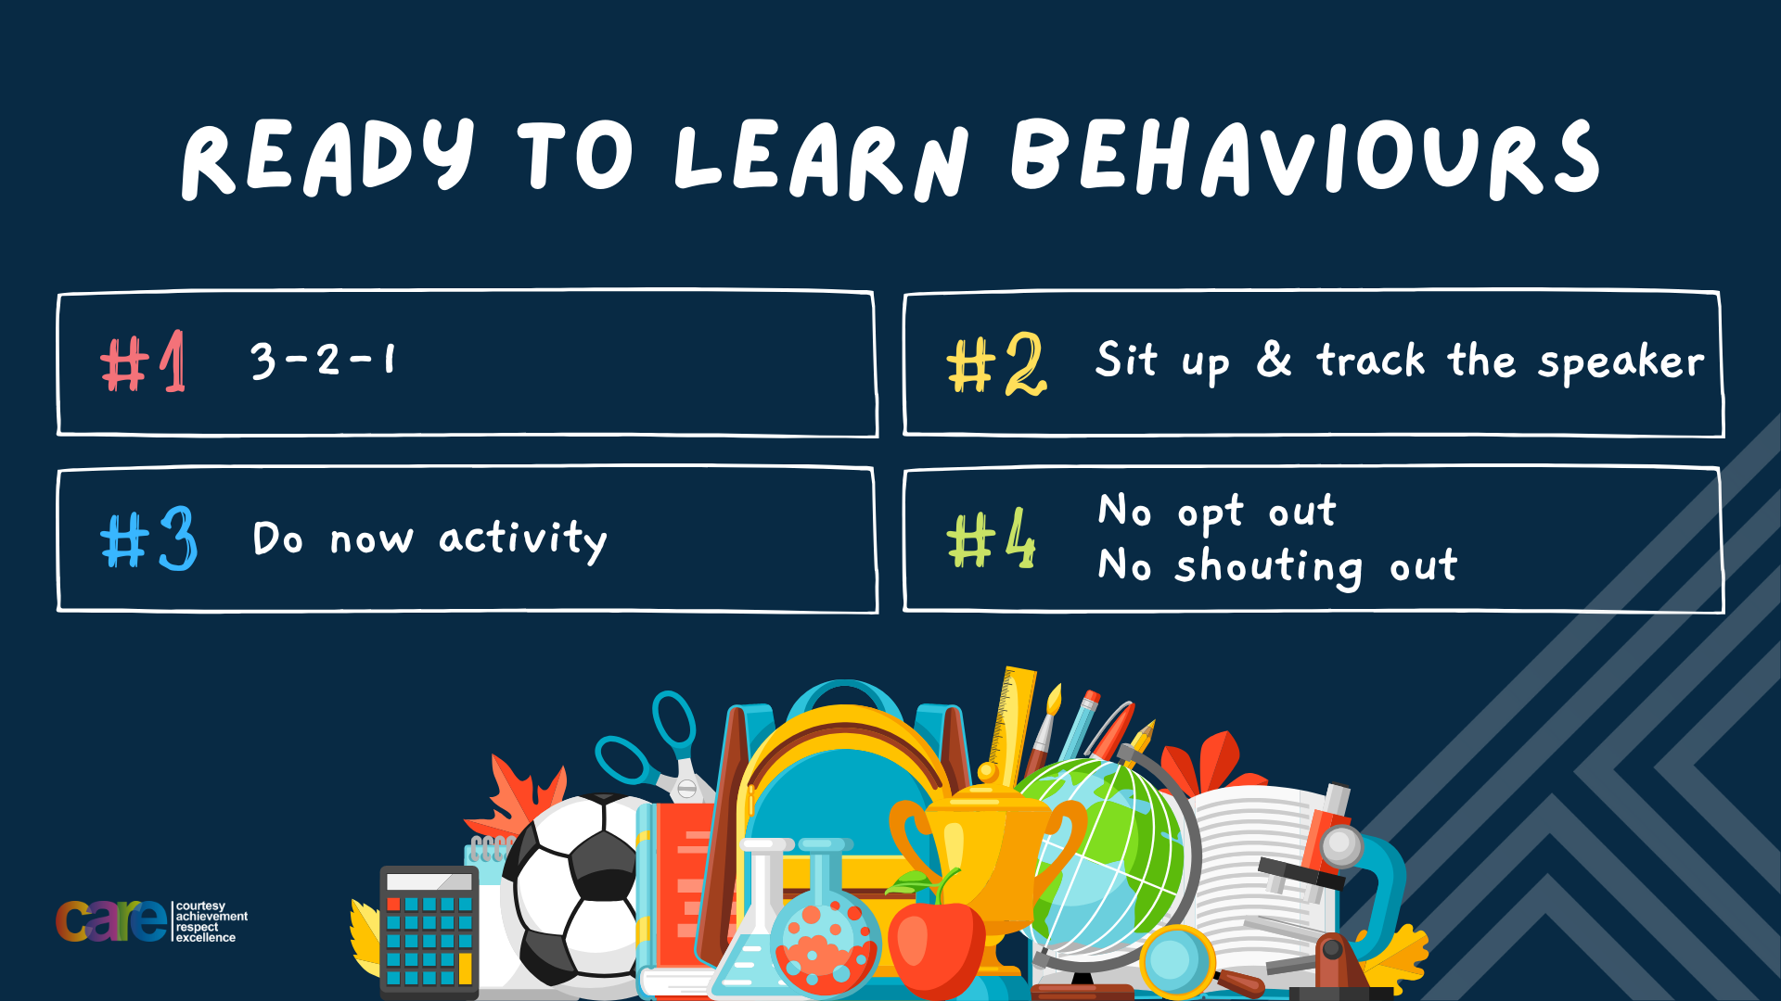

Slide 2





Write the date: 14 April 2025
Write the Title and Golden Thread
Title – Gender identity and sexual orientation
Golden Thread – Secure Your Relationships
Underline both using your ruler & take out your oracy helpsheet
Complete the following questions:
What is being described: ““a serious and lasting romantic relationship with someone”
True or False: “The reasons why people enter a romantic relationship are always positive”
How do you set goals?
Committed relationships
False
SMART

Slide 3


Secure your Relationships: Learning Journey
What does a healthy relationship look like
What does an unhealthy relationship look like?
What are romantic relationships?
Different types of committed relationships
What is gender identity and sexual orientation?
What are appropriate/ inappropriate images to send?
Today we will look at:
What is gender identity and sexual orientation?
This includes:
Definition of gender identity and sexual orientation
What are the different types of genders and sexual orientation
The law around gender identity and sexual orientation
Please remember that during the lesson we should not be asking any pupil or teacher personal questions.
Your teacher can ask you questions but this will be to check your knowledge in the lesson.

Slide 4

Tutor Time Recap
In your Personal Development Tutor Time activity, you started to look at gender identity and sexual orientation.
In your books answer the following question:
“What is the definition of gender identity and sexual orientation
Sentence starters – “gender identity is…” and “sexual orientation is…”

Slide 5
Tutor Time Recap
Gender identity is…
“the inner experience of gender”
Task – use your red pen to add to the definition you had written down.

Slide 6
Tutor Time Recap
Sexual orientation is…
“how a person feels romantically and physically towards others”
Task – use your red pen to add to the definition you had written down.

Slide 7
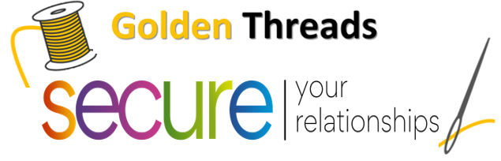

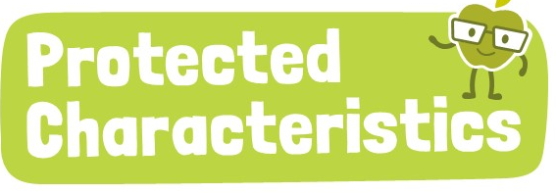
Tutor Time Recap
We are learning this because:
Links to the Golden Thread of “Secure your relationships”. It is important to know about different genders and sexual orientations so you can respect another person’s choice even if you do not agree with it.
Individual Liberty is a British Value. People are free to choose their own gender or sexual orientation. Many people follow their family or religious beliefs regarding this. However all decisions should be respected
Sexual orientation and gender reassignment are protected characteristics and no one should be treated differently for identifying with them.

Slide 8
Gender Identity
There are different keywords/phrases that need to be defined when looking more at gender identity
These are:
Sex assigned at birth
Gender Identity
Transgender
Non-binary
Gender Fluid

Slide 9

Gender Identity
While watching the video think about how these keywords/phrases are described:
Sex assigned at birth
Gender identity
Transgender
Non-binary
Gender fluid
Notes:
https://www.youtube.com/watch?v=i83VQIaDlQw watch up to 1:56

Slide 10
Gender Identity – keywords and phrases
Match up the keywords/phrase to their definition
Sex assigned at birth
A person who does not identify themselves as having a specific gender
Gender Identity
A person’s inner experience of gender
Transgender
The sex assigned to a person when they are born
Non-binary
A person who doesn’t fall into the category of either male or female
Gender Fluid
Gender identity is not consistent with their assigned birth sex

Slide 11
Gender Identity – keywords and phrases
Using these matched up definitions write 2 keywords and their definitions in your book. These should be keywords you have previously been unfamiliar with.
Sex assigned at birth
A person who does not identify themselves as having a specific gender
Gender Identity
A person’s inner experience of gender
Transgender
The sex assigned to a person when they are born
Non-binary
A person who doesn’t fall into the category of either male or female
Gender Fluid
Gender identity is not consistent with their assigned birth sex

Slide 12
Sexual Orientation
There are different keywords/phrases that need to be defined when looking more at sexual orientation
These are:
Sexual orientation
Homosexual/gay
Homosexual/lesbian
Heterosexual
Bisexual

Slide 13
Sexual Orientation
While watching the video think about how these keywords/phrases are described:
Sexual orientation
Homosexual/gay
Homosexual/lesbian
Heterosexual
Bisexual
Notes:
https://www.youtube.com/watch?v=P5x5Fo7rMvY up to 1:39

Slide 14
Sexual Orientation – keywords and phrases
Match up the keywords/phrase to their definition
Sexual Orientation
Boys who are attracted to boys
Homosexual/gay
People who are attracted to both boys and girls
Homosexual/lesbian
Girls that are attracted to girls
Heterosexual
People who are attracted to the opposite sex
Bisexual
How people feel physically and romantically towards other people

Slide 15
Sexual Orientation – keywords and phrases
Using these matched up definitions write 2 keywords and their definitions in your book. These should be keywords you have previously been unfamiliar with.
Sexual Orientation
Boys who are attracted to boys
Homosexual/gay
People who are attracted to both boys and girls
Homosexual/lesbian
Girls that are attracted to girls
Heterosexual
People who are attracted to the opposite sex
Bisexual
How people feel physically and romantically towards other people

Slide 16
Sexual Orientation – other examples
There are many more sexual orientations that shown in the video. Other sexual orientations people may be aware of are:
Asexual – A person who does not experience sexual attraction
Bi – This is the same a bisexual
Pan/Pansexual – A person whose romantic and/or sexual attraction towards others is not limited by sex or gender.

Slide 17
Hinge Questions – whiteboard activity
3
Rules!
I will ask the question and give you some thinking time. (no more than 10 seconds)
Write the answer and turn your whiteboard over so nobody can see it.
When I am ready I will put on the 3 to 1 counter.
When ‘Show me’ appears on the board you must hold up your whiteboard (even if you don’t know the answer and there is nothing on your board)
2
1
Show me!
(even if your whiteboard is blank)

Slide 18
Hinge Questions – whiteboard activity
What is being described?
“inner experience of gender”
Gender Identity

Slide 19
Hinge Questions – whiteboard activity
What is being described?
“how a person feels romantically and physically towards others”
Sexual Orientation

Slide 20

Hinge Questions – whiteboard activity
What golden thread does today’s lesson link to?
A – Secure your Future
B – Secure your Wellbeing
C – Secure your Relationships
D – Secure your Voice

Slide 21
Hinge Questions – whiteboard activity
True or False
“Gender identity and sexual orientation are the same thing”
A – True
B – False

Slide 22
Hinge Questions – whiteboard activity
What is being described?
“A person whose identity doesn’t fall in the category of either male or female”
A – Non-binary
B – Gender Identity
C – Gender Fluid

Slide 23
Hinge Questions – whiteboard activity
What is being described?
“girls who are attracted to other girls”
A – Homosexual/gay
B – Bisexual
C – Homosexual/Lesbian

Slide 24

Tarsia Puzzle
Working with a partner can you complete the tarsia shape without using your books
Each rectangle includes keywords or definitions
You need to match up the keywords and definitions together
You should try to make the shape on the right

Slide 25

What does the law say about gender identity and sexual orientation?
In the UK there is a law called “Equality Act 2010”
The Equality Act 2010 sets out 9 protected characteristics
The law protects people with these characteristics from discrimination in the workplace and in wider society
Sex and Sexual Orientation are 2 of these protected characteristics

Slide 26
How does this law impact you?
This means that you cannot be treated differently because of your sex/gender or your sexual orientation.
If you are treated or if you treat people differently because of their sex/gender or sexual orientation you are discriminating against them. This is against the law

Slide 27
What is the point of this law?
This law helps to promote respect and tolerance.
This means that we understand that not everyone shares the same beliefs or values.
However we respect other peoples beliefs and values while not imposing our own onto other people.

Slide 28
Hinge Questions – whiteboard activity
3
Rules!
I will ask the question and give you some thinking time. (no more than 10 seconds)
Write the answer and turn your whiteboard over so nobody can see it.
When I am ready I will put on the 3 to 1 counter.
When ‘Show me’ appears on the board you must hold up your whiteboard (even if you don’t know the answer and there is nothing on your board)
2
1
Show me!
(even if your whiteboard is blank)

Slide 29
Hinge Questions – whiteboard activity
True or False
“sex/gender and sexual orientation are protected characteristics”
A – True
B – False

Slide 30
Hinge Questions – whiteboard activity
True or False
“There is no law stopping people from being discriminated against because of their sex/gender identity or sexual orientation”
A – True
B – False

Slide 31



Support
If you ever need support about gender identity or sexual orientation for yourself, a friend or family member you can find support in the following places
giveusashout.org
Text 85258 for help
Themix.org.uk
You can email or have one-to-chat online.
There is also a crisis messenger which is available 24/7

Slide 32


