Slide 1


Remember to complete all homework tasks on SAM Learning
We still use Classcharts for announcements, surveys and revision material
Homework Club every morning in West Canteen from 8am
Library is open before school and at break times
Students on the following slides have not completed ALL tasks
Make sure you are completing the SET TASKS! These are the tasks your teachers have set.
Notes:
Please give time for the students to produce answers for themselves before showing answers.

Slide 2
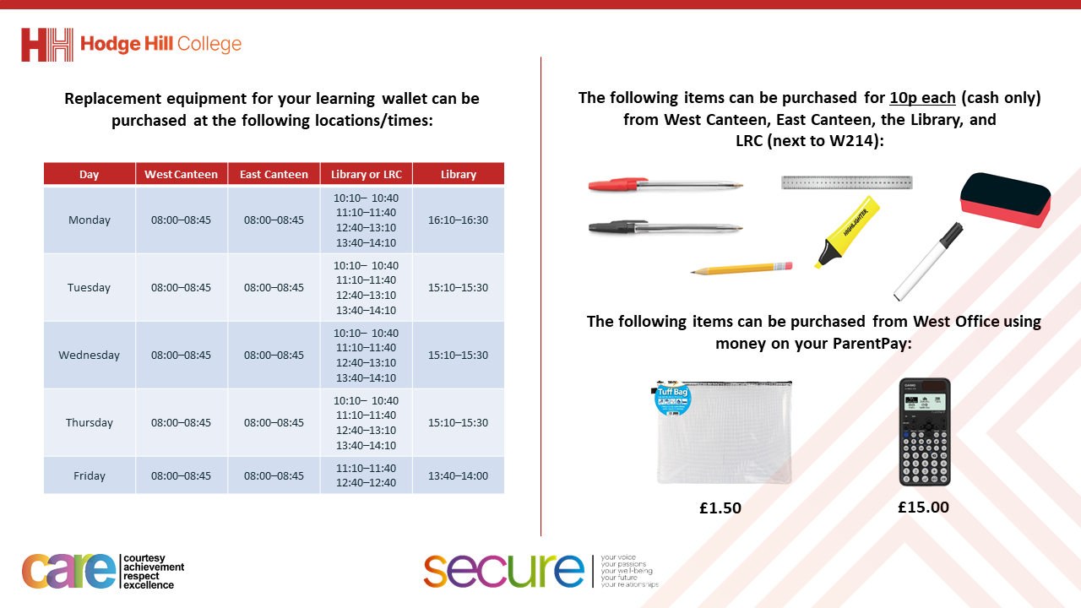

Slide 3
Thought of the Day
“Alone we can do so little; together we can do so much”
Helen Keller

Slide 4


Secure your Relationships: Learning Journey
Issues faced by people in the UK
What is loneliness?
Importance of working together
What is conflict resolution?
Importance of celebrating culture and diversity
Importance of charity work
Today we will look at:
The importance of working together
This includes:
Definition of teamwork
Examples of teamwork
Please remember that during the lesson we should not be asking any pupil or teacher personal questions.
Your teacher can ask you questions but this will be to check your knowledge in the lesson.

Slide 5


Why are we learning about this?
Teamwork is a valuable skill that is important in school and life outside of school as it increases your ability to work with other people.
Teamwork is one of the most sought after skills that employers look for.
This shows that teamwork will help you secure your relationships with other people and also your future in terms of jobs.

Slide 6

Why are we learning about this?
Article 15 of the UN Rights of a Child states that children have the right to form groups. As part of a group, you will have to work with other people for that group to be effective and be a success.
UN Rights
of a Child

Slide 7

What is teamwork?
Take out your oracy helpsheet from your learning wallet.
You have 1 minute to think about the following question:
“What does teamwork mean?”

Slide 8
What is teamwork?
Using your oracy helpsheet, with the person next to you, discuss your response to the question:
“What does teamwork mean?”
Remember to use the sentence starters to add, build or challenge what your partner has said.
Be ready to share your discussion with the class

Slide 9
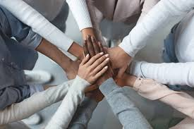
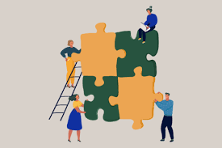

What is teamwork
Teamwork is…
“when a group of people come together to reach a shared goal”

Slide 10

Teamwork example
Notes:
https://www.youtube.com/watch?v=0pRLUta7QCY

Slide 11
Teamwork example
Take out your oracy helpsheet from your learning wallet.
You have 1 minute to think about the following question:
“What was the result of teamwork in the video?”

Slide 12
What is teamwork?
Using your oracy helpsheet, with the person next to you, discuss your response to the question:
“What was the result of teamwork in the video?”
Remember to use the sentence starters to add, build or challenge what your partner has said.
Be ready to share your discussion with the class

Slide 13
Teamwork example
Take out your oracy helpsheet from your learning wallet.
You have 1 minute to think about the following question:
“What would have happened if the fish had not worked as a team?”

Slide 14
What is teamwork?
Using your oracy helpsheet, with the person next to you, discuss your response to the question:
“What would have happened if the fish had not worked as a team?”
Remember to use the sentence starters to add, build or challenge what your partner has said.
Be ready to share your discussion with the class

Slide 15
Teamwork example
Take out your oracy helpsheet from your learning wallet.
You have 1 minute to think about the following question:
“When have you had to work as part of a team?”

Slide 16
What is teamwork?
Using your oracy helpsheet, with the person next to you, discuss your response to the question:
“When have you had to work as part of a team?”
Remember to use the sentence starters to add, build or challenge what your partner has said.
Be ready to share your discussion with the class

