Slide 1


Remember to complete all homework tasks on SAM Learning
We still use Classcharts for announcements, surveys and revision material
Homework Club every morning in West Canteen from 8am
Library is open before school and at break times
Students on the following slides have not completed ALL tasks
Make sure you are completing the SET TASKS! These are the tasks your teachers have set.
Notes:
Please give time for the students to produce answers for themselves before showing answers.

Slide 2
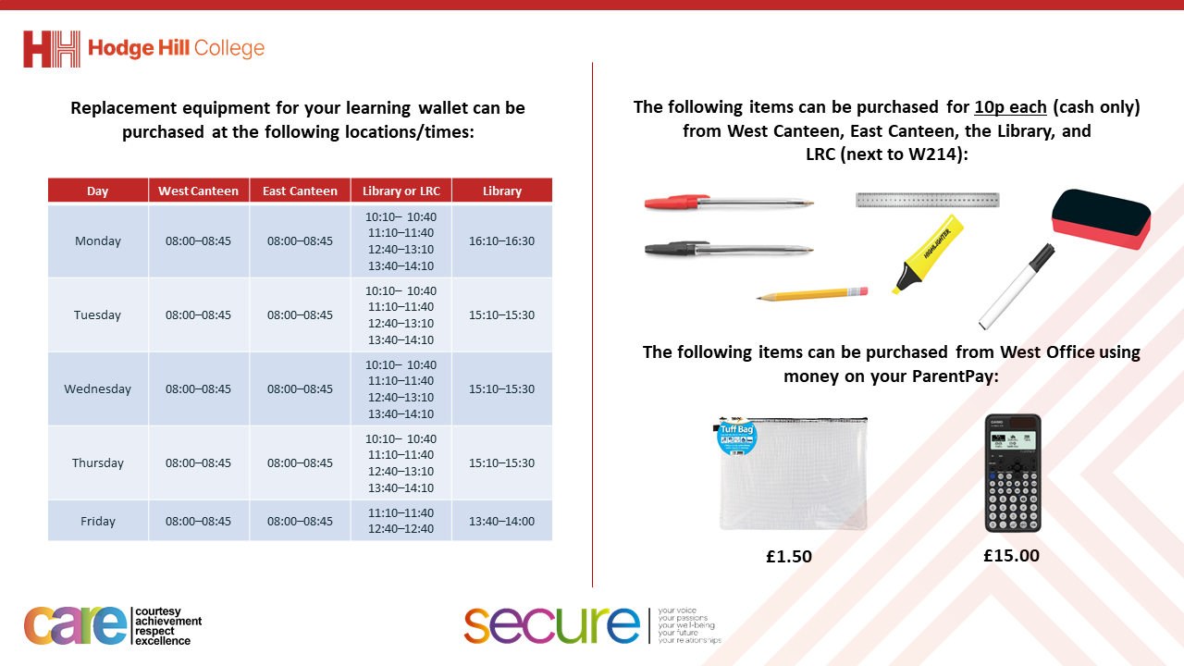

Slide 3
Thought of the Day
“Surround yourself with people who make you a better person”

Slide 4


Secure your Relationships: Learning Journey
What does a healthy relationship look like
What does an unhealthy relationship look like?
What are romantic relationships?
Different types of committed relationships
What is gender identity and sexual orientation?
What are appropriate/ inappropriate images to send?
Today we will look at:
What does a healthy relationship look like?
This includes:
Types of relationships
Why relationships are important
Please remember that during the lesson we should not be asking any pupil or teacher personal questions.
Your teacher can ask you questions but this will be to check your knowledge in the lesson.

Slide 5
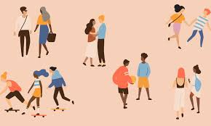
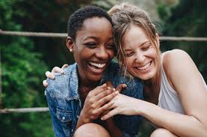
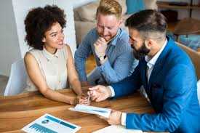
What is a relationship?
A relationship is…
“the way in which 2 or more people regard and behave towards each other.”

Slide 6




Why are we learning about this?
This links to the Golden Thread of “Secure your Relationships“
People have various relationships with many people. Regardless of the type of relationship, this should be healthy.
It is important to know how to have healthy relationships so you and the other person/people in the relationship feel safe and valued.

Slide 7

Why are we learning about this?
Individual Liberty is a British Value. This means everyone has the right to believe, act and express oneself freely. Each person in a relationship should respect other people for who they are and not force them to someone they are not.

Slide 8
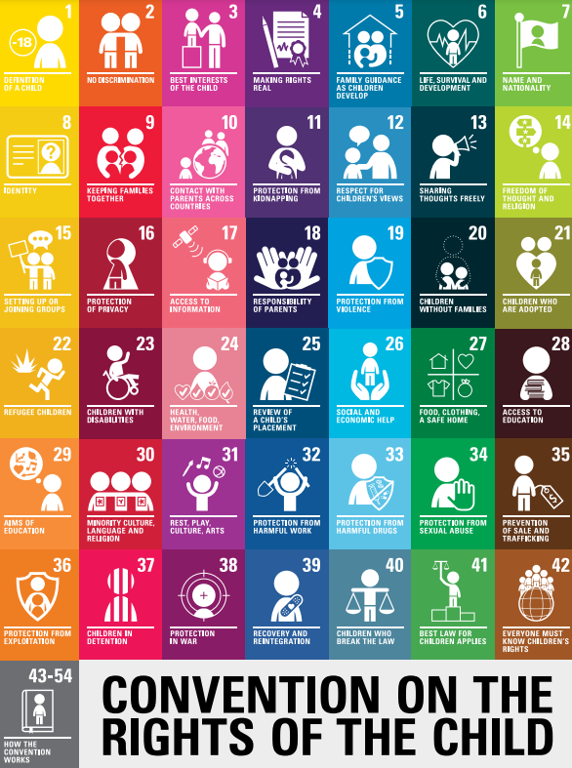
Why are we learning about this?
Relationships are throughout the UN Rights of a Child. This includes the right to meet with friends (article 15) and responsibility of parents/carers to protect children through positive and healthy relationships (article 5)
UN Rights
of a Child

Slide 9
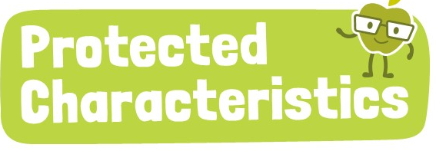
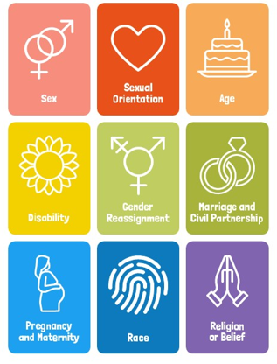
Why are we learning about this?
The protected characteristics outline things people should not be discriminated for. Any healthy relationship will celebrate these characteristics, especially if they are different from how they identify with that characteristic.

Slide 10

Types of relationships?
You have 1 minute to think about the following question:
“What types of relationships are there?”

Slide 11
Types of relationships?
Using your oracy helpsheet, with the person next to you, discuss your response to the question:
“What types of relationships are there?”
Remember to use the sentence starters to add, build or challenge what your partner has said.
Be ready to share your discussion with the class

Slide 12
Types of relationships?
There are a number of different types of relationships. Some examples are:
Friendships
Romantic relationships
Family relationships
Community relationships (this is with a key person within the community such as a youth worker, faith leader)
Professional relationships (this is between people who work together)

Slide 13
Why are relationships important?
All types of relationships are important elements of life. Everyone will experience all of the types of relationships outlined in the previous slide.
Due to this relationships are important as they can:
Make a person happy
Make a person physically healthier
Lead to fewer mental health issues for everyone in the relationship

Slide 14
Importance of relationships?
You have 1 minute to think about the following question:
“Why do you think relationships are important?”

Slide 15
Importance of relationships?
Using your oracy helpsheet, with the person next to you, discuss your response to the question:
“Why do you think relationships are important?”
Remember to use the sentence starters to add, build or challenge what your partner has said.
Be ready to share your discussion with the class

Slide 16
Relationships
In your Personal Development lessons this week you will be learning more about relationships, how and why these relationships should be healthy.

