Slide 1


Remember to complete all homework tasks on SAM Learning
We still use Classcharts for announcements, surveys and revision material
Homework Club every morning in West Canteen from 8am
Library is open before school and at break times
Students on the following slides have not completed ALL tasks
Make sure you are completing the SET TASKS! These are the tasks your teachers have set.
Notes:
Please give time for the students to produce answers for themselves before showing answers.

Slide 2
Remember to complete all homework tasks on SAM Learning
We still use Classcharts for announcements, surveys and revision material
Homework Club every morning in West Canteen from 8am
Library is open before school and at break times
Students on the following slides have not completed ALL tasks
Make sure you are completing the SET TASKS! These are the tasks your teachers have set.
Notes:
Please give time for the students to produce answers for themselves before showing answers.

Slide 3
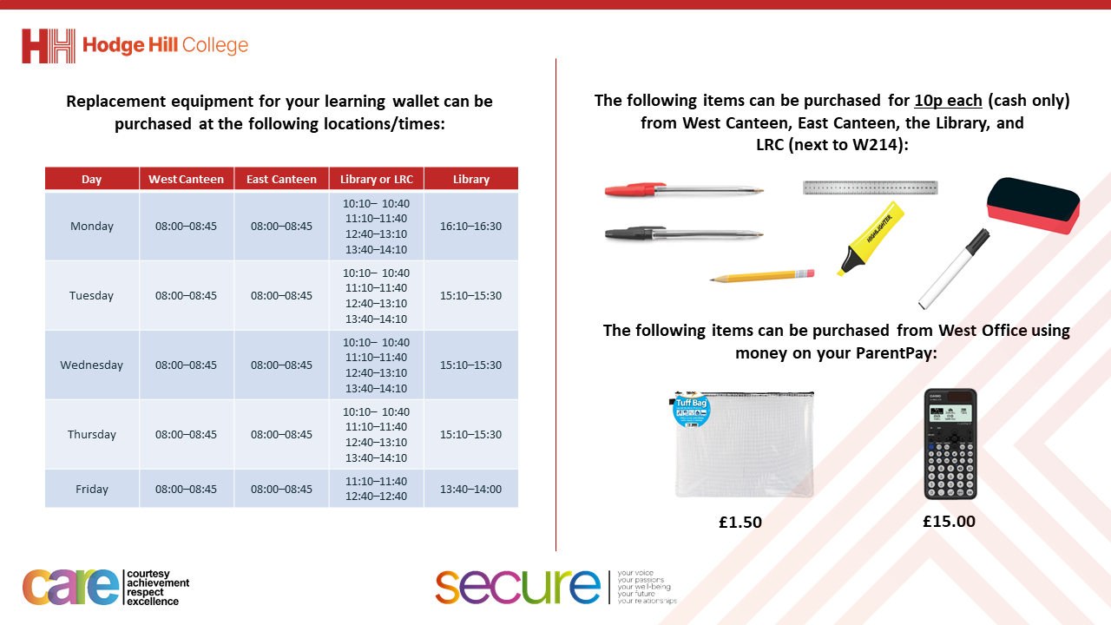

Slide 4
Thought of the Day
“The goal of resolving conflict is not victory or defeat. It’s really understanding and letting go of our need to be right”

Slide 5


Secure your Relationships: Learning Journey
Issues faced by people in the UK
What is loneliness?
Importance of working together
What is conflict resolution?
Importance of celebrating culture and diversity
Importance of charity work
Today we will look at:
What is conflict resolution?
This includes:
What is conflict
What is the fight, flight or freeze response
Please remember that during the lesson we should not be asking any pupil or teacher personal questions.
Your teacher can ask you questions but this will be to check your knowledge in the lesson.

Slide 6

Why are we learning about this?
Being able to resolve conflicts quickly is a great characteristic to develop.
Conflicts will happen between family and friends, so being able to resolve these conflicts quickly will ensure that the relationship is secured and not broken.

Slide 7

Why are we learning about this?
Mutual respect, Tolerance and Individual Liberty are British Values. These values mean that everyone in the UK has the right to their own opinions which must be respected by others if they disagree. These values also mean that we do not impose our own ideas onto other people.

Slide 8
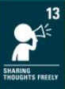
Why are we learning about this?
Article 13 of the UN Rights of a Child states that children have the right to freedom of expression. People won’t always agree with another person’s thoughts and opinions which can lead to conflict. Being able to resolve this calmly is an important skill to develop.
UN Rights
of a Child

Slide 9

What is conflict?
Take out your oracy helpsheet from your learning wallet.
You have 1 minute to think about the following question:
“What does conflict mean?”

Slide 10
What is teamwork?
Using your oracy helpsheet, with the person next to you, discuss your response to the question:
“What does conflict mean?”
Remember to use the sentence starters to add, build or challenge what your partner has said.
Be ready to share your discussion with the class

Slide 11
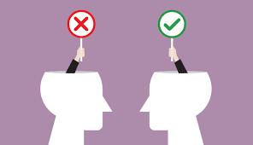
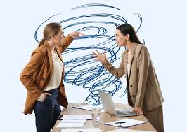
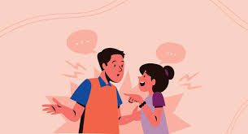
What is conflict?
Conflict is…
“a disagreement where there is tension”

Slide 12
What is conflict?
Disagreements happen all the time but don’t lead to conflict.
It becomes conflict when people get tense and take a position on the issue that has caused the disagreement.
This leads to people arguing over who is right or wrong about the disagreement.

Slide 13
What is conflict?
Conflict causes our brains to either:
Fight
Flight
Freeze

Slide 14
Fight, flight, freese
Take out your oracy helpsheet from your learning wallet.
You have 1 minute to think about the following question:
“What does fight, flight or freeze mean?”

Slide 15
What is teamwork?
Using your oracy helpsheet, with the person next to you, discuss your response to the question:
“What does fight, flight or freeze mean?”
Remember to use the sentence starters to add, build or challenge what your partner has said.
Be ready to share your discussion with the class

Slide 16
Fight, Flight or Freeze
Fight – a person is ready to stand up to or argue because they feel threatened or challenged.
An example is arguing back or being physically aggressive

Slide 17
Fight, Flight or Freeze
Flight – a person wants to remove themselves or escape from the situation.
An example is walking away when a conflict begins.

Slide 18
Fight, Flight or Freeze
Freeze – A person feels stuck or unsure so does not do anything at all when a conflict begins.
An example of this is staying silent even if someone is arguing with them.

Slide 19
Fight, Flight or Freeze – scenario
You are carrying food out of the canteen when another person in your year bumps into you. Your food falls out of your hand onto the floor. The line for the canteen is really long, you don’t have enough money on parentpay to buy the same items again and you think the person who bumped into you is laughing about it.
If you were the person in this scenario how would you react? Would you:
Fight
Flight
Freeze

Slide 20
Fight, Flight or Freeze – scenario
You are carrying food out of the canteen when another person in your year bumps into you. Your food falls out of your hand onto the floor. The line for the canteen is really long, you don’t have enough money on parentpay to buy the same items again and you think the person who bumped into you is laughing about it.
Discuss with the person next to you the response you would have.
Use your oracy helpsheet too add, build or challenge during the discussion.

