Slide 1


Remember to complete all homework tasks on SAM Learning
We still use Classcharts for announcements, surveys and revision material
Homework Club every morning in West Canteen from 8am
Library is open before school and at break times
Students on the following slides have not completed ALL tasks
Make sure you are completing the SET TASKS! These are the tasks your teachers have set.

Slide 2
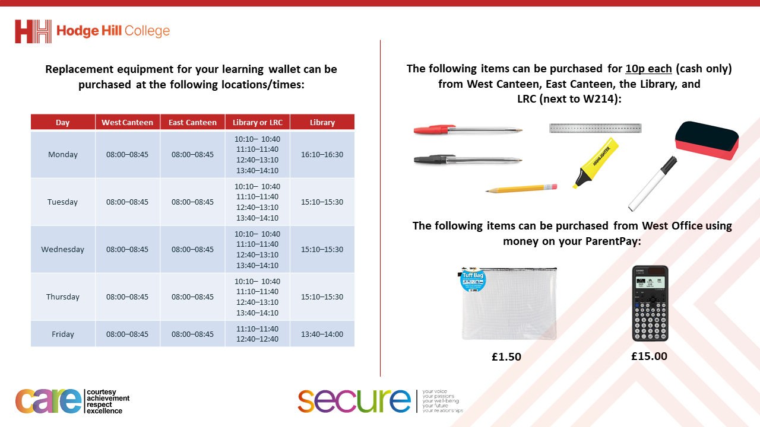

Slide 3
Thought of the Day
“The best way to find yourself is to lose yourself in the service of others”
Mahatman Gandhi

Slide 4


Secure your Relationships: Learning Journey
Issues faced by people in the UK
What is loneliness?
Importance of working together
What is conflict resolution?
Importance of celebrating culture and diversity
Importance of charity work
Today we will look at:
Importance of charity work
This includes:
What is charity
Different types of charity
Please remember that during the lesson we should not be asking any pupil or teacher personal questions.
Your teacher can ask you questions but this will be to check your knowledge in the lesson.

Slide 5



Why are we learning about this?
Charities are having a difficult time at the minute due the cost of living crisis. Research shows that 97% of charities have been directly affected by the cost of living crisis.
This is due to the costs of running the charity having increased and many volunteers not being able to commit to helping due to their own increased pressures.

Slide 6
Why are we learning about this?
This is on top of 25% of everyday people having cancelled or reduced their charitable donations.
This is despite having more people wanting to access the services provided by the charity.

Slide 7
What is charity work?
Charity work is…
“is giving time, money or resources to help people or causes in need”

Slide 8
What is charity work?
Charities often focus on issues like:
Poverty
Health
Education
environment

Slide 9

Charity work?
Take out your oracy helpsheet from your learning wallet.
You have 1 minute to think about the following question:
“What charity do you know about? What work do they do?”

Slide 10
Charity work?
Using your oracy helpsheet, with the person next to you, discuss your response to the question:
“What charity do you know about? What work do they do?”
Remember to use the sentence starters to add, build or challenge what your partner has said.
Be ready to share your discussion with the class

Slide 11
What is charity work?
One way people can help a charity is through volunteering.
This is when people give up their time to help the charity instead of donating money.

Slide 12

What is charity work?
Notes:
https://www.youtube.com/watch?v=gwjdw0lqtuI

Slide 13
Charity work?
Take out your oracy helpsheet from your learning wallet.
You have 1 minute to think about the following question:
“Do you think volunteering time is better than donating money?”

Slide 14
Charity work?
Using your oracy helpsheet, with the person next to you, discuss your response to the question:
““Do you think volunteering time is better than donating money?”
Remember to use the sentence starters to add, build or challenge what your partner has said.
Be ready to share your discussion with the class

Slide 15
What is charity work?
In your Personal Development lesson this week you will be leaning more about the impact of different charities and why taking part in charitable events is important.

