Slide 1




Tutor Notice
Homework will start being set on Monday 9th September.
You will go on to SAM Learning and click on Set Tasks to see all your tasks.
You will receive Homework on a weekly basis so you need to log in and complete work every week.
If you need help or access to a computer/device there is:
Homework Club every morning in West Canteen from 8am onwards.
Library computers available every break time and afterschool
You still need to be logging in to Classcharts as your teachers may send announcements out on there or attach revision material for upcoming assessments.
All log in details can be found on your Attainment cards in your passports.
Any issues please come see Mrs Shaheen in W309
Notes:
https://www.youtube.com/watch?v=QYmr9pVtryo

Slide 2


Slide 3
Secure your Future: Learning Journey
Impact of energy drinks
Drugs and alcohol impact on the body
Dangers of smoking and vaping
What is the importance of body image?
What changes can I expect during puberty?
What is FGM?
Today we will look at:
Impact of energy drinks
This includes:
What is in energy drinks
Introduction to impact of energy drinks
Please remember that during the lesson we should not be asking any pupil or teacher personal questions.
Your teacher can ask you questions but this will be to check your knowledge in the lesson.

Slide 4
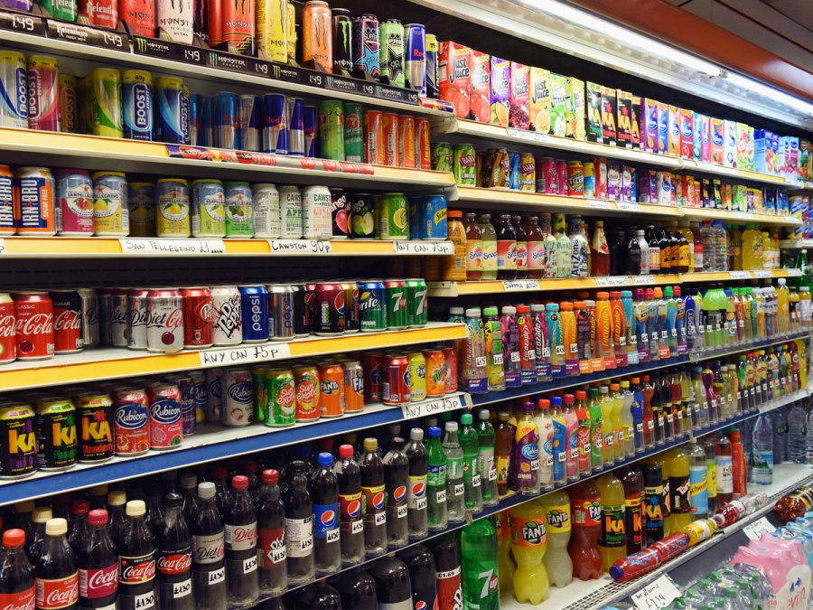
Scenario
You have gone into your local shop to buy a drink.
Put your hand up if you would buy:
A bottle of water?

Slide 5
Scenario
You have gone into your local shop to buy a drink.
Put your hand up if you would buy:
A fruit smoothie or juice?

Slide 6
Scenario
You have gone into your local shop to buy a drink.
Put your hand up if you would buy:
A bottle or can of coke/sprite/fanta etc?

Slide 7
Scenario
You have gone into your local shop to buy a drink.
Put your hand up if you would buy:
A energy drink such as lucozade, boost, monster?

Slide 8
Energy drink consumption
In 2022, energy drinks market in the UK was worth around £3 billion!
Studies have also shown that over a third of UK teenagers consume at least 1 energy drink a week.
The study also shows that 20% of teenagers consume an energy drink 4-5 days per week or more.
This explains why UK teenagers are the biggest consumers of energy drinks in Europe. UK teenagers consume over 1 litre a month more than the European average

Slide 9
Energy drink consumption
The study states 2 main reasons why teenagers in the UK consume energy drinks.
With the person next to you discuss what these may be.
Be ready to share your answers with the class

Slide 10
Energy drink consumption
The study states 2 main reasons why teenagers in the UK consume energy drinks.
The reasons given in the study were:
More energy when feeling tired
To help stay awake

Slide 11
Energy drink ingredients
The reason why energy drinks can do this is due to their high levels of caffeine and sugar.
The recommended daily consumption levels of these are:
Caffeine – 400mg
Sugar – 30g

Slide 12
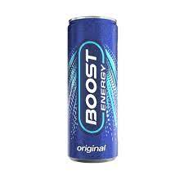
Energy drinks ingredients
How much sugar and caffeine is in a 250ml can of boost?
Sugar – 26.5g which is 7 teaspoons
Caffeine – 75mg – nearly 20% of the daily allowance

Slide 13
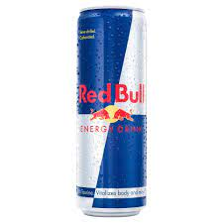
Energy drinks ingredients
How much sugar and caffeine is in a 500ml can of Red Bull?
Sugar – 55g which is 13.5 teaspoons
Caffeine – 160mg – 40% of the daily allowance

Slide 14
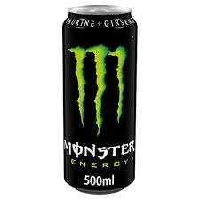
Energy drinks ingredients
How much sugar and caffeine is in a 500ml can of Monster?
Sugar – 55g which is 13.5 teaspoons
Caffeine - 160mg – 40% of the daily allowance

Slide 15
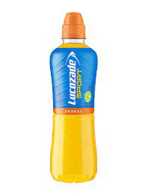
Energy drinks ingredients
How much sugar and caffeine is in a 380ml can of Lucozade?
Sugar – 60g which is 15 teaspoons
Caffeine – 60mg – 15% of daily allowance

Slide 16
Effects of Energy drinks
In your PD lessons you will asked to reflect on the effects of energy drinks on the body.
You learnt about this last year.
With the person next to you discuss the effects of energy drinks that you can remember to prepare you for your PD lesson.

