Slide 1


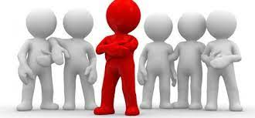
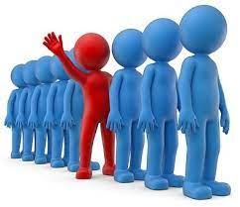
Pupil Leader Applications
Pupil Leader application form is on classcharts as an announcement and is available for anyone to apply
This is your opportunity to stand out in a positive way
Deadline is Tuesday 1st October at 8.30am
If you have any questions please speak to Mr Stewart

Slide 2
Thought of the Day
“Your body is not wrong. The way it moves, the way it looks—it's all a part of who you are, and that is beautiful”
Jessamyn Stanley

Slide 3


Slide 4
Secure your Future: Learning Journey
Impact of energy drinks
Drugs and alcohol impact on the body
Dangers of smoking and vaping
What is the importance of body image?
What changes can I expect during puberty?
What is FGM?
Today we will look at:
Importance of body image
This includes:
Definition of body image
Difference between positive and negative body image
Examples of people talking about body image
Please remember that during the lesson we should not be asking any pupil or teacher personal questions.
Your teacher can ask you questions but this will be to check your knowledge in the lesson.

Slide 5

Discussion
With the person next to you discuss the following:
“What is body image? Where have you heard this term before?”
Remember to use your oracy helpsheet to structure your discussion.
Be ready to share your discussions with the class.

Slide 6
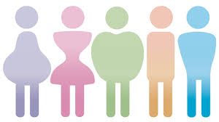
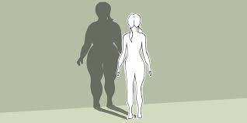

What is body image?
The definition of body image is…
“the way people see themselves and how they feel about their bodies”

Slide 7
Why does this matter?
Young people’s bodies are constantly growing and changing through their teenage years.
This can mean that young people feel differently about how they look during this time
However it is important that young people feel good and comfortable with their body as this will increase their overall happiness and confidence levels.

Slide 8

Talking about body image
What is the main learning point about body image you got from watching this video?
Be ready to share your ideas with the class.
Notes:
https://www.youtube.com/watch?v=7N6-mTvW9Zw

Slide 9
Positive vs Negative Body Image
Positive body image is defined as…
“When a person feels good about their body. They are more confident and comfortable”
Negative body image is defined as…
“Sometimes people may not feel happy about how they look, which can make them feel sad or insecure”

Slide 10
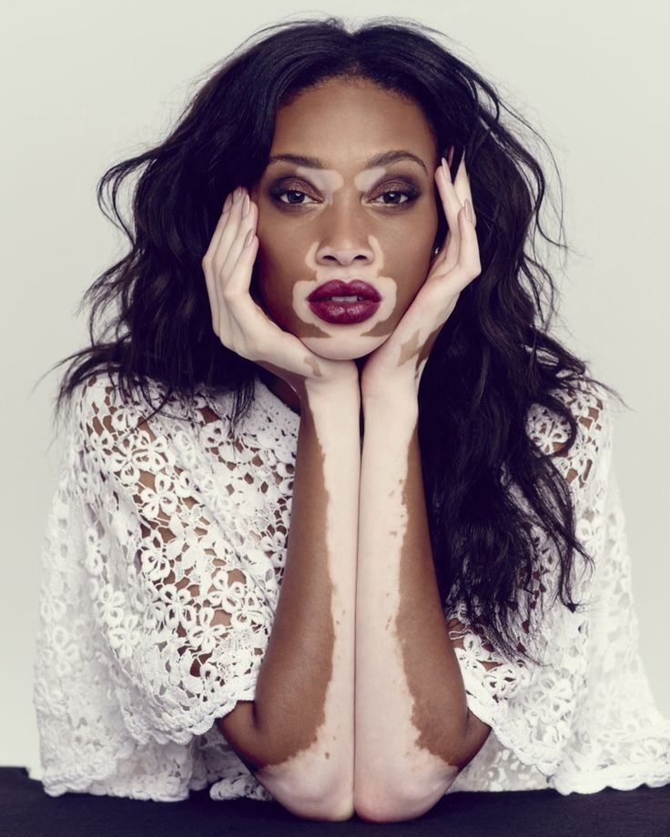
Positive Body Image example
Winnie Harlow is a Canadian fashion model.
However she has a condition called “vitiligo” which results in loss of pigmentation on portions of her of skin including the face.
This could have potentially meant that Winnie Harlow could have a negative body image. However, Winnie has not let the condition define her or her body image.

Slide 11
Positive Body Image example
Questions
When did Winnie start to think more about her skin condition?
Why does she not like the word “brave” being used to describe her?
What word does Winnie use to describe herself?
Notes:
https://www.youtube.com/watch?v=w4_ifU_OLM0

Slide 12



Types of abuse
If you need any support about body image, you can contact
Childline.org.uk
Call – 08001111
Email or chat online for support
Themix.org.uk
You can email or have one-to-chat online.
There is also a crisis messenger which is available 24/7

