Slide 1


Remember to complete all homework tasks on SAM Learning
We still use Classcharts for announcements, surveys and revision material
Homework Club every morning in West Canteen from 8am
Library is open before school and at break times
Students on the following slides have not completed ALL tasks
Make sure you are completing the SET TASKS! These are the tasks your teachers have set.
Notes:
Please give time for the students to produce answers for themselves before showing answers.

Slide 2
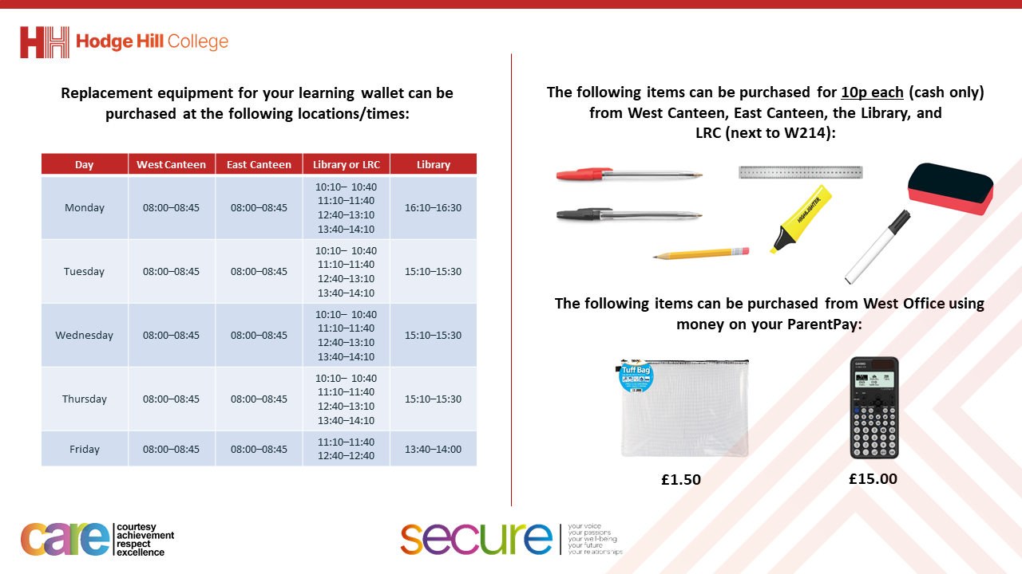

Slide 3
Thought of the Day
“Loneliness and solitude are two things that do not go hand in hand. One who is alone is not necessarily lonely; one who is lonely is alone.”
N.T. Bergeron

Slide 4


Secure your Relationships: Learning Journey
Issues faced by people in the UK
What is loneliness?
Importance of working together
What is conflict resolution?
Importance of celebrating culture and diversity
Importance of charity work
Today we will look at:
What is loneliness
This includes:
Definition of loneliness
Definition of solitude
Please remember that during the lesson we should not be asking any pupil or teacher personal questions.
Your teacher can ask you questions but this will be to check your knowledge in the lesson.

Slide 5

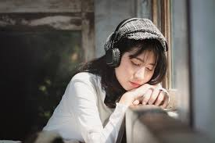
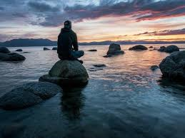
Loneliness and solitude
In today’s thought of the day there were 2 key words:
Loneliness
Solitude

Slide 6

Loneliness and Solitude
Take out your oracy helpsheet from your learning wallet.
You have 1 minute to think about the following question:
“What does loneliness and solitude mean?”

Slide 7
What political parties do you know?
Using your oracy helpsheet, with the person next to you, discuss your response to the question:
“What does loneliness and solitude mean?”
Remember to use the sentence starters to add, build or challenge what your partner has said.
Be ready to share your discussion with the class

Slide 8
Loneliness and solitude
Loneliness is…
“a feeling of sadness or distress about being by oneself, even if others are nearby”

Slide 9
Loneliness and solitude
Solitude is…
“choosing to be alone and feeling peaceful or content, often for relaxation, self-reflection, or engaging in personal interests”

Slide 10


Why are we learning about this?
Learning the difference between loneliness and solitude is important as it can help you secure your relationships by noticing when people are lonely so that you can help them.
It is also important for securing your own wellbeing by knowing what the difference is and how to stop you becoming lonely.
This is particularly important as recent research shows that 10% of 10-15 year old children report feeling lonely. This raises to 19% of children if they live in a city.

Slide 11

Why are we learning about this?
Although loneliness is not specifically mentioned in the UN Rights of a Child, many articles reference the importance of children being able to live in a way that help them reach their full mental and social potential. Understanding loneliness and solitude will help you reach this potential
UN Rights
of a Child

Slide 12
Loneliness or solitude
Decide if the scenario below is an example of the person experiencing loneliness or being in solitude
“Alex likes to draw and often goes to a quiet room to work on art projects after school. Alex feels happy and relaxed during this time.”
This is an example of solitude. This is because Alex is choosing to be alone and feels content.

Slide 13
Loneliness or solitude
Decide if the scenario below is an example of the person experiencing loneliness or being in solitude
“Jordan is new to the school and often sits alone during lunch because he hasn’t made friends yet but wishes he had”
This is an example of loneliness. Jordan feels isolated and wants to make friends.

Slide 14
Loneliness or solitude
Decide if the scenario below is an example of the person experiencing loneliness or being in solitude
“Taylor spends the weekend at home while friends are hanging out together. They weren’t invited and feel left out and sad.”
This is an example of loneliness. Taylor feels excluded and is not choosing to be alone.

Slide 15
Loneliness or solitude
Decide if the scenario below is an example of the person experiencing loneliness or being in solitude
“Riley goes to the park with a book and spends an hour reading under a tree. They feel calm and peaceful.”
This is an example of solitude. Riley has chosen alone time to relax and enjoy a hobby.

Slide 16
Loneliness or solitude
Decide if the scenario below is an example of the person experiencing loneliness or being in solitude
“Chris stays in his room all weekend playing video games but feels bored and wishes someone would invite him out.”
This is an example of loneliness. Chris wants to socialise despite staying in his room.

Slide 17
Loneliness or solitude
Decide if the scenario below is an example of the person experiencing loneliness or being in solitude
“Sam chooses to spend time in his room listening to music and journaling. He finds it refreshing and feels energized afterward.”
This is an example of solitude. Same is taking intentional time for himself and feels positive for it.

Slide 18
Loneliness or solitude
Decide if the scenario below is an example of the person experiencing loneliness or being in solitude
“Avery is home alone and feels like no one understands what they’re going through. They wish they had someone to talk to.”
This is an example of loneliness. Avery feels isolated and wants to connect with others.

Slide 19
Loneliness and Solitude
Take out your oracy helpsheet from your learning wallet.
You have 1 minute to think about the following question:
“What is the difference between loneliness and solitude? Give an example to develop your answer”

Slide 20
What political parties do you know?
Using your oracy helpsheet, with the person next to you, discuss your response to the question:
“What is the difference between loneliness and solitude? Give an example to develop your answer”
Remember to use the sentence starters to add, build or challenge what your partner has said.
Be ready to share your discussion with the class

Slide 21



Support
If you are concerned loneliness either about yourself, a friend or a family member, support is available through
Childline.org.uk
Call – 08001111
Email or chat online for support
Themix.org.uk
You can email or have one-to-chat online.
There is also a crisis messenger which is available 24/7

