Slide 1
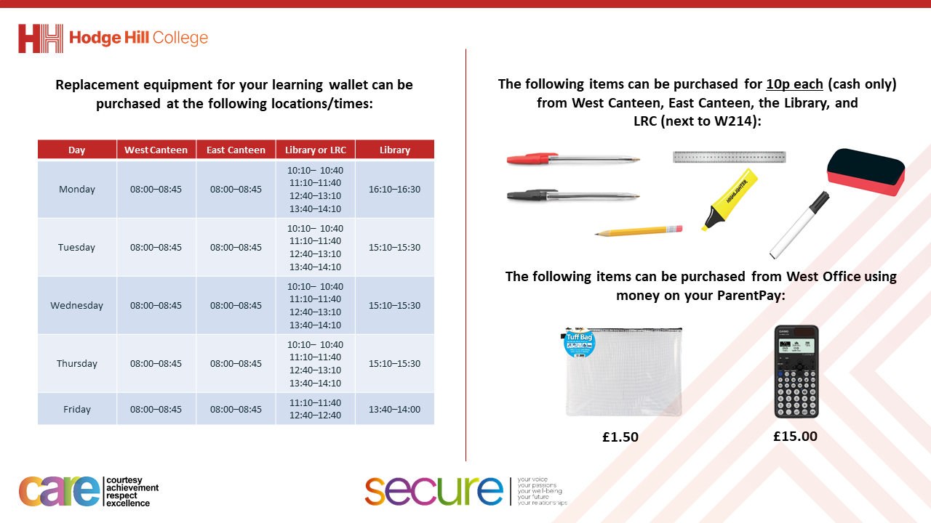

Slide 2
Thought of the Day
“We must end FGM to protect the health, rights and future of millions of girls”
Dr Tedros Adhanom Ghebreyesus

Slide 3


Slide 4


Secure your Future: Learning Journey
Impact of energy drinks
Drugs and alcohol impact on the body
Dangers of smoking and vaping
What is the importance of body image?
What changes can I expect during puberty?
What is FGM?
Today we will look at:
What is FGM?
This includes:
What is FGM
What is the law around FGM
Please remember that during the lesson we should not be asking any pupil or teacher personal questions.
Your teacher can ask you questions but this will be to check your knowledge in the lesson.

Slide 5

Discussion
With the person next to you discuss the following:
“What is FGM? Have you ever heard this phrase before?”
Remember to use your oracy helpsheet to structure your discussion.
Be ready to share your discussions with the class.

Slide 6

What is FGM?
FGM stands for…
“Female Genital Mutilation”
This is also sometimes known as “female circumcision” or “female genital cutting”

Slide 7
What is FGM?
This means that:
It affects girls and women
It is to do with female genitals (vulva, vagina and clitoris)
It causes injury, damage and disfiguration

Slide 8
Is FGM legal?
This next section looks at the law around FGM in the UK.
Before this it is worth remembering that “Rule of Law” is a British Value.
This means that everyone living in the UK should follow the laws set out by the Government. These laws are designed to protect everybody in the country.

Slide 9
Is FGM legal?
So is FGM legal in the UK?
No. FGM is illegal in the UK.

Slide 10
Is FGM legal?
So does this mean that FGM is legal in other countries?
Yes, it is legal in other countries.
However, it is illegal to take a British national or permanent resident abroad for FGM, or to help someone trying to do this.

Slide 11
FGM
You will be learning in more detail about FGM including:
Where FGM still happens
What parts of the body does it impact
How it impacts the rights of the person undergoing FGM
Looking at some myths around FGM.

Slide 12

FGM
To prepare for this lesson watch the following video. Think about some key learning points that you can take away about FGM.
Notes:
https://www.youtube.com/watch?v=WJwP6C5q6Qg

Slide 13



Support
If you, a friend or a family member need any support about FGM, you can contact the places below. If support is required urgently please contact the Police by dialing 999.
Childline.org.uk
Call – 08001111
Email or chat online for support
Themix.org.uk
You can email or have one-to-chat online.
There is also a crisis messenger which is available 24/7

