Slide 1


Remember to complete all homework tasks on SAM Learning
We still use Classcharts for announcements, surveys and revision material
Homework Club every morning in West Canteen from 8am
Library is open before school and at break times
Students on the following slides have incomplete Homework Tasks
Make sure you are completing the SET TASKS! These are the tasks your teachers have set.
Notes:
Please give time for the students to produce answers for themselves before showing answers.

Slide 2


Slide 3


Secure your Future: Learning Journey
Impact of energy drinks
Drugs and alcohol impact on the body
Dangers of smoking and vaping
What is the importance of body image?
What changes can I expect during puberty?
What is FGM?
Today we will look at:
The dangers of smoking
This includes:
The law around cigarettes
What new law is coming around cigarettes
Please remember that during the lesson we should not be asking any pupil or teacher personal questions.
Your teacher can ask you questions but this will be to check your knowledge in the lesson.

Slide 4

Discussion
With the person next to you discuss the following:
“What laws are there around using cigarettes in the UK”
Remember to use your oracy helpsheet to structure your discussion.
Be ready to share your discussions with the class.

Slide 5
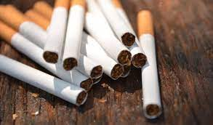
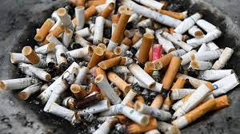
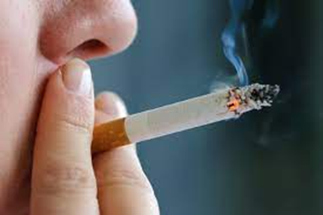
The law around cigarettes
In the UK it is illegal to:
-purchase cigarettes if you are under 18 years old.
Cigarettes have to be sold in plain packaging and display health warnings. These can be very graphic
- To smoke cigarettes in all enclosed workplaces, including shops, offices, restaurants and bars.

Slide 6

Why are there laws around cigarettes
The main reason for the laws is to limit use due to the long term health impacts to the person smoking and others around them due to secondary smoke.

Slide 7
Why are there laws around cigarettes
These health impacts happen due to the amount of chemicals in cigarette smoke.
There are over 2,700 chemicals found in cigarette smoke.
These have been found to be harmful to the body and can cause lung cancer, heart disease, strokes and premature death.
It is estimated that if everyone who currently smoke in the UK, it would save £19.1 billion per year. This would allow more money to be fund local services such as hospitals, policing, schools, dentists and much more.

Slide 8
Why are there laws around cigarette and vape use
Unlike cigarettes, vapes have only been around 20 years.
They are designed to act as a cigarette replacement for cigarette smokers as vapes still contain nicotine which is what makes smoking addictive.
This explains why there are less laws around vapes than cigarettes

Slide 9
What is the new law around cigarettes?
The government are due to make the following change to cigarette use in the UK:
Anyone born on or after 1st January 2009 will be banned from buying cigarettes or tobacco products

Slide 10
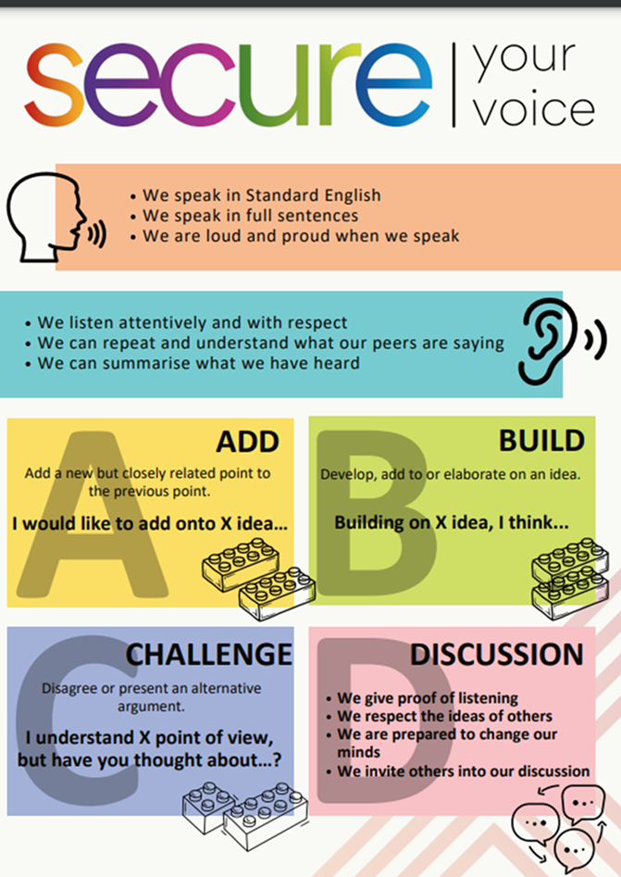
What is the new law around cigarettes?
This effectively raises the legal age for buying cigarettes by one year, every year until it applies to the whole population.
With your partner discuss how much you agree with this new law.
Remember to use your oracy helpsheet and be ready to share your discussion with the class

