Slide 1
Thought of the Day
“Love and identity come in many forms, and every one deserves respect and dignity.”
Benjamin Zephaniah

Slide 2


Remember to complete all homework tasks on SAM Learning
We still use Classcharts for announcements, surveys and revision material
Homework Club every morning in West Canteen from 8am
Library is open before school and at break times
Students on the following slides have not completed ALL tasks
Make sure you are completing the SET TASKS! These are the tasks your teachers have set.
Notes:
Please give time for the students to produce answers for themselves before showing answers.

Slide 3
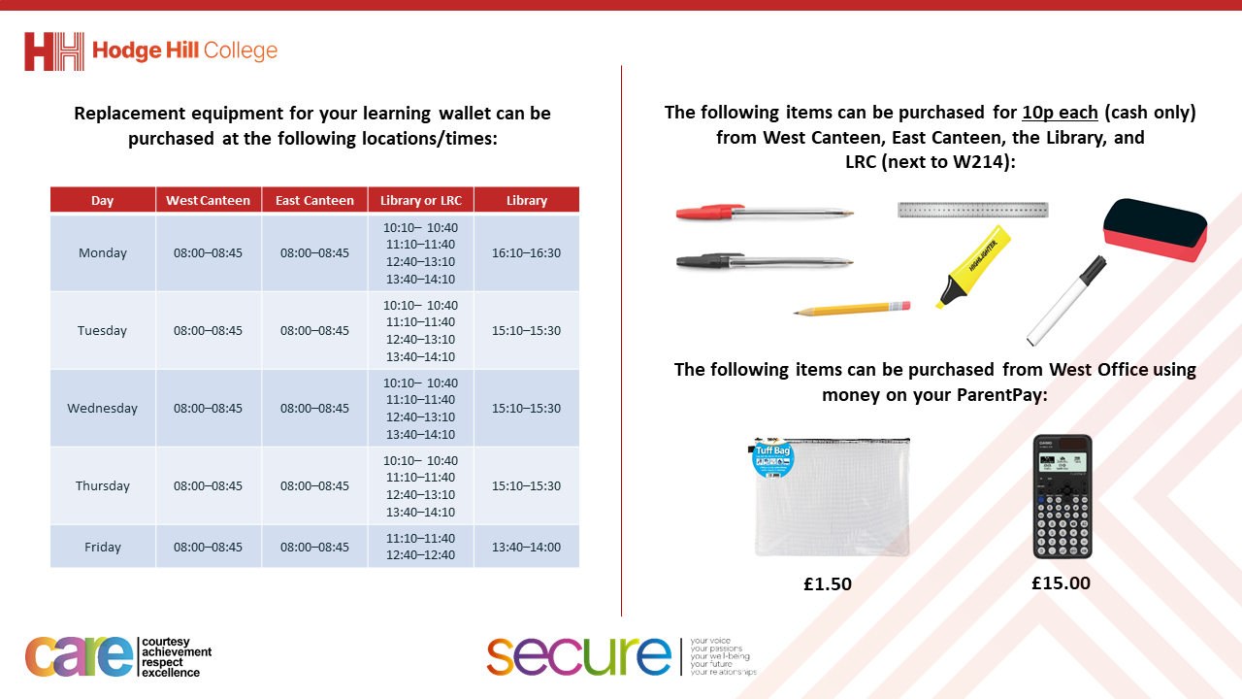

Slide 4


Secure your Relationships: Learning Journey
What does a healthy relationship look like
What does an unhealthy relationship look like?
What are romantic relationships?
Different types of committed relationships
What is gender identity and sexual orientation?
What are appropriate/ inappropriate images to send?
Today we will look at:
What is gender identity and sexual orientation
This includes:
Definition of gender identity
Definition of sexual orientation
Please remember that during the lesson we should not be asking any pupil or teacher personal questions.
Your teacher can ask you questions but this will be to check your knowledge in the lesson.

Slide 5


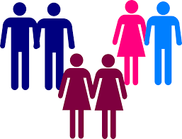
What is gender identity?
Gender identity is…
“the inner experience of gender”
People sometimes do not always identity with the gender they have been assigned at birth.

Slide 6

More on gender identity
Notes:
https://www.youtube.com/watch?v=i83VQIaDlQw watch up to 1:56

Slide 7
What is sexual orientation?
Sexual orientation is…
“how a person feels romantically and physically towards others”

Slide 8
More on sexual orientation?
Notes:
https://www.youtube.com/watch?v=P5x5Fo7rMvY up to 1:39

Slide 9




Why are we learning about this?
This links to the Golden Thread of “Secure your Relationships“
As you get older and start to explore the world more you will meet people who are different than you. This could include their gender identity and sexual orientation. Although you may not always agree on these things, it is important to understand and respect their decision.

Slide 10

Why are we learning about this?
Individual Liberty is a British Value that means people have the right to believe, act and express themselves freely. This includes their gender identity and sexual orientation. Everyone should be shown respect (another British Value) in their decision on these topics.

Slide 11
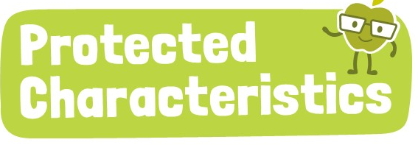
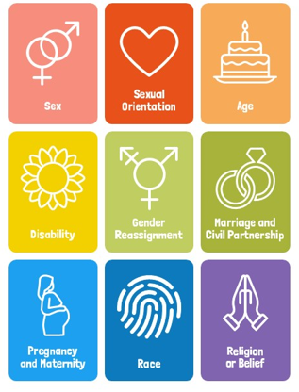
Why are we learning about this?
Sexual orientation and Gender Reassignment are two Protected Characteristics in the Equality Act (2010). This means that regardless of a person’s sexual orientation or gender identity they should not be treated any differently.

Slide 12
Examples of gender identity and sexual orientation
Sam Smith – UK artist does not identify with the gender they were assigned at birth.
Lady Gaga – a global artist and actress, is bisexual.
Miley Cyrus – a global artist and actress does not identify with a gender.

Slide 13
Gender Identity and Sexual Orientation
Many people often get gender identity and sexual orientation mixed up and think they are the same thing.
However these terms are very different
Gender Identity is about an inner feeling
Sexual orientation is about feelings towards other people.
You will be learning more about these terms in your Personal Development lessons this week.

Slide 14



Support
If you ever need support about gender identity or sexual orientation for yourself, a friend or family member you can find it here:
Childline.org.uk
Call – 08001111
Email or chat online for support
Themix.org.uk
You can email or have one-to-chat online.
There is also a crisis messenger which is available 24/7

