Slide 1
Thought of the Day
“Once something is shared online, it’s like throwing glitter in the wind; it is impossible to get it all back.”
Carrie Hope Fletcher

Slide 2


Remember to complete all homework tasks on SAM Learning
We still use Classcharts for announcements, surveys and revision material
Homework Club every morning in West Canteen from 8am
Library is open before school and at break times
Students on the following slides have not completed ALL tasks
Make sure you are completing the SET TASKS! These are the tasks your teachers have set.
Notes:
Please give time for the students to produce answers for themselves before showing answers.

Slide 3


Slide 4


Secure your Relationships: Learning Journey
What does a healthy relationship look like
What does an unhealthy relationship look like?
What are romantic relationships?
Different types of committed relationships
What is gender identity and sexual orientation?
What are appropriate/ inappropriate images to send?
Today we will look at:
What are appropriate/inappropriate images to send online?
This includes:
Why people send images
Thoughts and feeling around images been shared
The law around sending inappropriate images
Please remember that during the lesson we should not be asking any pupil or teacher personal questions.
Your teacher can ask you questions but this will be to check your knowledge in the lesson.

Slide 5

What is sharing online?
Sharing online is…
“sharing information online such as text, image or video with other people”
This information may be shared with a limited group of people or made publicly available for anyone to view.

Slide 6




Why are we learning about this?
This links to the Golden Thread of “Secure your Relationships“
Sharing data, particularly images and videos, is something that is commonly done between friends and partners. However it is important to know what is appropriate to send and what is inappropriate as the content may not always stay with the person it was shared with.

Slide 7

Why are we learning about this?
Rule of Law is a British Value. This means people are expected to follow laws to keep everyone safe. There are laws around the types of images that can be shared that involve children. This laws also apply to images children send of themselves.

Slide 8
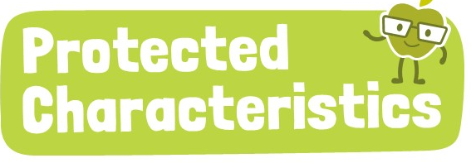
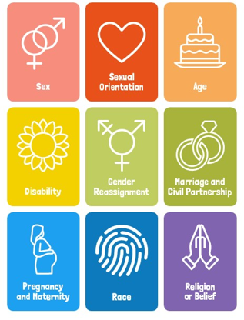
Why are we learning about this?
Regardless of content that is shared online, no one should be treated any differently if the content relates to one of the protected characteristics outlined in The Equality Act 2010.

Slide 9

Sharing Content
You have 1 minute to think about the following question:
“Why do people share content online?”

Slide 10
Sharing Content
Using your oracy helpsheet, with the person next to you, discuss your response to the question:
“Why do people share content online?”
Remember to use the sentence starters to add, build or challenge what your partner has said.
Be ready to share your discussion with the class

Slide 11
Sharing Content
The internet makes sharing instant, widespread and in majority of cases, permanent.
Shared content can impact friendships, reputation, safety and even future opportunities.
It may also lead to cyberbullying and in some cases legal issues for the person sharing the content and for those who viewed/received the content.

Slide 12

Sharing Content

Slide 13
Sharing Content
Content that should be avoided sending online is:
Personal information such as address, school and school uniform, financial details
Private or sensitive moments such as family/friendship arguments or personal struggles
Anything that could embarrass, harm or put people at risk

Slide 14
Sharing Content
You have 1 minute to think about the following question:
“should this be shared online? - Your friend trips and falls during a game. Someone recorded it.”

Slide 15
Sharing Content
Using your oracy helpsheet, with the person next to you, discuss your response to the question:
“should the content described be shared online?”
Remember to use the sentence starters to add, build or challenge what your partner has said.
Be ready to share your discussion with the class

Slide 16
Sharing Content
You have 1 minute to think about the following question:
“should this be shared online? -A group photo includes someone who doesn’t like their picture taken”

Slide 17
Sharing Content
Using your oracy helpsheet, with the person next to you, discuss your response to the question:
“should the content described be shared online?”
Remember to use the sentence starters to add, build or challenge what your partner has said.
Be ready to share your discussion with the class

Slide 18
Sharing Content
You will be looking more specifically at what are appropriate and inappropriate images/videos to be sharing online during your Personal Development lessons this week.

Slide 19



Support
If you ever need support about content shared online for yourself, a friend or family member you can find it here:
Childline.org.uk
Call – 08001111
Email or chat online for support
Themix.org.uk
You can email or have one-to-chat online.
There is also a crisis messenger which is available 24/7

