Slide 1
Thought of the Day
“Healthy relationships are built on kindness, honesty and understanding.”

Slide 2


Remember to complete all homework tasks on SAM Learning
We still use Classcharts for announcements, surveys and revision material
Homework Club every morning in West Canteen from 8am
Library is open before school and at break times
Students on the following slides have not completed ALL tasks
Make sure you are completing the SET TASKS! These are the tasks your teachers have set.
Notes:
Please give time for the students to produce answers for themselves before showing answers.

Slide 3
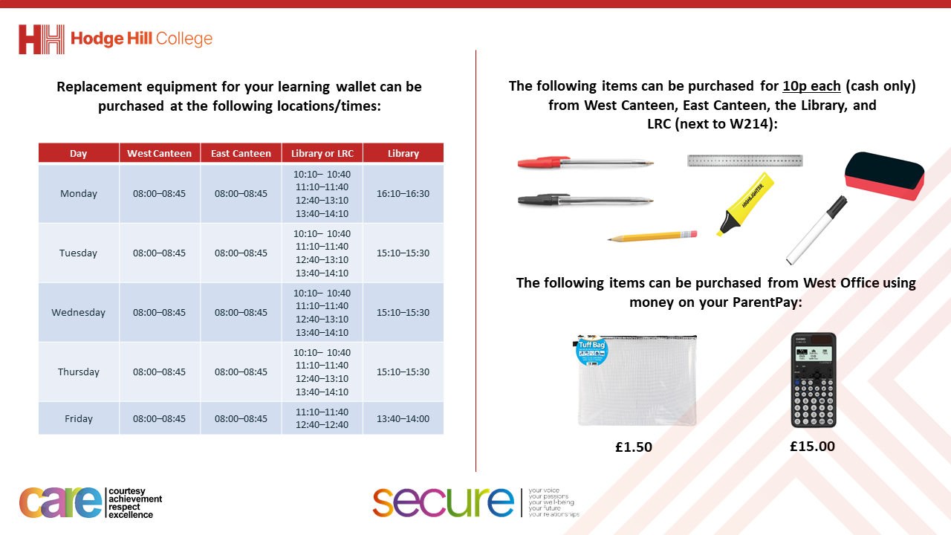

Slide 4


Secure your Relationships: Learning Journey
What does a healthy relationship look like
What does an unhealthy relationship look like?
What are romantic relationships?
Different types of committed relationships
What is gender identity and sexual orientation?
What are appropriate/ inappropriate images to send?
Today we will look at:
What are romantic relationships?
This includes:
Definition of romantic relationships
Recap on characteristics of healthy and unhealthy relationships
Where do you see romantic relationships?
Please remember that during the lesson we should not be asking any pupil or teacher personal questions.
Your teacher can ask you questions but this will be to check your knowledge in the lesson.

Slide 5

What are romantic relationships?
Romantic relationships are…
“any relationship between people with a desire to be intimate with each other. Both parties must feel an attraction to each other.”

Slide 6




Why are we learning about this?
This links to the Golden Thread of “Secure your Relationships“
Although this may not be relevant to you right now, a romantic relationship may be a large part of your adult life. It is important that you know the difference between a romantic relationship, friendship and to ensure any romantic relationship is healthy for all parties.

Slide 7
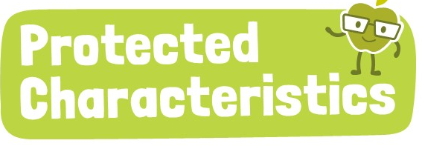
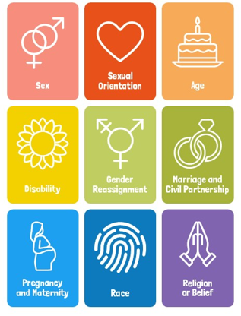
Why are we learning about this?
Romantic relationships link directly to sexual orientation and marriage and civil partnership. As these are protected characteristics, no one should be treated differently due to who they choose to be in a romantic relationship with, regardless if people agree with the relationship or not.

Slide 8

Romantic Relationships
You have 1 minute to think about the following question:
“Where may people see romantic relationships?”

Slide 9
Romantic Relationships
Using your oracy helpsheet, with the person next to you, discuss your response to the question:
“Where may people see romantic relationships?”
Remember to use the sentence starters to add, build or challenge what your partner has said.
Be ready to share your discussion with the class

Slide 10
Romantic Relationships
Places were romantic relationships may be seen are:
Family – this could be between parents, older siblings having a partner or any other older family member
Community – this could be seeing couples out shopping together or on a date in a restaurant/café
Media – This could be as part of a TV show/movie or on social media

Slide 11
Romantic Relationships
Like all other relationships, it is important that all romantic relationships are healthy for all parties involved.
We have previously looked at what makes a relationship healthy or unhealthy.

Slide 12
Characteristics of healthy relationship
You have 1 minute to think about the following question:
“What are the characteristics of a healthy relationship?”

Slide 13
Characteristics of a healthy relationship
Using your oracy helpsheet, with the person next to you, discuss your response to the question:
“What are the characteristics of a healthy relationship?”
Remember to use the sentence starters to add, build or challenge what your partner has said.
Be ready to share your discussion with the class

Slide 14

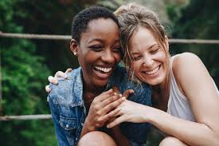

Characteristics of a healthy relationship
The characteristics of a healthy relationship you learnt about in Personal Development were:
Communication
Respect
Best Interests
Trust
Equality
Honesty

Slide 15
Characteristics of an unhealthy relationship
You have 1 minute to think about the following question:
“What are the characteristics of an unhealthy relationship?”

Slide 16
Characteristics of an unhealthy relationship
Using your oracy helpsheet, with the person next to you, discuss your response to the question:
“What are the characteristics of an unhealthy relationship?”
Remember to use the sentence starters to add, build or challenge what your partner has said.
Be ready to share your discussion with the class

Slide 17
Characteristics of an unhealthy relationships
Common characteristics of an unhealthy relationship are:
Disrespect
Control
Neglect

Slide 18
Reflection
You will be learning more about romantic relationships in your Personal Development lessons.
As discussed the media is one place where you may see romantic relationships. When you see a romantic relationship think about if it is healthy or unhealthy

Slide 19



Support
If you need any support about any type of relationship for yourself, a friend or family member there is support out there for you
Childline.org.uk
Call – 08001111
Email or chat online for support
Themix.org.uk
You can email or have one-to-chat online.
There is also a crisis messenger which is available 24/7

