Slide 1
Thought of the Day
“The most valuable thing in life is a relationship that makes you feel safe, valued, and loved.”
Malorie Blackman

Slide 2


Remember to complete all homework tasks on SAM Learning
We still use Classcharts for announcements, surveys and revision material
Homework Club every morning in West Canteen from 8am
Library is open before school and at break times
Students on the following slides have not completed ALL tasks
Make sure you are completing the SET TASKS! These are the tasks your teachers have set.
Notes:
Please give time for the students to produce answers for themselves before showing answers.

Slide 3
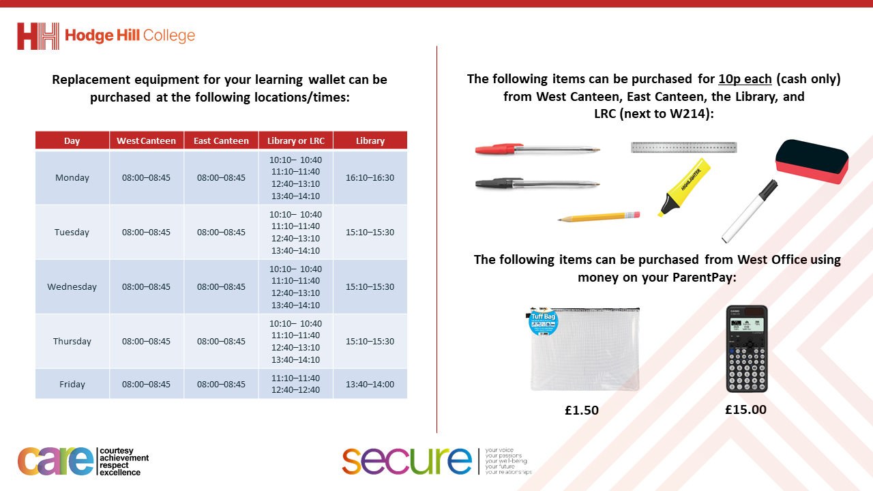

Slide 4


Secure your Relationships: Learning Journey
What does a healthy relationship look like
What does an unhealthy relationship look like?
What are romantic relationships?
Different types of committed relationships
What is gender identity and sexual orientation?
What are appropriate/ inappropriate images to send?
Today we will look at:
The different types of committed relationships
This includes:
Definition of committed relationships
Features of a committed relationship
Please remember that during the lesson we should not be asking any pupil or teacher personal questions.
Your teacher can ask you questions but this will be to check your knowledge in the lesson.

Slide 5
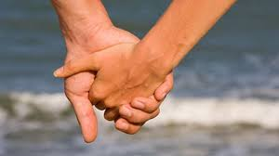

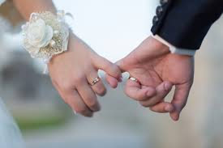
What are committed relationships
Committed relationships are…
“a serious and lasting romantic relationship with someone”

Slide 6




Why are we learning about this?
This links to the Golden Thread of “Secure your Relationships“
Although this may not be relevant to you right now, many of you will have a committed relationship. There are many different types of committed relationships and it is important that people choose the correct type to suit their relationship

Slide 7

Why are we learning about this?
Rule of Law is a British Value that means people are expected to follow all laws. Many committed relationships end up being legally binding. This means people in the relationship are protected by some specific laws.

Slide 8
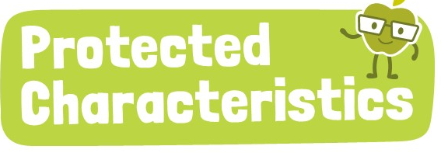
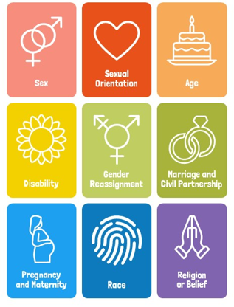
Why are we learning about this?
Committed relationships link directly to sexual orientation and marriage and civil partnership. As these are protected characteristics, no one should be treated differently due to who they choose to be in a committed relationship with, regardless if people agree with the relationship or not.

Slide 9

Committed Relationships
You have 1 minute to think about the following question:
“What do you think the characteristics of a committed relationship are?”

Slide 10
Committed Relationships
Using your oracy helpsheet, with the person next to you, discuss your response to the question:
“What do you think the characteristics of a committed relationship are?”
Remember to use the sentence starters to add, build or challenge what your partner has said.
Be ready to share your discussion with the class

Slide 11
Committed Relationships
Some characteristics of committed relationships are:
People enjoy spending time together
Plan their future together
Move in together
Want to get married
Want to have children
People love each other
There is trust and honesty in the relationship

Slide 12
Committed Relationships
Not all committed relationships have the same characteristics.
For example, there can be multiple couples in committed relationships. Some of the couples may want to get married, others may not.
Some relationships may want to have children and others may not.

Slide 13
Committed Relationships
It is important that each person in the committed relationship understands what the other wants from the relationship.
This requires there to be open and honest communication between the people in the relationship to understand what is important for them and less important.

Slide 14
Committed Relationships - scenario
“Andrew and Camila love being with family and friends. This often happens in the form of holidays especially to celebrate big occasions. They want to be married and start a family one day but first they want to save up money to buy their own house”
Task
Think about your answer to the following question
“Do you think Andrew and Camila are in a stable and committed relationship? Why?”

Slide 15
Committed Relationships - scenario
Using your oracy helpsheet, with the person next to you, discuss your response to the question:
“Do you think Andrew and Camila are in a stable and committed relationship? Why?”
Remember to use the sentence starters to add, build or challenge what your partner has said.
Be ready to share your discussion with the class

Slide 16
Committed Relationships - scenario
“Jordan and Ellie have been together for 5 years and really enjoy being together. Jordan has always wanted to move abroad and has been looking at jobs. He is unsure about marriage as he knows lots of people who have gotten divorced. Ellie loves living near her parents and can’t wait to get married.
Task
Think about your answer to the following question
“Do you think Jordan and Ellie have good communication in their relationship? What is a potential consequence of their communication?”

Slide 17
Committed Relationships - scenario
Using your oracy helpsheet, with the person next to you, discuss your response to the question:
“Do you think Jordan and Ellie have good communication in their relationship? What is a potential consequence of their communication?”
Remember to use the sentence starters to add, build or challenge what your partner has said.
Be ready to share your discussion with the class

Slide 18
Committed Relationships
You will be learning much more about the different types of committed relationships that are recognised in the UK in your Personal Development lesson this week.

