Slide 1
Thought of the Day
“We must ensure that social media platforms are safe spaces for young people, protecting them from harmful content and interactions.”
Yvette Cooper – UK Home Secretary

Slide 2


HWK Detention will be held afterschool on Friday
We still use Classcharts for announcements, surveys and revision material
Homework Club every morning in West Canteen from 8am
Library is open before school and at break times
Students on the following slides have not completed ALL tasks
Make sure you are completing the SET TASKS! These are the tasks your teachers have set.
Notes:
Please give time for the students to produce answers for themselves before showing answers.

Slide 3
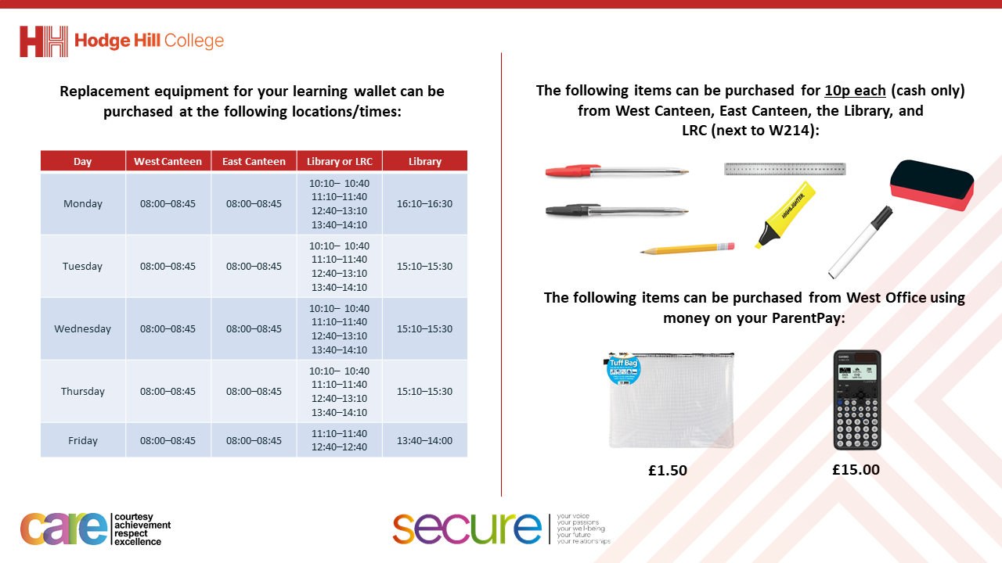

Slide 4


Secure your Wellbeing: Learning Journey
What is social media and how should you use it?
What are online trends and should you follow them?
What impact can social media influences have?
What is fake news?
What is hate speech online?
What is fake news?
Today we will look at:
What is social media?
This includes:
Definition of social media
History of social media
Social media platforms and why people use it
Please remember that during the lesson we should not be asking any pupil or teacher personal questions.
Your teacher can ask you questions but this will be to check your knowledge in the lesson.

Slide 5



What is social media?
Social Media is…
“a way people use the internet to share ideas, photos, videos and communicate with others.”

Slide 6

Why are we learning about this?
This links to the Golden Thread of “Secure your Wellbeing”
Although there are many positive things about social media, there are also some potential dangers to be aware off. One thing it can impact is mental health. Understanding more about social media will help you protect your mental health.

Slide 7

Why are we learning about this?
Rule of Law is a British Value. This means people are expected to follow laws to keep everyone safe. People forget that laws apply online as well as offline. Saying something online, that would be against the law offline, is still against the law.

Slide 8
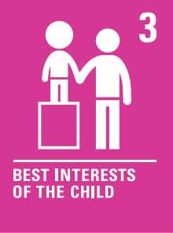
Why are we learning about this?
Article 3 of the UN Rights of a Child state that governments and all adults should do what is best for children. Although this may mean that children disagree with the decisions, the government have laws around what age social media can be used. This is ultimately to protect children.
UN Rights
of a Child

Slide 9
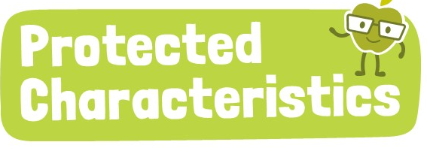
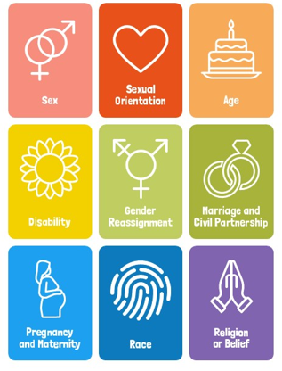
Why are we learning about this?
The Equality Act (2010) sets out 9 Protected Characteristics. No one should be treated differently due to identifying with one or more of the characteristics. This applies online over social media too.

Slide 10

History of Social Media
Notes:
https://www.youtube.com/watch?v=c0WpWA0TJ3U

Slide 11

Social Media
You have 1 minute to think about the following question:
“How many social media platforms can you name?”

Slide 12
Social Media
Using your oracy helpsheet, with the person next to you, discuss your response to the question:
“How many social media platforms can you name?”
Remember to use the sentence starters to add, build or challenge what your partner has said.
Be ready to share your discussion with the class

Slide 13
Social Media Platforms
Some popular social media platforms are:
Instagram – 2 billion monthly active users
TikTok – 1.6 billion monthly active users
WhatsApp – 2.95 billion active users
YouTube – 2.7 billion active monthly active users
SnapChat – 800 million active monthly users
Facebook – 3.07 billion active monthly users

Slide 14
Why people use social media
There are many reasons why people use social media. These include:
To stay connected with family and friends. This is especially true if you live far away from them.
To share updates, photos and videos
To follow celebrities, influences and content that is linked to their hobbies
To keep updated on the news

Slide 15
Social Media
You have 1 minute to think about the following question:
“From the reasons given what do you think the most important reason is for using social media?”

Slide 16
Social Media
Using your oracy helpsheet, with the person next to you, discuss your response to the question:
“From the reasons given what do you think the most important reason is for using social media?”
Remember to use the sentence starters to add, build or challenge what your partner has said.
Be ready to share your discussion with the class

Slide 17
Social Media
You will be learning lots more about social media in your Personal Development lessons this week.
Before then, think about how often you see or hear social media mentioned. Do you always see family and friends on social media?

Slide 18



Support
If you ever need support about social media for yourself, a friend or family member you can find it here:
Childline.org.uk
Call – 08001111
Email or chat online for support
Themix.org.uk
You can email or have one-to-chat online.
There is also a crisis messenger which is available 24/7

